Slide 1
Audit Report Writing
Tools for Enhancing Reader Comprehension
Emily Jacobson
Communications Specialist
City and County of Denver
Office of the Auditor

Slide 2
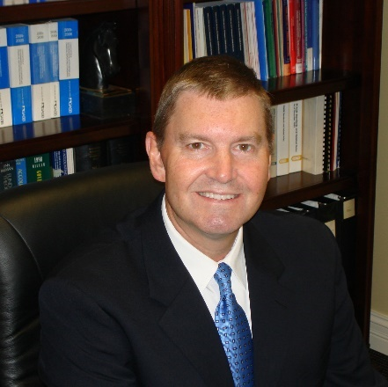
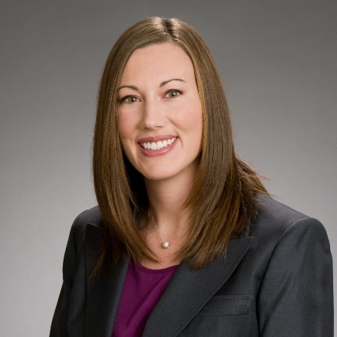
Opening Remarks
Moderator R. Kinney Poynter
Executive Director
NASACT
Speaker Emily Jacobson
Communications Specialist
City and County of Denver (CO)

Slide 3
LEARNING OBJECTIVES
Deductive Writing
Understand the difference between inductive and deductive writing, and why deductive writing is beneficial for audit reports.
Economy of Words
Recognize when you are using too many words to explain a concept or make a point, and learn how to cut your words by at least 10 percent.
Descriptive Headings
How adding greater detail to your headings can help busy readers navigate lengthy reports.

Slide 4
DEDUCTIVE WRITING
Reasoning: Induction v. Deduction
Inductive Writing
Deductive Writing
The Case for Deductive Writing in Audit Reports

Slide 5
INDUCTION v. DEDUCTION
Approaches to Reasoning:
Induction
Moving from specific observations to broader generalizations and theories
Build up to conclusion
Bottom-up approach
Deduction
Working from the more general to the more specific
Begin with conclusion
Top-down approach

Slide 6
INDUCTIVE WRITING
Inductive Writing
Concrete to abstract
Start with details and lead your reader to the conclusion
Allow your readers to discover things with you
Keeps the reader’s attention, as he or she must read all the pieces of the puzzle before they are connected

Slide 7
INDUCTIVE WRITING EXAMPLE
My dog Max wants to chase every non-human living creature he sees, whether it is the cats in the house or rabbits and squirrels in the backyard. Sources indicate that this is a behavior typical of Jack Russell terriers. While Max is a mixed breed dog, he is approximately the same size and has many of the typical markings of a Jack Russell. From these facts along with his behaviors, we surmise that Max is indeed at least part Jack Russell terrier.

Slide 8
INDUCTIVE WRITING EXAMPLE
Within that short paragraph, you learned about Max’s manners and a little about what he might look like, and then the concluding sentence connected these ideas together.

Slide 9
CASE FOR INDUCTIVE WRITING
Purposes for this kind of writing include:
Creative writing
Persuasive essays
Speeches
Used for controversial topics to maintain reader attention
Helps you clarify (not prove) your stance to insure logical progression and conclusion

Slide 10
DEDUCTIVE WRITING
Deductive Writing
Abstract to concrete
Start with the conclusion, then supply the supporting evidence
Use if your audience is not likely to read the entire piece
Allows the reader to look for what he or she wants by quickly scanning first sentences of each paragraph

Slide 11
DEDUCTIVE WRITING EXAMPLE
My backyard is in dire need of cleaning and new landscaping. The Kentucky bluegrass that was planted there five years ago has been all but replaced by Creeping Charlie, a particularly invasive weed. The stone steps leading to the house are in some disrepair, and there are some slats missing from the fence. Perennials were planted three years ago, but the moles and rabbits destroyed many of the bulbs, so we no longer have flowers in the spring.

Slide 12
DEDUCTIVE WRITING EXAMPLE
The reader knows from the very first sentence that the backyard is a mess!
The next three sentences give examples of why (your evidence).

Slide 13
CASE FOR DEDUCTIVE WRITING
Appropriate for:
business letters
project documents
scientific writing
research papers
Use when the reader is more likely to skim the work for generalities or to hunt for only the parts that are important to him or her.

Slide 14
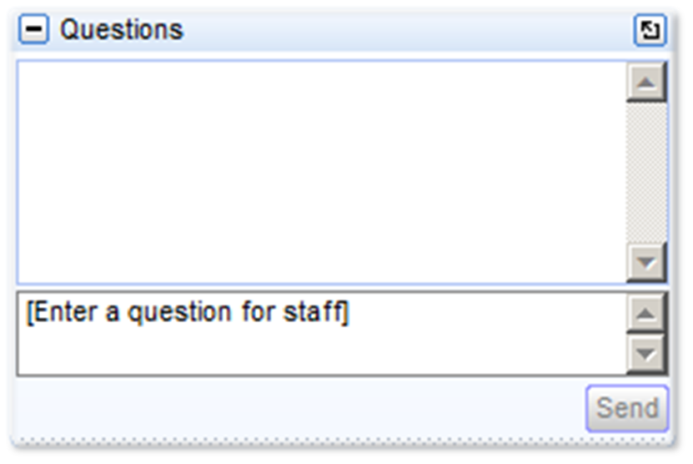
Polling Question 1 of 2
For individuals: Please be sure to answer the polling questions as they are also your attendance checks for today’s webinar.
For groups: Please answer in a way that reflects the consensus of the group.
Attendance for groups is still monitored via the sign-in sheet.
Don’t forget to send in your questions!

Slide 15
ECONOMY OF WORDS
Defining Word Economy
Common Sources of Wordiness
Before & After (60% reduction)

Slide 16
ECONOMY OF WORDS
What is Word Economy?
Reducing the number of words used to convey a point
Common Sources of Wordiness:
Attempts to meet length requirements
Attempts to sound more sophisticated
Lack of attention to detail
Not thinking about your audience

Slide 17
EXERCISING WORD ECONOMY
Why do it?
Clarity
Time
When to do it:
During the editing process.
Don’t worry too much about it when writing your first draft. Just get your thoughts down.

Slide 18
EXERCISING WORD ECONOMY
Eliminate formal and archaic expressions:
henceforth
for all intents and purposes
suffice to say
deem it inappropriate
pursuant to his request
null and void

Slide 19
EXERCISING WORD ECONOMY
Eliminate redundancies:
official business
current trend
new innovation
advance planning
end result
first priority
basic fundamentals
entirely eliminate
join together

Slide 20
EXERCISING WORD ECONOMY
Avoid clichés:
any way, shape, or form
in the final analysis
leaves much to be desired
at the end of the day
a step in the right direction
in this day and age
par for the course
the path of least resistance

Slide 21
EXERCISING WORD ECONOMY
Don't use vague, wordy expressions when you can't – or don’t want to – be precise about a number.
Instead, use one simple word to express the concept.
Wordy Expression | Simple Alternative
a great number of times | often
a little less than | almost
a small number of | few
a large number of | many
once in a great while | seldom
in the majority of cases | usually

Slide 22
EXERCISING WORD ECONOMY
Don’t fear simplicity! Excessive wordiness do not equal eruditeness.
Wordy | Succinct
at no time | never
at this point in time | now
in the near future | soon
during the time that | while
called attention to the fact | reminded
draw to a close | end
due to the fact that | because
despite the fact that | although
on behalf of | for
in the event that | if

Slide 23
EXERCISING WORD ECONOMY
Example from a report on Family and Medical Leave Act Administration
Original: 295 words
Revised: 119 words

Slide 27
EXERCISING WORD ECONOMY
Opt for succinct phrasing:
their own → internal
identified best practices → best practices
in a way that is consistent with → in accordance with
to get further clarification → for clarification
reviewing certifications to ensure they are complete and contain sufficiently detailed information → reviewing for completeness
Examples of these practices are outlined below → …as follows:

Slide 28
EXERCISING WORD ECONOMY
Use bullet lists to your advantage
No need to repeat similar introductory phrases with each bullet:
“Each of the agencies reported that they…”
“Leave teams reported…”
“All agencies reported…”
“Six of the agencies reported…while two of the agencies reported…”

Slide 29
EXERCISING WORD ECONOMY
Remove excessive detail:
Specific material that was already communicated
e.g., listing the agencies with their own HR teams
Nuances that do not affect overall message
e.g., sufficient to state that agencies assessed for ADA eligibility, not the slightly different ways in which they did so
Unnecessary caveats
e.g., no need to say that the agencies have slight differences in how they administer; only matters that they are all doing so in accordance with best practice

Slide 30
Descriptive Headings
An Instance Where More Is Better

Slide 31
AUDIT REPORT HEADINGS
Headings in Audit Reports:
Provide a road map for the reader
Clarify the main points…before you make them
Allow the reader to skim more effectively
Complement the deductive approach
Act as an outline

Slide 32
BACKGROUND SECTION EXAMPLES
Minimal Heading | Descriptive Alternative
Assets | Types of Assets Owned by the City and County of Denver
Voter Approval | Designated Park Land Cannot Be Sold Without Approval of Denver Voters
DSBO | Division of Small Business Opportunity Structure and Responsibilities

Slide 33
HEADING HIERARCHY
DIA’s Airport Concession Disadvantaged Business Enterprise Program Requirements
Program Plan
Certification Activities
Compliance Activities
Setting Program Goals
Annual Non-Car Rental Goal Setting
Concession-Specific Goal Setting
Reporting

Slide 34
HEADING HIERARCHY
Community Policing
Theoretical Foundations of Community Policing
Direct Interaction between Police and Community Members
Effectiveness of Community Policing
Legal Considerations Surrounding the Self-Initiated Actions Associated with Community Policing

Slide 35
FINDING SECTION EXAMPLES
Minimal Heading | Descriptive Alternative
Financial Reporting | Controller’s Office Has Enhanced Capital Asset Financial Reporting
Expand FAR 4.2 | Capital and Controlled Assets Fiscal Accountability Rule Should Be Expanded to Include Practices Specific to Land and Infrastructure
Reporting Disposal of Traffic Signals | Not Removing the Correct Traffic Signal from the System of Record Potentially Causes an Overstatement of Asset Values
Parks Designation Policy | The Department of Parks and Recreation Has Designated Additional Parks but Has Not Formally Adopted the Draft Parks Designation Policy
Contract Administration | Technology Services Can Strengthen Contract Administration Practices for the Vendor That Provides After-Hours IT Support
Policies and Procedures | The Board’s Outdated Policies and Procedures Do Not Reflect Current Administrative Practices

Slide 36
HEADING HIERARCHY
The Board Appears To Be Operating in a Professional and Unbiased Manner
The Mayor Judiciously Appoints Board Members from an Open Pool of Candidates
Board Members Are Appointed Based on Relevant Professional Experience
No Evidence That Board Decisions Are Influenced by the Mayor

Slide 37
HEADING HIERARCHY
DIA’s Emergency Plan Complies with FAA Requirements and Personnel Appear Prepared for Emergencies
DIA’s Emergency Plan Is FAA Compliant and Is Effectively Updated
DIA Has a Skilled, Full-Time Emergency Preparedness Staff
Strong Coordination and Collaboration Exists between Airport Personnel and DIA First Responder Groups

Slide 38
HEADING HIERARCHY
Weak Internal Controls Surrounding Open Media Foundation Asset Procurement and Accounting Practices
DMS Is Not Using the City’s Established Procurement Process
Open Media Foundation Has Made Payments to Questionable Vendors
OMF Assets Are Not Reported Timely
Utilizing the City’s Established Procurement Processes Can Reduce Risk

Slide 39
In Closing
Deductive Writing: Don’t bury the lead
Economy of Words: Less is more
Descriptive Headings: More is more

Slide 40
Polling Question 2 of 2
For individuals: Please be sure to answer the polling questions as they are also your attendance checks for today’s webinar.
For groups: Please answer in a way that reflects the consensus of the group.
Attendance for groups is still monitored via the sign-in sheet.
Don’t forget to send in your questions!

Slide 42
Question and Answer Session
Moderator R. Kinney Poynter
Executive Director
NASACT
Speaker Emily Jacobson
Communications Specialist
City and County of Denver (CO)

Slide 43
Attendance Check FOR INDIVIDUALS ONLY
Please type “I have completed the webinar.” in your Question toolbar.
Be sure to hit the send button after typing your response.

