Slide 1
Audit Quality
Don Thomson
IESBA Board Meeting
New York, USA
October 17-19, 2011

Slide 2
Audit Quality
Topics for Discussion
Draft audit quality framework
A work in progress
Environments conducive to audit quality
Public consultation in 2012
Ethics coverage in the framework
Significance for the Code

Slide 3
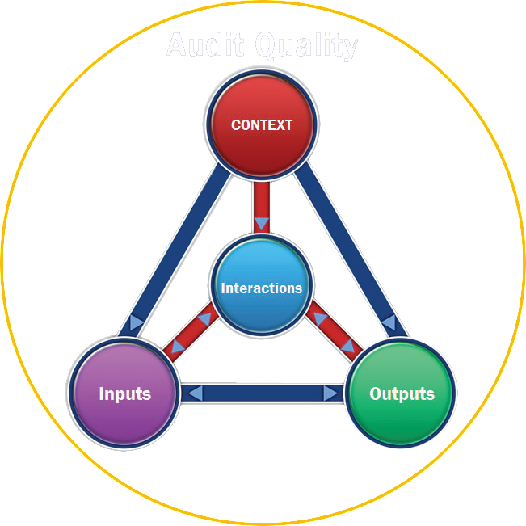
The Audit Quality Framework

Slide 4
Key Interactions Influencing Audit Quality
Auditors
Management
Those charged with governance & financial statement users
Regulators

Slide 5
Contextual Factors (pages 15-22)
Business practices
Corporate governance requirements
Audit regulation
Industry & the general economic environment
Educational environment
Broader cultural issues

Slide 6
Input Factors (pages 23-26)
Culture within an audit firm
Knowledge, experience, personal attributes & values of audit partners & staff
Compliance with ethical standards, etc
Effectiveness of the audit process

Slide 7
Output Factors (pages 37-40)
Reliability & usefulness of audit reporting to users of audited financial statements
Quality & usefulness of audit communications to those charged with governance
Quality & usefulness of audit communications to management
Transparency reports

Slide 8
Audit Quality Framework
Are there any ethical issues that should be discussed further by the IAASB Task Force?
Does the IESBA have any other comments on the draft audit quality framework?
Does the draft audit quality framework highlight any matters that should be addressed more comprehensively in the Code?

Slide 9
IESBA Code of Ethics
Professional competence & due care
Linkage to IESs & ISAs; extent of detail
Professional behaviour
Cultural differences / challenges
Corporate ethics; international ethics
Interaction; perspectives; perceptions
Other

