Slide 1
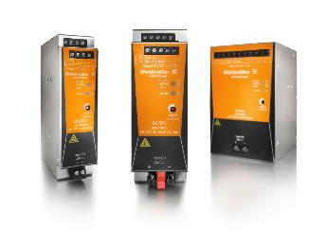
DC/DC Converter

Slide 2
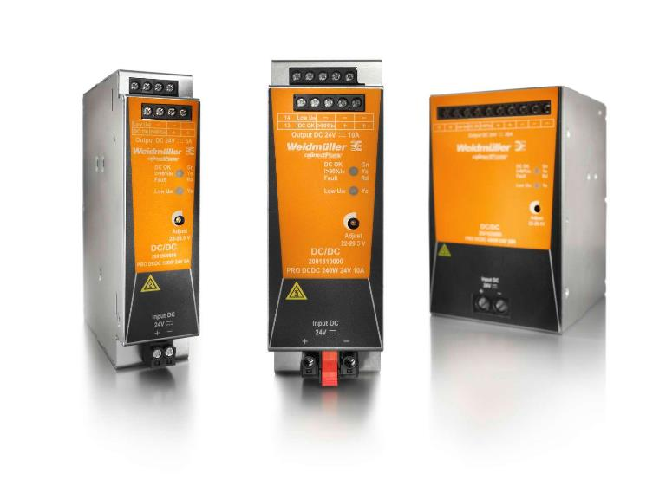
Stabilize control voltages in 24 V DC systems Compact and powerful DC/DC converters for an everlasting supply
Innovative products for industrial automation

Slide 3
The compact DC/DC converters feature protection class III.
They are suitable for applications in floating systems,
e.g. emergency backup systems in ships.
The extraordinary performance:
High efficiency up to 94%
High shock and vibration immunity
Narrow housing
Galvanic isolation: Protection Class III
Super boost with more than 600% * IN for 16 ms
Integrated status relay and active switching outputs
Comprehensive international approvals : TUV, UL, Class I, Div2, ATEX, GL, DNV, ABS, BV, RINA, LR
All these make the converter an all-rounder in all 24 V DC supply systems!

Slide 4
Target industries and customers
Machinery
Process
Energy
Transportation
Device
Manufacturer
Machine Tools
Automotive
Oil & Gas
Renewables
Railway
I/O control devices
Food & Beverage
Elevators & Escalators
Chemical / Pharma
Traditional
Infrastructure
Drive Controls & Power Electronics
Conveying Systems
Water Treatment
Transmission & Distribution
Ship Building
Interface Electronics

Slide 5
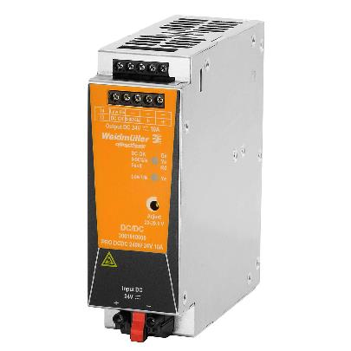
Product Utility / Attribute
All-purpose use
International approvals like cULus, Class1.Div2 ,ATEX as well as GL ,DNV,BV ensure the world-wide use in different applications.
Space saving
The compact design saves up to 30% space in the cabinet.
Preventive function monitoring
The integrated alarm outputs provide the status supervision for PLC or DCS systems.
Applicable for use in floating systems
DC/DC converter for protection class III. Typical applications are emergency battery banks in buffer mode.
Super boost with more than 600% * IN for 16 ms
Fast and reliable tripping of circuit breakers
Robust and reliable
Reliable operation in a wide temperature range of -25…+70°C (Start-Up:– 40 °C) and MTBF value > 1.000.000 Hours
A galvanic isolated DC/DC converter avoids critical earth loops and regenerates a stable output voltage out of an unregulated or distorted input voltage.

Slide 6
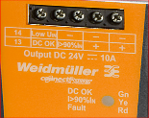
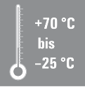
Key Benefits against competitors
Rapid status diagnosis
LED indicators and integrated status
relay and transistor outputs facilitate status and rapid error analysis
Robust and reliable
Reliable operation throughout a wide temperature range of – 25 °C …+70 °C
High MTBF value of > 1.000.000 hours
Space saving
perfectly suitable for all standard control
cabinets and the compact design
can saves up to 30% space in the cabinet.
Energy saving
High efficiency up to 94% and low idling power losses ensure low energy consumption and long product life time
Space saving
Up to 30%
Comprehensive applications around the world
They can be used reliably in different regions and industries
because of the international approvals
(UL, Cl1.Div2, GL, DNV and ATEX)
Up to 94%
High Efficiency

Slide 7
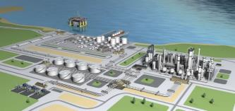
Application: Power supply system with DC/DC converter
Galvanic isolation required due to different potential
Control cabinet
Control box
AC
+24VDC
DC
230VAC
DC
DC
24VDC
-24VDC
-24VDC
PE1
Udiff <> 0
PE2
Reconditioning of the 24V DC
due to voltage drops
Control cabinet
Control box
230VAC
AC
DC
DC
DC
24VDC
Voltage drop
24VDC
Principle diagram 1
fluctuations due
to load currents
stable
voltage

Slide 8
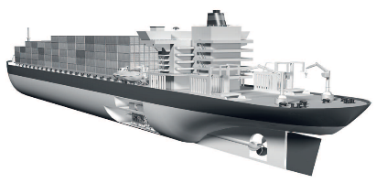
Application: Principle power supply system in shipbuilding industry
3x400VAC
generator 1
Control cabinet
10A PROmax
Power Good: A
AC
DC
10A DC/DC
3x400VAC
generator 2
charger
DC
DC
Central
Battery bank
Power Good: B
24VDC
24VDC
CP M DM20
Emergency power distribution
Principle diagram 2

Slide 9
Selection chart
DC/DC Converter
Type | Order code | Input /Output voltage | Output current
PRO DCDC 120W 24V 5A | 2001800000 | 24 V DC | 5 A
PRO DCDC 240W 24V 10A | 2001810000 | 24 V DC | 10 A
PRO DCDC 480W 24V 20A | 2001820000 | 24 V DC | 20 A
Accessories modules for different applications
Type | Order code | Application note
CP DM 10 | 8710620000 | Diode module 10A for redundancy power
CP M DM20 | 1222210000 | Diode module 20A for redundancy power
CP DC UPS 24V 20A/10A | 1370050010 | DC UPS for 10A/20A
CP DC UPS 24V 40A | 1370040010 | DC UPS for 40A

Slide 10
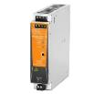
Competitive Analysis
– we are Best in class !
Technical feature
Variants | 5 A | 5, 10, 20 A | 5, 10, 20 A
Input Voltage DC | 14,4…32,4 V | 14…32 V | 14…32 V
Dimension | 32*124*102 (5A) | 48*130*120 | 43*130*120
[W*H*D (mm)]
[10A Version]
MTBF | > 800.000 Hours | > 750.000 Hours | > 1.250.000 Hours
Efficiency | 90% | 92% | 93%
Operating Temperature | -25°C … +70°C | -25°C … +70°C | -25°C …+70°C
 |  |  | (Start-up: - 40 °C)
Power boost | Not applicable | 600% x IN for 12ms | 600% x IN for 16 ms
 |  |  | Weidmüller Patent
Hold up time | 6 ms | 12 ms | 14 ms
Terminals input | NON Pluggable | Pluggable | Pluggable
Status indication | Uin < 19.2 V DC OK: Green | Boost: Yellow Uin < 19.2 V DC OK: Green | DC OK:Green >90%In: Yellow Fault: Red Low Uin: Yellow
Approvals | cURus; cULus; ATEX; GL | cURus; cULus; GL,DNV,BV, ABS,RINA,LR | TÜV; cULus;
 |  |  | Cl1,Div.2; ATEX;
 |  |  | GL,DNV,BV, ABS, RINA, LR;

Slide 11
DC/DC converter Point of difference
Feature | Customer benefit | Competition
Status signaling with integrated status relay, transistor outputs and triple-color LED | ➔ Remote monitoring through status relay and transistor outputs for PLC, DCS ➔ Easy handling during the setting up of new machinery and system Time saving during trouble shooting | No competitor can offer such combined status signaling with different methods. Triple-LED is true USP from Weidmüller
Narrow housing 5A: 32 x 120 x 130 mm (W x D x H) 10A: 43 x 120 x 130 mm (W x D x H) 20A: 75 x 120 x 130 mm (W x D x H) | ➔ up to 30% space saving | Phoenix Contact: 32 mm (5A) 48 mm (10A) 82 mm (20A)
High efficiency up to 94% & minimal no-load losses | ➔ Cost saving due to low energy consumption | Phoenix Contact: 92% efficiency
Super boost of > 600% * In for minimal 14 ms (Dynamic Current Limiting: Weidmüller Patent) | Tripping of circuit breaker reliably and quickly in case of short circuits Reliable starting up of high capacitive load: e.g. Motor | Weidmüller-Technology has higher performance than SFB technology from Phoenix Contact.
Full set of approvals for shipbuilding and heavy process segments | Suitable for both marine applications and Ex applications in hazardous areas | Only Phoenix contact

Slide 12
Cross-Reference List
Weidmüller Order Code | Puls Order Code | Phoenix Contact Order Code
2001800000 | CD5.241 /CD5.241-L1 | 2320034 / 2320542
2001810000 | Not available | 2320092 / 2320555
2001820000 | Not available | 2320102 / 2320568

Slide 13
Thank you
DC/DC Converter

