Slide 1
UNIVERSAL COLLEGE OF ENGINEERING & TECHNOLOGY
SUBJECT :
DC Machine & Transformer

Slide 2
AIM. :
SPECIAL TRANSFORMERS :Current Transformer, Potential Transformer, Pulse Transformer, Audio Frequency Transformer, Grounding Transformer.
GROUP NO.9
AGRAWAL MILAP M.(130460109027)
AMIT MUNJANI C. (130460109028)
Dwijkumar mewada(130460109026)
BE 3RD SEM. ELECTRICAL
Navin sharma & Ravisankar sir

Slide 3
SPECIAL TRANSFORMERS :
Topic name :
SPECIAL TRANSFORMERS
Current Transformer
Potential Transformer
Pulse Transformer
Audio Frequency Transformer
Grounding Transformer

Slide 4
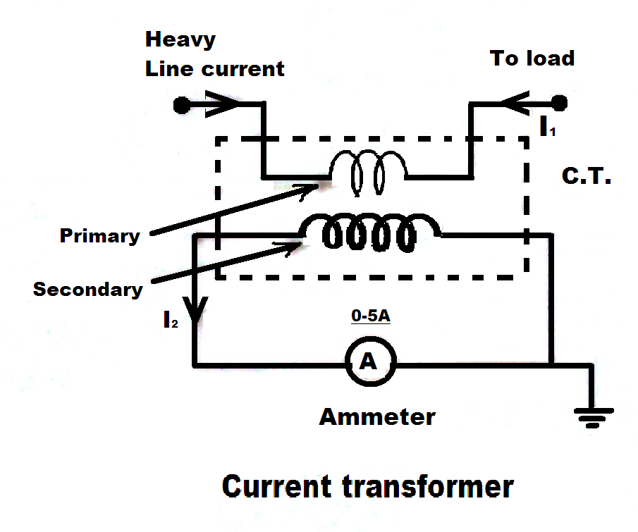
Current Transformer
The large alternating currents which can not be sensed or passed through normal ammeters and current coil of wattmeter's, energy meters can easily be measured by use of current transformers along with normal low rang instruments.

Slide 5
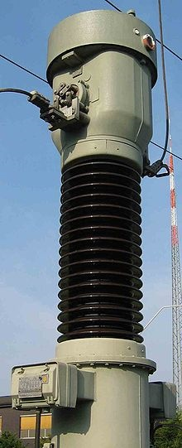
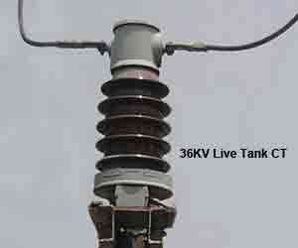
36 KV Live Tank CT
A transformer is a device which consists of two windings called primary and secondary.
A CT for operations on a 110 kV grid

Slide 6
It transfers energy from one side to another with suitable change in the level of current or voltage.
A current transformer basically has a primary coil of one or more turns of heavy cross-sectional area.
In some, the bar carrying high current may act as a primary.
Current Transformer

Slide 7
This is connected in series with the line carrying high current.
The secondary of the transformer is made up of a large number of turns of fine wire having small cross-sectional area.
Current Transformer

Slide 8
Current Transformer
This is usually rated for 5 A.
This is connected to the coil of normal range ammeter.
Symbolic representation of a current transformer is as shown in the figure.

Slide 9
These transformers are basically step up transformers i.e. stepping up a voltage from primary to secondary.
Thus the current reduces from primary to secondary.
Current Transformer

Slide 10
So from current point of view, these are step down transformer, stepping down the current value considerably from primary to secondary.
Current Transformer

Slide 11
Let N1 = Number of turns of primary
N2 = Number of turns of secondary
I1 = Primary current,
I2 = Secondary current
For a transformer,
Current Transformer

Slide 12
2. Potential Transformer
The basic principal of these transformers is same as current transformers.
The high alternating voltage is reduced in a fixed proportion for the measurement purpose with the help of potential transformers.
Potential Transformer

Slide 13
The construction of these transformer is similar to the normal transformer.
These are extremely accurate ratio step down transformers.
The windings are low power rating windings.
Potential Transformer

Slide 14
Primary winding consists of large number of turns while secondary has less number of turns and usually rated for 110 V, irrespective of the primary voltage rating.
The primary is connected across the high voltage line while secondary is connected to the low range voltmeter coil.
Potential Transformer

Slide 15
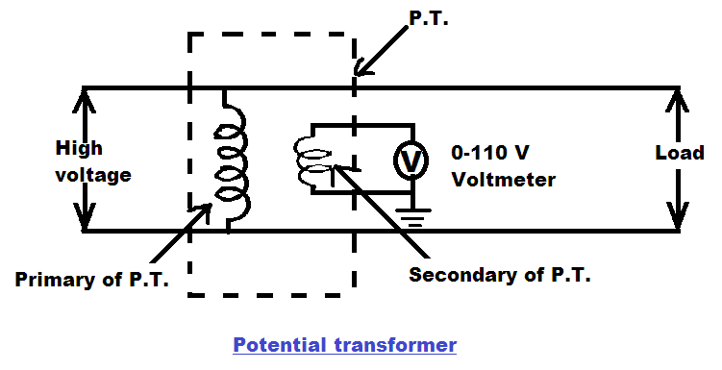
Potential Transformer
One end of the secondary is always grounded for safety purpose.
The connections are shown in the figure.

Slide 16
As a normal transformer, its ratio can be specified as,
So if voltage ratio of P.T. is known and the voltmeter rating is known then the high voltage to be measured, can be determined.
Potential Transformer

Slide 17
Application of C.T. and P.T.
The C.T.s and P.T.s are used for,
Circulating current differential protection.
Over current phase fault protection.
Distance protection.
Intermediate CTs for feeding protective devices, measuring systems, relays etc.
Potential & Current Transformer

Slide 18
3. Pulse Transformer
The pulse transformer is basically a transformer which couples a source of pulses of electrical energy to the load with its shape and other properties maintained.
Pulse Transformer
Pulse Transformer

Slide 19
Working principle of pulse transformer
The traditional transformers deals with sinusoidal waveforms, but pulse transformers deals with square pulse waveforms.
Signal processing is the vital part of this transformers. Initially, input signal waves are provided in the primary side of pulse transformer, it may be distorted sinusoidal or square pulse signal.
But, this distorted signal usually randomize the flux distribution in primary coil.
Pulse Transformer

Slide 20
Then the high reluctance path(core) is confine those fluxes into it and reduces the leakage fluxes.
The distortion of pulses are are also reduced as the core is made by high permeability material.
Pulse Transformer

Slide 21
Then the flux linkages in secondary winding leads to develop another pulse series, which is nothing but the dV / dt of the input signal.
Amplitude of the pulses are depended upon the turns ratio. So, it gives a distortionless and modified pulse series as the output.
Pulse Transformer

Slide 22
Construction of Pulse Transformer
The general construction of pulse transformer are quite similar to that of the power transformers.
But some special improvement or modification is provided.
As they are used in sophisticated electronics applications, therefore the design of that transformers should carried out in such a way, that they can minimize the effects of signal distortion.
Pulse Transformer

Slide 23
The pulse transformers are designed on shell type core construction.
The main reason is, shell type core construction provides reduce susceptibility for eddy current as well it can withstand with high voltage level ( specially in case of power pulse transformer ).
As those transformers are based on shell type core construction, therefore the capacitance effect in between the primary and secondary winding is reduced.
Pulse Transformer

Slide 24
Types of Pulse Transformers
In general, pulse transformers are classified in two categories, namely signal type pulse transformer and power type pulse transformer.
The product of those is termed as voltage time integral. Large voltage time integral means the pulse peak voltages are high.
Pulse Transformer

Slide 25
The classification of pulse transformers are done with the help of a determining factor ‘Voltage Time Integral’. Each pulse has its peak voltage ( that is the maximum amplitude ) and a certain time period (duration of the pulse).
Pulse Transformer

Slide 26
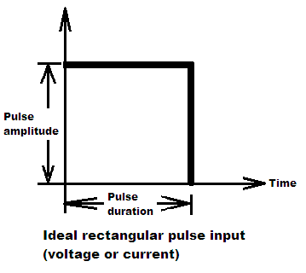
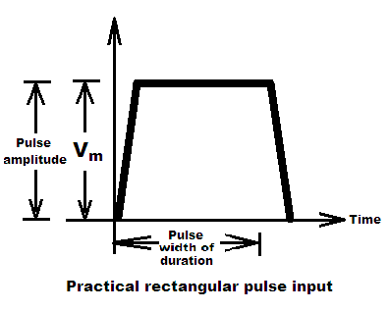
Pulse
Pulse Transformer

Slide 27
Application of pulse transformers
Small sized pulse transformers, that is signal transformers are used in low voltage electronics applications like camera flasher, and they are also used in controlling of digital logic circuits.
Pulse Transformer

Slide 28
These generated pulse from this type of transformers are used for gate turn on process.
They are also used in telecommunication system.
High voltage pulse transformers, that is power pulse transformers are used in radars, particle acceleration purposes.
Pulse Transformer

Slide 29
4. Audio Frequency Transformer
The transformers used in power systems operating at a frequency of 50 Hz transformers power from one voltage level into other.
These transformers come across wide range of frequencies i.e. bandwidth of the signal dependent on type of application like audio, video etc.

Slide 30
There are basically two main applications of these transformers used in electronic circuit and handling variable frequencies.
Firstly the load is coupled to the source in such a way as to have maximum power to transfer from source to load which requires impedance matching.

Slide 31
Under this case, the efficiency may be as low as 50% but it is not the important consideration here.
Since the prime importance here is for maximum power transfer rather than maximum efficiency in case of power transformer.
These transformers are called output transformers.
Audio Frequency Transformer

Slide 32
If these transformers are employed in audio applications, they are called audio transformers.
Secondly these transformers provide a path for dc bias current through its primary circuit while it keeps this current away from secondary circuit.
The main factor to be considered in case of these transformers is that the amplitude of voltage gain which is ratio of output voltage to input voltage should remain nearly constant over the range of frequencies.
Audio Frequency Transformer

Slide 33
The phase shift between input and output voltage should also be small over the working range of frequencies.
To study the gain and phase characteristics with frequency , logarithmic scale should be used as frequency range is large.
Audio Frequency Transformer

Slide 34
Audio Frequency Transformer
The phase shift between input and output voltage To study these characteristic under various range of frequencies, let us consider the equivalent circuit of the transformer as shown in Fig.

Slide 35
The source is having internal resistance Rs and it is driving the load resistance RL .
Lo is magnetizing branch inductance inductance while L1 and L2 are leakage inductance of primary and secondary coil respectively.
Let us consider the mid frequency region first.
Audio Frequency Transformer

Slide 36
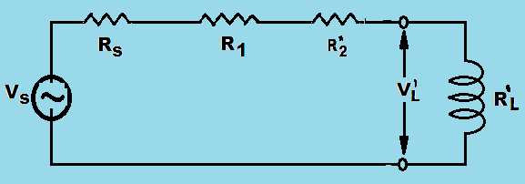
In this region the leakage inductances on both sides be neglected as they cause very small voltage drops while the magnetizing inductance branch treated as open circuit.
The equivalent circuit in this is shown in the Fig.
Audio Frequency Transformer

Slide 37
= Equivalent resistance of secondary referred to primary
= Transformation ratio =
Audio Frequency Transformer

Slide 38
Now to find out the ratio we can use potential divider rule,
We have,
Audio Frequency Transformer

Slide 39
Let
But
Audio Frequency Transformer

Slide 40
Audio Frequency Transformer
Voltage gain,

Slide 41
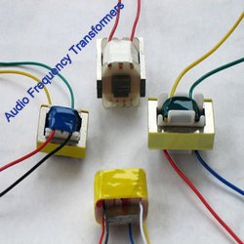
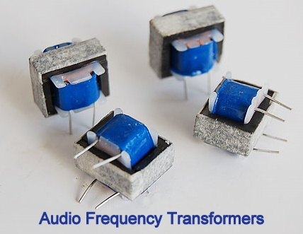
Audio Frequency Transformer
Audio Frequency Transformers

Slide 42
5.Grounding Transformer
The grounding transformer is also called earthing transformer.
Its main purpose is to provide neutral point for grounding purposes.
Grounding Transformer

Slide 43
When the transformers or generators are delta connected or if the neutral points are not accessible then artificially the neutral earthing point can be created with the help of star connected grounding transformer.
Such transformer has no secondary winding.
Each phase of primary has two equal parts.
Grounding Transformer

Slide 44
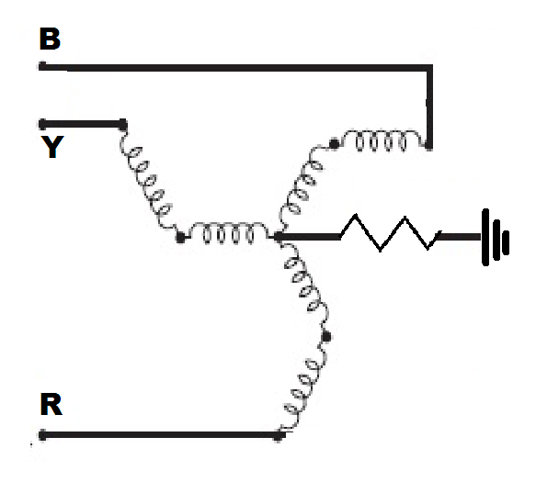
There are three limbs and each limb has two winding opposite flux during normal condition.
Such a transformer is shown in Figure.
Grounding Transformer

Slide 45
One set of winding are connected in star providing the neutral point.
The other ends of this set of windings are connected to the second set of windings as shown in the figure.
The directions of the currents in the two windings each limb are opposite to each other.
Grounding Transformer

Slide 46
This is necessary in systems with operating voltage between 2.2 kV and 3.3 kV
These transformer are of short time rating in the rang of 10 seconds to 1 minute.
Hence the size of these transformers is small as compared to power transformers of same rating.
Grounding Transformer

Slide 47
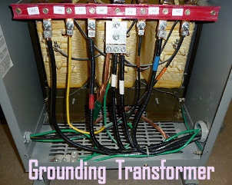
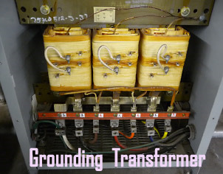
Grounding Transformers

Slide 48
Reference :
U.A.Bakashi, Technical publications
Tech-max publications
B.L.Thereja
www.google.com
Wikipedia

