Slide 1
HYDROTHERMAL SYSTEM ECONOMIC DISPATCH

Slide 2
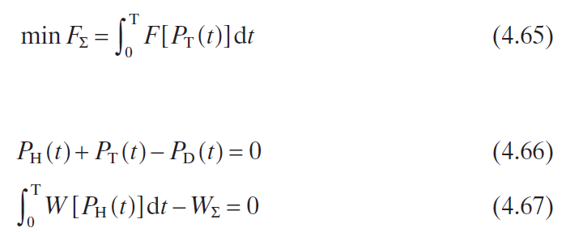
Neglect Network Losses

Slide 3
For any time stage, suppose that the power output of the hydro plant and the thermal plant as well as load demand are constant.
The objective function

Slide 4
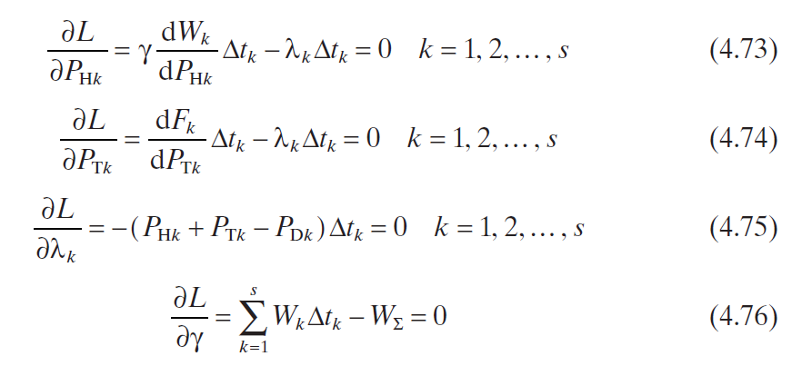
The Lagrange function

Slide 5
From equations (4.73) and (4.74) , we get
If the time stage is very short, equation (4.77) can be expressed as
Equation (4.78) is the equal incremental principle of hydrothermal system economic dispatch

Slide 6
From equations (4.78) – (4.80) , we obtain
where γ is the coeffi cient that converts water consumption to fuel. In other words, the water consumption of a hydro unit multiplied by γ is equivalent to the fuel consumption of a thermal unit. Thus the hydro unit is equivalent to a thermal unit.

Slide 7
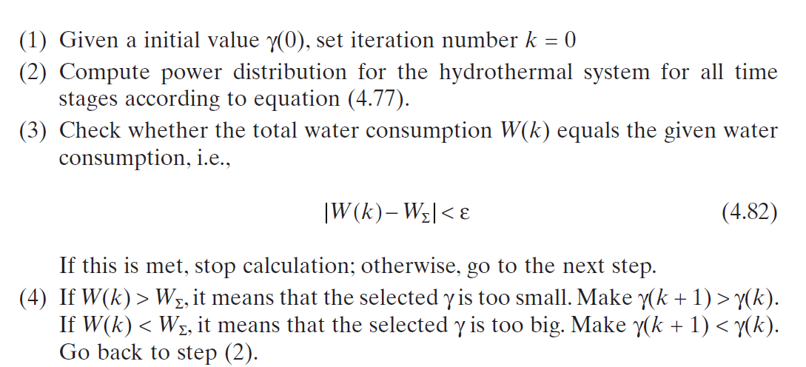
Solution Algorithm

Slide 8
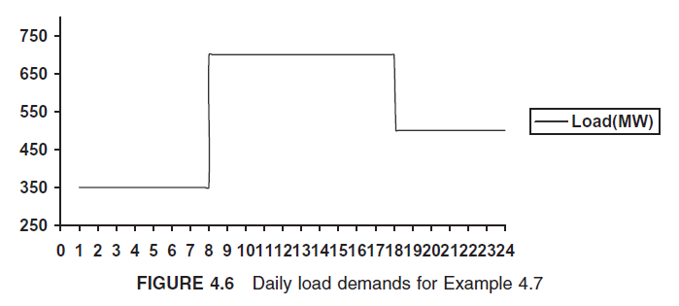
Example
A system has one thermal plant and one hydro plant. The input – output characteristic of the thermal plant :
The input - output characteristic of the hydro plant

Slide 9
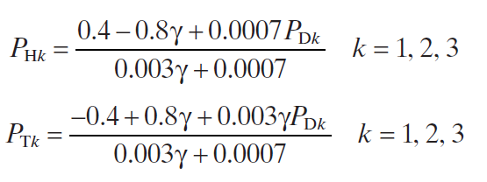
coordination equation
power balance equation

Slide 10
Select the initial value of γ as 0.5. For the fi rst time stage, the load level is 350 MW; we get
For the second time stage, the load level is 700 MW; we get

Slide 11
For the third time stage, the load level is 500 MW; we get
The water consumption is greater than the daily given amount. So increase the value of γ , say let γ = 0.52, and recompute the power output

Slide 14
Consider Network Losses
Suppose there are m hydro plants and n thermal plants. The system load is given in the time period. The given water consumption of hydro plant j is W Σ j . The hydrothermal system economic dispatch with network loss can be expressed as below

Slide 15
The Lagrange function

Slide 16
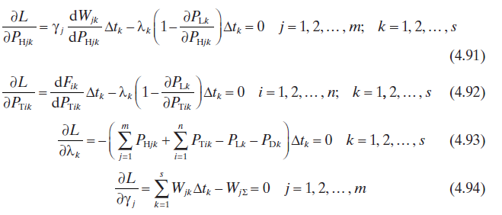

Slide 17
From equations (4.91) and (4.92) , we get
Equation (4.95) is true for any time stage, i.e.,

Slide 18
تکلیف: یک سیستم قدرت شامل دو واحد حرارتی و یک واحد آبی با مشخصات ورودی-خروجی به شرح زیر می باشد.
6 | 5 | 4 | 3 | 2 | 1 | دوره زمانی
3 | 6 | 4 | 5 | 4 | 2 | مدت زمان (ساعت)
200 | 300 | 450 | 240 | 200 | 120 | بار (مگاوات)
الگوی بار مصرف در یک دوره زمانی 24 ساعته در جدول(2) نشان داده شده است. با فرض در مدار بودن هر سه واحد، معادلات هماهنگی را برای حل مسئله توزیع اقتصادی بار بین واحدهای آبی- حرارتی، با در نظر گرفتن تلفات شبکه انتقال تشکیل دهید و تعداد معادلات را مشخص و دستگاه معادلات را حل نمایید. حجم آب قابل استفاده برای واحدآبی می باشد. همچنین با استفاده از دستور fmincon در matlab مسئله بهینه سازی را حل کنید.

