Slide 1
Electromagnetic Waves for Physics and MOSAIC
A Physics MOSAIC
MIT Haystack Observatory RET 2010
Background Image from Wikipedia, Creative Commons

Slide 2
Why Electromagnetic Waves?
The existence of electromagnetic waves can be derived from simply the laws of electricity and magnetism already studied.
Maxwell’s Equations predict a transverse wave that travels at and consists of electric and magnetic fields oscillating perpendicular to each other and to the direction of propagation.
Notes:
This information will be particularly interesting to students who have studied electromagnetism already. These students may recognize the constants ε₀ and μ₀ as the permittivity and permeability of a vacuum, respectively.

Slide 3
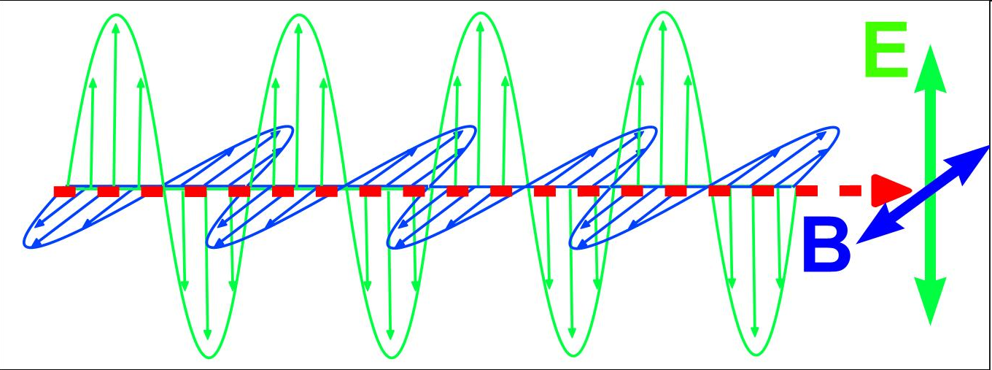
Oscillating Electric and Magnetic Fields
Image Courtesy Canadian Space Agency
Notes:
The electric and magnetic fields oscillate perpendicular to each other and to the direction of wave propagation.

Slide 4
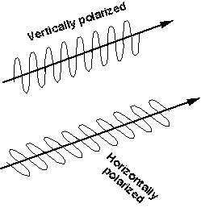
Polarization
Electromagnetic radiation is created by oscillating charges.
Usually, these charges oscillate in all directions, randomly, creating electric and magnetic field that oscillate in all directions. This light is called unpolarized.
In some situations, however (such as in lasers or when light is reflected at large angles), the oscillations of the electric field occur only in one orientation. This light is said to be polarized.
The electric field oscillations are drawn to the left for vertically and horizontally polarized radiation. Radiation can also be circularly polarized, or polarized at any angle.
Image from NASA

Slide 5
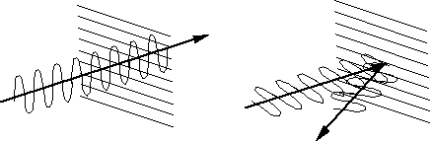
Polarized Filters
Because light that is reflecting off roads and bodies of water is polarized, many boaters and drivers appreciate using sunglasses with a polarizing filter. This filter is specifically designed to absorb light with the particular polarization that corresponds to glare off the road or water.
Because the electric field inside a conductor is always zero, these materials can be created with very thin strips of conductors. Electric fields oscillating perpendicular to these conductors can pass through the material with no problem, while electric fields oscillating parallel to these conductors is absorbed or reflected.
Image from NASA

Slide 6
Electromagnetic Spectrum
Regardless of wavelength, all electromagnetic waves share certain properties.
  speed in vacuum = c = 3.0 x 10⁸ m/s
  transverse wave, oscillating E and B fields
  can propagate (travel) through a vacuum
Just as with all waves
  The speed of the wave is a property of the medium.
  The frequency of a wave is fixed by its source.
  Wavelength and frequency are inversely related, since v = λf.
Additionally, we have seen that for light and other electromagnetic energy, E = hf.
Electromagnetic waves are classified according to wavelength range into different parts of the spectrum.

Slide 7
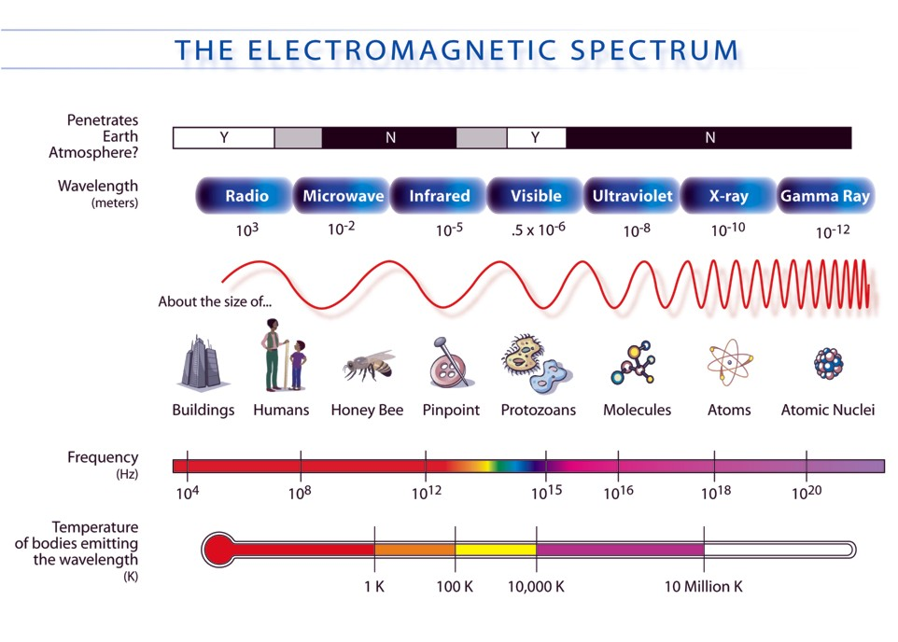
The Electromagnetic Spectrum
Notes:
Point out that the frequency scale is logarithmic on this diagram, indicating the huge range of frequencies between radio and gamma rays.

Slide 8
Visible Spectrum
As you could see in the previous slide, visible light is a very small part of the electromagnetic spectrum.
White light from the sun is actually made up of all the colors of the visible spectrum, as demonstrated by rainbows and prisms.
Within visible light, the order from longest wavelength (lowest frequency) to shortest wavelength (highest frequency) is Red, Orange, Yellow, Green , Blue, (Indigo), Violet. [ROY.G.B(I)V]
Notes:
Sometimes indigo is included in a list of colors in the visible spectrum, and sometimes it is not. Newton originally only identified five colors (Red, Yellow, Green, Blue, Violet), but later added Orange and Indigo so that the number of colors would be seven and thus analogous to the number of notes in the musical scale.

Slide 9
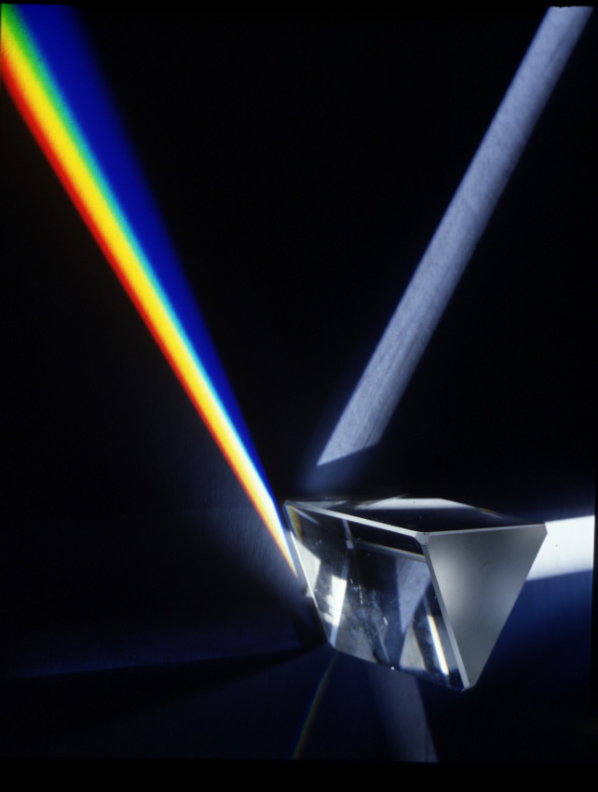
Courtesy Adam Hart-Davis
© Adam Hart Davis
Notes:
Point out to students that this is classic illustration of a classic experiment, first published by Newton in the early 1600’s. This is proof that white light is not its own color but instead consists of the combination of the other colors in the spectrum.

Slide 10
Trends in the EM Spectrum
In going from radio waves to gamma rays (or red to blue visible light)
  Wavelength decreases
  Frequency increases
  Energy increases
  Speed remains constant
This means that
  The surface of a visible telescope must be much smoother than the surface of a radio telescope.
  FM antennae are shorter than AM antennae, since the higher frequency requires quicker oscillations of the electrons in the metal.
  We are more concerned about UV damage to our skin than IR damage.
  All parts of the electromagnetic spectrum from an astronomical object reach us at the same time.

Slide 11
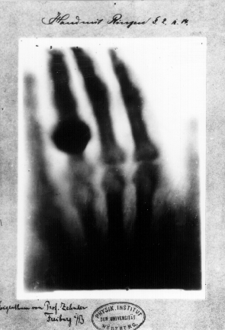
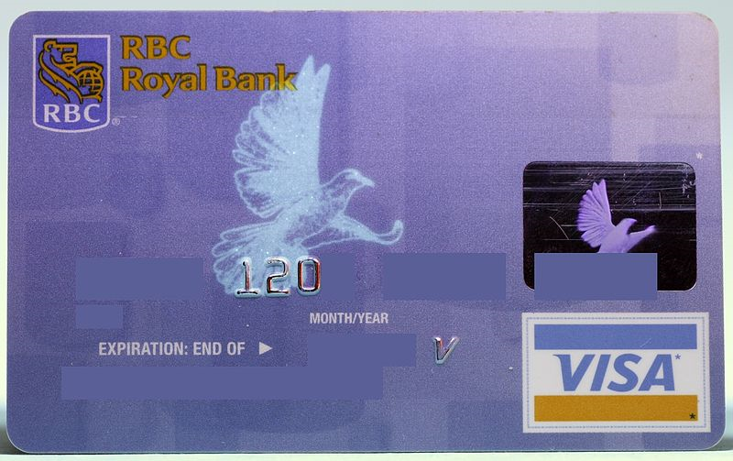
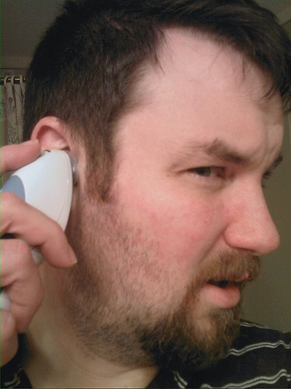
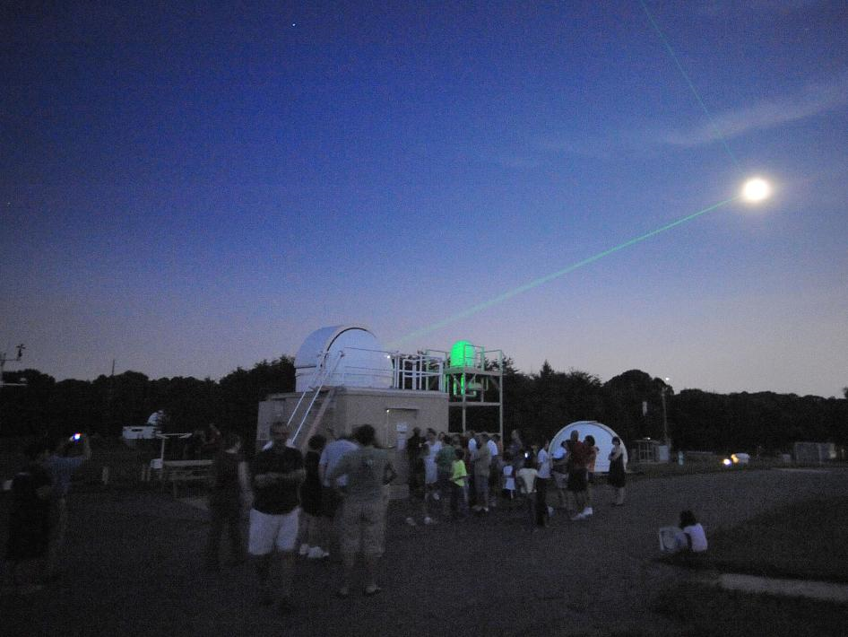
Uses of Electromagnetic Waves, I
Wikipedia, user Nebrot, Creative Commons
From Flickr, Armand Agasi, Creative Commons
From Wikipedia, Public Domain
Image by Wilhelm Roentgen, 1896, of wife Anna’s hand (with wedding ring)
Image from NASA
Notes:
Gamma – Irradiating food to kill bacteria. Radioactive sources for radiation therapy in cancer patients. A new system called VACIS (vehicle and container imaging system) uses gamma rays to check containers for stowaways and other contraband.
X-Rays – Used to take pictures of inside the body. X- Rays can penetrate tissue but not bone.
Ultraviolet – Used for tanning and detecting forgeries on checks and credit cards.
Visible – Used for seeing and for lasers.
Infra Red – used for cooking and thermal imaging, and ear thermometers
Microwaves – used for cooking, since water oscillates at microwave frequencies, creating friction and therefore heat in food.
Radio Waves – used for radio, tv, cell phone, and satellite signals

Slide 12
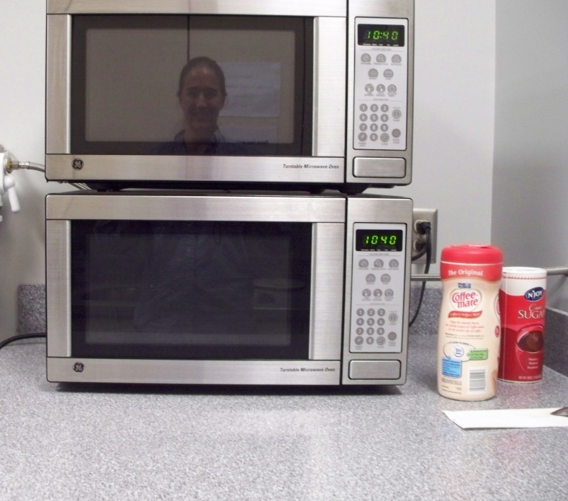
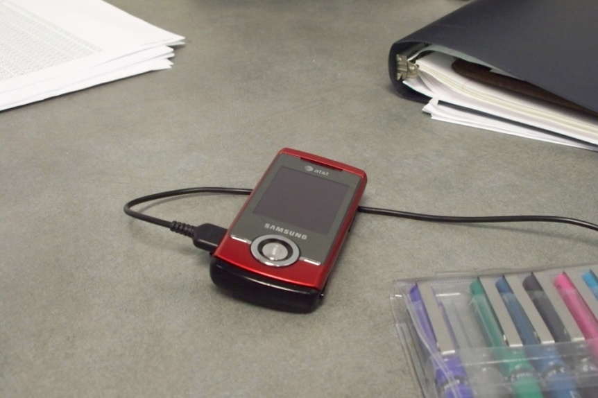
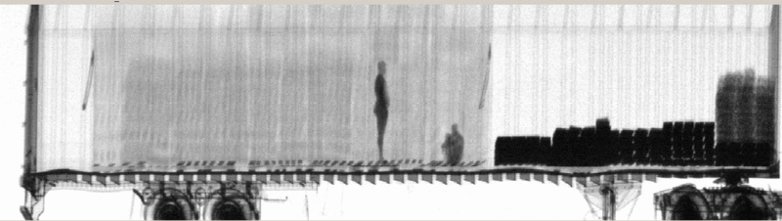
Uses of Electromagnetic Waves, II
Image by SKMay
Image by SKMay
From Wikipedia, Public Domain
Notes:
Gamma – Irradiating food to kill bacteria. Radioactive sources for radiation therapy in cancer patients. A new system called VACIS (vehicle and container imaging system) uses gamma rays to check containers for stowaways and other contraband.
X-Rays – Used to take pictures of inside the body. X- Rays can penetrate tissue but not bone.
Ultraviolet – Used for tanning and detecting forgeries on checks and credit cards.
Visible – Used for seeing and for lasers.
Infrared – used for cooking and thermal imaging, and ear thermometers
Microwaves – used for cooking, since water oscillates at microwave frequencies, creating friction and therefore heat in food.
Radio Waves – used for radio, tv, cell phone, and satellite signals

Slide 13
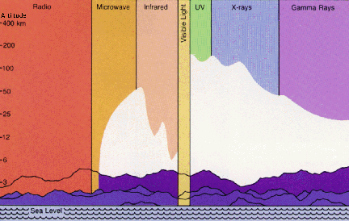
Image from NASA

Slide 14
Atmospheric Transparency
Earth’s atmosphere serves as a shield, blocking some parts of the electromagnetic spectrum from reaching us on the surface.
  Water vapor in Earth’s troposphere absorbs microwave and IR radiation.
  Ozone in Earth’s stratosphere absorbs UV, X, and Gamma rays.
If astronomers want to observe in these parts of the spectrum (and they do!),
  They can often observe parts of the IR and microwave spectrum from high elevations on Earth on clear days.
  Planes can be turned into IR and Microwave observatories, since they often fly above much of the water vapor in Earth’s atmosphere.
  Observations of UV, X- and Gamma rays must be done from Earth’s orbit.
  Observations of all parts of the spectrum have higher resolution from space, and thus, it is an ideal location for observing.

Slide 15
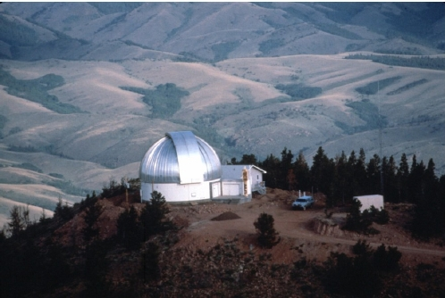
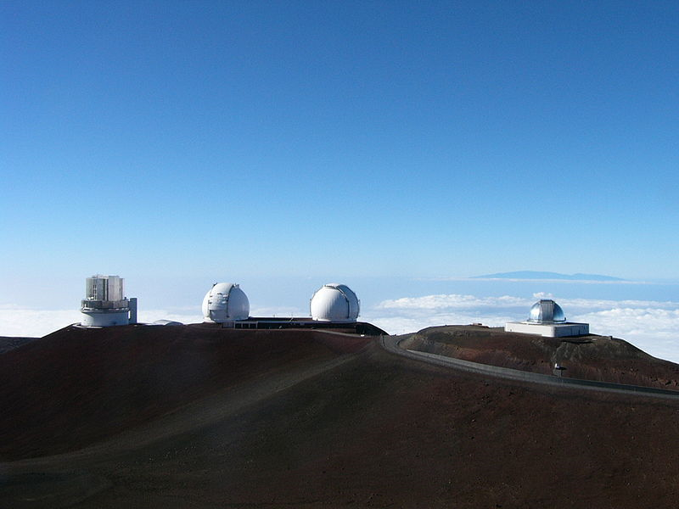
Observing above Clouds
Some of the telescopes (Subaru, Keck I and II, and NASA IR telescope) on Mauna Kea, Hawaii (elevation = 13,800 ft)
Image from Wikipedia, Creative Commons
University of Wyoming’s IR Observatory, located at an elevation of 9656 ft.
Picture from http://physics.uwyo.edu/~mpierce/WIRO/
Notes:
Infrared observing really can be done from Earth, provided the telescope is above much of the water vapor in Earth’s atmosphere.

Slide 16
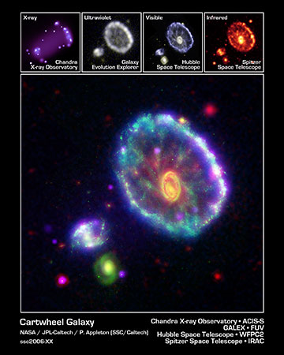
Observing in Multiple Wavelengths
Credit: NASA/JPL-Caltech/P. N. Appleton (SSC-Caltech)
Notes:
This image was found at http://www.galex.caltech.edu/media/glx2006-01r_img02.html

Slide 17
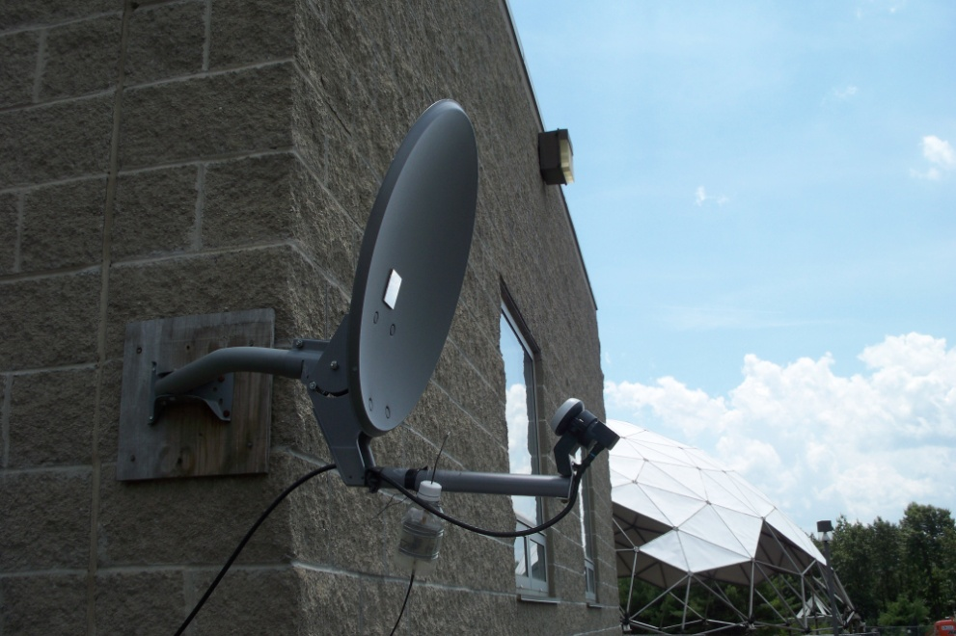
The MOSAIC System
The MOSAIC system receives electromagnetic radio waves from the ozone molecules in the mesosphere.
Because the lower atmosphere is transparent to radio waves, they pass through unimpeded.
What, besides mesospheric ozone, might we be detecting with our observations?
Photo by SKMay
Notes:
The MOSAIC system will detect any frequency emission at 11.07 GHz along the path it is pointed. In the US, this band is relatively quiet from television and other manmade frequencies, but this is the frequency used for satellite television in Europe. The ozone in the lower atmosphere certainly emits some radiation at 11.07 GHz, and it will be detected by MOSAIC along with mesospheric ozone (but the signal is pressure-broadened, making it easy to remove in analysis). Further, any radio sources from space that happen to pass through the line of sight of MOSAIC will be measured if they emit significant radiation at 11.07 GHz.

