Slide 1
Electromagnetic Waves
Physical Science Chapter 11

Slide 2
Electromagnetic Waves
Transverse waves
Not mechanical waves
Do not require a medium
Like all waves, results of vibrations
Result from vibrations of electric charges

Slide 3
Recall Electromagnetism?
Magnetism and electricity are related
You can generate an electric current with moving magnetic fields
You can generate magnetism with changing electric fields
Electromagnetic Waves result from changing electric and magnetic fields
Both of these fields can exist without matter
When an electric charge vibrates, the electric field changes and induces a changing magnetic field
This induces an electric field, and so on
Each electric field creates a magnetic field, and each magnetic field creates an electric field
They induce one another

Slide 4
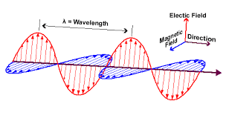

Slide 5
Properties of EM waves
The magnetic and electric fields are perpendicular to one another
At a right angle
They travel outward from the moving charge
This creates a transverse wave
Wavelength and frequency are the same as in any transverse wave
$v=fλ$ explains how the frequency and wavelength are related

Slide 6
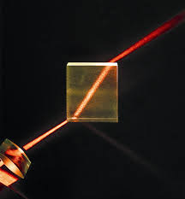
Speed of EM waves
Very fast
Much faster than sound
In a vacuum, the speed of an EM wave is 3x10⁸ m/s
Note: This is the speed of light
It slows down in matter
This causes refraction (bending of light in mediums)

Slide 7
Energy Transfer
As EM waves hit objects, it causes them to gain energy and vibrate
This heats the object up
The energy carried by an EM wave is called radiant energy (radiation)

Slide 8
Particle-Wave Duality of EM Waves
EM waves are waves
They carry energy as they disturb matter
EM waves are also particles
Pieces of matter
Heinrich Hertz
Created spark shining light on a metal
Albert Einstein
Determined that and EM wave can behave as a massless particle
Called a photon
Photon’s energy depends on the frequency of the wave

Slide 12
Particles as Waves
Quantum Physics
All particles can behave as waves
This means that they can interfere with one another

Slide 13
The Electromagnetic Spectrum

Slide 14
Wavelength vs Frequency
On the EM spectrum, as wavelength decreases, frequency increases and vice versa
Radio waves have the longest wavelength, and the lowest frequency
Gamma waves have the shortest wavelength, and the highest frequency

Slide 15
Radio Waves
Longest wavelength (1 meter or more)
Lowest frequency (~10⁵-10⁹ Hz)
Used in communications and medical imaging
RADAR (Radio Detecting And Ranging)
Similar to sonar and echolocation
Radio wave is released and bounce off of an object. How long it takes determines the distance
MRI (Magnetic Resonance Imaging)
Uses radio waves to penetrate into bones and tissues

Slide 16
Microwaves
1 mm to 1 meter wavelength
~10⁹-10¹² Hz
Used in microwaves and communication
Microwaves use microwaves to interact with water molecules
The waves cause water molecules to rotate, increasing their kinetic energy
The KE and Friction causes thermal energy, which heats the material up

Slide 17
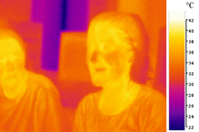
Infrared Waves
~750nm-1mm wavelength
~10¹²-10¹⁵ Hz
Leads to heat from fire
Infrared detectors can be used to form images from the Infrared waves
Also used in Night Vision
Used in CD-ROMs
Also used in meteorology (helps determine cloud heights and temperature)

Slide 18
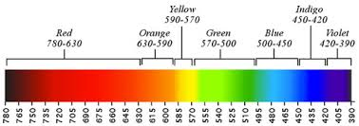
Visible Light
390-750 nm wavelength
Around 10¹⁵ Hz
Portion of EM spectrum we can see
ROYGBIV
Red has the longest wavelength and lowest frequency
Violet has the shortest wavelength and highest frequency

Slide 19
Ultraviolet Waves
10nm to 390nm wavelength
10¹⁵ - 10¹⁶ Hz
Are able to enter organism’s cells
Can be beneficial or harmful
Beneficial
UV waves help humans make Vitamin D, which helps bones and skin
Can also disinfect foods and medical supplies by killing bacteria
Can also make things become fluorescent
Harmful
Can destroy proteins and DNA
Causes sunburn and can lead to skin cancer

Slide 20
The Ozone Layer
Ozone is a molecule composed of 3 oxygen atoms (O₃)
Earth’s atmosphere has a layer of ozone that absorbs a lot of harmful UV rays
Humans have damaged the ozone layer with chemicals called chlorofluorocarbons (CFCs)
UV rays interact with CFCs by breaking a chlorine atom off of the molecule
The chlorine atom breaks an oxygen off of the ozone molecule, creating chlorine monoxide and oxygen
The chlorine monoxide then gives up the oxygen atom to a free oxygen atom, and is once again free to break apart a new ozone molecule
The cycle continues
The process results in the ozone layer becoming depleted and less able to absorb harmful UV radiation

Slide 21
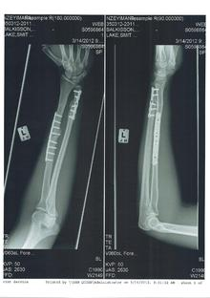
X-Rays
0.1 nm to 10 nm wavelength
10¹⁷-10¹⁹ Hz
Their large energy and short wavelengths allow them to penetrate skin and soft tissue
Cannot penetrate bone or teeth
Makes them useful for medical imaging

Slide 22
Gamma Rays
Less than 0.1 nm wavelength
Greater than 10¹⁹ Hz
Highest energy
Produced in a process that happens naturally in the nucleus of atoms
Used in radiation therapy for cancer treatment

Slide 23
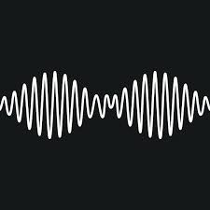
Radio Communication
Radio stations are assigned a frequency that is called a carrier wave
The wave is then modulated
A signal is added to the carrier wave
2 modulation methods
Amplitude modulation (AM)
Amplitude of the carrier wave is varied
Frequency modulation (FM)
Frequency of the carrier wave is varied
The strength is fixed, so it is more clear than AM

Slide 24
Broadcasting Radio Waves
An electric signal from the station causes electrons in the transmission antenna to vibrate
The vibration in the antenna causes an EM wave that travels outward
The wave causes electrons in a receiving antenna to vibrate
The vibrations create an electrical signal that a radio reads

Slide 25
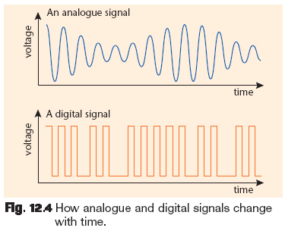
Digital Revolution
Analogue signals are electrical signals whose values change smoothly over time
This is what was used in the past
Now we use digital signals for much of our communication
In a digital signal, there are only 2 options: ON and OFF

Slide 26
Transceivers
Objects that transmit one radio signal and receive another
Allows incoming and outgoing signals at the same time
Useful for telephones
Use radio waves
Also, satellites are transceivers
Satellites use microwaves
Global Positioning System (GPS)
System of satellites that determines an exact location on Earth

