Slide 1
Author: Craig Harrison
Managing Director, I S Systems Pty Limited
PPA Conference, 1st to 5th August 2016
Power System Stability & Efficiency Improvements through DC Techniques

Slide 2
Presentation Outline
Medium Utility Scale - Problems Needing Solutions
2. Flexible Generation - Minimum Spinning Reserve & Dynamic Behaviour
- example
3 Network Management & Stability - DC Interconnectivity
- example

Slide 3
Conference Theme - Network & RE
Integration Problems
Maintaining Higher Load Factors
Reducing Spinning Reserve
Reducing Cyclic Operation of Conventional Generation
Minimising RE Spillage in the Absence of Storage
Increasing Efficiency & Reduced Fuel Consumption

Slide 4
Network & RE Integration Problems
"We cannot solve our problems
using the same thinking
we used to create them"
Albert Einstein
DC Techniques Offer an Alternative Approach

Slide 5
Review of Studies
Network Stability & Variable RE Studies suggest “standard solutions”!
Variable DE generation is not considered
Networks & Generation segmentation is not considered

Slide 6
Topic 1
Existing Generator Sets
conversion to
Flexible & Dynamic “Hybrid Generators”

Slide 7
Variable Speed Generation!
Spinning
Reserve
Set
open
closed
VS
Generation
Power Flow
closed

Slide 8
How Does this Work?
Step 1: Spinning Reserve Set (off bus) is idling at say 50 % Speed
&
Inverter is on-line & lightly loaded, say 200 kW
Step 2: Station load rapidly increasing above the base load
(e.g. loss of PV)
Step 3: Inverter instantly starts delivering power from generator via the
DC rectifier - independent of volts and frequency and the DC link capacitors
Step 4: Generator engine is accelerated – increasing the available power
to match the increasing load – less than 10 s response
(0 to 100 % power)
Step 5: Excess load reduces – engine speed reduced

Slide 9
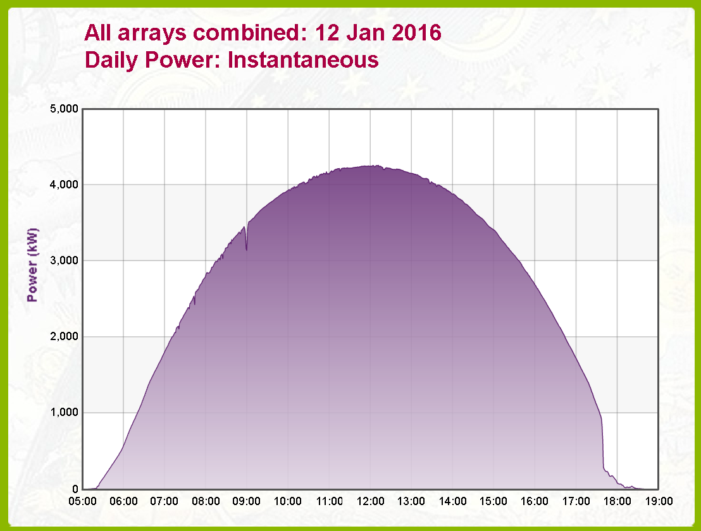
Typical Solar Data (Source: UQ)
A Nearly Perfect Day!

Slide 10
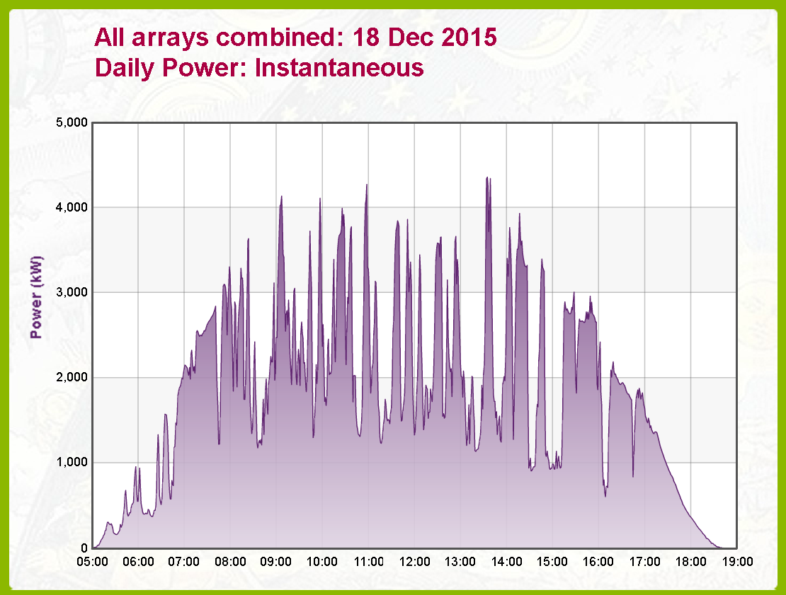
Typical Solar Data (Source: UQ)
A More Typical Day …

Slide 11
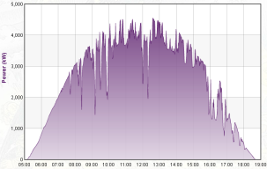
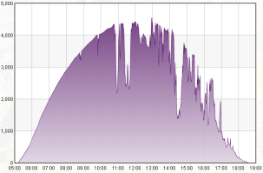
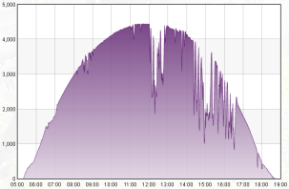
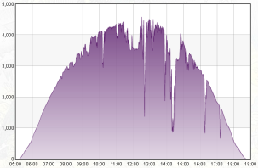
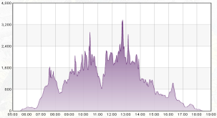
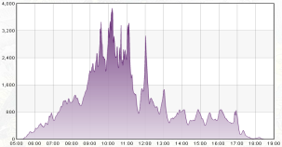
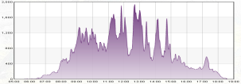
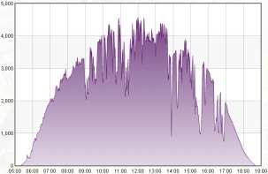
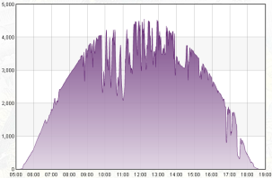
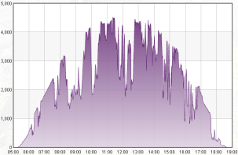
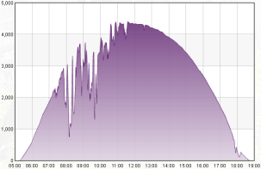
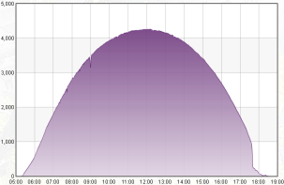
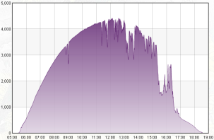
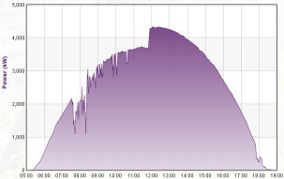
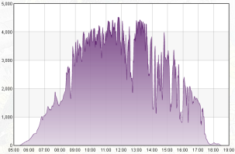
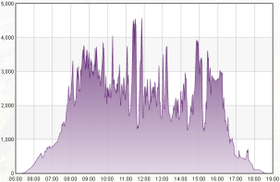
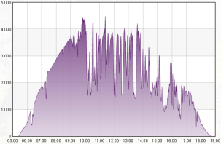
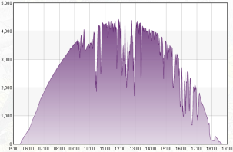
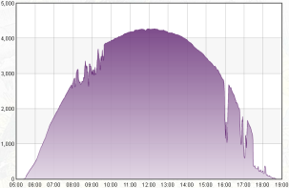
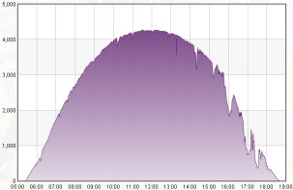
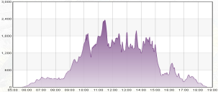
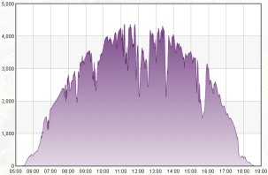
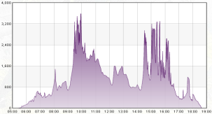
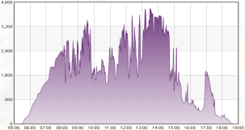
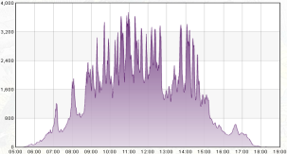
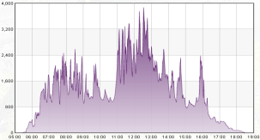
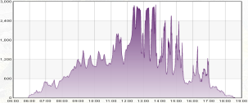
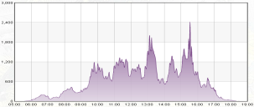
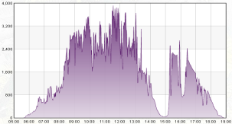
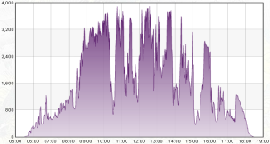
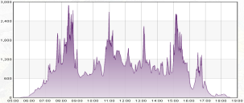
Typical Solar Data (Source: UQ)
A Month in January 2016

Slide 12
Variable Speed Generation
Fast Response
Spinning reserve Genset is online – No starting or synchronising time
Reduced fuel consumption – Spinning reserve
Facilitates higher load factor – Security without burning more fuel
Ramp rate smoothing option with large DC link capacitors
Online Inverter can function as a static VAR generator – Reduced VAR
demand on generators – Higher load factors

Slide 13
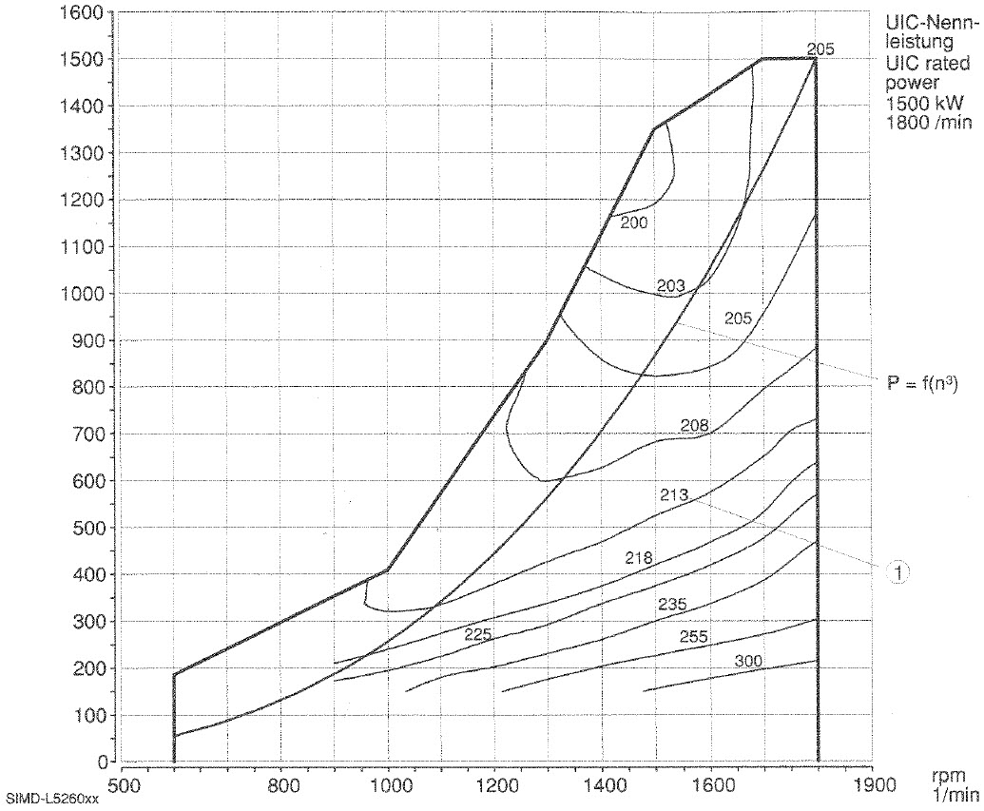
Engine & Generation Characteristics
1500 kW,
1800 RPM
Engine
Load
(kW)
Power = f(n³)
Specific
Fuel
Consumption
Contours
(g/kWh)
Speed (RPM)
Example Only

Slide 14
Engine & Generation Characteristics
1500 kW,
1800 RPM
Engine
Load
(kW)
~ 305 g/kWh
@
100 % Speed
Speed (RPM)
Example Only

Slide 15
Engine & Generation Characteristics
1500 kW,
1800 RPM
Engine
Load
(kW)
~ 218 g/kWh
@
50 % Speed
~ 305 g/kWh
@
100 % Speed
Speed (RPM)
Example Only

Slide 16
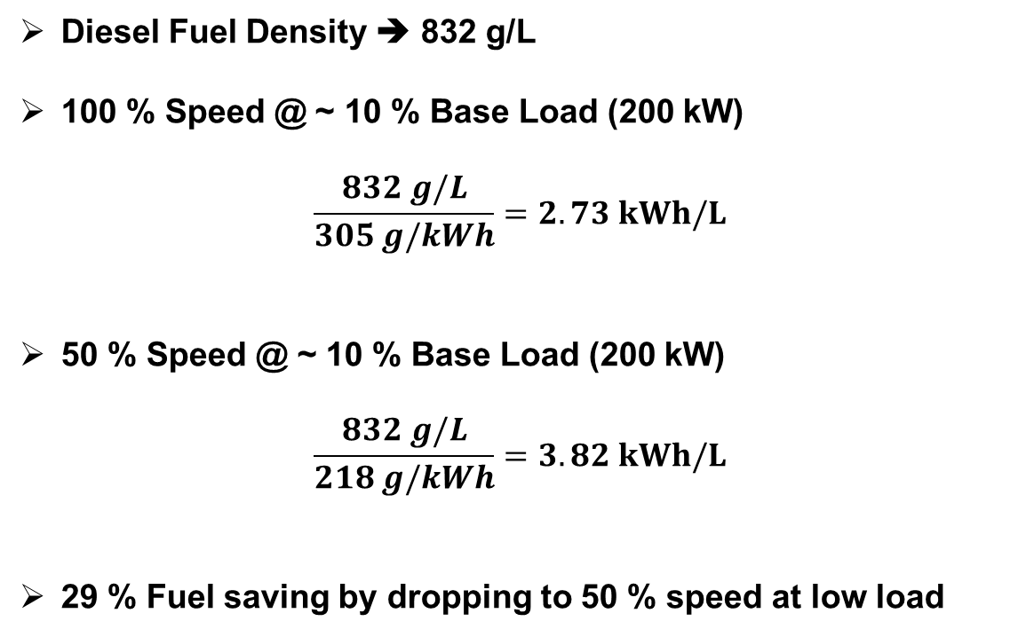
Engine & Generation Characteristics
Diesel Fuel Density ➔ 832 g/L
100 % Speed @ ~ 10 % Base Load (200 kW)
$$\frac{832 g/L}{305 g/kWh}=2.73 kWh/L$$
50 % Speed @ ~ 10 % Base Load (200 kW)
$$\frac{832 g/L}{218 g/kWh}=3.82 kWh/L$$
29 % Fuel saving by dropping to 50 % speed at low load

Slide 17
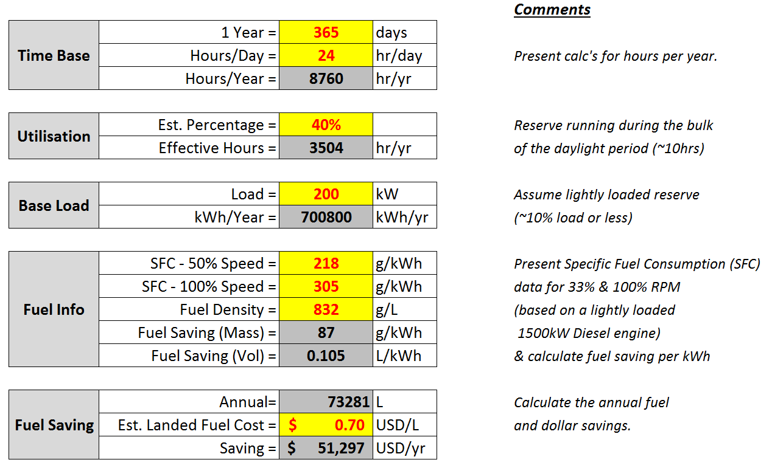
1,500kW Set - Savings at Low Utilisation
(approx. 10 hrs per day)

Slide 18
1,500kW Set - Savings at High Utilisation
(approx. 22 hrs per day)

Slide 19
Commercial Considerations
System cost will vary according to the engine, power required, utilization
& specific site specifics
System life expectancy ➔ 20 years +
Cost Recovery Time typically – 4 to 6 years

Slide 20
Slow Speed Running - Impact on the Engine
Quotes from Caterpillar:
“The most prevalent consequence of under loading is exhaust manifold
slobber, or wet stacking”
“Long periods of light loading can lead to deposit build-up behind the
piston rings or inside the cylinders”
Marine Engines:
Extensively studied and managed
Solution:
Generation scheduling to load sets for short periods
Fan control for correct temperature operation

Slide 21
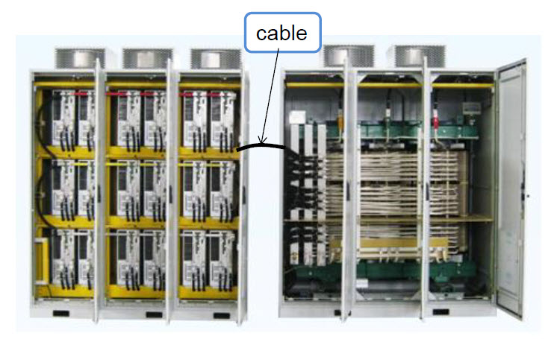
MV Inverter VSD - Technology
Inverter Cells
Transformer
Image: Delta Electronics, Taiwan

Slide 22
Topic 2
AC Power Network Stabilisation
with
DC Interconnector Units

Slide 23
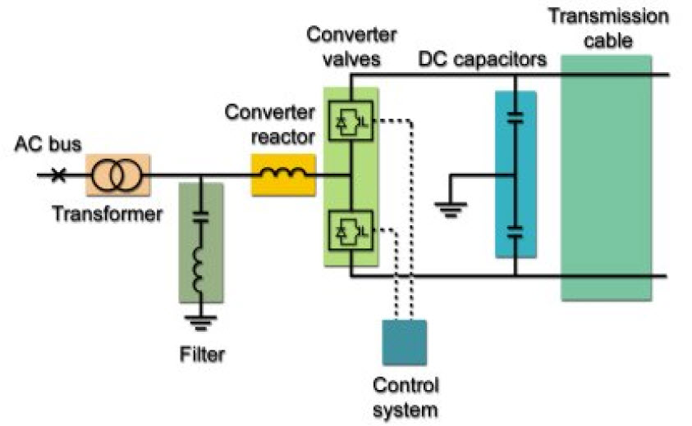
HVDC LINKS – HIGH POWER TRANSMISSION
Established Technology for High Powers
ABB: HVDC Light
Siemens: Basslink – Victoria & Tasmania
Siemens: Pole 3 – NZ North & South Islands

Slide 24
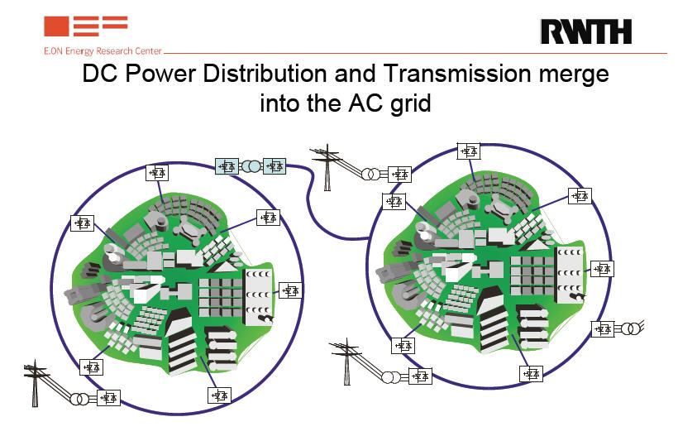
DC Applied in Electrical Distribution Networks
DC Ring Main
Decoupling of AC Network Segments & Reactive Power Demand
Presentation by: Dr. R. W. De Doncker, Director

Slide 25
Distribution Network Issues
Poor Transmission Lines – Fringe of Network
Power Quality – Reactive Power & Voltage Regulation
Network Stability – Reactive Power & Voltage Regulation
Increased RE Penetration – Transient Behaviour

Slide 26
Network Segmentation – DC Interconnector Unit
(back to back inverters)
Ramp Rate Smoothing Capacitor

Slide 27
DC Interconnector Unit - Features
Bidirectional OR Unidirectional Active Power Flow
No Frequency OR Phase Synchronising Requirements
Network Voltage Regulation
Network Support AND Fault Clearance
Load Transient Smoothing Capacitors
Static VAR Compensator – Import & Export VARs – both sides

Slide 28
DC Interconnector Unit - Example

Slide 29
THANK YOU
FOR
YOUR INTEREST

