Slide 1
Control Systems
Lect. 1 Introduction
Basil Hamed

Slide 2
Introduction
1. What is a control system.
2. Why control systems are important.
3.What are the basic components of a control system.
4. Some examples of control-system applications.
5.Why feedback is incorporated into most control systems.
6. Types of control systems.

Slide 3
What is a control system
A control system is considered to be any system which exists for the purpose of regulating or controlling the flow of energy, information, money, or other quantities in some desired fashion.

Slide 4
What is a control system
An interconnection of components forming a system configuration that will provide a desired system response
The study of control provides us with a process for analyzing and understanding the behavior of a system given some input
It also introduces methods for achieving the desired system response

Slide 5
Systems and Control
A System is a device or process that takes a given input and produces some output:
  A DC motor takes as input a voltage and produces as output rotary motion
  A chemical plant takes in raw chemicals and produces a required chemical product
Input
Output
System

Slide 6
Why control systems are important
In recent years, control systems have assumed an increasingly important role in the development and advancement of modern civilization and technology.
Practically every aspect of our day-to-day activities is affected by some type of control system.
Control systems are found in abundance in all sectors of industry, such as quality control of manufactured products, automatic assembly lines, machine-tool control, space technology and weapon systems, computer control, transportation systems, power systems, robotics, Micro-Electro-Mechanical Systems, nanotechnology, and many others.

Slide 7
Basic Components of a Control System
1. Objectives of control.
2. Control-system components.
3. Results or outputs.

Slide 8
Examples of Control-System Applications
Potential applications of control of these systems may benefit the following areas:
• Machine tools. Improve precision and increase productivity by controlling chatter.
• Flexible robotics. Enable faster motion with greater accuracy.
•Photolithography. Enable the manufacture of smaller microelectronic circuits by controlling vibration in the photolithography circuit-printing process.
• Biomechanical and biomedical. Artificial muscles, drug delivery systems, and other assistive technologies.
• Process control. For example, on/off shape control of solar reflectors or aerodynamic surfaces.

Slide 9
Examples of Control-System Applications
Steering Control of an Automobile:
As a simple example of the control system, consider the steering control of an automobile. The direction of the two front wheels can be regarded as the controlled variable, or the output, y; the direction of the steering wheel is the actuating signal, or the input, u.
The control system, or process in this case, is composed of the steering mechanism and the dynamics of the entire automobile. However, if the objective is to control the speed of the automobile, then the amount of pressure exerted on the accelerator is the actuating signal, and the vehicle speed is the controlled variable.

Slide 10
Examples of Control Applications
Aerospace Applications:
  Aircraft or missile guidance and control
  Space vehicles and structures

Slide 11
Examples of Control-System Applications
Sun-Tracking Control of Solar Array:
To achieve the goal of developing economically feasible non-fossil-fuel electrical power, development of solar power conversion methods, including the solar-cell conversion techniques

Slide 12
Why feedback is incorporated into most control systems
Control Systems can be classified as :
open loop system (Nonfeedback System)
closed loop system (Feedback System).

Slide 13
Open-Loop Control Systems (Nonfeedback Systems)
The elements of an open-loop control system can usually be divided into two parts: the controller and the controlled process, as shown by the block diagram

Slide 14
Open Loop Control Systems
A system in which the output has no effect on the control action is known as an open loop control system. For a given input the system produces a certain output. If there are any disturbances, the out put changes and there is no adjustment of the input to bring back the output to the original value.

Slide 15
Open-Loop Control Systems
• The controlled ‘output’ is the resulting toast
• System does not reject changes in component characteristics

Slide 16
Closed-Loop Control Systems (Feedback Control Systems)
What is missing in the open-loop control system for more accurate and more adaptive control is a link or feedback from the output to the input of the system.
To obtain more accurate control, the controlled signal y should be fed back and compared with the reference input.

Slide 17
Open-Closed Loop Control
Open-loop control is ‘blind’ to actual output
Closed-loop control takes account of actual output and compares this to desired output
Desired
Output
Input
Controller/
Amplifier
Process
Dynamics
Output
+
-
Measurement

Slide 18
TYPES OF FEEDBACK CONTROL SYSTEMS
Feedback control systems may be classified in a number of ways, depending upon the purpose of the classification. For instance, according to the method of analysis and design, control systems are classified as:
Linear or Nonlinear
Time-varying or Time-invariant
Continuous-data or Discrete-data

Slide 19
Control
Many control systems can be characterised by these components
Disturbance
Plant
Control
Signal
u(t)
Reference
r(t)
Error
e(t)
Output
y(t)
Control
Actuator
Process
+
-
Feedback
Sensor
Sensor Noise

Slide 20
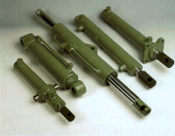
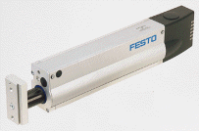
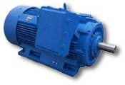
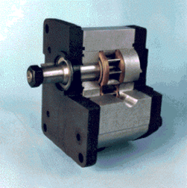
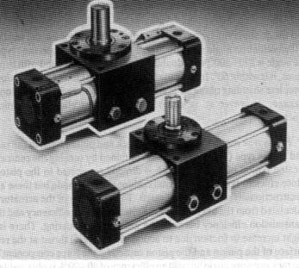
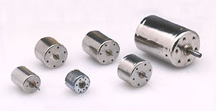
Actuation
A device for acting on the environment

Slide 21
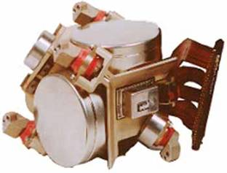
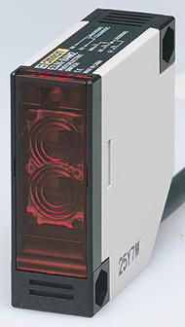
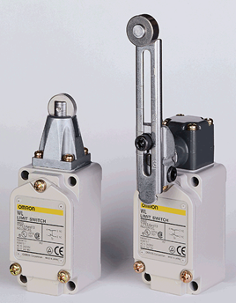
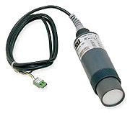
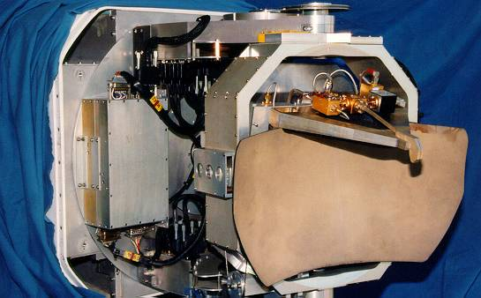
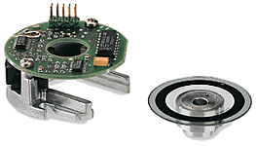
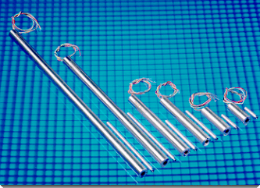
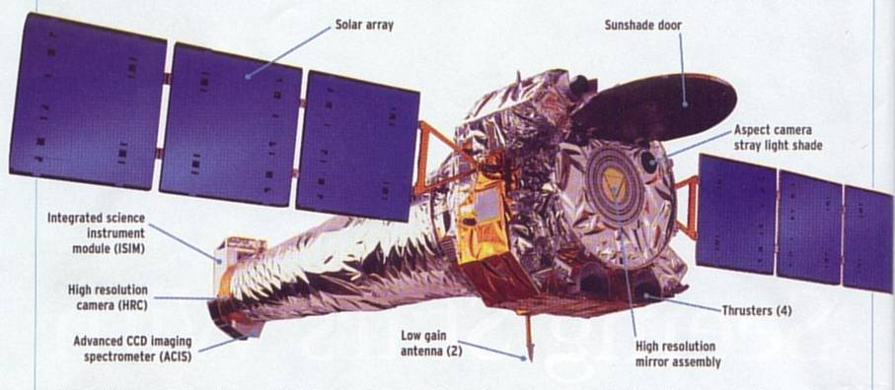
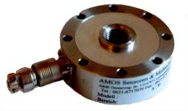
Sensing
A device for measuring some aspect of the environment

Slide 22
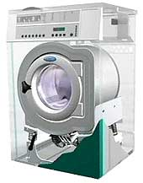
Examples : Washing Machine
System Requirements
  Understanding of load sizes
  Receptacle to hold clothes
  ‘Plumbing’
  Ease of use, Reliability
  Low Cost
Actuators
  AC or DC Motors
  Water inlet/drain
Sensors
  Water level
  Load speed/balance
Control
  Choice depends on design

Slide 23
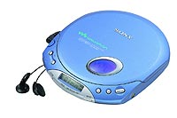
Examples : The CD Player
A CD player is an example of control system
Requires
  Accurate positioning of the laser read head
  Precise control of media speed
  Conversion of digital data to analogue signal

Slide 24
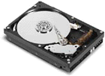
Examples : Hard Drive
A computer disk drive is another example of a rotary control system
Requires
  Accurate positioning of the magnetic read head
  Precise control of media speed
  Extraction of digital data from magnetic media

Slide 25
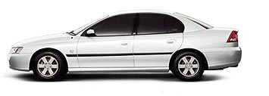
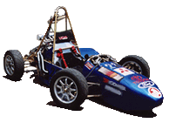
Examples : Modern Automobiles
Modern Automobiles are controlled by a number of computer components
Requires
  Control of automobile sub systems
    Brakes and acceleration
    Cruise control
    ABS
    Climate control
    GPS
  Reliability
  Low cost
  Ease of use

Slide 26
The Control Problem
Generally a controller is required to filter the error signal in order that certain control criteria or specifications, be satisfied. These criteria may involve, but not be limited to:
Disturbance rejection
Steady state errors
Transient response characteristics
Sensitivity to parameter changes in the plant

Slide 27
The Control Problem
Solving in control problem generally involves;
Choosing sensors to measure the plant output
Choosing actuators to drive the plant
Developing the plant, actuator, and sensors equations
Designing the controller
Evaluating the design analytically by simulation, and finally by testing the physical system.
If the physical tests are unsatisfactory, iterating these steps.

Slide 28
The Control Problem
Problem Formulation
Solution Translation
Mathematical model system
Physical System
Mathematical solution of mathematical problem

Slide 29
Modeling Physical Systems - Overview

Slide 30
Modeling – Remarks
• Modeling is the most important and difficult task in control system design.
• No mathematical model exactly represents a physical system.
Math Model ≠ Physical System
Math Model ≈ Physical System
• Do not confuse models with physical systems!
• In this course, we may use the term “system” or “plant” to mean a mathematical model.

