Slide 1
Semiconductor industry association and International technology Roadmap for semiconductors (itrs)
Kelsey Miller
4/29/2016
Abstract: The United States semiconductor industry is supported by the Semiconductor Industry Association which lobbies for policies favorable for industry and helps create goals along with other top semiconductor producing regions through the International Technology Roadmap for Semiconductors.

Slide 2
Outline
1. Semiconductor Industry Association
A. Policy Priorities
B. Industry Overview
C. Global Market
D. Capital and R&D Investment
E. Jobs/Productivity
2. International Technology Roadmap for Semiconductors (ITRS)
A. History
B. ITRS 2.0

Slide 3
Semiconductor Industry Association
Trade Association and Lobbying Group Founded in 1977
Located in Washington DC
Represents US Semiconductor Association
Founded by Wilfred Corrigan of Fairchild Semiconductor, Robert Noyce of Intel Corporation, Jerry Sanders of Advanced Micro Devices, Charles Sporck of National Semiconductor Corporation and John Welty of Motorola
Joins companies that produce 80% of United States Semiconductors Production

Slide 4
Policy Priorities
Trade
Tax
Immigration
Export Controls
Research
Environment, Health and Safety
Anti-Counterfeiting
Intellectual Property

Slide 5
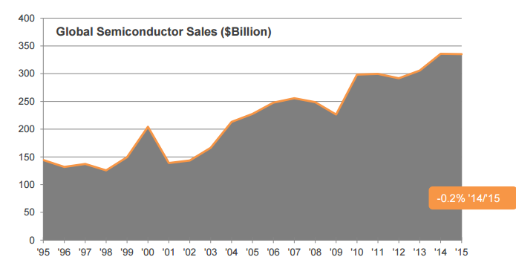
Industry Overview
144.4 Billion in 1995 to $335.2 billion in 2015, an average annual rate of increase of 9.5 percent per year.
Forecast: worldwide semiconductor industry sales are to reach $341 billion in 2016 and $352 billion in 2017.
Image courtesy of SIA 2016 Factbook

Slide 6
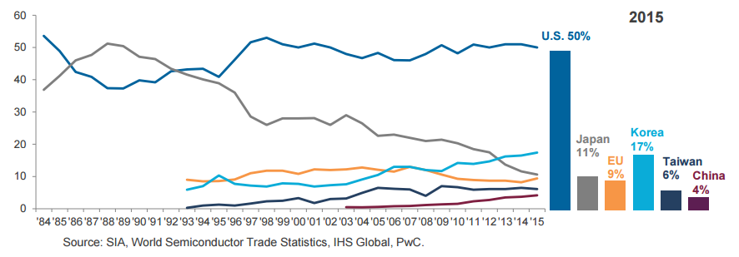
Industry Overview
The U.S. has half the Semiconductor market share
Image courtesy of SIA 2016 Factbook

Slide 7
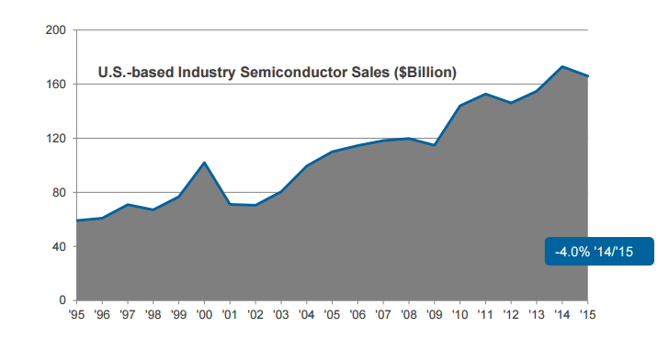
Industry Overview
U.S. sales in 2015 $165.9 billion dollars
Market share leader
Manufactured in the US
Image courtesy of SIA 2016 Factbook

Slide 8
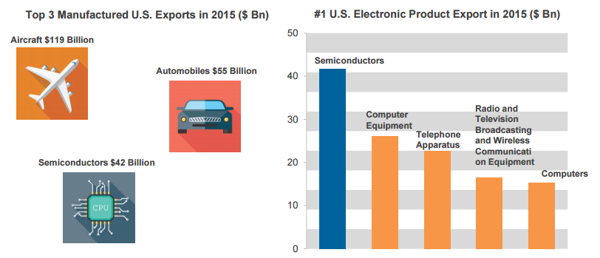
Industry Overview
Image courtesy of SIA 2016 Factbook

Slide 9
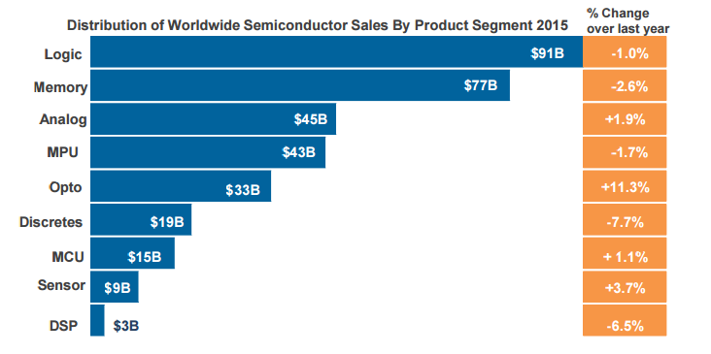
Global Market
Majority of Semiconductors bought by consumers (for cellphones and personal computers)
Most of the semiconductor industry have been logic, memory, MPU, and analog. In 2015, these products accounted for 76 percent of semiconductor industry sales.
Image courtesy of SIA 2016 Factbook

Slide 10
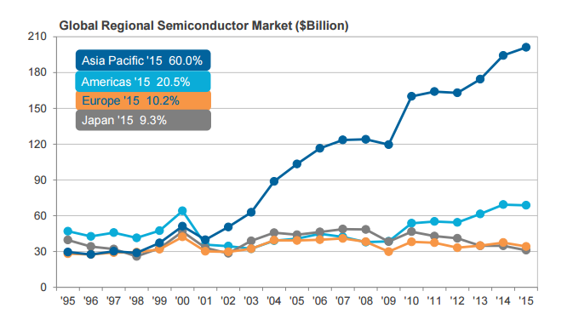
Global Market
In 2001 the Asia Pacific Market surpassed all other regional markets and only increasing
New markets in Asia, Latin America, Eastern Europe and Africa
Image courtesy of SIA 2016 Factbook

Slide 11
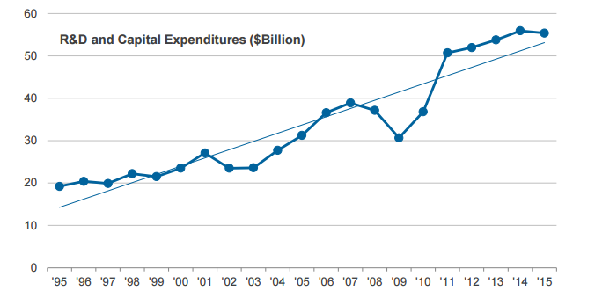
CAPITAL AND R&D INVESTMENT
Total Capital and R&D expenditures for U.S. in 2015: $55.4 billion
Growth Rate: 9.5%
Companies must put in at least 30% of sales into R&D to stay competitive
Investment per Employee at an all time high
Image courtesy of SIA 2016 Factbook

Slide 12
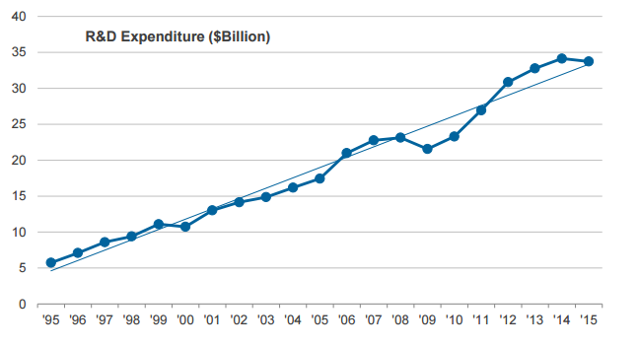
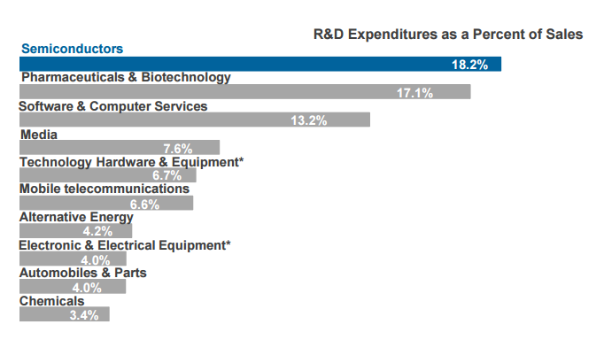
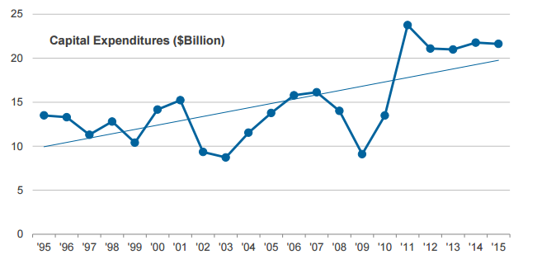
CAPITAL AND R&D INVESTMENT
R&D expenditures grew at an average annual rate of approximately 25 percent during the 1995 to 2015 period
R&D expenditures have generally exceeded 10% of sales
Semiconductor spends highest percent of sales on R&D
Gross Capital Expenditures was $21.6 Billion in 2015
Image courtesy of SIA 2016 Factbook

Slide 13
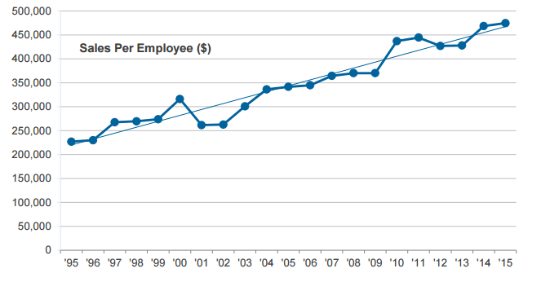
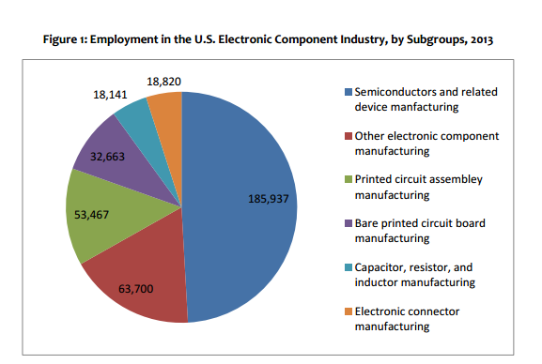
Jobs/ Productivity
U.S. semiconductor employment is estimated at 242,337
One U.S. semiconductor job supports 4.89 jobs in other parts of the U.S. economy leading to 1 million additional American Jobs (multiplier is fairly high)
In 2015 the U.S. Semiconductor industry had an average sales revenue per employee of over $475,000 which is a record high
Images courtesy of SIA 2016 Factbook and US Semiconductor Industry Employment

Slide 14
International Technology Roadmap for Semiconductors (ITRS)
Set of Documents produced by Semiconductor Experts
Overseen by European Semiconductor Industry Association (ESIA), the Japan Electronics and Information Technology Industries Association (JEITA), the Korean Semiconductor Industry Association (KSIA), the Taiwan Semiconductor Industry Association (TSIA), and the United States Semiconductor Industry Association (SIA).
“The objective of the ITRS is to ensure cost-effective advancements in the performance of the integrated circuit and the advanced products and applications that employ such devices, thereby continuing the health and success of this industry.”
Looks 15 Years into Future with each publication

Slide 15
History
Started in 1992 with National Technology Roadmap for Semiconductors produced by SIA
Semiconductors became global industry leads to the creation of ITRS with first publication of the ITRS in 1999

Slide 16
ITRS 2.0
Because the Semiconductor Industry is ever-changing so did the ITRS
In 2012 started restructuring ITRS and completed in 2014
Originally had 17 International Technology Working Groups replaced in 2015 by 7 Focus Teams

Slide 17
conclusion
Semiconductor Industry Association supports the rapidly growing semiconductor industry and helping to advance policies favorable to the Semiconductor industry
One of the SIA crowning achievements was the creation of the National Technology Roadmap for Semiconductors which led to the international collaboration on the International Technology Roadmap for Semiconductors
The International Technology Roadmap for Semiconductors looks 15 years in the future to create goals for the international semiconductor industry

Slide 18
References
Gargini, Paolo. "The International Technology for Semiconductors (ITRS): “Past, Present and Future”." Ieeexplore.ieee.org. IEEE, 2000. Web. 27 Apr. 2016.
"ITRS News." International Technology Roadmap for Semiconductors. International Technology Roadmap for Semiconductors, n.d. Web. 26 Apr. 2016.
"Semiconductor Industry Association." Wikipedia. Wikimedia Foundation, n.d. Web. 19 Apr. 2016.
SIA 2016 Policy Priorities. Rep. Semiconductor Industry Association, n.d. Web.
Yinug, Falan. "U.S. Semiconductor Industry Employment." U.S. Semiconductor Industry Employment (2015): 1-3. Jan. 2015. Web.
"2016 SIA Factbook." Semiconductor Industry Association. Semiconductor Industry Association, Mar. 2016. Web.

Slide 19
Five Key Points
Know the Policy Priorities of the SIA
The U.S. has half the market share of the Semiconductor industry
Semiconductors are the 3rd largest export from the U.S.
The Semiconductor Industry directly employs 242,337 individuals and supports over a million jobs
ITRS helps the world collaborate on making cost effective advancements in the Semiconductor industry

