Slide 1
Current and Voltage Relationship for a Capacitor: Derivative
Scott Starks, PhD, PE
Department of Electrical & Computer Engineering
UTEP

Slide 2
What is a Capacitor?
A capacitor is an electrical component that stores energy in an electric field.
It consists of two conductors separated by a dielectric material.
Capacitors are widely used as parts of circuits in many common electrical devices.
Energy is stored in the electrostatic field.

Slide 3
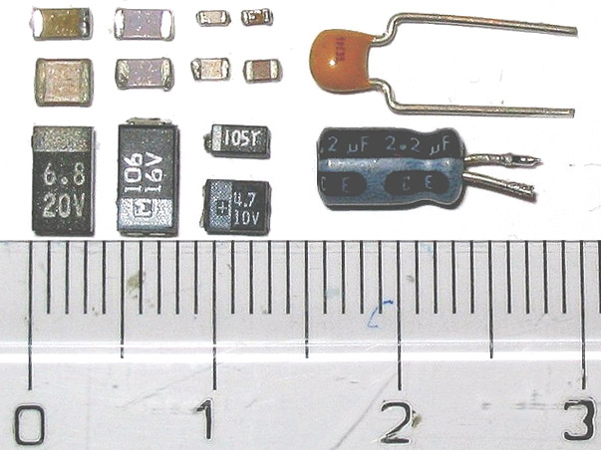
Images of Physical Capacitors

Slide 4
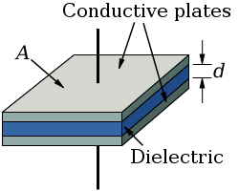
How a Capacitor Operates
When a voltage is placed across a capacitor, an electric field develops across the dielectric.
This causes positive charge to collect on one plate and negative charge on the other plate.
As the voltage is varied, so too does the amount of charge on each plate.
The change in charge constitutes and electric current.
Explanation
Functional Diagram

Slide 5
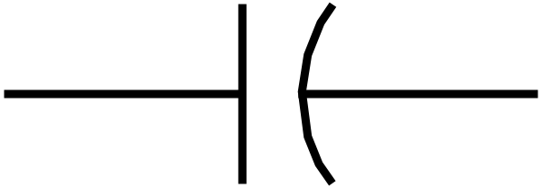
Relationship between Current and Voltage
Current and voltage obey the following law,
where i is current (Amps),
v is voltage (Volts), and
C is capacitance (Farads).
i
+ v -
Current/Voltage Law
Schematic Diagram

Slide 6
Plots for Voltage and Current Note: C = 1 Farad
i (A)
5
-5
t (s)
0 2 4 6 8
Plot of Voltage
Plot of Current

