Slide 1
Capacitors
Energy Storage Devices

Slide 2
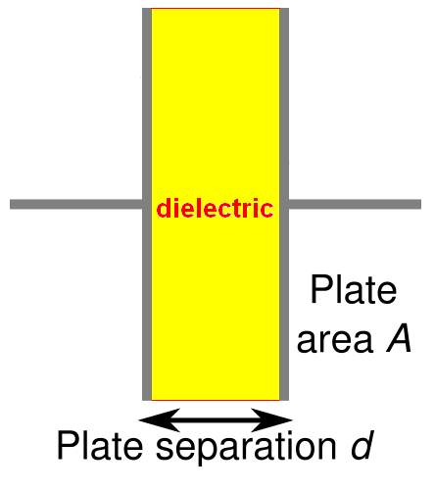
Capacitors
Composed of two conductive plates separated by an insulator (or dielectric).
Commonly illustrated as two parallel metal plates separated by a distance, d.
C = ε A/d
where ε = ε_{r} ε_{o}
ε_{r} is the relative dielectric constant
ε_{o} is the vacuum permittivity

Slide 3
Effect of Dimensions
Capacitance increases with
increasing surface area of the plates,
decreasing spacing between plates, and
increasing the relative dielectric constant of the insulator between the two plates.

Slide 4
Types of Capacitors
Fixed Capacitors
Nonpolarized
May be connected into circuit with either terminal of capacitor connected to the high voltage side of the circuit.
Insulator: Paper, Mica, Ceramic, Polymer
Electrolytic
The negative terminal must always be at a lower voltage than the positive terminal
Plates or Electrodes: Aluminum, Tantalum

Slide 5
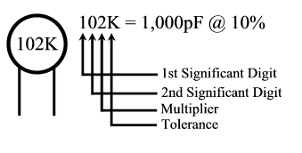
Nonpolarized
Difficult to make nonpolarized capacitors that store a large amount of charge or operate at high voltages.
Tolerance on capacitance values is very large
+50%/-25% is not unusual
PSpice Symbol
http://www.marvac.com/fun/ceramic_capacitor_codes.aspx

Slide 6
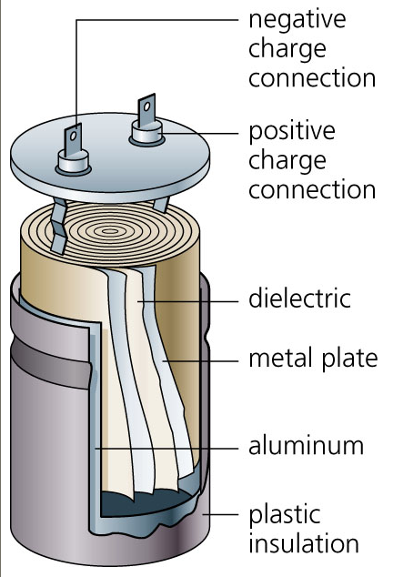
Electrolytic
Pspice Symbols
Fabrication
http://www.digitivity.com/articles/2008/11/choosing-the-right-capacitor.html

Slide 7
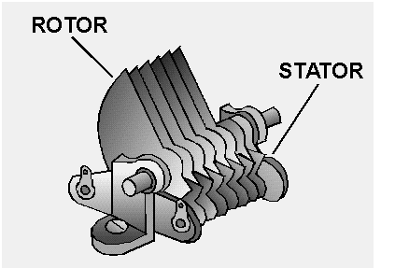
Variable Capacitors
Cross-sectional area is changed as one set of plates are rotated with respect to the other.
PSpice Symbol
http://www.tpub.com/neets/book2/3f.htm

Slide 8
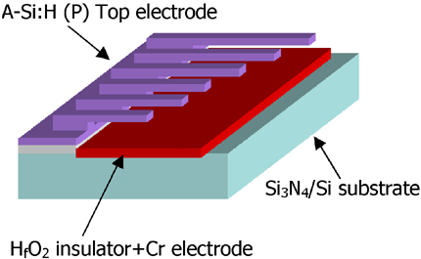
MEMS Capacitor
MEMS (Microelectromechanical system)
Can be a variable capacitor by changing the distance between electrodes.
Use in sensing applications as well as in RF electronics.
http://www.silvaco.com/tech_lib_TCAD/simulationstandard/2005/aug/a3/a3.html

Slide 9
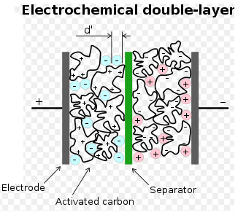
Electric Double Layer Capacitor
Also known as a supercapacitor or ultracapacitor
Used in high voltage/high current applications.
Energy storage for alternate energy systems.
http://en.wikipedia.org/wiki/File:Supercapacitor_diagram.svg

Slide 10
Electrical Properties of a Capacitor
Acts like an open circuit at steady state when connected to a d.c. voltage or current source.
Voltage on a capacitor must be continuous
There are no abrupt changes to the voltage
An ideal capacitor does not dissipate energy, it takes power when storing energy and returns it when discharging.

Slide 11
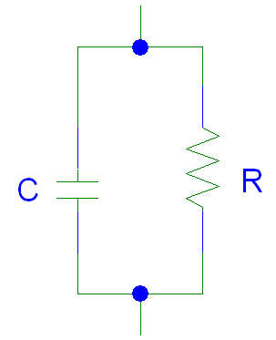
Properties of a Real Capacitor
A real capacitor does dissipate energy due leakage of charge through its insulator.
This is modeled by putting a resistor in
parallel with an ideal capacitor.

Slide 12
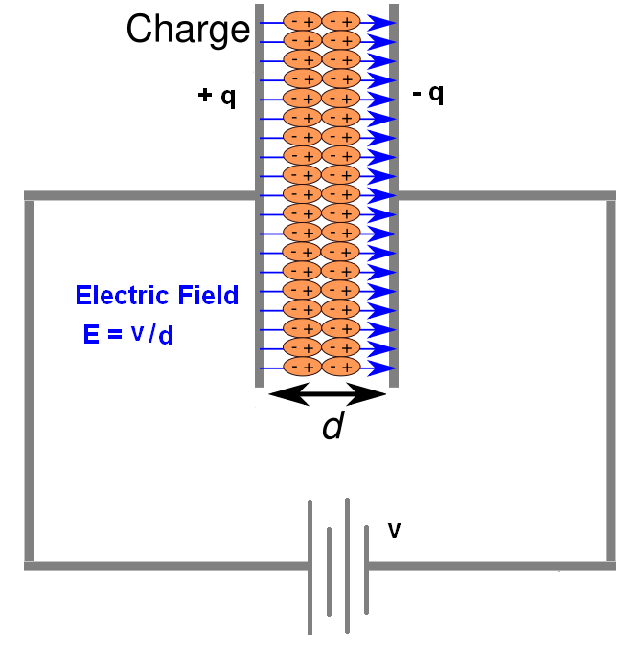
Energy Storage
Charge is stored on the plates of the capacitor.
Equation:
Q = CV
Units:
Coulomb = Farad.Voltage
C = F V

Slide 13
Adding Charge to Capacitor
The ability to add charge to a capacitor depends on:
the amount of charge already on the plates of the capacitor
and
the force (voltage) driving the charge towards the plates (i.e., current)

Slide 14
Charging a Capacitor
At first, it is easy to store charge in the capacitor.
As more charge is stored on the plates of the capacitor, it becomes increasingly difficult to place additional charge on the plates.
Coulombic repulsion from the charge already on the plates creates an opposing force to limit the addition of more charge on the plates.
Voltage across a capacitor increases rapidly as charge is moved onto the plates when the initial amount of charge on the capacitor is small.
Voltage across the capacitor increases more slowly as it becomes difficult to add extra charge to the plates.

Slide 15
Discharging a Capacitor
At first, it is easy to remove charge in the capacitor.
Coulombic repulsion from the charge already on the plates creates a force that pushes some of the charge out of the capacitor once the force (voltage) that placed the charge in the capacitor is removed (or decreased).
As more charge is removed from the plates of the capacitor, it becomes increasingly difficult to get rid of the small amount of charge remaining on the plates.
Coulombic repulsion decreases as the charge spreads out on the plates. As the amount of charge decreases, the force needed to drive the charge off of the plates decreases.
Voltage across a capacitor decreases rapidly as charge is removed from the plates when the initial amount of charge on the capacitor is small.
Voltage across the capacitor decreases more slowly as it becomes difficult to force the remaining charge out of the capacitor.

Slide 16
Current-Voltage Relationships

Slide 17
Power and Energy

Slide 18
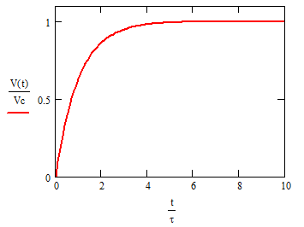
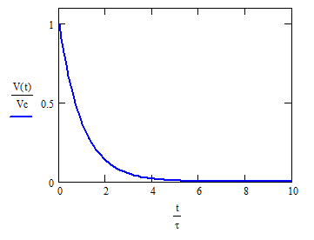
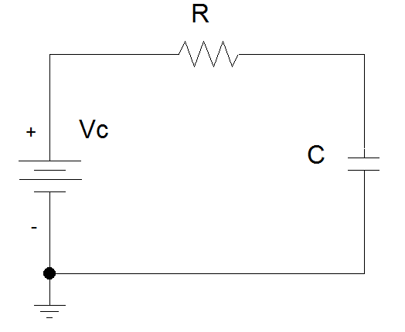
Capacitor Voltage vs. Time
d.c. voltage, Vc, is applied at t = 0s
d.c. voltage, Vc, is removed at t = 0s

Slide 19
Time constant, τ
The rate at which charge can be added to or removed from the plates of a capacitor as a function of time can be fit to an exponential function.
Charging Discharging

Slide 20
Transition to steady state
We approximate that the exponential function reaches its final value when the charging or discharging time is equal to 5τ.

Slide 21
Equivalent Capacitance
Capacitors in parallel

Slide 22
C_{eq} for Capacitors in Parallel

Slide 23
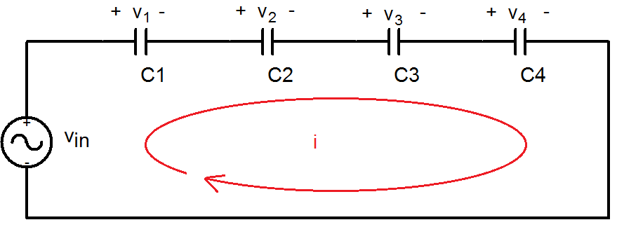
Equivalent Capacitance
Capacitors in series

Slide 24
C_{eq} for Capacitors in Series

Slide 25
General Equations for C_{eq}
Parallel Combination
Series Combination
If P capacitors are in parallel, then
If S capacitors are in series, then:

Slide 26
Summary
Capacitors are energy storage devices.
An ideal capacitor act like an open circuits when a DC voltage or current has been applied for at least 5 τ.
The voltage across a capacitor must be a continuous function; the current flowing across a capacitor can be discontinuous.
The equation for equivalent capacitance for
capacitors in parallel capacitors in series

