Slide 1
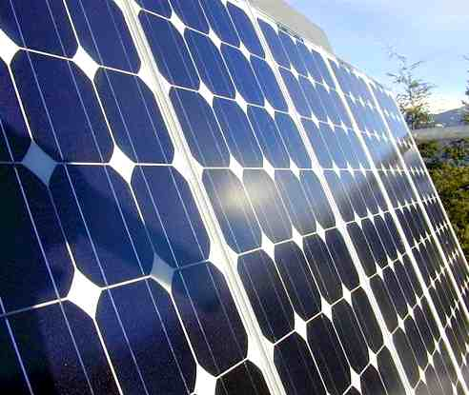
Efficiency of Solar Cells
Robert Riestenberg and Aayush Singh
Physics 141A
April 23, 2013
http://solarcellstringer.com

Slide 2
Outline
Basic Physics of Solar Cells
Intrinsic and Extrinsic Semiconductors
p-n Junctions
Photogeneration and Separation of Charge Carriers
Efficiency of Solar Cells
Shockley-Queisser Limit Derivation
Exceeding the Shockley-Queisser Limit
Multi-Junction Solar Cells
Concentration of Sunlight
Multiple Exciton Generation

Slide 3
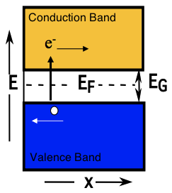
Intrinsic Semiconductors
The Fermi Level, E_{F}, corresponds to a potential energy, ε, that is equal to the chemical potential μ at a given temperature.
For intrinsic semiconductors, E_{F} lies in the middle of a small band gap.
In an intrinsic semiconductor, the numbers of electrons and holes can be assumed to be equal.
Intrinsic semiconductors are usually composed of elements with an average valence shell of 4 electrons.
(J.W. Morris)
Notes:
At the fermi level, epsilon and mu are equal

Slide 4
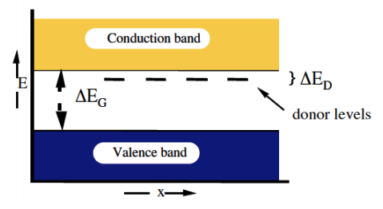
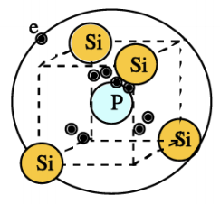
Extrinsic Semiconductors: n-type
(J.W. Morris)
N-type extrinsic semiconductors are doped with small amounts of an element that acts as an electron donor.
The additional electrons from the dopant reside in “donor levels” just below the conduction band, leading to a Fermi level that is closer to the conduction band.
Electrons can be excited from the donor levels to produce charge carriers in the conduction band.
Notes:
The electron donor is an element that has extra valence electrons.

Slide 5
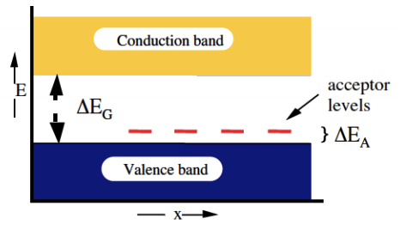
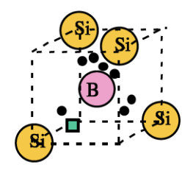
Extrinsic Semiconductors: p-type
(J.W. Morris)
P-type semiconductors are doped with a small amount of an element that acts as an electron acceptor.
The lack of electrons creates “acceptor levels” just above the valence band, leading to a Fermi level that is closer to the valence band.
Electrons can be excited from the valence band to the acceptor levels to produce free hole charge carriers in the valence band.
Notes:
The electron acceptor has fewer valence electrons than the material that the semiconductors is constructed from.

Slide 6
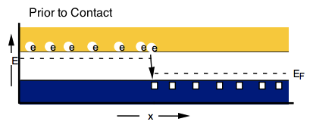
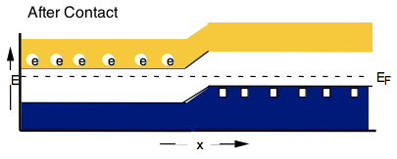
p-n Junctions
p-n junctions are created from the contact of p-type and n-type semiconductors.
Prior to contact, E_{F} is higher on the n side.
Upon contact, electrons flow from the n side to the p side, until E_{F} is constant across the interface.
An electric potential (ΔV) develops across the interface, and raises the energy on the p side as higher energy orbitals are filled (ΔE = -eΔV).
(J.W. Morris)

Slide 7
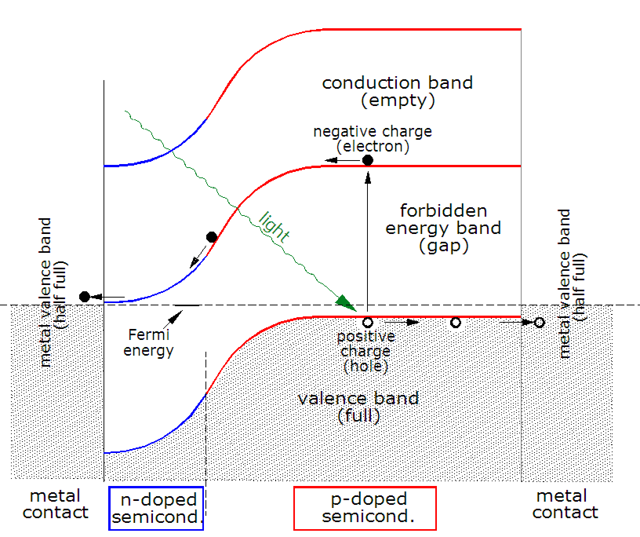
Photogeneration of Charge Carriers
Photons contacting the semiconductor can either:
Pass through the material (low energy photons).
Be absorbed by the semiconductor and excite an electron to a higher energy state (high energy photons).
Be reflected off the surface.
The minimum photon energy required to create an exciton (electron-hole pair) is the band gap energy of the material.
(Wikipedia)

Slide 8
Photogeneration of Charge Carriers
Much of the solar radiation reaching Earth consists of photons with energies much greater than the band gaps of typical semiconductors.
When higher energy photons are absorbed, electrons are excited further into the conduction band.
But the difference in energy between these photons and the band gap is quickly converted into heat via phonons (lattice vibrations).
(Wikipedia)

Slide 9
Charge Carrier Separation
Charges move in two ways:
Drift, driven by the electric field.
Diffusion, driven by concentration gradients.
In thin film solar cells, the electric field penetrates the whole material, so drift is the dominant mode of charge separation.
Excited electrons irreversibly move toward the n side and holes move toward the p side.
(Wikipedia)
(J.W. Morris)

Slide 10
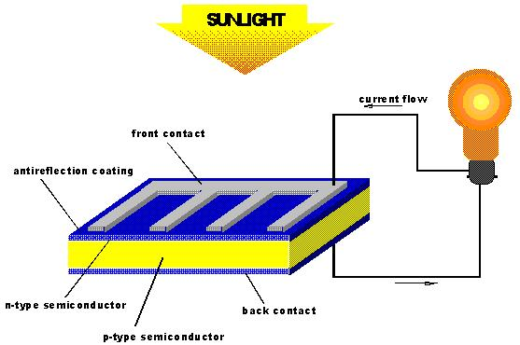
http://upload.wikimedia.org/wikipedia/commons/

Slide 11
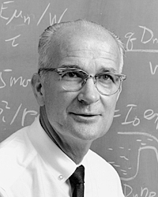
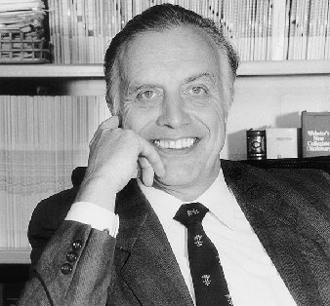
Efficiency of Solar Cells
In 1961 William Shockley and Hans Queisser calculated the maximum theoretical efficiency of an ideal single p-n junction.
The total efficiency is defined as follows:
where u(x_{g}) accounts for energy gap losses, v(x_{g},x_{c},f) denotes the ratio of the operational voltage to the energy gap, m(x_{g},x_{c},f) is the impedance matching factor, and t_{s} is the probability that an electron-hole pair will be produced from a photon.
(Wikipedia)
/www.ulm.de/sixcms/media.php

Slide 12
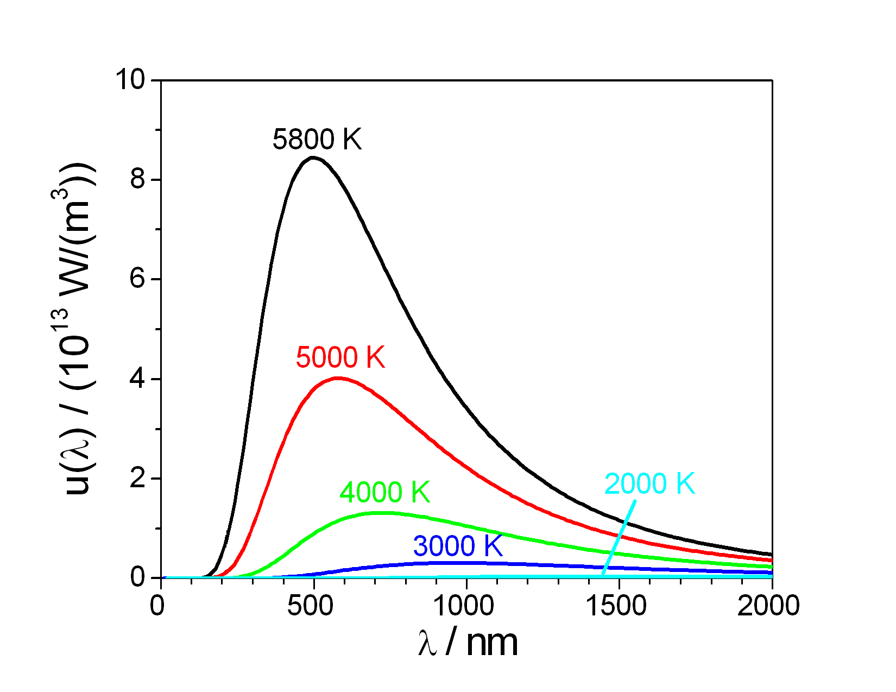
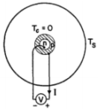
Ultimate Efficiency Derivation: Assumptions
The solar frequency spectrum can be approximated as a black body emitter at 5800 K.
No photons with energy less than the band gap energy are absorbed.
All photons with energy greater than the band gap energy are absorbed.
The useful electrical energy generated from each absorbed photon is equal to the band gap energy.
The system consists of a spherical p-n junction (with T_{c}= 0 K) surrounded by a spherical black body emitter (with T_{s}= 5800 K).
(Wikipedia)
(Liao, Hsu)

Slide 13
Parameters and Definitions
(Liao, Hsu)

Slide 14
Ultimate Efficiency Derivation
Photons obey Bose-Einstein statistics, so Q_{S} (the number of quanta of frequency greater than ν_{g}) can be calculated based on the Planck distribution.
The three-dimensional density of states is proportional to K² (lecture) and the photon dispersion relation (just as for phonons) is as follows:
Therefore, the density of states (dN/dν) is proportional to ν²/c².
Notes:
Note: nu looks like v

Slide 15
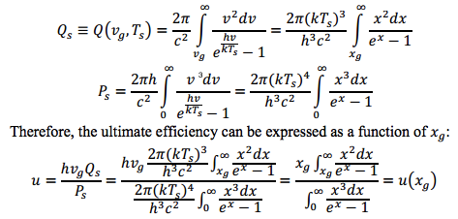
Ultimate Efficiency Derivation
(Liao, Hsu)

Slide 16
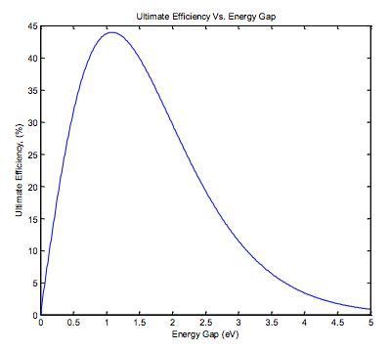
(Liao, Hsu)
The maximum theoretical Efficiency is 43.96%, for E_{g} = 1.08 eV

Slide 17
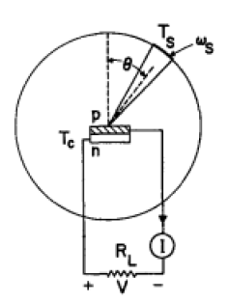
More Realistic Situation: Detailed Balance Principle
Consider a more realistic planar solar cell with a nonzero T_{C} and a view factor relating the incident power to the power of the sun.
The T_{C} = 0 assumption previously allowed radiative recombination to be neglected (negligible population of excited states).
But by the Detailed Balance Principle for a system with a finite excited state population, some electron-hole pairs must recombine and re-radiate photons.
Therefore, the free energy available for electrical work is smaller than the band gap of the material.
(Liao, Hsu)

Slide 18
Alternative Explanation…
Consider a gas of N photons with energy E₁ and entropy S₁.
Upon absorption of a photon by a material, the gas now contains N-1 photons, with energy E₂ and entropy S_{2,} where E₂ < E₁ (energy decreases by E₁ – E₂) and S₂ < S₁ (entropy decreases by S₁ – S₂)
The available free energy for electrical work, ΔF, is given by :
ΔF = (E₁ – E₂) – T(S₁ – S₂) < (E₁ – E₂)
Therefore, not all of the absorption energy can be utilized by the solar cell.

Slide 19
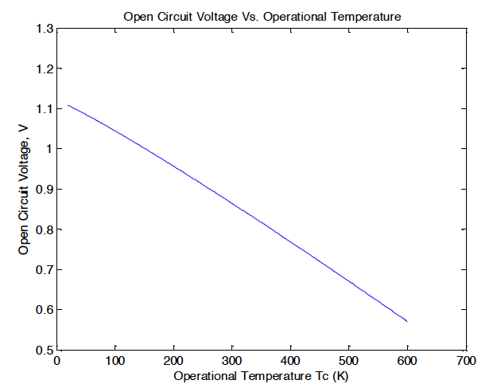
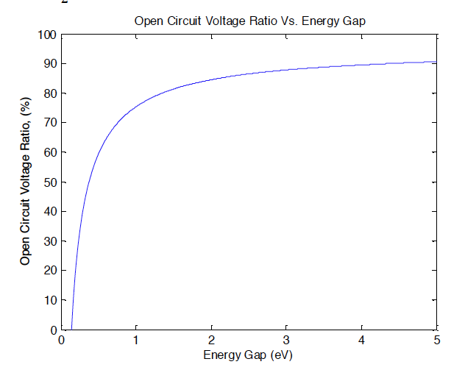
Inclusion of Recombination Losses
T_{C} = 300K
(Liao, Hsu)

Slide 20
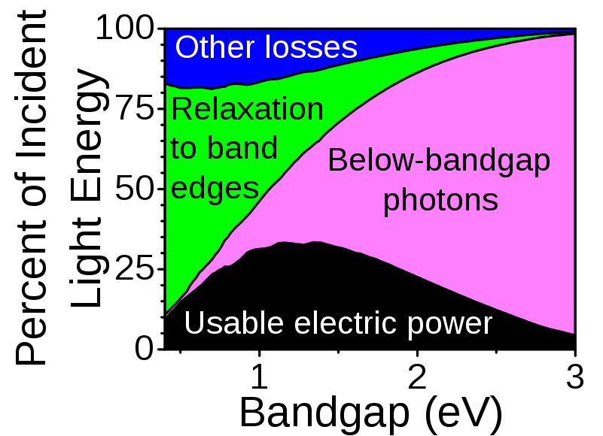
Inclusion of Impedance Matching Factor
In a practical device the maximum values of current and voltage (I_{sh} and V_{op}) cannot be achieved simultaneously, which leads to further losses…
Shockley-Queisser Limit: For a p-n junction with a band gap of 1.34 eV, the maximum efficiency is approximately 33.7%
(Wikipedia)

Slide 21
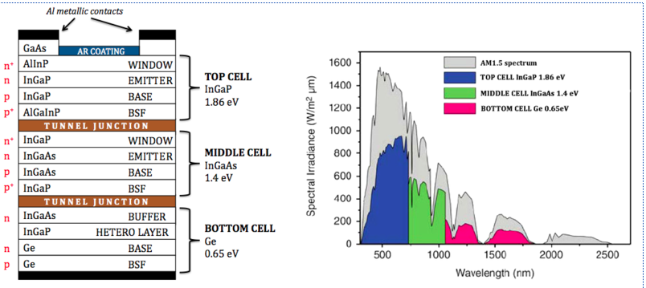
Exceeding the Shockley-Queisser Limit: Multi-Junction Solar Cells
A multi-junction solar cell can be made (at higher cost…) by layering different materials on top of each other, with the largest band gap materials on top and decreasing band gap materials through the body of the cell.
(Wikipedia)

Slide 22
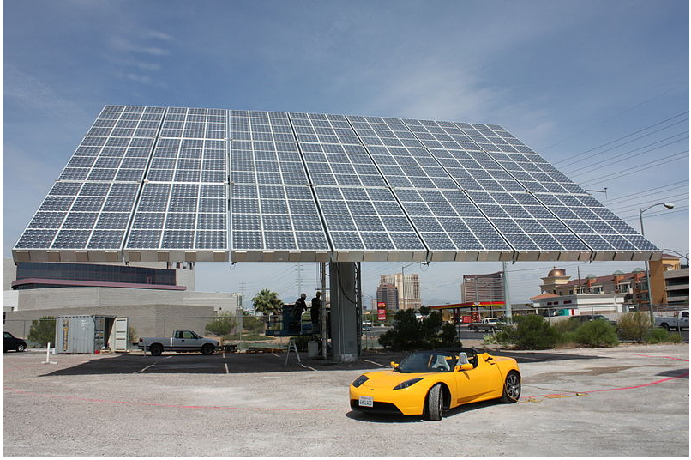
Exceeding the Shockley-Queisser Limit: Concentration of Sunlight
Another way to increase theoretical efficiency is to concentrate the sunlight using lenses or mirrors.
Provided that the temperature of the cell does not increase, the increase in intensity of light improves the Shockley-Queisser efficiency, since a gas with more photons suffers a smaller change in entropy upon the creation of an exciton.
This Amonix system contains thousands of small lenses, each of which focuses sunlight by a factor of 500 onto a small multi-junction cell.
(Wikipedia)

Slide 23
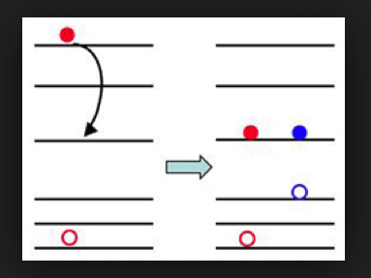
Exceeding the Shockley-Queisser Limit: Multiple Exciton Generation (MEG)
Nanocrystal-based solar cell efficiency can be theoretically improved by the generation of multiple electron-hole pairs from the absorption of one photon.
MEG been demonstrated in nanocrystals (quantum dots) such as PbS, PbSe, PbTe, CdS, CdSe, and InAs, as well as in single-walled carbon nanotubes.
The origin of MEG is complicated and still under debate, but one explanation is that light excites a high energy exciton which then decays irreversibly into a quasi-continuum of states available at that energy.
http://www.chem.rochester.edu

Slide 24
: http://www.nrel.gov/

Slide 25
Conclusion
Solar cells are created by forming an electrical circuit with a p-n junction and a load.
The theoretical efficiency of solar cells is highly limited, even in the limit of perfect engineering.
Researchers are developing ways to increase this maximum efficiency, but the cost of implementing these new technologies remains an issue.
Questions?

Slide 26
References
Shockley, W., Queisser, H.J., Journal of Applied Physics, 32, 510 (1961).
Morris, J. W. The Structure and Properties, Vols. 1-2. McGraw-Hill (2012).
Morris, J. W. Engineering 45 Lecture Slides (2013).
Liao, Bolin and Hsu, Wei-Chun, “An Investigation of Shockley-Queisser Limit of Single p-n Junction Solar Cells”, Massachusetts Institute of Technology 2.997 Project Report (2012).

Slide 27
References (Images)
Slide 1: http://solarcellstringer.com/images/solar_cells_panels_array_monocrystaline.jpg
Slides 3-6, 9: Morris, J. W. Engineering 45 Lecture Slides (2013).
Slides 7-9: http://upload.wikimedia.org/wikipedia/commons/8/86/BandDiagramSolarCell-en.gif
Slide 10: http://www.pres.org.pk/category/re-technologies/solar-energy/solar-pv/
Slide 11: http://en.wikipedia.org/wiki/File:William_Shockley,_Stanford_University.jpg
Slide 11: http://www.ulm.de/sixcms/media.php/123/thumbnails/Prof_Queisser.jpg.57479.jpg
Slide 12: http://upload.wikimedia.org/wikipedia/commons/1/19/Black_body.svg
Slides 12, 13, 15-17, 19: Liao, Bolin and Hsu, Wei-Chun, “An Investigation of Shockley-Queisser Limit of Single p-n Junction Solar Cells”, Massachusetts Institute of Technology 2.997 Project Report (2012).
Slide 20: http://upload.wikimedia.org/wikipedia/commons/9/99/ShockleyQueisserBreakdown2.svg
Slide 21: http://upload.wikimedia.org/wikipedia/commons/thumb/1/19/StructureMJetspectre.png/550px-StructureMJetspectre.png
Slide 22: http://en.wikipedia.org/wiki/File:Amonix7700.jpg
Slide 23: http://www.chem.rochester.edu/highlights/sum09.php
Slide 24: http://www.nrel.gov/ncpv/images/efficiency_chart.jpg

