Slide 1
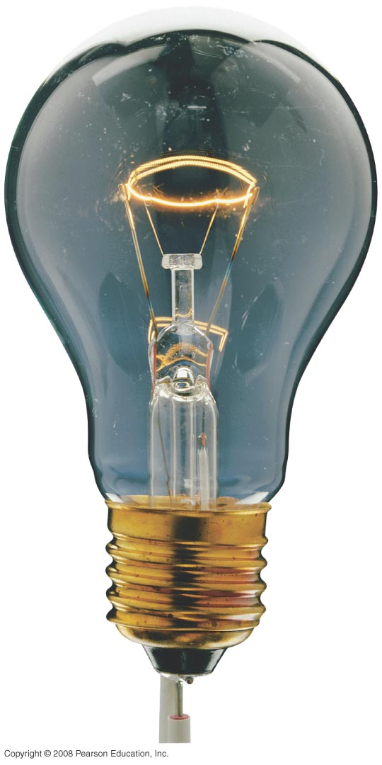
Electric Currents and Resistance
Notes:
Chapter 25 opener. The glow of the thin wire filament of a light bulb is caused by the electric current passing through it. Electric energy is transformed to thermal energy (via collisions between moving electrons and atoms of the wire), which causes the wire’s temperature to become so high that it glows. Electric current and electric power in electric circuits are of basic importance in everyday life. We examine both dc and ac in this Chapter, and include the microscopic analysis of electric current.

Slide 2
25-4 Resistivity
The resistance of a wire is directly proportional to its length and inversely proportional to its cross-sectional area:
The constant ρ, the resistivity, is characteristic of the material. ρ is in Ω.m

Slide 3
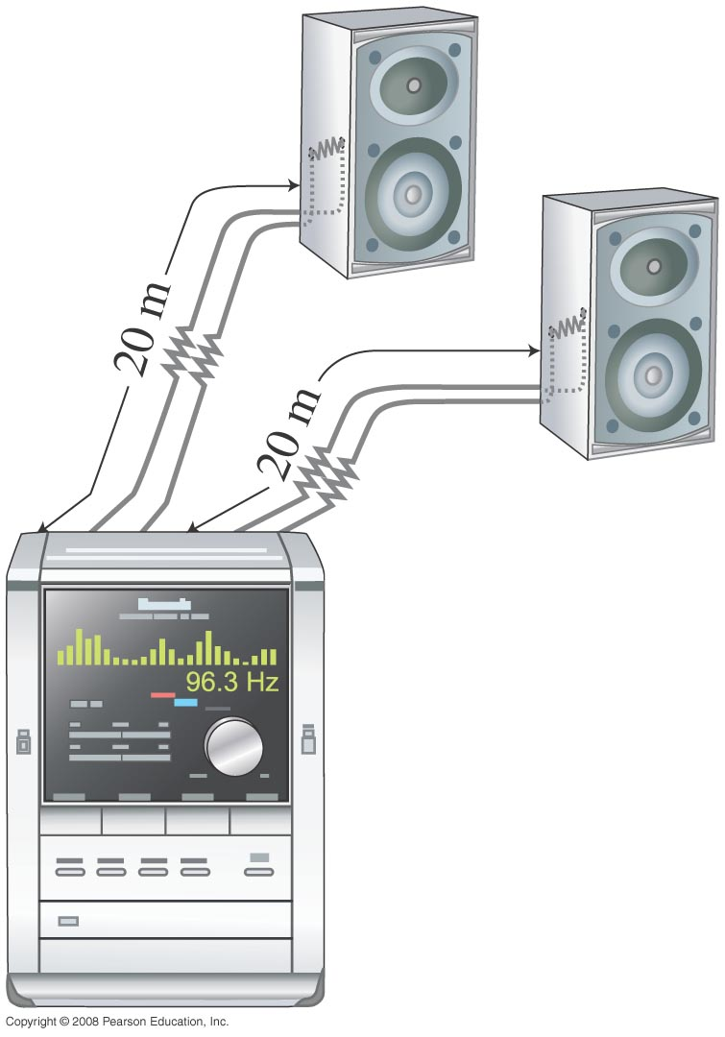
25-4 Resistivity
Example 25-5: Speaker wires.
Suppose you want to connect your stereo to remote speakers. (a) If each wire must be 20 m long, what diameter copper wire should you use to keep the resistance less than 0.10 Ω per wire? (b) If the current to each speaker is 4.0 A, what is the potential difference, or voltage drop, across each wire? ( Cu: ρ=1.68$×$ 10⁻⁸Ωm)
Notes:
Solution: a. R = ρl/A; you can solve this for A and then find the diameter. D = 2.1 mm.
b. V = IR = 0.40 V.

Slide 4
25-4 Resistivity
For any given material, the resistivity increases with temperature:
Semiconductors are complex materials, and may have resistivities that decrease with temperature.ρ₀ and T₀ are the resistivity and temperature at 0ºC or 20ºC.α is the temperature coefficient in °C⁻¹

Slide 5
25-4 Resistivity
Example 25-7: Resistance thermometer.
The variation in electrical resistance with temperature can be used to make precise temperature measurements. Platinum is commonly used since it is relatively free from corrosive effects and has a high melting point. Suppose at 20.0°C the resistance of a platinum resistance thermometer is 164.2 Ω. When placed in a particular solution, the resistance is 187.4Ω. What is the temperature of this solution? ( α=3.927 10⁻³ °C⁻¹)
Notes:
Solution: The resistance is proportional to the resistivity; use the temperature dependence of resistivity to find the temperature. T = 56.0 °C.

Slide 6
Problem 23
23. (II) A length of aluminum wire is connected to a precision 10.00-V power supply, and a current of 0.4212 A is precisely measured at 20.0°C. The wire is placed in a new environment of unknown temperature where the measured current is 0.3818 A. What is the unknown temperature? α=0.00429°C⁻¹

Slide 7
25-5 Electric Power
Power, as in kinematics, is the energy transformed by a device per unit time:
or

Slide 8
25-5 Electric Power
The unit of power is the watt, W.
For ohmic devices, we can make the substitutions:

Slide 9
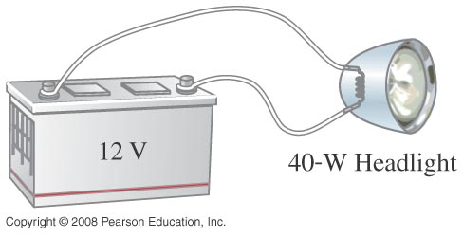
25-5 Electric Power
Example 25-8: Headlights.
Calculate the resistance of a 40-W automobile headlight designed for 12 V.
Notes:
Solution: R = V²/P = 3.6 Ω.

Slide 10
25-5 Electric Power
What you pay for on your electric bill is not power, but energy – the power consumption multiplied by the time.
We have been measuring energy in joules, but the electric company measures it in kilowatt-hours, kWh:
1 kWh = (1000 W)(3600 s) = 3.60 x 10⁶ J.

Slide 11
25-5 Electric Power
Example 25-9: Electric heater.
An electric heater draws a steady 15.0 A on a 120-V line. How much power does it require and how much does it cost per month (30 days) if it operates 3.0 h per day and the electric company charges 9.2 cents per kWh?
Notes:
Solution: P = IV = 1800 W. 1800 W x 3.0 h/day x 30 days = 162 kWh. At 9.2 cents per kWh, this would cost $15.

Slide 12
Problem 36
36.(II) A 120-V hair dryer has two settings: 850 W and 1250 W. (a) At which setting do you expect the resistance to be higher? After making a guess, determine the resistance at (b) the lower setting; and (c) the higher setting.

Slide 13
25-6 Power in Household Circuits
The wires used in homes to carry electricity have very low resistance. However, if the current is high enough, the power will increase and the wires can become hot enough to start a fire.
To avoid this, we use fuses or circuit breakers, which disconnect when the current goes above a predetermined value.

Slide 14
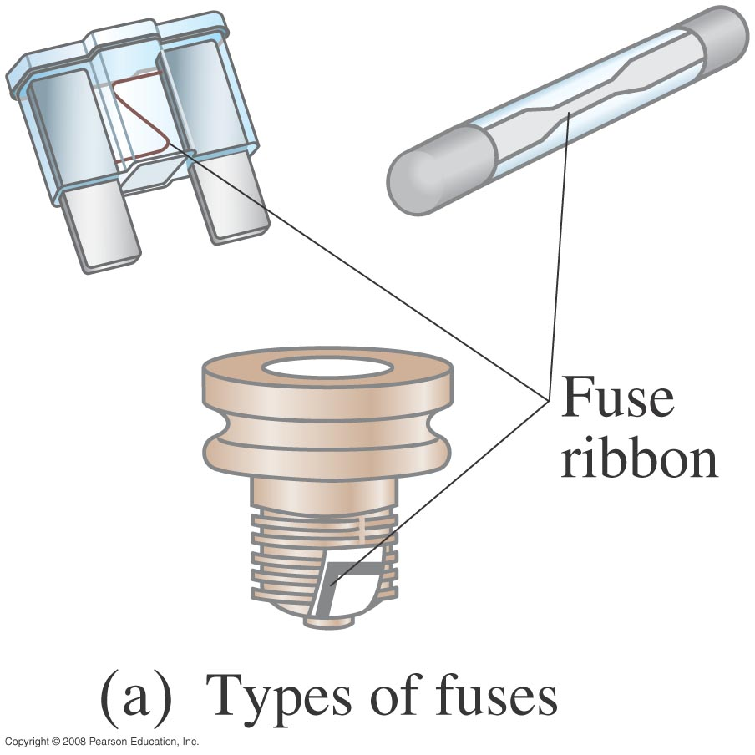
25-6 Power in Household Circuits
Fuses are one-use items – if they blow, the fuse is destroyed and must be replaced.
Notes:
Figure 25-19a. Fuses. When the current exceeds a certain value, the metallic ribbon melts and the circuit opens. Then the fuse must be replaced.

Slide 15
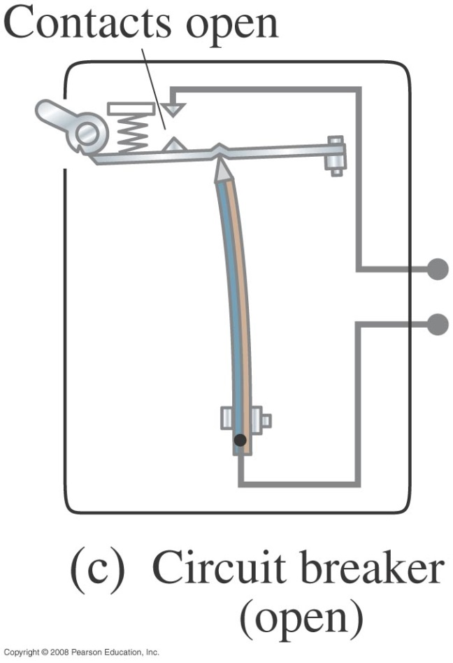
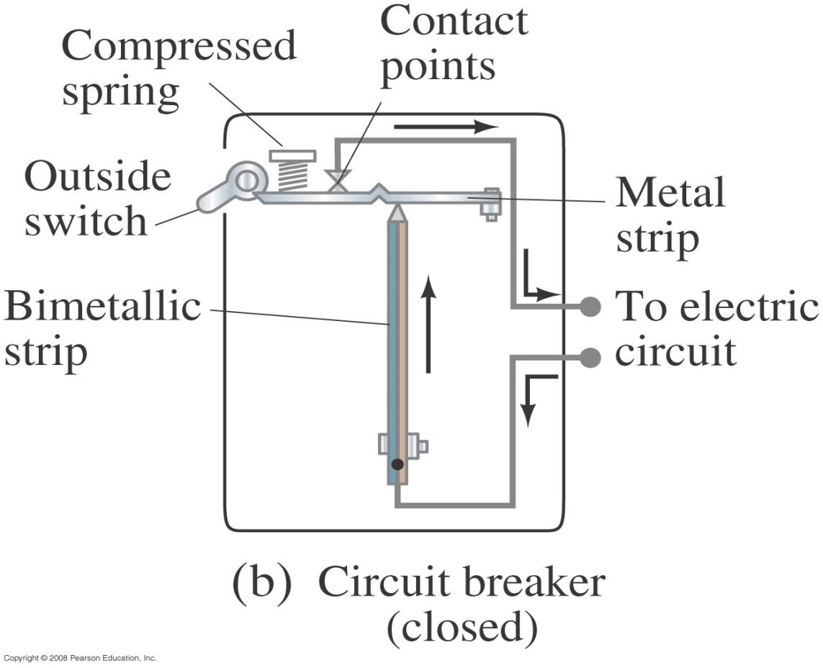
25-6 Power in Household Circuits
Circuit breakers, which are now much more common in homes than they once were, are switches that will open if the current is too high; they can then be reset.
Notes:
Figure 25-19. (b) One type of circuit breaker. The electric current passes through a bimetallic strip. When the current exceeds a safe level, the heating of the bimetallic strip causes the strip to bend so far to the left that the notch in the spring-loaded metal strip drops down over the end of the bimetallic strip; (c) the circuit then opens at the contact points (one is attached to the metal strip) and the outside switch is also flipped. As soon as the bimetallic strip cools down, it can be reset using the outside switch. Magnetic-type circuit breakers are discussed in Chapters 27 and 29.

Slide 16
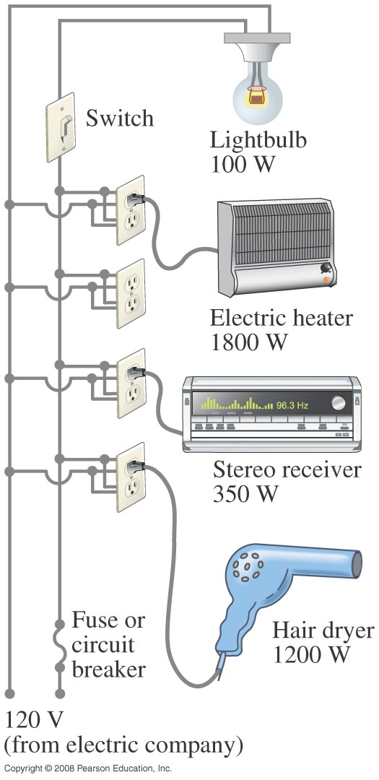
25-6 Power in Household Circuits
Example 25-11: Will a fuse blow?
Determine the total current drawn by all the devices in the circuit shown.
Notes:
Solution: The current is given by I = P/V, where V = 120 V. Adding the currents gives 28.7 A, which exceeds the usual 20-A circuit breakers found in most household applications. The electric heater should probably be on its own circuit.

Slide 17
25-6 Power in Household Circuits
Conceptual Example 25-12: A dangerous extension cord.
Your 1800-W portable electric heater is too far from your desk to warm your feet. Its cord is too short, so you plug it into an extension cord rated at 11 A. Why is this dangerous?
Notes:
Solution: An 1800-W heater operating at 120 V draws 15 A of current, which exceeds the rating of the extension cord. This creates a risk of overheating and fire.

Slide 18
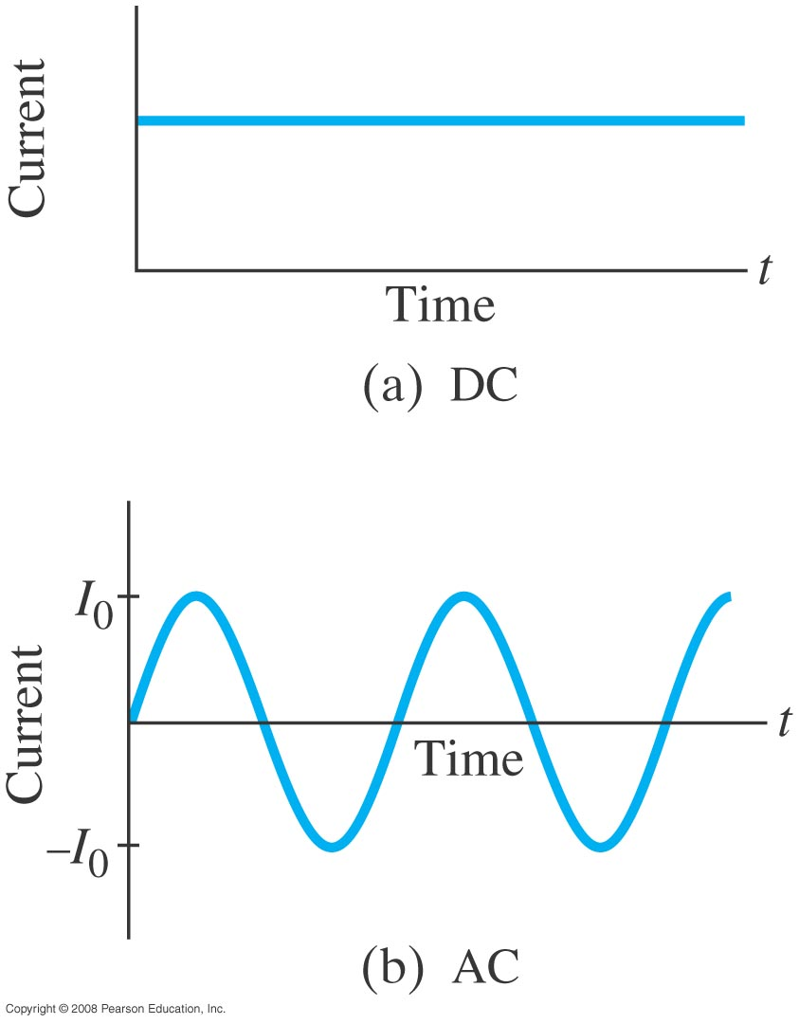
25-7 Alternating Current
Current from a battery flows steadily in one direction (direct current, DC). Current from a power plant varies sinusoidally (alternating current, AC).
Notes:
Figure 25-21. (a) Direct current. (b) Alternating current.

Slide 19
25-7 Alternating Current
The voltage varies sinusoidally with time:
,
as does the current:
I₀ is the peak current
f is the frequency, and is 60Hz in the US and Canada,
and 50Hz in Europe

Slide 20
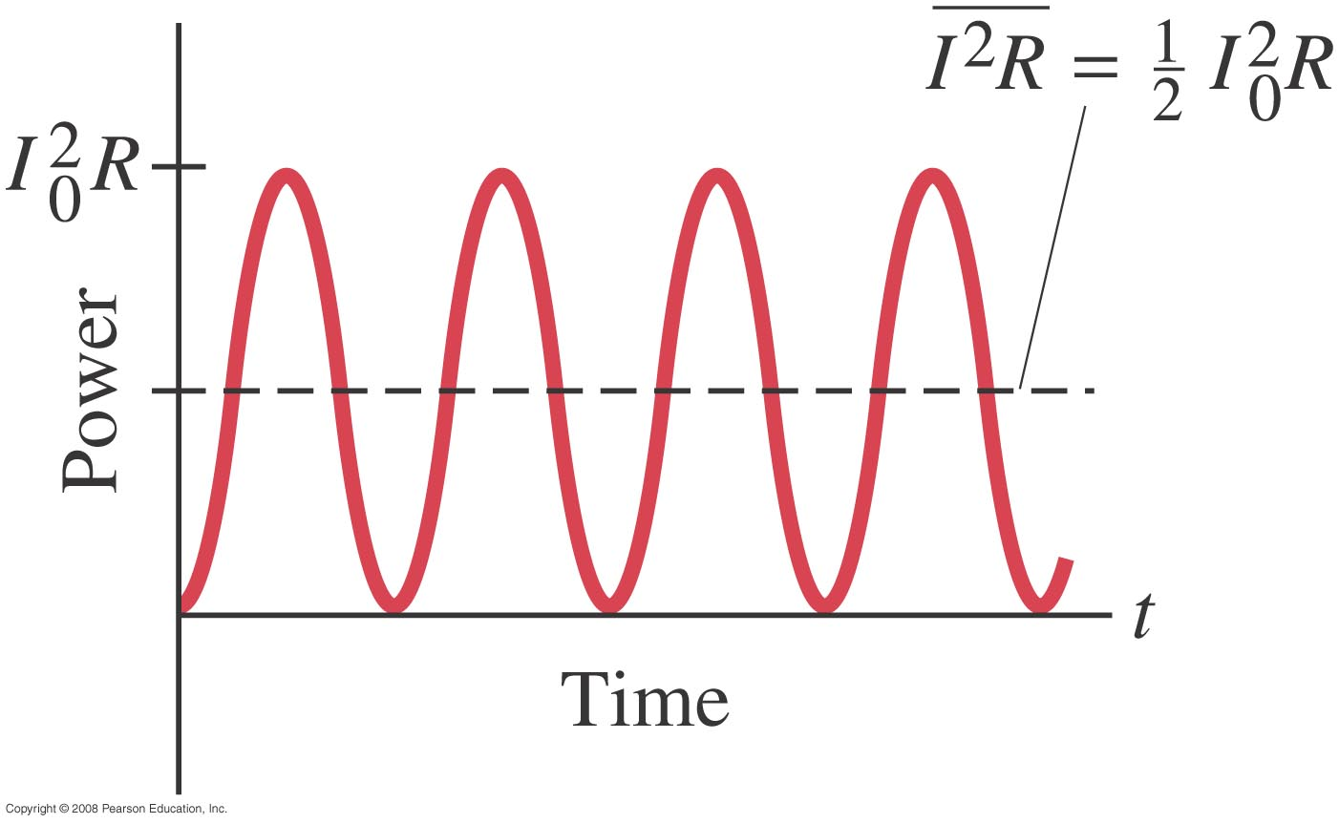
25-7 Alternating Current
Multiplying the current and the voltage gives the power:
This the average power
Notes:
Figure 25-22. Power transformed in a resistor in an ac circuit.

Slide 21
25-7 Alternating Current
Usually we are interested in the average power:
I₀ and V₀ are the maximum current and power

Slide 22
25-7 Alternating Current
The current and voltage both have average values of zero, so we square them, take the average, then take the square root, yielding the root-mean-square (rms) value:

Slide 23
Problem 54
54. (II) (a) What is the maximum instantaneous power dissipated by a 2.5-hp pump connected to a 240-Vrms ac power source? (b) What is the maximum current passing through the pump?

Slide 24
25-8 Microscopic View of Electric Current: Current Density and Drift Velocity
Electrons in a conductor have large, random speeds just due to their temperature. When a potential difference is applied, the electrons also acquire an average drift velocity, which is generally considerably smaller than the thermal velocity.
Notes:
Figure 25-24. Electric field E in a uniform wire of cross-sectional area A carrying a current I. The current density j = I/A.

Slide 25
25-8 Microscopic View of Electric Current: Current Density and Drift Velocity
We define the current density (current per unit area) – this is a convenient concept for relating the microscopic motions of electrons to the macroscopic current:
If the current density is not uniform:
.

Slide 26
25-8 Microscopic View of Electric Current: Current Density and Drift Velocity
This drift speed v_{d} is related to the current in the wire, and also to the number of electrons per unit volume:
V is the volume and

Slide 27
25-8 Microscopic View of Electric Current: Current Density and Drift Velocity
The electric field inside a current-carrying wire can be found from the relationship between the current, voltage, and resistance. Writing R = ρ l/A, I = jA, and V =El , and substituting in Ohm’s law gives:
ρ Is the resistivity and σ is the conductivity =1/ ρ

Slide 28
26-1 EMF and Terminal Voltage
Electric circuit needs battery or generator to produce current – these are called sources of electromotive force (emf).
emf is not a force but a voltage
Battery is a nearly constant voltage source, but does have a small internal resistance, which reduces the actual voltage from the ideal emf.

Slide 29
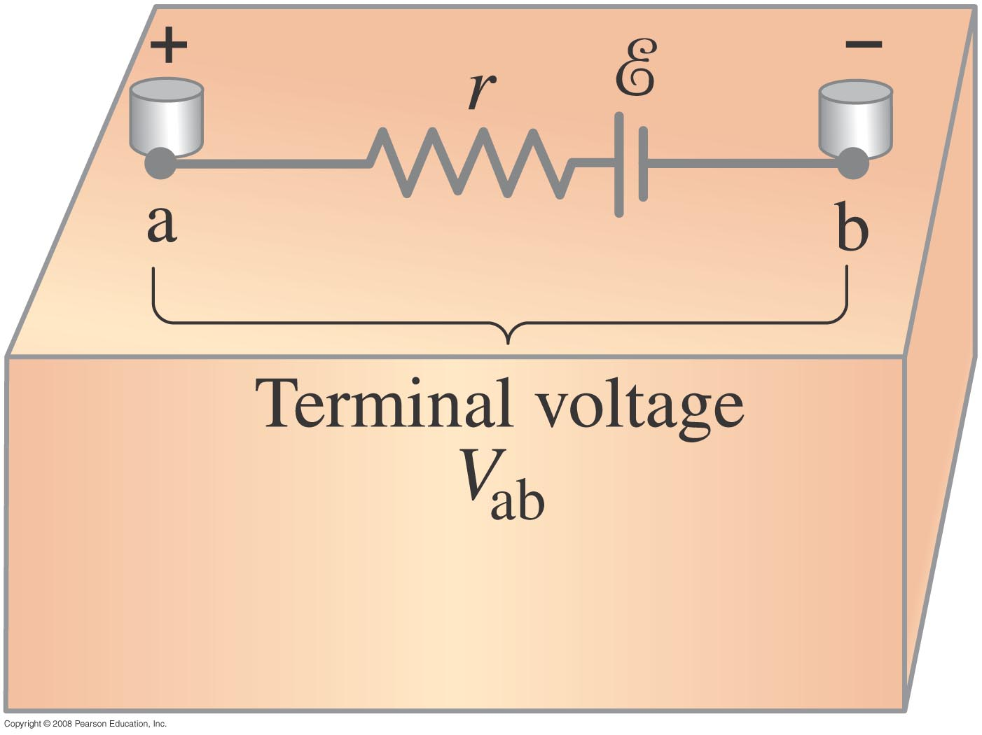
26-1 EMF and Terminal Voltage
This resistance behaves as though it were in series with the emf.
Notes:
Figure 26-1. Diagram for an electric cell or battery.

Slide 30
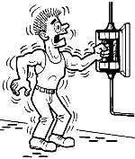
Electric Current and the Human Body
< 5 mA - No harm
10 – 20 mA – Involuntary muscle contraction or paralysis, burns
100 – 300 mA – Ventricular fibrillation
Shock disturbs heart rhythm
Shock restores heart rhythm

Slide 31
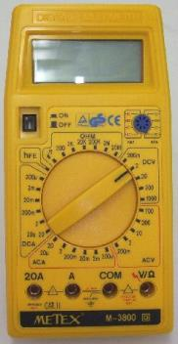
Resistance and the Human body
I=V/R
Most resistance is due to skin
Dry resistance-- 10kΩ− 1MΩ
Wet or sweaty-- 1000 Ω
1.00
If V= 120 V
R
I (mA)
1MΩ
10kΩ
1kΩ
0.12
12
120

