Slide 1
Participating in Electricity Markets

Slide 2
Perspective
Generator
Consumer
Retailer
Operator of a pumped-hydro plant

Slide 3
Participating in Electricity Markets:
The Generator’s Perspective

Slide 4
Marginal, infra-marginal, extra-marginal producers
Everything is sold at the market clearing price. Price is set by the “last” unit sold
Marginal producer:
  Sells this last unit
  Gets exactly its bid
Infra-marginal producers:
  Get paid more than their bid
  Collect economic profit
Extra-marginal producers:
  Sell nothing
No difference between centralized auction and bilateral market
Price
supply
Extra-marginal
demand
Infra-marginal
Quantity
Marginal producer

Slide 5
Load profile
Load
Peak load
Minimum load
Time
00:00
06:00
12:00
18:00
24:00

Slide 6
Demand curves for electricity
$/MWh
Minimum load
Peak load
Daily fluctuations
MWh

Slide 7
Supply curve for electricity
$/MWh
Peaking generation
Base generation
Intermediate generation
MWh

Slide 8
Supply and demand for electricity
$/MWh
Minimum load
Peak load
π_{max}
π_{min}
MWh
Price of electricity fluctuates during the day

Slide 9
Supply curve for electricity
In a centralized market, the supply curve is built by ranking the offers made by the generators
An offer specifies the quantity that the generator is willing to sell at a given price
$/MWh
MWh

Slide 10
Bidding in a centralized market
How should a generator bid to maximize its profit?
It depends on how much competition it has!

Slide 11
Market Structure
Monopoly
Oligopoly
Perfect Competition
Monopoly:
  Monopolist sets the price at will
  Must be regulated
Perfect competition:
  No participant is large enough to affect the price
  All participants act as “price takers”
Oligopoly:
  Some participants are large enough to affect the price
  Strategic bidders have market power
  Others are price takers

Slide 12
Short run profit maximization for a price taker
Output of one of the generators
Production cost
Revenue
Independent of quantity produced because price taker
Adjust production y until the marginal
cost of production is equal to the
price π

Slide 13
Bidding under perfect competition
Since there are lots of small producers, a change in bid causes a change in the order of the bids
If I bid at my marginal cost
  I get paid the market clearing price if marginal or infra-marginal producer
If I bid higher than my marginal cost
  I could become extra-marginal and miss an opportunity to sell at a profit
If I bid lower than my marginal cost
  I could have to produce at a loss
No incentive to bid anything else than marginal cost of production
Price
supply
demand
Quantity

Slide 14
Profit of an infra-marginal producer
$/MWh
Economic profit
π
MWh
Variable cost of producing energy

Slide 15
Profit of an infra-marginal producer
Selling at marginal cost covers the variable cost of production
The difference between the market price and the marginal cost must pay for the fixed costs:
  No-load cost, startup cost
  Cost of building the plant
  Interest payments for the bank, dividends for the shareholders
A plant must therefore be infra-marginal often enough to cover its fixed costs
  Market price > marginal cost for enough hours of the year

Slide 16
Profit of a marginal producer
$/MWh
No economic profit!
Variable cost of producing energy
MWh

Slide 17
Profit of a marginal producer
If a marginal generator bids at its marginal cost, it makes no economic profit
  Covers only its variable cost of production
  Does not cover its fixed cost
Generators that are too often marginal or just below marginal will not recover their fixed costs if they bid at their marginal cost of production
  They must include part of their fixed costs in their offer price
  Their offer price is therefore higher than their marginal cost
  They can do it because competition is not perfect when the load is high because most generators are already producing

Slide 18
Price spikes because of increased demand
$/MWh
π_{ext}
Extreme
peak
Normal peak
π_{nor}
Small increases in peak demand cause
large changes in peak prices
MWh

Slide 19
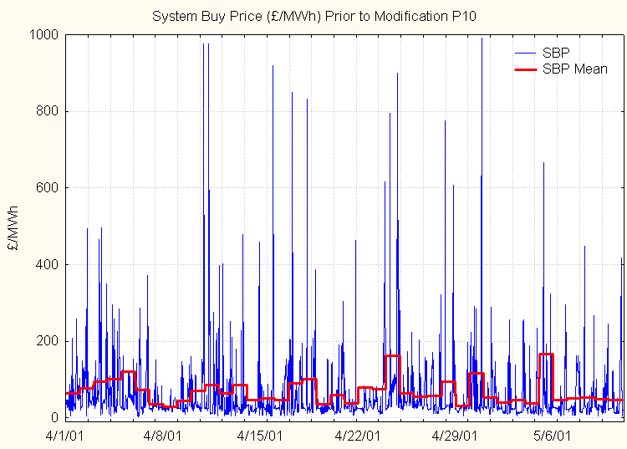
Price volatility in the balancing mechanism

Slide 20
Price duration curve
PJM system (USA) for 1999
Actual peak price reached $1000/MWh for a few hours
(Source: www.pjm.com)

Slide 21
Oligopoly and market power
A firm exercises market power when
  It reduces its output (physical withholding)
  or
  It raises its offer price (economic withholding)
in order to change the market price

Slide 22
Example
A firm sells 10 units and the market price is $15
  Option 1: offer to sell only 9 units and hope that the price rises enough to compensate for the loss of volume
  Option 2: offer to sell the 10th unit for a price higher than $15 and hope that this will increase the price
Profit increases if price rises sufficiently to compensate for possible decrease in volume

Slide 23
Price spikes because of reduced supply
$/MWh
Normal supply
π_{ext}
Reduced supply
π_{nor}
Normal peak
Small reductions in supply cause
large changes in peak prices
MWh

Slide 24
Short run profit maximization with market power
Production of generator i
is the total industry output
Not zero because of market power

Slide 25
Short run profit maximization with market power
is the price elasticity of demand
is the market share of generator i
< 1 ↑ optimal price for generator i is higher than its marginal cost

Slide 26
When is market power more likely?
Imperfect correlation with market share
Demand does not have a high price elasticity
Supply does not have a high price elasticity:
  Highly variable demand
  All capacity sometimes used
  Output cannot be stored
Electricity markets are more vulnerable than others to the exercise of market power

Slide 27
Mitigating market power
Increase elasticity
Increase number of competitors

Slide 28
Increasing the elasticity reduces price spikes and the generators’ ability to exercise market power
$/MWh
π_{max}
π_{min}
MWh

Slide 29
Increasing the elasticity of the demand
Obstacles
  Tariffs
  Need for communication
  Need for storage (heat, intermediate products, dirty clothes)
Not everybody needs to respond to price signals to get substantial benefits
Increased elasticity reduces the average price
  Not in the best interests of generating companies
  Impetus will need to come from somewhere else

Slide 30
Further comments on market power
ALL firms benefit from the exercise of market power by one participant
Unilaterally reducing output or increasing offer price to increase profits is legal
Collusion between firms to achieve the same goal is not legal
Market power interferes with the efficient dispatch of generating resources
  Cheaper generation is replaced by more expensive generation

Slide 31
Modelling Imperfect Competition
Bertrand model - Competition on prices
Cournot model - Competition on quantities

Slide 32
Game theory and Nash equilibrium
Each firm must consider the possible actions of others when selecting a strategy
Classical optimization theory is insufficient
Two-person non-co-operative game:
  One firm against another
  One firm against all the others
Nash equilibrium:
  given the action of its rival, no firm can increase its profit by changing its own action:

Slide 33
Bertrand Competition
Example 1
  C_{A} = 35 . P_{A} $/h
  C_{B} = 45 . P_{B} $/h
Bid by A?
Bid by B?
Market price?
Market shares?
P_{A}
P_{B}
A
B
C_{A}(P_{A})
C_{B}(P_{B})
Inverse demand curve

Slide 34
Bertrand Competition
Example 1
  C_{A} = 35 . P_{A} $/h
  C_{B} = 45 . P_{B} $/h
Marginal cost of A: 35 $/MWh
Marginal cost of B: 45 $/MWh
A will bid just below 45 $/MWh
B cannot bid below 45 $/MWh because it would loose money on every MWh
Market price: just below 45 $/MWh
Demand: 55 MW
P_{A} = 55MW
P_{B} = 0
P_{A}
P_{B}
A
B
C_{A}(P_{A})
C_{B}(P_{B})

Slide 35
Bertrand Competition
Example 2
  C_{A} = 35 . P_{A} $/h
  C_{B} = 35 . P_{B} $/h
Bid by A?
Bid by B?
Market price?
P_{A}
P_{B}
A
B
C_{A}(P_{A})
C_{B}(P_{B})

Slide 36
Bertrand Competition
P_{A}
P_{B}
Example 2
  C_{A} = 35 . P_{A} $/h
  C_{B} = 35 . P_{B} $/h
A cannot bid below 35 $/MWh because it would lose money on every MWh
A cannot bid above 35 $/MWh because B would bid lower and grab the entire market
Market price: 35 $/MWh
Paradox of Bertrand model of imperfect competition
  Identical generators: bid at marginal cost
  Non-identical generators: cheapest gets the whole market
  Not a realistic model of imperfect competition
A
B
C_{A}(P_{A})
C_{B}(P_{B})

Slide 37
Cournot competition: Example 1
P_{A}
P_{B}
C_{A} = 35 . P_{A} $/h
C_{B} = 45 . P_{B} $/h
Suppose P_{A}= 15 MW and P_{B} = 10 MW
Then D = P_{A} + P_{B} = 25 MW
π = 100 - D = 75 $/MW
R_{A}= 75 . 15 = $ 1125 ; C_{A}= 35 . 15 = $ 525
R_{B}= 75 . 10 = $ 750 ; C_{B}= 45 . 10 = $ 450
Profit of A = R_{A} - C_{A} = $ 600
Profit of B = R_{B} - C_{B} = $ 300
A
B
C_{A}(P_{A})
C_{B}(P_{B})

Slide 38
Cournot competition: Example 1
Summary:
For P_{A}=15MW and P_{B} = 10MW, we have:
Demand
Profit of A
Profit of B
Price

Slide 39
Cournot competition: Example 1
P_{A}=15
P_{A}=20
P_{A}=25
P_{A}=30
P_{B}=10
P_{B}=15
P_{B}=20
P_{B}=25

Slide 40
Cournot competition: Example 1
P_{A}=15
P_{A}=20
P_{A}=25
P_{A}=30
P_{B}=10
P_{B}=15
P_{B}=20
P_{B}=25
Price decreases as supply increases
Profits of each affected by other
Complex relation between production
and profits

Slide 41
Let’s play the Cournot game!
P_{A}=15
P_{A}=20
P_{A}=25
P_{A}=30
P_{B}=10
P_{B}=15
P_{B}=20
P_{B}=25
Equilibrium solution!
A cannot do better without B doing worse
B cannot do better without A doing worse
Nash equilibrium

Slide 42
Cournot competition: Example 1
Demand
Profit of A
P_{A}=25
C_{A} = 35 . P_{A} $/h
C_{B} = 45 . P_{B} $/h
P_{B}=15
Profit of B
Price
Generators achieve price larger than their marginal costs
The cheapest generator does not grab the whole market
Generators balance price and quantity to maximize profits
Warning: price is highly dependent on modeling of demand curve and are thus often not realistic

Slide 43
Cournot competition: Example 2
P_{A}
P_{B}
P_{N}
C_{A} = 35 . P_{A} $/h
C_{B} = 45 . P_{B} $/h
…
C_{N} = 45 . P_{N} $/h
A is a “strategic” player
  i.e. with market power
The others are “the competitive fringe”
...
A
B
N
C_{A}(P_{A})
C_{B}(P_{B})
C_{N}(P_{N})

Slide 44
Cournot competition: Example 2

Slide 45
Cournot competition: Example 2

Slide 46
Cournot competition: Example 2

Slide 47
Other competition models
Supply functions equilibrium
  Bid price depends on quantity
Agent-based simulation
  Represent more complex interactions
Maximising short-term profit is not the only possible objective
  Maximizing market share
  Avoiding regulatory intervention

Slide 48
Conclusions on imperfect competition
Electricity markets do not deliver perfect competition
Some factors facilitate the exercise of market power:
  Low price elasticity of the demand
  Large market shares
  Cyclical demand
  Operation close to maximum capacity
Study of imperfect competition in electricity markets is a difficult research topic
  Generator’s perspective
  Market designer’s perspective

Slide 49
Participating in Electricity Markets: The consumer’s perspective

Slide 50
Options for the consumers
Buy at the spot price
  Lowest cost, highest risk
  Must be managed carefully
  Requires sophisticated control of the load
Buy from a retailer at a tariff linked to the spot price
  Retailers acts as intermediary between consumer and market
  Risk can be limited by placing cap (and collar) on the price
Interruptible contract
  Reasonable option only if cost of interruption is not too high
  Savings can be substantial

Slide 51
Options for the consumers
Buy from a retailer on a time-of-use tariff
  Shifts some of the risk to the consumer
  Need to control the load to save money
Buy from a retailer at a fixed tariff
  Lowest risk, highest cost
  Two components to the price: average cost of energy and risk premium

Slide 52
Choosing a contract
Best type of contract depends on the characteristics of the consumer:
  Cost of electricity as a proportion of total cost
  Risk aversion
  Flexibility in the use of electricity
  Potential savings big enough to justify transactions cost

Slide 53
Buying at the spot price
Must forecast prices
  Much harder than load forecasting because price depends on demand and supply
  Supply factors are particularly difficult to predict (outages, maintenance, gaming, locational effects)
  Good accuracy for average price and volatility
  Predicting spikes is much harder
Must optimize production taking cost of electricity into account
  Complex problem because of:
    Production constraints
    Cost of storage (losses, loss of efficiency in other steps,…)
    Price profiles

Slide 54
Participating in Electricity Markets: The retailer’s perspective

Slide 55
The retailer’s perspective
Sell energy to consumers, mostly at a flat rate
Buy energy in bulk
  Spot market
  Contracts
Want to reduce risks associated with spot market
Increase proportion of energy bought under contracts
Must forecast the load of its customers
Regional monopoly: traditional top-down forecasting
Retail competition: bottom-up forecasting
  Difficult problem: customer base changes
  Much less accurate than traditional load forecasting

Slide 56
Participating in Electricity Markets: The hybrid participant’s perspective

Slide 57
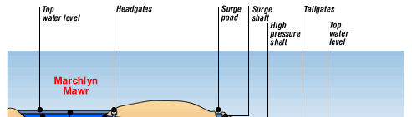
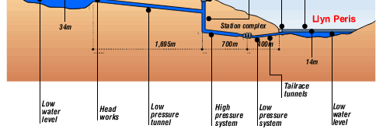
Example: pumped storage hydro plant

Slide 58
Example

Slide 59
Example
Energy cycle in a pumped storage plant is only about 75% efficient
Difference between high price and low price periods must be large enough to cover the cost of the lost energy
Profit is unlikely to be large enough to cover the cost of investments
Pumped hydro plants can also make money by helping control the system

