Slide 1
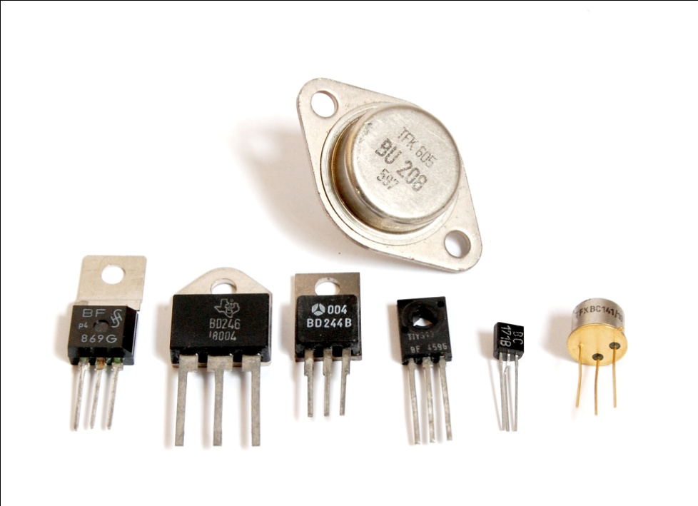
ME 6405 Student Lecture: Transistors
Ryan Akin Xin Chen
Will Dahlin
Thursday October 6, 2011 Georgia Institute of Technology

Slide 2
Presentation Outline
1
Introduction to Transistors
Ryan Akin
2
Transistor Types and Checks
Ryan Akin
3
Bipolar Junction Transistors
Xin Chen
4
Field Effect and Power Transistors
Will Dahlin
5
Transistor Part Numbers and Catalog
Will Dahlin
Notes:
But there are much more than these.

Slide 3
Definition & Fundamental Need
Brief History
Transistor Role in Modern Electronics
Two Basic Transistor Functions
Doping process and its effects on function
Introduction to Transistors
Notes:
to understand the transistor, conceptually, we must address the three questions:

Slide 4
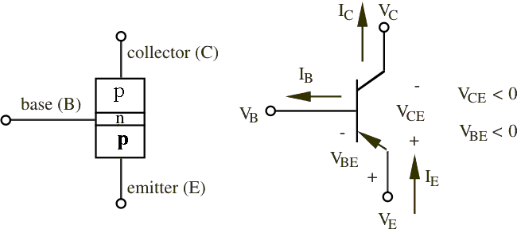
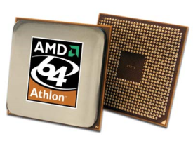
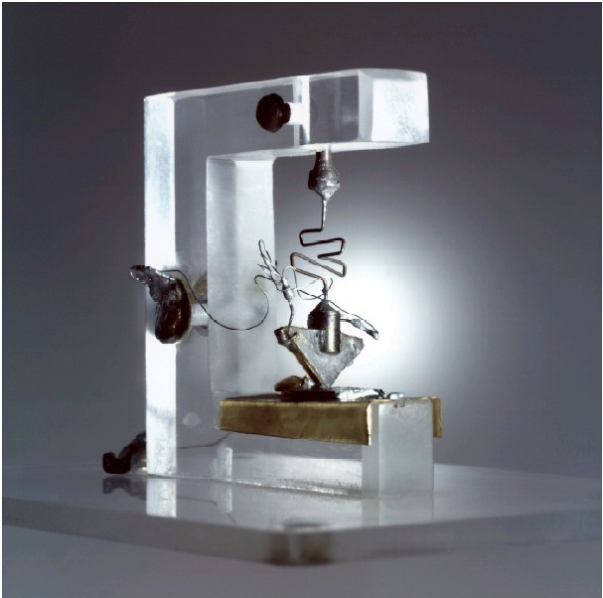
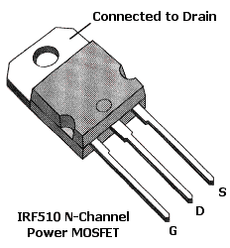
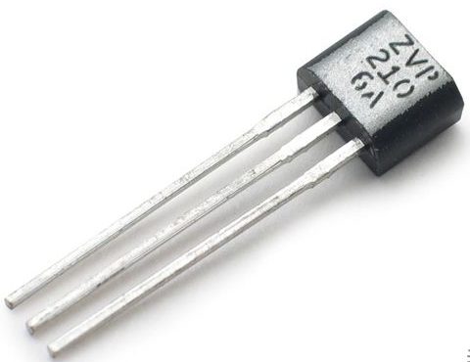
Transistors
Transistors of various type & size
BJT (PNP) Electrical Diagram Representation
First Transistor Model, 1947
Used in all modern electronics
FET Transistor
BJT Transistor
Notes:
You’ve all seen the transistor before, but instead of regurgitation, provide student perspective….

Slide 5
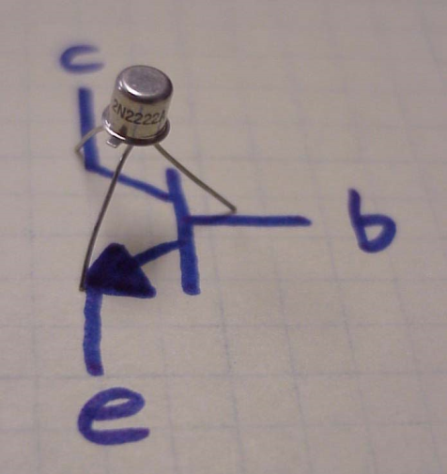
tran·sis·tor
a semiconductor device that amplifies, oscillates, or switches the flow of current between two terminals by varying the current or voltage between one of the terminals and a third. (www.dictionary.com)
www.coltecnica.com

Slide 6
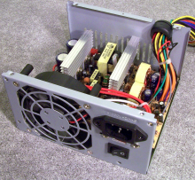
Basic Purpose
[1] To electronically switch (no moving parts) a signal on or off (high/low)
[2] To amplify signals
Role in Modern Electronics
Basic building blocks for all modern electronics
Microprocessors, Microcontrollers, Computers, Digital watches, Digital Logic Circuits, Cell Phones….
Motor Controllers
Microprocessor
PC & Cell Phones
Headphones
Notes:
ROADMAP OF BUILD TRANSISTOR -> PROPERTIES

Slide 7
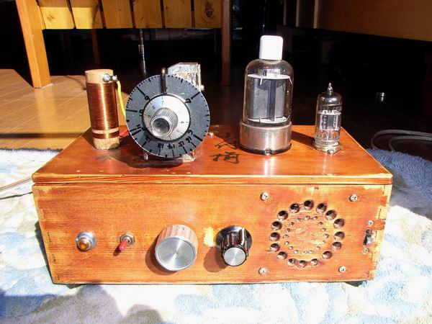
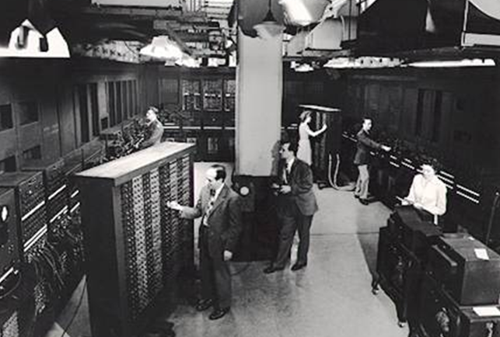
Reason for Transistor’s Invention:
Early 20th century, vacuum tube were used as signal amplifiers & switches.
Use of vacuum tube* resulted in extremely large, fragile, energy inefficient, and expensive electronics.
Evolution of electronics required device that was small, light weight, robust, reliable, cheap to manufacture, energy efficient…
*Vacuum tube advantages: operation at higher voltages (10K region vs. 1K region of transistors); high power, high frequency operation (over-the-air TV broadcasting) better suited for vacuum tubes; and silicon transistors more vulnerable to electromagnetic pulses than vacuum tubes
Vacuum Tube Radios
ENIAC : 17, 468 vacuum tubes

Slide 8
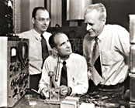
Invention
In 1947, John Bardeen, Walter Brattain, and William Schockly, researchers at Bell Lab, invented Transistor.
They found Transistor Effect: “when electrical contacts were applied to a crystal of germanium, the output power was larger than the input.”
Awarded the Nobel Prize in physics (1956)
Revolutionized portability and efficiency of electronic devices
John Bardeen, Walter Brattain, and William Schockly
First model of Transistor, 1947

Slide 9
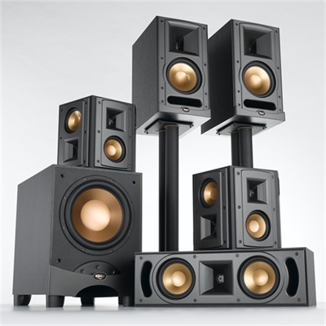
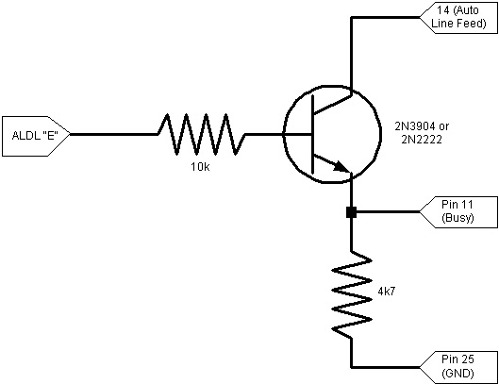
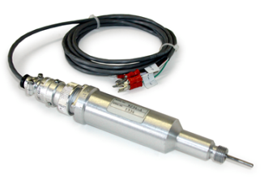
Infinite possibilities
V
mV
ground

Slide 10
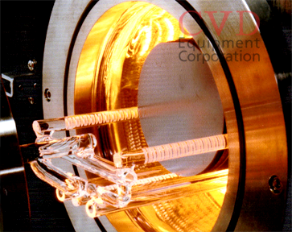
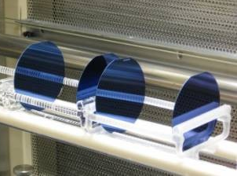
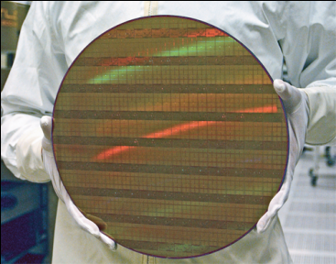
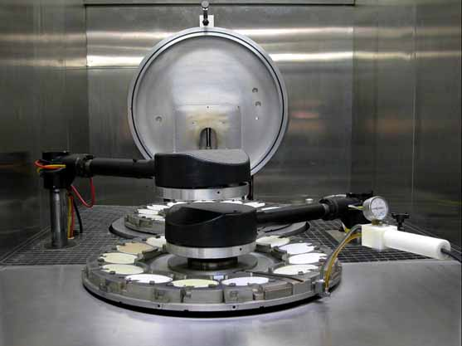
Transistor Manufacturing Process
Doping: “Process of introducing impure elements (dopants) into semiconductor wafers to form regions of differing electrical conductivity.”
Doping impurities into a “pure”semiconductor will increase conductivity.
Doping results in an “N-Type” or “P-Type” semiconductor.
High-Temp Furnace
“Pure” Wafers
“Doped” Wafers
Wafer Refinement
Ion Implanter
Notes:
Read doping slowly

Slide 11
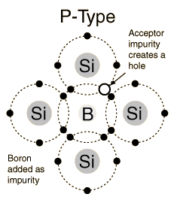
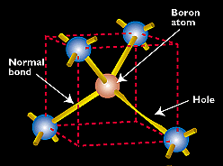
Effect of Doping on Semi-Conductors
P-Type Semiconductors : Positively charged Semiconductor Dopant Material: Boron, Aluminum, Gallium Effect of Dopant:
Creates “holes” (positive charges where electrons have been removed) in lattice structure

Slide 12
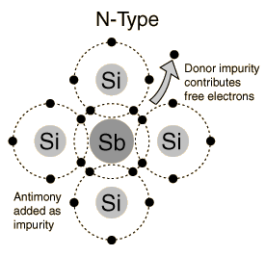
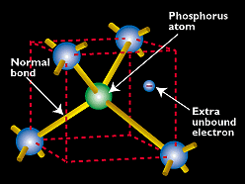
Effect of Doping on Semi-Conductors
N-Type Semiconductors : Negatively charged Semiconductor Dopant Material: Phosphorous, Arsenic, Antimony (Sb) Effect of Dopant:
Added unbound electrons create negative charge in lattice structure
Remember: Dopant is added to same piece of semiconductor material
Resulting Material: Single, solid material called “P-N Junction”

Slide 13
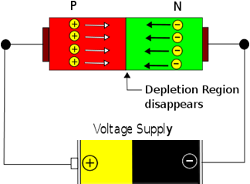
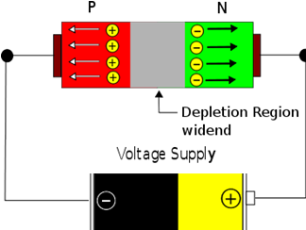
Electrical Switching on P-N Junction
Applying External Voltage…
…of Forward Biasing polarity facilitates motion of free electrons
…of Reverse Biasing polarity impedes motion of free electrons
Forward Biasing
Reverse Biasing
Circuit is “On”
Current is Flowing
Circuit is “Off”
Current not Flowing

Slide 14
Finally – combining all concepts
Semiconductor -> Doping -> P-N Junction -> Depletion Region
One P-N Junction can control current flow via an external voltage
Two P-N junctions (bipolar junction transistor, BJT) can control current flow and amplify the current flow.
Also, if a resistor is attached to the output, the resulting voltage output is much greater than the applied voltage, due to amplified current. Example at end.

Slide 15
http://www.youtube.com/watch?v=QO5FgM7MLGg

Slide 16
Presentation Outline
1
Introduction to Transistors
Ryan Akin
2
Transistor Types and Checks
Ryan Akin
3
Bipolar Junction Transistors
Xin Chen
4
Field Effect and Power Transistors
Will Dahlin
5
Transistor Part Numbers and Catalog
Will Dahlin
Notes:
But there are much more than these.

Slide 17
Types and Categorization of Transistors
Meter Check of Unknown Transistor
Transistor Types and Checks
Notes:
to understand the transistor, conceptually, we must address the three questions:

Slide 18
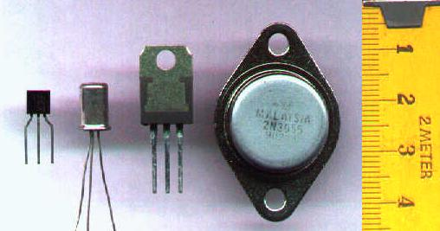
Transistor Categories and Types
Transistor are categorized by
Semiconductor material: germanium, silicon, gallium arsenide, etc.
Structure: BJT, FET, IGFET (MOSFET), IGBT
Polarity: NPN, PNP (BJTs); N-channel, P-channel (FETs)
Maximum power rating: low, medium, high
Maximum operating frequency: low, medium, high
Application: switch, audio, high voltage, etc.
Physical packaging: through hole, surface mount, ball grid array, etc.
Amplification factor, β
Various Types of Transistor:
http://en.wikipedia.org/wiki/Category:Transistor_types
Various Types of Transistors
Bipolar Junction Transistor (BJT)
Field Effect Transistors (FET)
Power Transistors

Slide 19
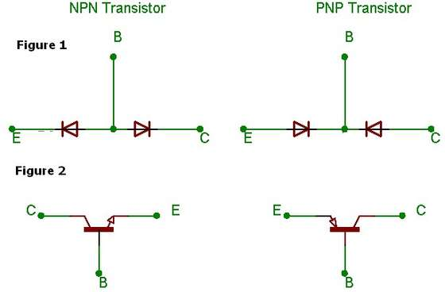
Meter check of a transistor
Bipolar transistors are constructed of a three-layer semiconductor “sandwich,” either PNP or NPN. As such, transistors register as two diodes connected back-to-back when tested with a multimeter's “resistance” or “diode check” function

Slide 20
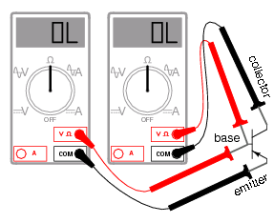
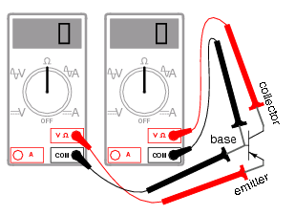
Meter check of a transistor
For PNP Transistors
1. Set multimeter to Ohmmeter Ohm Scale.
2. Connect the Negative Probe (Black) to Emitter and the Positive Probe (Red) to the Base(R=R1).
3. Now invert the probe connections to the Emitter for the Red Probe and to the Base for Black. R = “OL”. If this works, your Emitter-Base junction is OK.
4. Now test the Base-Collector junction. Connect the Red probe to the Base and the Black probe to the Collector (R=R2).
5. Invert the probes again, Black to the Base and the Red probe to the Collector. R = “OL”. If this works, your Base-Collector junction is Ok.
6. Connect the probes to the Emitter and Collector (probes may be inverted), R = “OL”indicates a working transistor.

Slide 21
Meter check of a transistor
For NPN Transistors
1. Set multimeter to Ohmmeter Ohm Scale.
2. Connect the Negative Probe (Black) to Base and the Positive Probe (Red) to the Emitter.(R=R 1).
3. Now invert the probe connections to the Base for the Red Probe and to the Emitter for Black. R = “OL”. If this works, then your Emitter-Base junction is OK.
4. Now test the Base-Collector junction. Connect the Black probe to the Base and the Red probe to the Collector(R=R 2).
5. Invert the probes again, Red to the Base and the Black probe to the Collector. R = “OL”. If this works, then your Base-Collector junction is Ok.
6. Connect the probes to the Emitter and Collector (probes may be inverted), R “OL” indicates a working transistor.

Slide 22
Meter check of a transistor
Detecting defective Transistors
1. If their is no resistance between any of the pairs during test (R = 0) for all the steps, then the transistor is shorted.
2. If for all the steps R = “OL”, then the transistor is open.
“OL” – resistance is greater than the meter can read

Slide 23
Presentation Outline
1
Introduction to Transistors
Ryan Akin
2
Transistor Types and Checks
Ryan Akin
3
Bipolar Junction Transistors
Xin Chen
4
Field Effect and Power Transistors
Will Dahlin
5
Transistor Part Numbers and Catalog
Will Dahlin
Notes:
But there are much more than these.

Slide 24
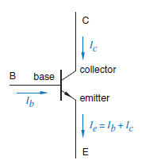
BJT introduction
BJT = Bipolar Junction Transistor
A BJT consists of two back-to-back p-n junctions.
The three regions are the emitter(E),base(B),and collector(C).
The middle region, the base is very thin. Since the base is thin, most carriers from emitter injected into base diffuse into collector.

Slide 25
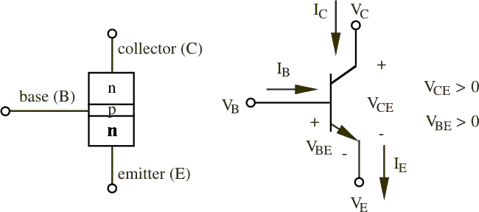
BJT schematic
NPN
NPN:
BE forward biased
BC reverse biased
PNP
PNP:
BE reverse biased
BC forward biased

Slide 26
BJT Transistor Operation
http://www.learnabout-electronics.org/bipolar_junction_transistors_05.php

Slide 27
BJT formulae
Current control
NPN
β is the amplification factor and ranges from 20 to 200
It is dependent on temperature and voltage
Notes:
Suggestion: state the qualitative definition behind these equations: when ib =0, when ib !=0, etc, what happens?

Slide 28
BJT formulae
Emitter is more heavily doped than the collector.
Therefore,
V_{C} > V_{B} > V_{E}
for NPN transistor
NPN
Notes:
Why do more heavily doped (less electrons, more electrons) are of less/more voltage? Write it on the slide. Change the font. Change the background. b/c e is heavily doped…lower potential

Slide 29
BJT formulae
NPN
α is the fraction of electrons that diffuse across the narrow base region
1 – α is the fraction of electrons that recombine with holes in the base region to create base current

Slide 30
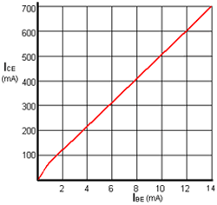
BJT Characteristic Curves
Transfer Characteristic
The graph of I_{CE} / I_{BE} shown (right) is called the Transfer Characteristic
The slope of the graph shows the β
Characteristic curves (graphs) can be drawn to show other parameters of a transistor, and are used both to detail the performance of a particular device and as an aid to the design of amplifiers.

Slide 31
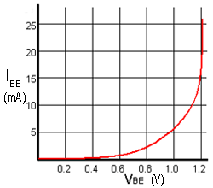
BJT Characteristic Curves
Input Characteristic
The Input Characteristic is the base emitter current I_{BE} against base emitter voltage V_{BE}(I_{BE}/V_{BE}) shows the input Conductance of the transistor.
The steepness of this particular curve when the V_{BE} is above 1 volt shows that the input conductance is very high, and there is a large increase in current (in practice, usually enough to destroy the transistor!) for a very small increase in V_{BE}.
Therefore the input RESISTANCE must be low.

Slide 32
BJT Characteristic Curves
Output Characteristic
The slope gives the value of output conductance (and by implication output resistance).
The near horizontal parts of the graph lines show that a change in collector emitter voltage V_{CE} has almost no effect on collector current in this region, just the effect to be expected if the transistor output had a large value resistor in series with it.
Therefore the graph shows that the output resistance of the transistor is high.

Slide 33
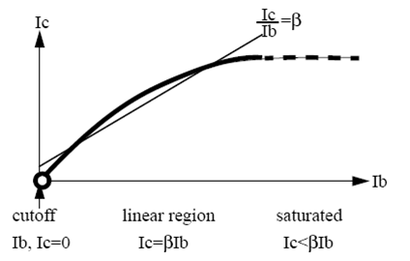
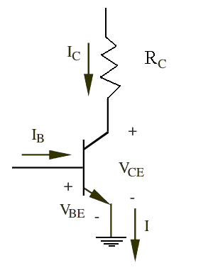
BJT operating regions
Operating Region | Parameters | Mode
Cut Off | V_{BE} < V_{cut-in} V_{CE} > V_{supply} I_{B} = I_{C} = 0 | Switch OFF
Linear | V_{BE} = V_{cut-in} V_{sat} < V_{CE} < V_{supply} I_{C} = β*I_{B} | Amplification
Saturated | V_{BE} = V_{cut-in}, V_{CE} < V_{sat} I_{B} > I_{C,max}, I_{C,max} > 0 | Switch ON

Slide 34
The Transistor as A Switch
While there are limitations as to what we can switch on and off, transistor switches offer lower cost and substantial reliability over conventional mechanical relays.
The secret to making a transistor switch work properly is to get the transistor in a saturation state

Slide 35
The Transistor as A Amplifier
From
exercise 3
Turns on/off coils digitally

Slide 36
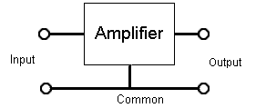
The Transistor as A Amplifier
Transistor Connections
Because an amplifier must have two input and two output terminals, a transistor used as an amplifier must have one of its three terminals common to both input and output as shown on the right. The choice of which terminal is used as the common connection has a marked effect on the performance of the amplifier.
There are three connection modes:
Comm0n Emitter Mode
Common Collector Mode
Common Base Mode

Slide 37
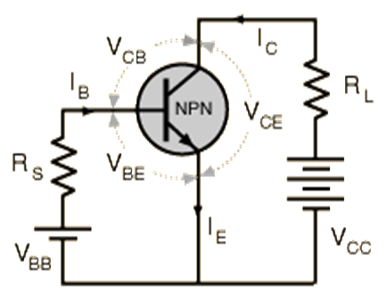
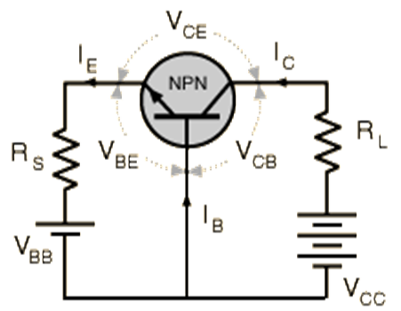
The Transistor as A Amplifier
Summary of the three types transistor connection
Parameter | Common Emitter | Common Collector | Common Base
Voltage gain Av | High (about 100) | Unity (1) | Medium (10-50)
Current Gain | High (50 - 800) | High (50 -800) | Less than unity (<1)
Input Impedance | Medium (about 3 to 5k) | High (several k) | Low (about 50R)
Output Impedance | Medium, Approx = Load resistor value | Low (a few ohms) | High (about 1M)

Slide 38
Several Comments about Transistor
Bipolar transistor consists of two PN junctions, with two types: NPN and PNP
BJT is a current control device.
The ratio of currents leads to one of the most important parameters of a transistor, which is its “current gain”, often referred to as its “Beta”.
BJT itself does not generate extra energy for amplifying, it just uses small current change to control big current change, which comes from the power supply.

Slide 39
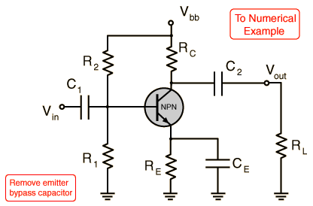
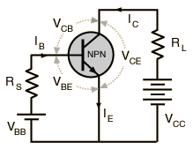
The Common Emitter Amplifier
NPN Transistor
- Both the signal source and the load share the emitter lead as a common connection point
- The common emitter configuration lends itself to voltage amplification and is the most common configuration for transistor amplifiers.

Slide 40
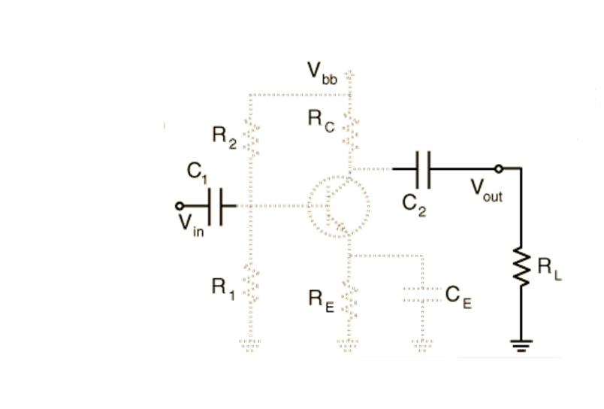
The Common Emitter Amplifier
The capacitor C1 must be used t0 keep
any DC component from disturbing the carefully developed biasing which establishes the operating point
But C1 also puts a High-Pass Filter on the
Input and must be chosen so that it does not filter out the lowest frequency which is to be amplified
Likewise, the capacitor C2 provides DC blocking and must be prevented from attenuating the signal

Slide 41
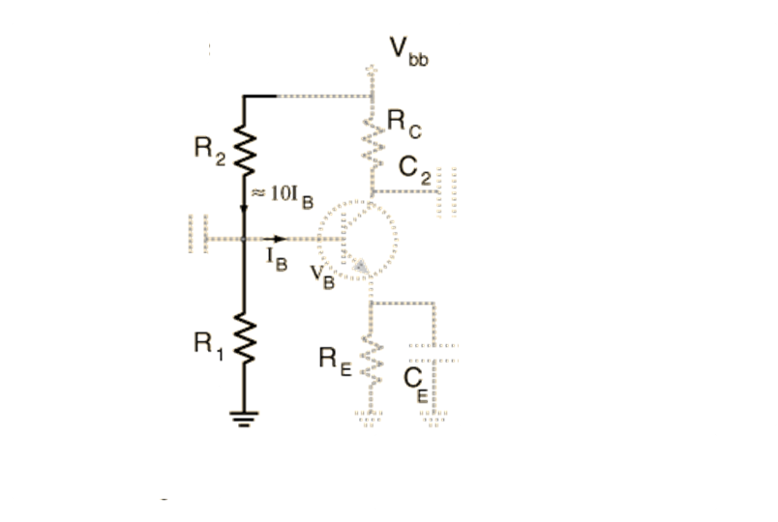
The Common Emitter Amplifier
Resistors R1 and R2 are used to properly bias the transistor to keep it working in the active region
These resistors are used as a voltage divider to provide proper value of base voltage to fit the chosen operating point.
For reasonable stability, usually make the current through these resistors at least 10 times of the base current.
In the range of active operation of the Transistor
$$V_{B}=V_{E}+0.6$$
${ I}_{C} ≅I_{E}$
The base voltage is
$$V_{B}= I_{E}R_{E}+0.6$$
The voltage divider requirement is
$$\frac{R_{1}}{R_{1}+R_{2}}=\frac{I_{E}R_{E}+0.6}{V_{bb}}$$
$$R_{1}+R_{2}=\frac{V_{bb}}{10I_{C}/β}$$

Slide 42
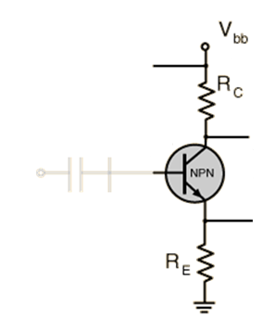
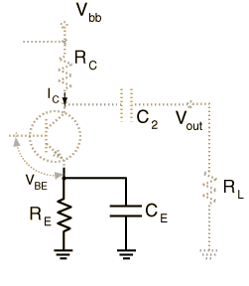
The Common Emitter Amplifier
The resistance R_{C} + R_{E} determines the maximum collector current
The capacitor C_{E} bypasses the emitter resistor R_{E,} making it an AC ground.
The reason is that a rise in signal would increase the current through the resistor and therefore the voltage at the emitter.

Slide 43
The Common Emitter Amplifier
NPN Transistor
- Both the signal source and the load share the emitter lead as a common connection point
- The common emitter configuration lends itself to voltage amplification and is the most common configuration for transistor amplifiers.

Slide 44
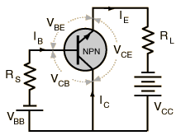
The Common Collector Amplifier
NPN Transistor
The common collector amplifier, often called an emitter follower since its output is taken from the emitter resistor, is useful as an impedance matching device since its input impedance is much higher than its output impedance. It is also termed a "buffer" for this reason and is used in digital circuits with basic gates.

Slide 45
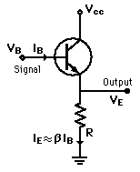
The Common Collector Amplifier
Emitter Follower Discussion
The voltage gain of an emitter follower is just a little less than one since the emitter voltage is constrained at the diode drop of about 0.6 volts below the base . Its function is not voltage gain but current or power gain and impedance matching. It's input impedance is much higher than its output impedance so that a signal source does not have to work so hard. This can be seen from the fact that the base current in on the order of 100 times less that the emitter current. The low output impedance of the emitter follower matches a low impedance load and buffers the signal source from that low impedance

Slide 46
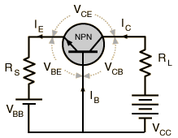
The Common Base Amplifier
NPN Transistor
This configuration is used for high frequency applications because the base separates the input and output, minimizing oscillations at high frequency. It has a high voltage gain, relatively low input impedance and high output impedance compared to the common collector.

Slide 47
Presentation Outline
1
Introduction to Transistors
Ryan Akin
2
Transistor Types and Checks
Ryan Akin
3
Bipolar Junction Transistors
Xin Chen
4
Field Effect and Power Transistors
Will Dahlin
5
Transistor Part Numbers and Catalog
Will Dahlin
Notes:
But there are much more than these.

Slide 48
Power Transistors
Concerned with delivering high power
Used in high voltage and high current application
In general
Fabrication process different in order to:
Dissipate more heat
Avoid breakdown
Different types: Power BJTs, power MOSFETS, etc.

Slide 49
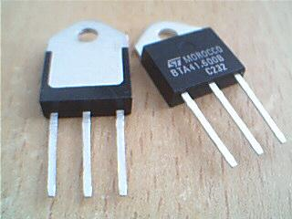
Field-Effect Transistor (FET)

Slide 50
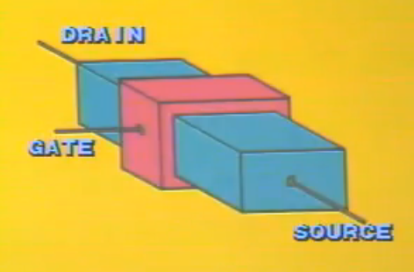
What makes a Field-Effect Transistor?
FETs have three main parts
Drain
Source
Gate
The body has contacts at the ends: the drain and source
Gate surrounds the body and can induce a channel by use of an electric field
FET | BJT
Input voltage controls output current | Input current controls output current
Gate | Base | Controls flow of current
Drain | Collector | Current goes out here
Source | Emitter | Current comes in here

Slide 51
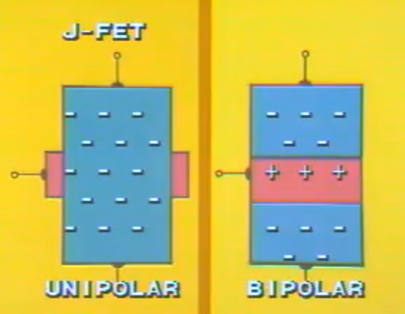
What is a Field-Effect Transistor (FET)?
Semiconductor device that depends on electric field to control the current
Performs same functions as a BJT; amplifier, switch, etc.
Relies on PNP or NPN junctions to allow current flow
However, mechanism that controls current is different from the BJT
Remember the BJT is bipolar. The FET is sometimes called a unipolar transistor
One type of charge carrier

Slide 52
How does a FET work?
Flow of current is similar to water flow through a garden hose
Pinch the hose (decrease current channel width) to decrease flow
Open the hose (increase channel width) to increase flow
Also, the pressure differential from the front and back of the hose (synonymous with the voltage from drain to source) effects the flow
JFET Animation

Slide 53
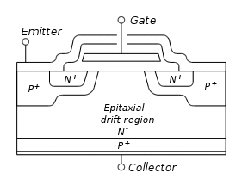
Types of Field-Effect Transistors
Type | Function
Junction Field-Effect Transistor (JFET) | Uses reversed biased p-n junction to separate gate from body
Metal-Oxide-Semiconductor FET (MOSFET) | Uses insulator (usu. SiO₂) between gate and body
Insulated Gate Bipolar Transistor (IGBT) | Similar to MOSFET, but different main channel
Organic Field-Effect Transistor (OFET) | Uses organic semiconductor in its channel
Nanoparticle Organic Memory FET (NOMFET) | Combines the organic transistor and gold nanoparticles
MOSFET
IGBT

Slide 54
JFET
A single channel of single doped SC material with terminals at end
Gate surrounds channel with doping that is opposite of the channel, making the PNP or NPN type
Uses reversed biased p-n junction to separate gate from body
n-channel
JFET
p-channel
JFET

Slide 55
Characteristics and Applications of FETs
JFETs
Simplest type of FET – easy to make
High input impedance and resistance
Low Capacitance
Slower speed in switching
Uses?
Displacement sensor
High input impedance amplifier
Low-noise amplifier
Analog switch
Voltage controlled resistor

Slide 56
MOSFET
Similar to JFET
A single channel of single doped SC material with terminals at end
Gate surrounds channel with doping that is opposite of the channel, making the PNP or NPN type
BUT, the MOSFET uses an insulator to separate gate from body, while JFET uses a reverse-bias p-n junction
p-channel
n-channel
MOSFET enhanced mode
MOSFET depleted mode

Slide 57
How does a MOSFET work?
No Voltage to Gate
Voltage to Gate
Source
Drain
Source
Drain
n
n
Simplified Notation
No current flow
“Short” allows current flow

Slide 58
MOSFET
FETs vary voltage to control current. This illustrates how that works
MOSFET drain current vs. drain-to-source voltage for several values of V_{GS} − V_{th}; the boundary between linear (Ohmic) and saturation (active) modes is indicated by the upward curving parabola.

Slide 59
MOSFET
Triode Mode/Linear Region
V_{GS} > V_{th} and V_{DS} < ( V_{GS} - V_{th} )
Saturation/Active Mode
V_{GS} > V_{th} and V_{DS} > ( V_{GS} - V_{th} )
V_{GS} : Voltage at the gate
V_{th} : Threshold voltage
V_{DS} : Voltage from drain to source
μ_{n}: charge-carrier effective mobility
W: gate width
L: gate length
C_{ox} : gate oxide capacitance per unit area
λ : channel-length modulation parameter

Slide 60
Characteristics and Applications of FETs
MOSFETs
Oxide layer prevents DC current from flowing through gate
Reduces power consumption
High input impedance
Rapid switching
More noise than JFET
Uses?
Again, switches and amplifiers in general
The MOSFET is used in digital CMOS logic, which uses p- and n-channel MOSFETs as building blocks
To aid in negating effects that cause discharge of batteries
Use of MOSFET in battery
protection circuit

Slide 61
Presentation Outline
1
Introduction to Transistors
Ryan Akin
2
Transistor Types and Checks
Ryan Akin
3
Bipolar Junction Transistors
Xin Chen
4
Field Effect and Power Transistors
Will Dahlin
5
Transistor Part Numbers and Catalog
Will Dahlin
Notes:
But there are much more than these.

Slide 62
Transistor Part Numbers and Catalog
How to choose and appropriate transistor
Reading part numbers
Numerous “Standards” – JIS, JEDEC, Pro Electron, etc.
Dependent on manufacturer and customer
Transistor Catalog
ZTX 652/653 Datasheet
If in doubt, meter check

Slide 63
Presentation Summary
1
Introduction to Transistors Ryan Akin
Qualitative explanation of the what & how behind transistors
General application and history of transistors
“Physics” behind transistors : Doping Process, Effect on Semiconductors, & Formation of P-N Junction Electrical Properties of P-N Junction & using P-N to control / amplify current
2
Transistor Types and Checks Ryan Akin
Categorized by type, ratings, structure
Meter check of unknown transistor
3
Bipolar Junction Transistors Xin Chen
Introduction & Formulae
Explain function and characteristics of common emitter transistor
Describe BJT operating regions
Applications of BJTs

Slide 64
Presentation Summary
4
Field Effect and Power Transistors Will Dahlin
Definition and Applications
Use of electric field to change the output current
JFETs and MOSFETs are most common, and accomplish similar goals as BJTs
Used for switches, amplification, applications for protecting electronics
5
Transistor Part Numbers and Catalog Will Dahlin
Part numbers can be arbitrary
Transistor Catalog and Datasheet

Slide 65
Example Problem – Ryan Akin

Slide 66
References
http://www.utdallas.edu/research/cleanroom/TystarFurnace.htm
http://www.osha.gov/SLTC/semiconductors/definitions.html
http://www.products.cvdequipment.com/applications/diffusion/1/
http://amath.colorado.edu/index.php?page=an-immersed-interface-method-for-modeling-semiconductor-devices
http://www.extremetech.com/article2/0,2845,1938467,00.asp
http://macao.communications.museum/eng/Exhibition/secondfloor/moreinfo/2_10_3_HowTransistorWorks.html
http://fourier.eng.hmc.edu/e84/lectures/ch4/node3.html
http://www.appliedmaterials.com/htmat/animated.html
http://hyperphysics.phy-astr.gsu.edu/hbase/solids/dope.html#c3
http://www.tpub.com/neets/book7/25.htm
http://esminfo.prenhall.com/engineering/wakerlyinfo/samples/BJT.pdf
http://web.engr.oregonstate.edu/~traylor/ece112/lectures/bjt_reg_of_op.pdf
http://www.me.gatech.edu/mechatronics_course/transistors_F09.ppt
http://en.wikipedia.org/wiki/Bipolar_junction_transistor
http://en.wikipedia.org/wiki/Common_emitter
http://en.wikipedia.org/wiki/Diode
http://www.kpsec.freeuk.com/trancirc.htm
http://en.wikipedia.org/wiki/Field-effect_transistor
http://en.wikipedia.org/wiki/JFET
http://en.wikipedia.org/wiki/MOSFET
http://www.slideshare.net/guest3b5d8a/fets
http://www.rhopointcomponents.com/images/jfetapps.pdf
http://cnx.org/content/m1030/latest/
http://www.play-hookey.com/semiconductors/enhancement_mode_mosfet.html
http://www.youtube.com/watch?v=-aHnmHwa_6I&feature=related
http://www.youtube.com/watch?v=v7J_snw0Eng&feature=related
http://info.tuwien.ac.at/theochem/si-srtio3_interface/si-srtio3.html
http://hyperphysics.phy-astr.gsu.edu/hbase/solids/dope.html#c4
http://inventors.about.com/library/inventors/blsolar5.htm
http://thalia.spec.gmu.edu/~pparis/classes/notes_101/node100.html
http://hyperphysics.phy-astr.gsu.edu/hbase/solids/pnjun.html#c3
http://science.jrank.org/pages/6925/Transistor.html ← really good explanation!
http://www.learnabout-electronics.org/fet_01.php
http://www.learnabout-electronics.org/bipolar_junction_transistors_01.php

Slide 67
Questions?
Thank you!
Notes:
But there are much more than these.

