Slide 1
Today’s Moderator: Neil Dennehy (NESC)
Today’s Speaker: Irene Gregory (LaRC)
Welcome to THE NESC GN&C TDT WEBCAST Series
Fundamentals of
Adaptive Control

Slide 2




Slide 3
Fundamentals of Adaptive Control
Flight Control Perspective
Dr. Irene M. Gregory
Dynamic Systems and Control
NASA Langley Research Center
NESC GNC Webcast
28 November 2012

Slide 4
Outline
Why adaptive control?
Brief history of adaptive control in flight
What is adaptive control?
  Working definition
Recent methods in flight
Advantages/Limitations
Open problems and future directions

Slide 5
Why Adaptive Control?
Linear control methods often unable to provide good stability margins and desired tracking performance in the presence of highly non-linear airframe characteristics
  Leads to high gain feedback to dominate nonlinearity
  Requires extensive gain scheduling and accurate aerodynamic models
Benefits of Adaptive Control
  provides consistent performance in the presence of modeling uncertainties, large parameter variations and unknown unknowns
  does not need accurate aerodynamic model
Direct Adaptive Control
  provides incremental command to cancel / dominate uncertainties in aerodynamic modeling
    nonlinear moments
  “freezes” if desired tracking performance is achieved
  does not rely on system (plant) ID
Nonlinear Solution to a Nonlinear Problem

Slide 6
Brief History of Adaptive Flight Control

Slide 7
Motivation for Adaptive Control
Early 1950s – design of autopilots operating at a wide range of altitudes and speeds
  Fixed gain controller did not suffice for all conditions
    Gain scheduling for various conditions
    Poor sensors for efficient gain scheduling
  Several schemes for self-adjustment of controller parameters
    Sensitivity rule, MIT rule
  1958, R. Kalman, self-tuning controller
    Optimal LQR with explicit identification of parameters
1950-1960 – flight tests X-15 (NASA, USAF, US Navy)
  Bridge the gap between manned flight in the atmosphere and space flight
  Mach 4 - 6, at altitudes above 30,500 meters (100,000 feet)
  199 flights beginning June 8, 1959 and ending October 24, 1968
  Nov. 15, 1967, X-15A-3

Slide 8

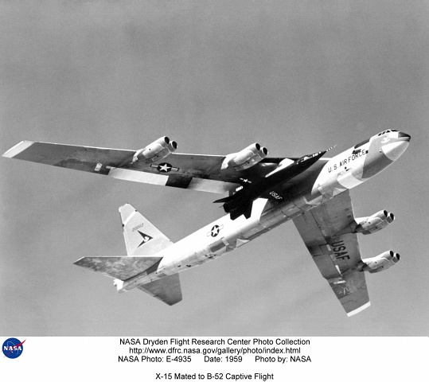
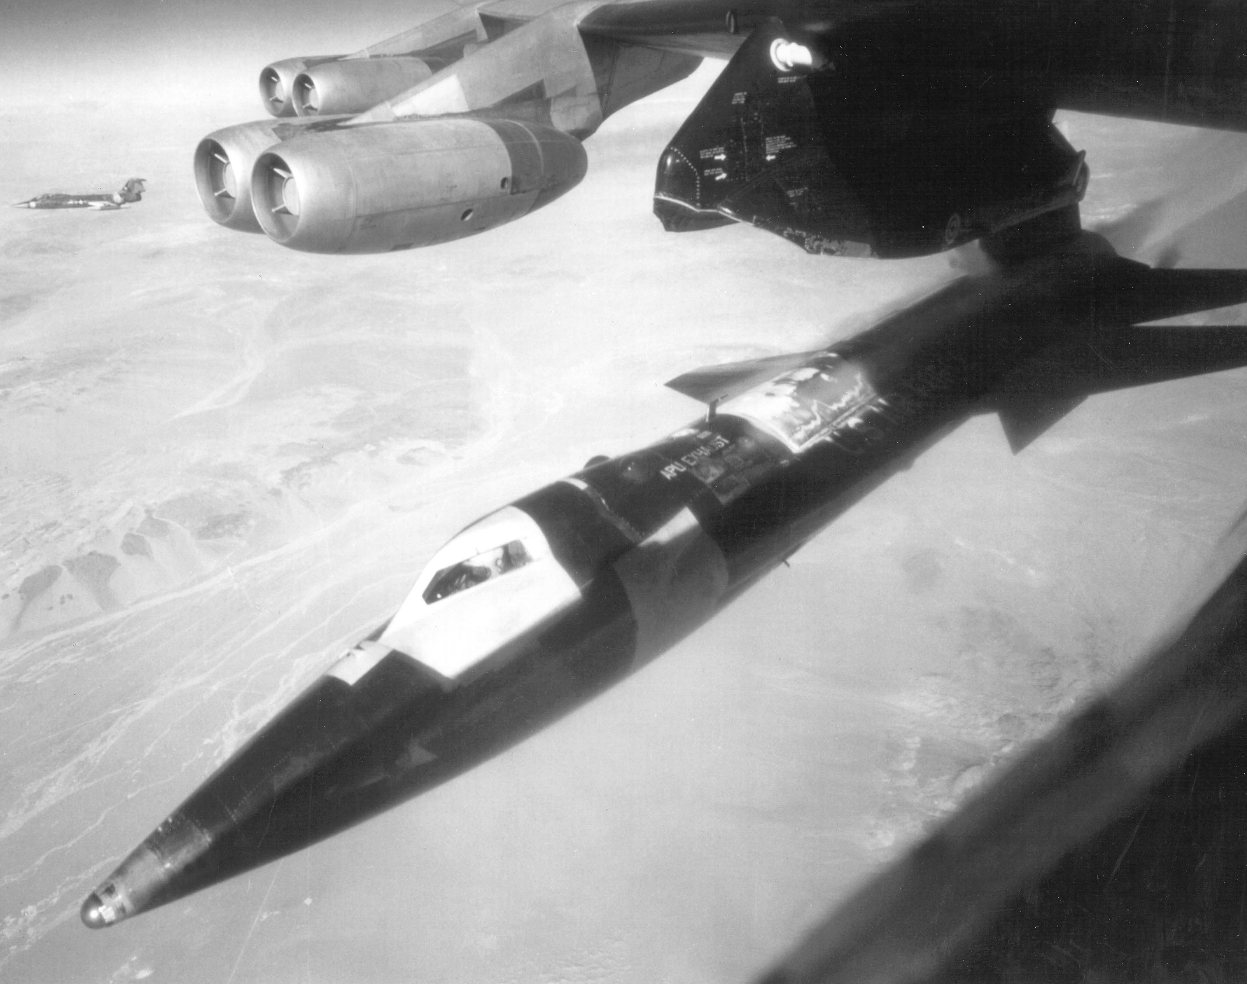

First Flight Test in 1967 (“Brave era” a la Astrom)
The crash of the X-15A-3 (November 15, 1967)
Crash due to stable, albeit non-robust adaptive controller!
Crash site of the X-15A-3

Slide 9




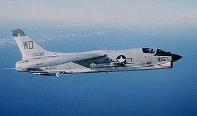
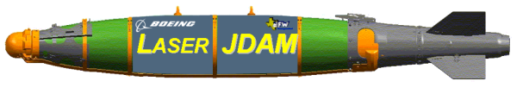





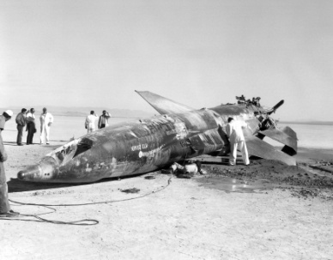
Adaptive Control in Transition
Fast adaptation
Single design AFCS
F-8
(NASA)
NPS Flight Test Program
Sig RASCAL
GTM T2
(NASA)
60s
90
95
00
05
10
NASA LaRC
X-15
(NASA/USAF/ US Navy)
IFCS
(NASA/Boeing)
F-15 ACTIVE
RESTORE
(AFRL-VA/Boeing)
X-36
Adaptive Control
for Munitions
(AFRL-MN/GST/Boeing)
MK-84
MK-82 L-JDAM
in production
J-UCAS
(DARPA/USAF/US Navy)
Boeing X-45A & X-45C
MK-84 JDAM
Gen I: flown 1999, 2003
Gen II: 2002 – 2006
  flight test 4th Q 2005
Gen III: 2006
Slow adaptation
“Expensive” gain-scheduled AFCS
in production
evaluated in flight
sim environment
Source: Kevin Wise, Boeing
(adapted)

Slide 10
What is Adaptive Control?

Slide 11
What is Adaptive Control?
Pragmatic definition: An adaptive controller is a controller with adjustable parameters and a mechanism of adjusting the parameters. (Astrom)
An adaptive control system can be thought of as having two loops.
  One loop is a normal feedback loop with the process and the controller.
  The other loop is the parameter adjustment loop.
    The variation in uncertainty that an adaptive system can handle depends directly on the speed of the parameter adjustment loop
Notes:
The controller becomes nonlinear because of the parameter adjustment mechanism. It has, however, a very special structure. Since general nonlinear systems are difficult to deal with, it makes sense to consider special classes of nonlinear systems.
An adaptive control system can be thought of as having two loops. One loop is a normal feedback loop with the process and the controller. The other loop is the parameter adjustment loop.
The parameter adjustment loop is often slower than the normal feedback loop.

Slide 12
Stability, Performance and Robustness
Absolute Stability versus Relative Stability
Linear Systems Theory
    Absolute stability is deduced from eigenvalues
    Relative stability is analyzed via Nyquist criteria: gain and phase margins
    Performance of input/output signals analyzed simultaneously
Nonlinear Systems Theory
  Lack of availability of equivalent tools
  Absolute stability analyzed via Lyapunov’s direct method
  Relative stability resolved in Monte-Carlo type analysis
  No correlation between the time-histories of input/output signals

Slide 13
Direct & Indirect Methods of Adaptive Control
Direct Method:
Estimate the controller parameters
The stable error dynamics and adaptive laws are derived using the structure of the control signal
Indirect Method:
Estimate the system parameters
The stable error dynamics and adaptive laws are derived independent of the control signal
The control signal is synthesized using the estimated system parameters
Focus on model based adaptive systems
  Specify desired performance for the plant dynamics

Slide 14
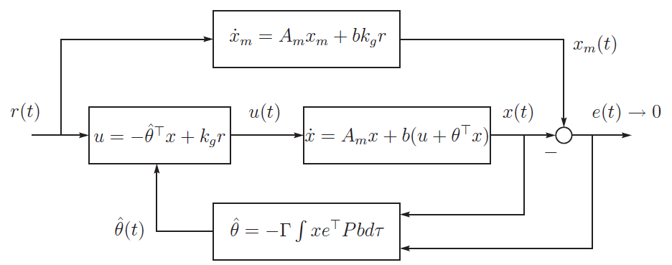
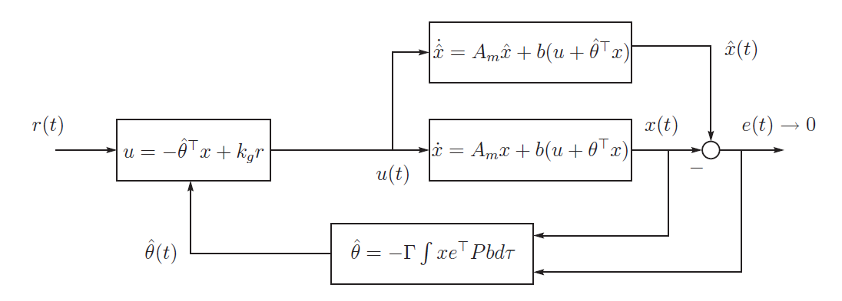
Implementation Architectures
Reference system
Direct MRAC
Indirect MRAC
State Predictor

Slide 15
Recent Methods in Flight
Model Reference Adaptive Control
MRAC

Slide 16
Model-Reference Adaptive Control
reference model
controller
plant
adaptation law
Plant has a known structure but the parameters are unknown
Reference model specifies the ideal (desired) response y_{m} to the external command r
Controller is parameterized and provides tracking
Adaptation is used to adjust parameters in the control law

Slide 17
MRAC: 1st Order Nonlinear System
System Dynamics:
  are constant unknown parameters
  uncertain nonlinear function:
    vector of constant unknown parameters:
    regressor vector of known RBF-s:
Stable Reference Model:
Control Goal
  find u such that:

Slide 18
MRAC: 1st Order Nonlinear System (cont’d)
Adaptive Control Solution:
  (N + 2) parameters to estimate on-line:
Closed-Loop System:
Desired Dynamics:
Matching Conditions Assumption
  there exist ideal gains such that:
  Note: knowledge of the ideal gains is not required, only their existence is needed, (in this case, ideal gains always exist)
Tracking error:

Slide 19
MRAC: 1st Order Nonlinear System (cont’d)
Adaptive Law
  makes time-derivative of a Lyapunov function decrease along the error dynamics trajectories
Time-derivative of the Lyapunov function becomes semi-negative definite, (that is closed-loop system energy dissipates), yields stable dynamics
Barbalat’s Lemma ensures that is bounded

Slide 20
MRAC: 1st Order Nonlinear System
Reference
Model
Plant
Adaptive gains:
On-line function estimation:
Adaptive Control Solution:

Slide 21
Robustness: Parameter Drift & Unmodeled Dynamics
When external input r(t) is persistently exciting the system, both simulation and analysis indicate that MRAC systems are robust w.r.t non-parametric uncertainties (unmodeled dynamics)
When external input r(t) IS NOT persistently exciting even small uncertainties may lead to severe problems
  estimated parameters drift slowly as time goes on, and suddenly diverge sharply
  reference input contains insufficient parameter information
  adaptation has difficulty distinguishing parameter information from noise
Inability to properly model the true plant coupled with significant excitation in the frequency band where that ineffective modeling occurs may cause instability.
In Summary
  Parameter drift occurs when signals are not persistently exciting
  Mainly caused by measurement noise and disturbances; unmodeled dynamics
  Does not effect tracking accuracy until the instability occurs
Leads to sudden failure

Slide 22
MRAC Key Implementation Components
Radial Basis Functions, (RBF-s)
  on-line approximation of system uncertainties
  nonlinear integrators in the closed-loop
e & σ – Modification – robustification of MRAC (no PE)
  adds damping to adaptive dynamics
  keeps adaptive parameters bounded (similar to Projection Operator)
μ – Modification
  explicitly accounts for actuator position limits
  keeps adaptive dynamics stable by changing external command in the presence of actuator constraints
Dead – Zone Modification – dealing with noise
  stops adaptation when tracking error is small
  prevents learning from noise
  can be used to not let adaptive augmentation change nominal closed-loop tracking performance
Projection Operator, (smooth version)
  integrator anti-windup protection
  keeps all adaptive parameters within pre-specified bounds
Notes:
Damping style modifications;
Basic idea of all modifications was to limit the gain of the adaptation loop and to eliminate integral action → attempts to address parameter drift but not the architectural problem identified by Rohrs

Slide 23
Flight Control State-of-the-Art – Brief Summary
Model Reference Adaptive Control (MRAC) Augmentation
  Flight proven on X-36 RESTORE, MK-82 LJDAM, MK-82 JDAM (production), etc.
Theoretically justifiable and verifiable characteristics
  State feedback - satisfactory for standard flight control
  Guarantees bounded tracking
  Bounds adaptive parameters (using modifications)
  Provides anti-windup protection during control saturation (using μ-mod)
Guarantee stability, but not transient performance
  Transient performance achieved by tuning control parameters
  Schedule adaptive gains with flight condition
  Requires intensive Monte Carlo runs, i.e. no a priori guarantees
Notes:
The lack of analytical quantification of the relationship between the rate of adaptation, the transient response and the robustness margins lead to gain-scheduled (on adaptive gain) designs

Slide 24
Transient Performance of MRAC
Parameters of interest in transient performance
  overshoot
  settling time
  control signal frequencies
  etc.
The transient of MRAC depends on
  Adaptive gain and other tuning parameters
  Knowledge of the true unknown parameter
  Initial values of system states
  Reference Input
Highly nonlinear relationship between these parameters is introduced via adaptive law
Linear systems
  System response and control signal are linear (scaled and sum) with respect to reference input and initial conditions
  Performance can be predicted using unit step response
MRAC is highly nonlinear process
  The transient for a new condition can be totally different and unpredictable

Slide 25
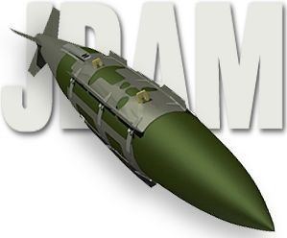
Lessons Learned From Previous Programs
Lessons Learned*:
  Limited to slowly-varying uncertainties, lack of transient characterization
  Fast adaptation leads to high-frequency oscillations in control signal, reduces the tolerance to time-delay in input/output channels
  Determination of the “best rate of adaptation” heavily relies on Monte-Carlo runs
Challenge: How to achieve FAST adaptation with NO OSCILLATIONS and with GUARANTEED Time Delay Margins
*V. Patel, C. Cao, N. Hovakimyan, K. Wise, E. Lavretsky, “L1 Adaptive Controller for Tailless Unstable Aircraft in the Presence of Unknown Actuator Failures”, In Proc. of AIAA Guidance, Navigation and Control Conference, Hilton Head Island, SC, 2007.
Notes:
The fundamental question is determining an architecture that would allow for fast adaptation without losing robustness.
Fast adaptation → compensates for negative effects of rapid variation of uncertainties on the system response
L1 provides such an architecture that decouples adaptation from robustness

Slide 26
Recent Methods in Flight
L1 Adaptive Control

Slide 27
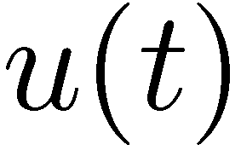

Implementation Architectures
Reference system
Direct MRAC
cannot be low-pass filtered directly
Indirect MRAC
Enables insertion
of a low-pass filter
No reference system with filtering

Slide 28

Notional L1 Control Law
Control
Law
State
Predictor
Adaptation
Law
Performance vs. Robustness
Tradeoff
L1 control law consists of a fast estimation scheme and a control law
Fast estimation scheme includes
  state predictor – generates a prediction of system state
  adaptation law - used to generate estimates of plant uncertainties
Error e , between actual system state and prediction , drives the adaptation process.
Adaptation law updates the estimates of the plant uncertainties at a high adaptation rate.
Based on the uncertainty estimates, control law generates control surface deflection commands u as the output of low pass filters -

Slide 29
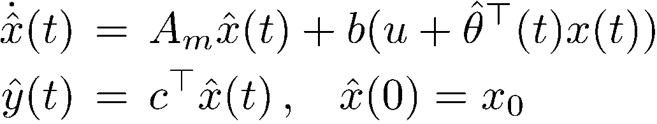
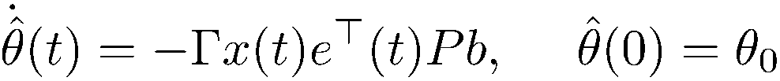
L1 Adaptive Control
System dynamics:
State predictor:
Controller:
Adaptive law:

Slide 30
Separation Between Adaptation & Robustness
Key feature of L₁ adaptive control: Feasibility of the control objective
System:
Nominal controller in MRAC:
Desired Reference System:
Nominal controller in L₁:
Achievable reference system:
High-pass filter -
attenuates low freq. uncertainty
Desired system
behavior
w/o uncertainty
Ideal system
response to IC
Notes:
Kg = 1/c^{T}A_{m}⁻¹b
The choice of k_{g} ensures that y_{m}(t) tracks step reference input with zero steady-state error

Slide 31
Main Features of L₁ Adaptive Control
  Separation (decoupling) between adaptation & robustness
  Performance limitations consistent with hardware limitations
  Guaranteed fast adaptation
  Guaranteed transient response for system’s input and output
      NOT achieved via persistence of excitation or gain-scheduling of adaptive gains
  Guaranteed (bounded away from zero) time-delay margin
  Uniform scaled transient response dependent on changes in initial conditions, unknown parameters, and reference input
  Suitable for development of theoretically justified Verification & Validation tools for feedback systems

Slide 32


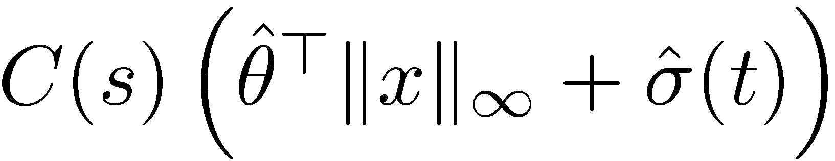
Benefits of Fast Adaptation
MRAC adaptive control
L₁ adaptive control
locally uniformly
bounded error
arbitrarily fast time-varying parameter and disturbance
basis function,
constant parameters
adaptive control signal
adaptive control signal
ignores the explicit dependence upon time
choice of basis functions based on intuition
significant tuning
local results
transient needs to be tuned
no selection of basis function needed
systematic tuning
semi global results
guaranteed transient

Slide 33
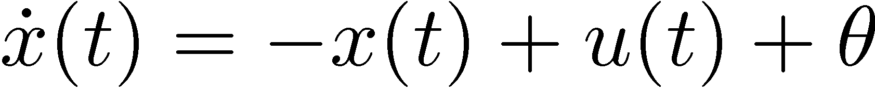
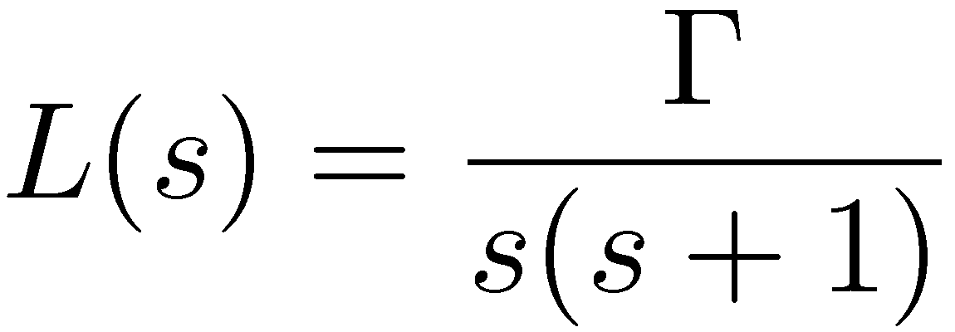
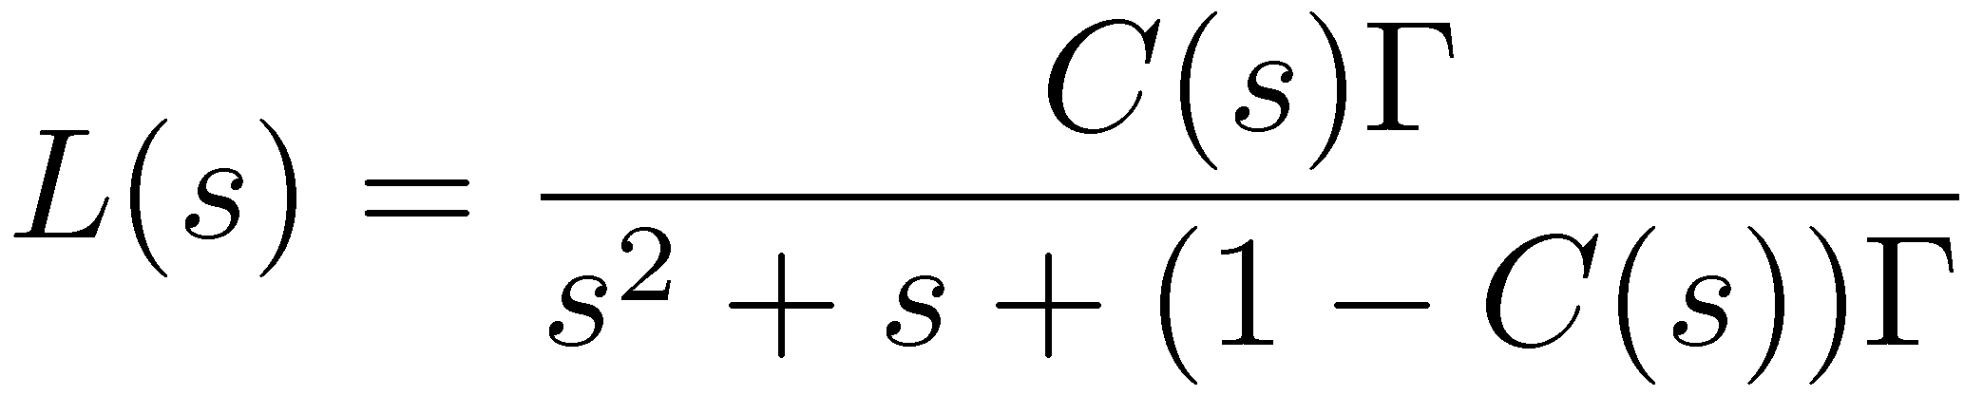

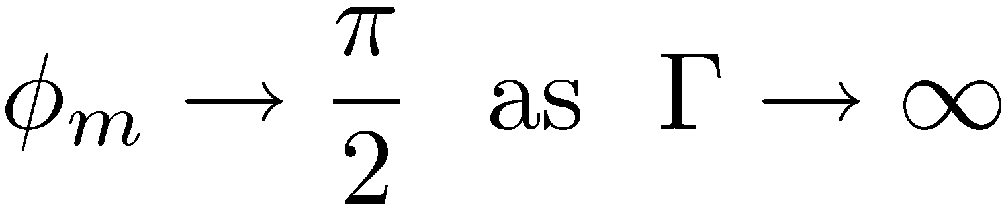
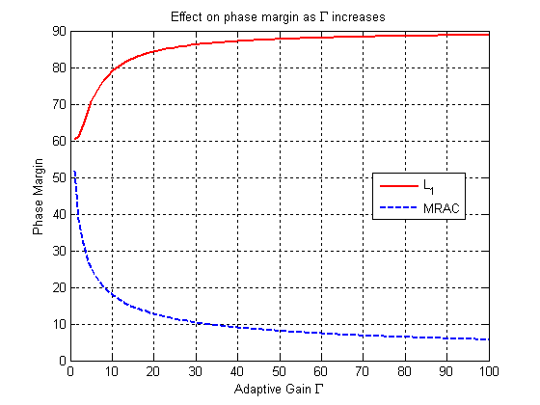
Phase Margin: MRAC and L₁ for a PI Controller
MRAC
L₁
Loop transfer functions:
Phase margin:
Phase margin:
Notes:
As Gamma→ inf C(s)/(1-C(s)) = w_{c}/s

Slide 34
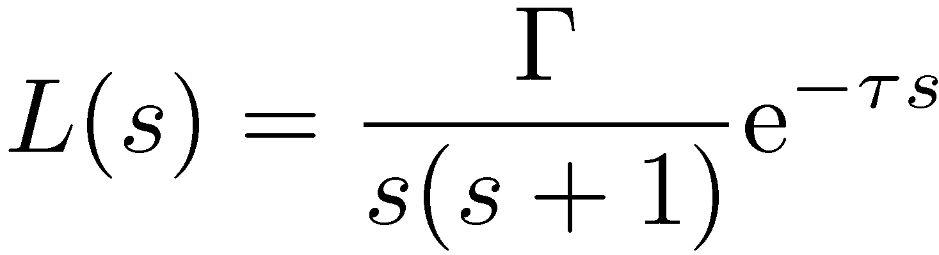
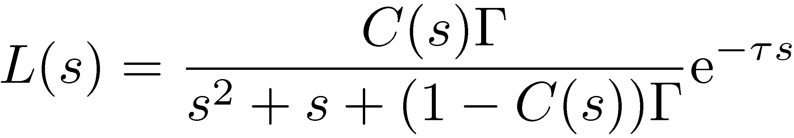
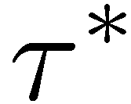

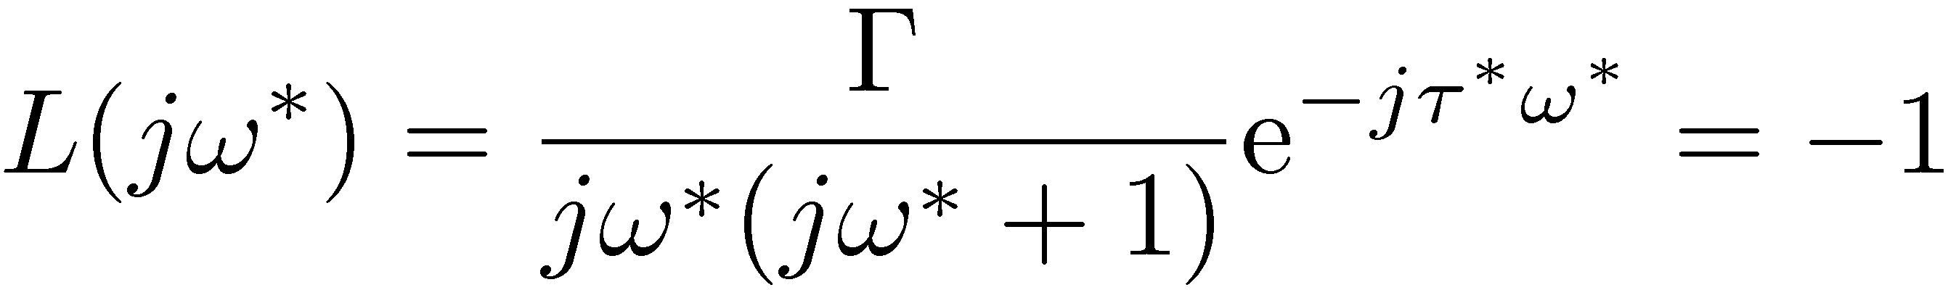
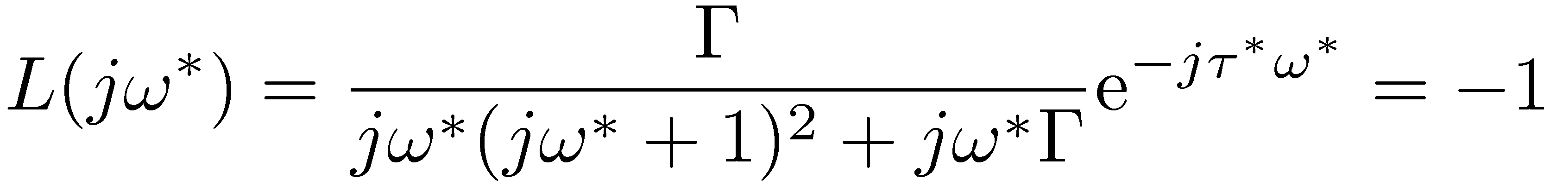
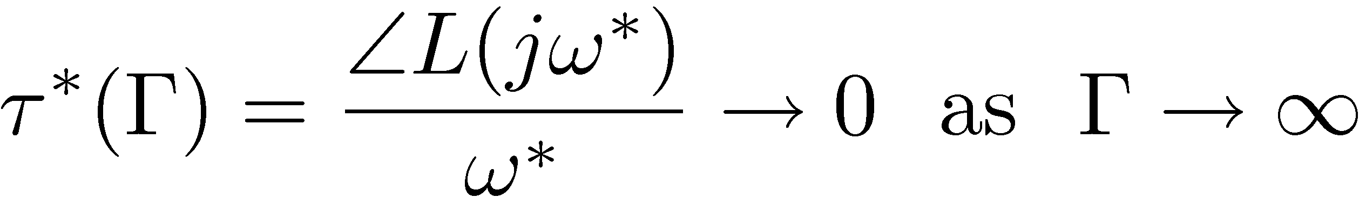
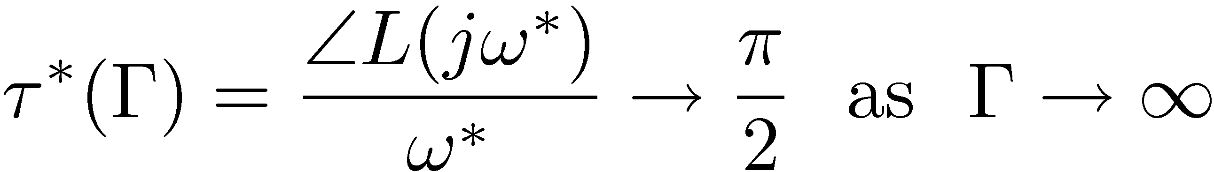
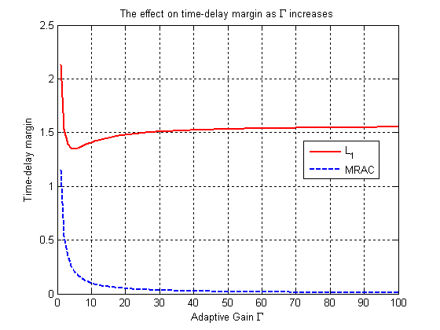
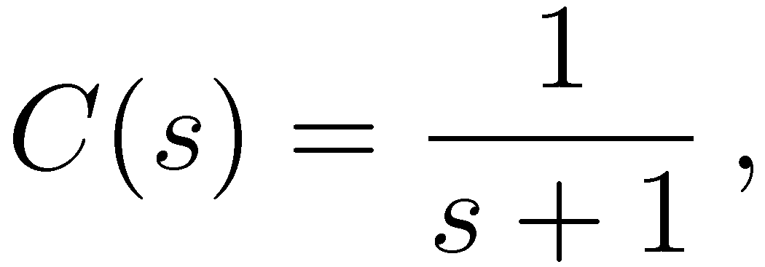
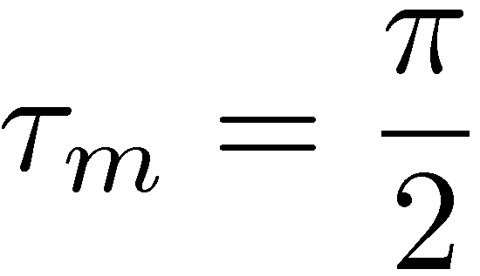
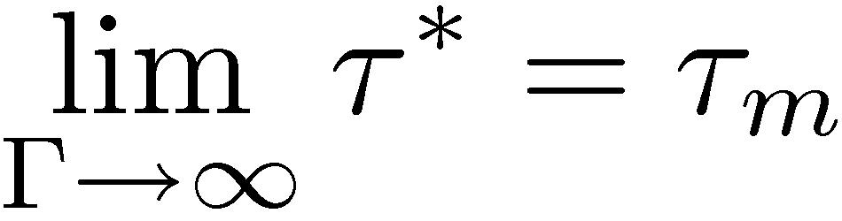
Time-Delay Margin: MRAC and L₁ for a PI Controller
MRAC
L₁
Open loop transfer functions in the presence of time-delay:
Time-delay margin :
Time-delay margin :
Application of nonlinear L₁ theory:

Slide 35
Recent Methods in Flight
L1 Adaptive Control
Supporting Extended Flight Envelope Modeling through stall and departure
Flight Test Example

Slide 36
MIMO Nonlinear System with Cross-Coupling
Consider nonlinear system dynamics
Can be expressed as the following system:
Control objective:
  Design an adaptive state feedback control law u(t) to ensure that the system output response y(t) tracks the output response y_{m}(t) of the desired system
Matched
uncertainty
Unmatched
uncertainty
Unmodeled
dynamics
Actuator
dynamics

Slide 37
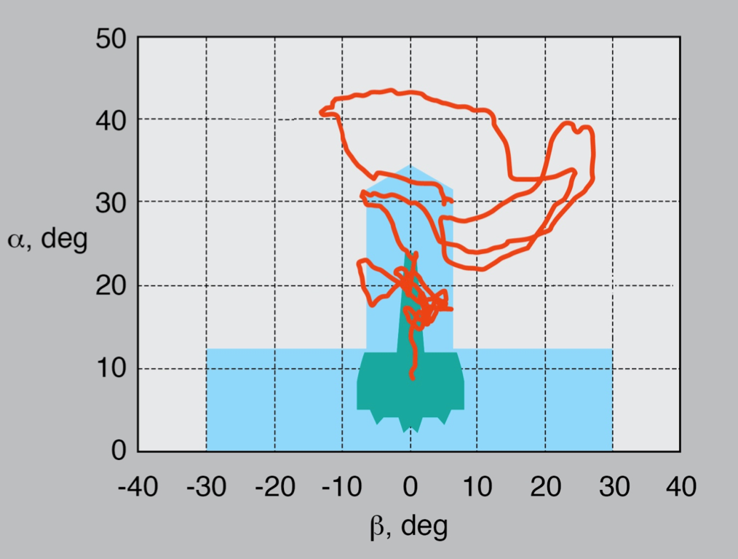
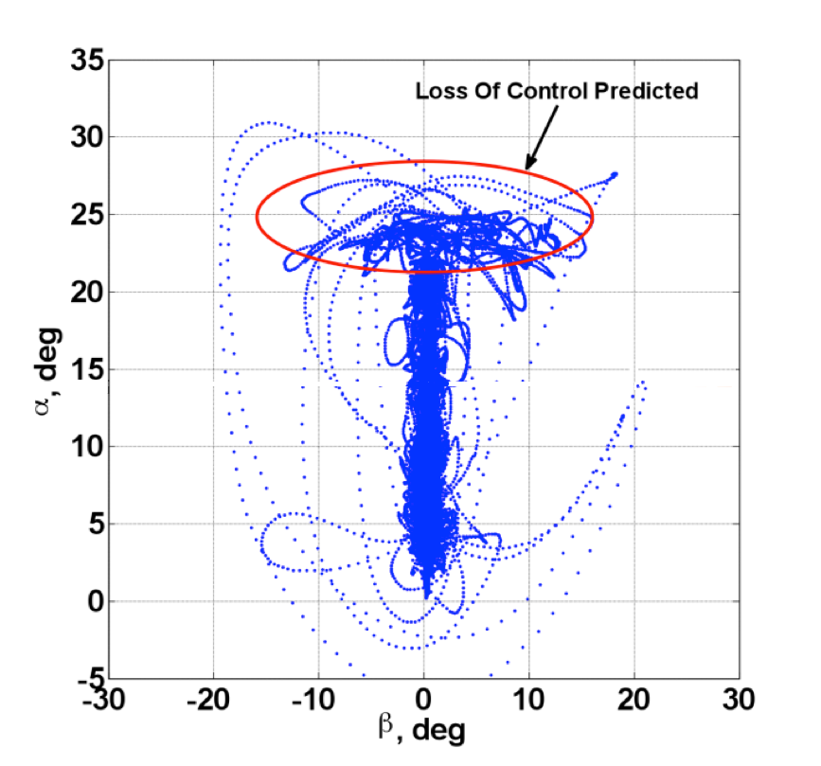

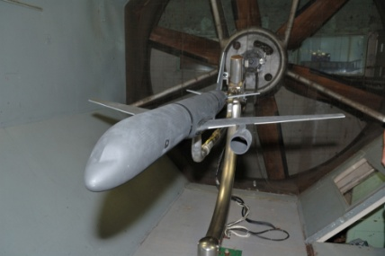
Post-Stall Flight Testing
Conducted testing to obtain parameter identification data and evaluate control law performance in an envelope relevant to LOC conditions.
LOC Accident Data
AirSTAR Departure Maneuvers:
Flights 54, 55, 58
Flight Validation
Training Simulation
Database

Slide 38
AirSTAR Flight Testing in Upset Conditions
May 2011 Deployment, Ft. Pickett, VA
Demonstrated real-time stability and control characterization during approach to stall, and through departure and recovery.
Single maneuver coverage
Applied L1 adaptive control to lengthen time on condition with stabilization that allowed slow transition through stall boundary and improved stall/departure recovery
Notes:
Notes:
Important: flight results are from a single 30-sec maneuver, whereas the wind tunnel results are from hours of testing.
Red bars are 1-sigma uncertainty bounds for the parameter estimates
The flight results were available in real time, i.e., no post-flight processing was used to obtain these results (other than plotting versus alpha rather than time).

Slide 39
Adaptive Flight Control: Open Problems
Reference model design
Optimization of filtering structure for L1 adaptive control
Adaptive structural mode suppression
  Output feedback with a priori specified transient performance
Gain and time delay margins for adaptive systems
  generalization to include nonlinear systems via output feedback
  Switching reference systems

Slide 40
Thank you for
Attending TODAy’s WeBCAST
ANY QUESTIONS?

Slide 41
Upcoming NESC GN&C
TDT Webcast
    “Fundamentals of Spacecraft Attitude Determination”, John Crassidis (Univ. of Buffalo), on 16 January 2013
20 June 2012 Update

Slide 42
Backup Slides

Slide 43
Instability/Bursting due to Unmodeled Dynamics
Rohr’s Example
Unmodeled
dynamics
plant
dynamics
System output
Instability
Parameters
Bursting

Slide 44
Rohrs’ Example: Unmodeled dynamics
System with unmodeled dynamics:
Nominal values
of plant parameters:
plant
dynamics
Unmodeled
dynamics
Reference system dynamics:
Control signal:
Adaptive laws from Rohrs’ simulations:

Slide 45
Difference in Feedforward TFs
P_{ref}(s)
MRAC
r(t)
+
u
y(s)
+
+
-
P_{um}(s)
P(s)
MRAC cannot alter the phase in the feedforward loop
The phase shift in the feedforward loop is the mechanism that prevents instability
+
+
P_{pr} (s)
r(t)
u
y(s)
+
k_{g}
+
+
-
P_{um}(s)
P(s)
L₁

Slide 46
What do we need to know?
Boundaries of uncertainties → sets the filter bandwidth
CPU (hardware → sets adaptive gain
What do we get?
Provides fast adaptation to rapid variation of uncertainties
  Arbitrarily fast time-varying parameters and disturbances
Uniform closed-loop tracking performance across flight envelope

Slide 47
n^{th} Order Systems with Matched Uncertainties
System Dynamics:
  are constant unknown matrices
  is known constant matrix, and
  is known, assuming
Uncertainty Approximation:
  matrix of constant unknown parameters:
  vector of N fixed RBF-s:
  function approximation tolerance:

Slide 48
n^{th} Order Systems with Matched Uncertainties
Stable Reference Model:
Control Goal
  bounded tracking, (UUB):
MRAC Design Process
  choose N fixed RBF functions
    can be performed off-line in order to incorporate any prior knowledge about the uncertainty
  design MRAC and evaluate closed-loop system performance
  repeat previous two steps, if required

Slide 49
Control Solution: Adaptive Augmentation
Nominal Control:
Adaptive Control:
Total Control:
  asymptotic tracking
not required

Slide 50
MRAC Block-Diagram
x
Reference Input, r(t)
Reference Model provides desired response
Nominal Baseline Controller may be incorporated
Solution: Total Adaptive Control or Adaptive Augmentation of a Baseline Controller

Slide 51
n^{th} Order Systems with Matched Uncertainties
System Dynamics:
  are constant unknown matrices
  is known constant matrix, and
  is known
Stable Reference Model:
  defines stable nominal closed-loop dynamics achievable under baseline control
  forms desired dynamics for adaptive augmentation with uncertainties
Control Goal
  bounded tracking, (UUB):

Slide 52
MRAC Design Algorithm Summary
Approximation of uncertainty:
  matrix of constant unknown parameters:
  vector of N fixed RBF-s:
  function approximation tolerance:
Control law:

Slide 53
Introducing Projection Operator
Requires no damping terms
Designed to keep NN weights within pre-specified bounds
Maintains negative values of the Lyapunov function time-derivative outside of a compact subset
Contributes to providing closed-loop SISL
Equivalent to a nonlinear integrator anti-windup protection

Slide 54
Projection Operator
Function defines pre-specified parameter domain boundary
Example:
specifies boundary
specifies boundary tolerance

Slide 55
Projection Operator, (continued)
Definition:
Depends on
Does not alter y if is within the pre-specified bounds:
Gradient:
In the operator subtracts gradient vector (normal to the boundary) from y
  get a smooth transition from y for to a tangent vector field for
Important Property
  yields closed-loop SISL

Slide 56
Adaptation with Parameter Projection
Modified adaptive laws:
Projection Operator, its bounds and tolerances are defined column-wise
Lyapunov function time-derivative is negative outside of a compact domain
  implies system stability and boundedness of tracking error
Adaptive parameters stay within the pre-specified bounds

Slide 57
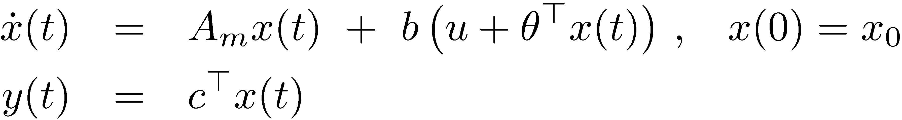
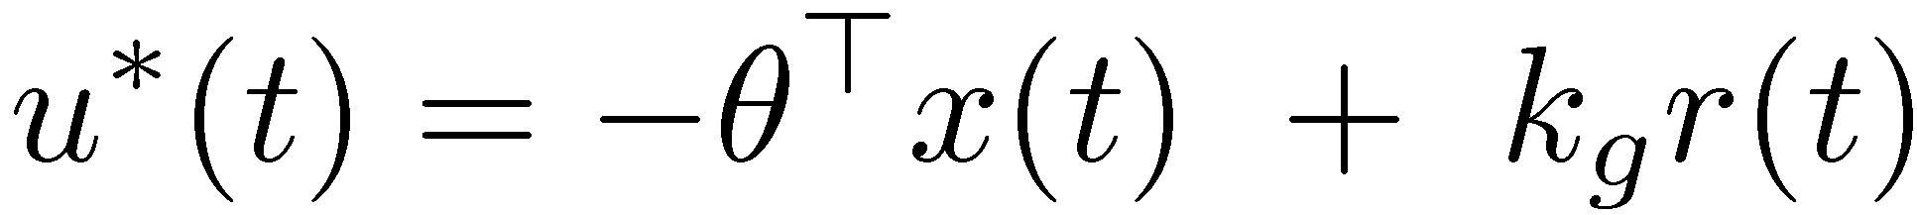
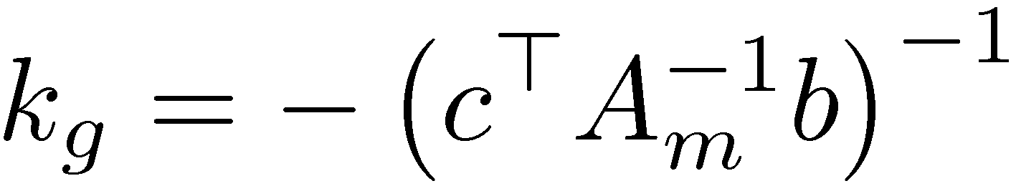
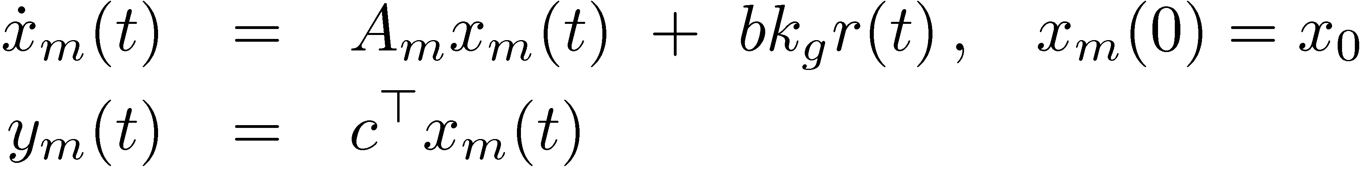
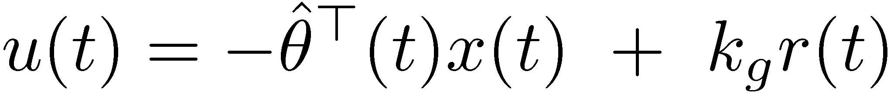
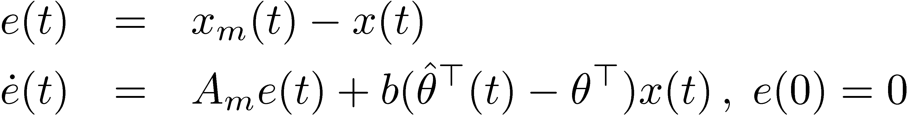
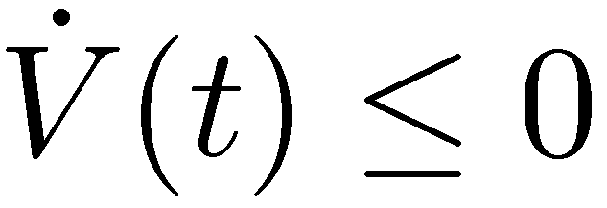
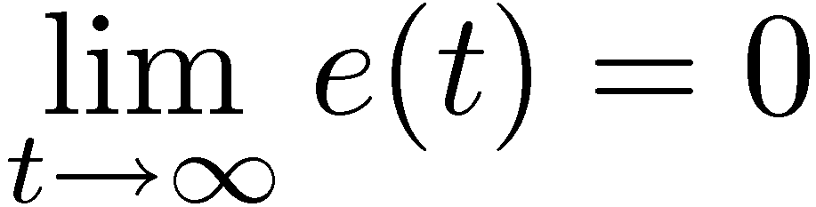

Direct Method of Adaptive Control
System dynamics:
Ideal controller:
Reference System:
Adaptive controller:
Error dynamics:
Adaptive law:
Lyapunov function:
Barbalat’s lemma:
uses boundedness of

Slide 58
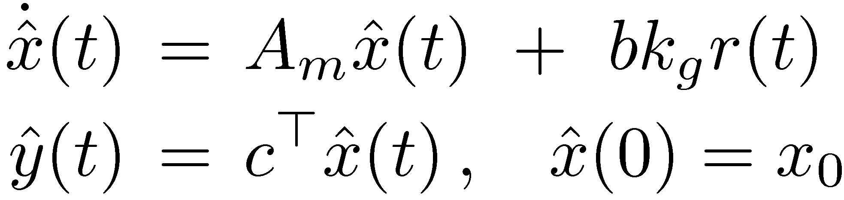

Indirect Method of Adaptive Control
System dynamics:
State predictor:
Error dynamics:
independent of control
Adaptive law:
Lyapunov function:
Stability does not imply asymptotic stability!
Adaptive controller:
Closed-loop state predictor
Barbalat’s lemma:
uses boundedness of

Slide 59
Rohr’s Counterexample
Robustness issue with MRAC – illustrative example (1980’s)
Problems typically occurred in one or both of two situations
In the first situation, the reference signal comprised as step, which meant that it was not persistently exciting.
The observed instability was bursting [
  set point problem – identifier can get the plant dc gain but not unknown dynamics (a,b) if u=constant, but thinks it knows
  Instability occurs, which produces richer signals, thus identifying
In the second situation, a sinusoidal excitation was used, the frequency of which intruded into the region where there were significant unmodeled dynamics.
The situation was very much like MIT rule instability (not knowing Z(p), where inability to properly model the true plant coupled with significant excitation in the frequency band where that ineffective modeling was occurring.

Slide 60
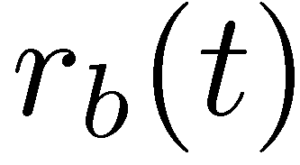
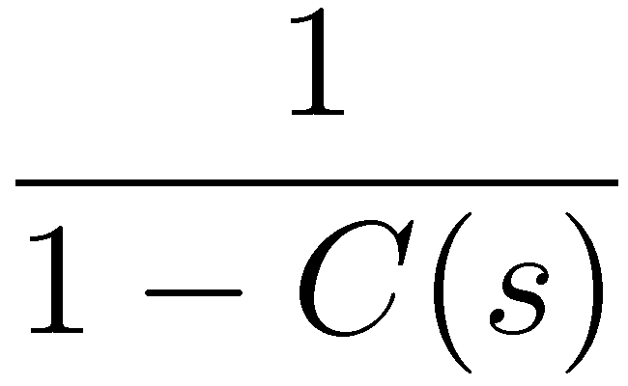
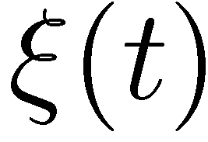

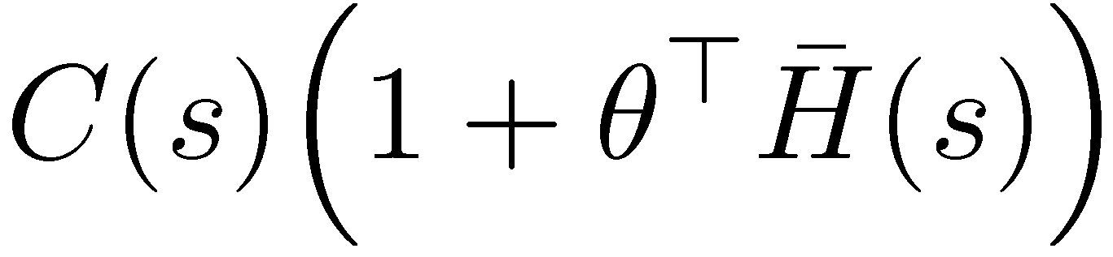
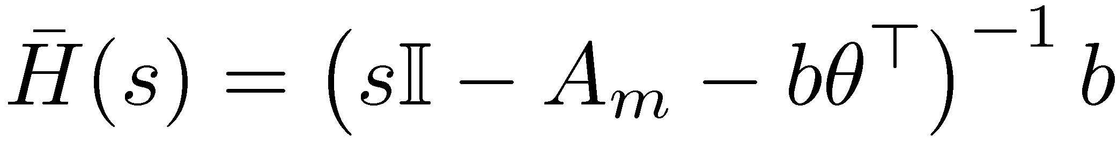
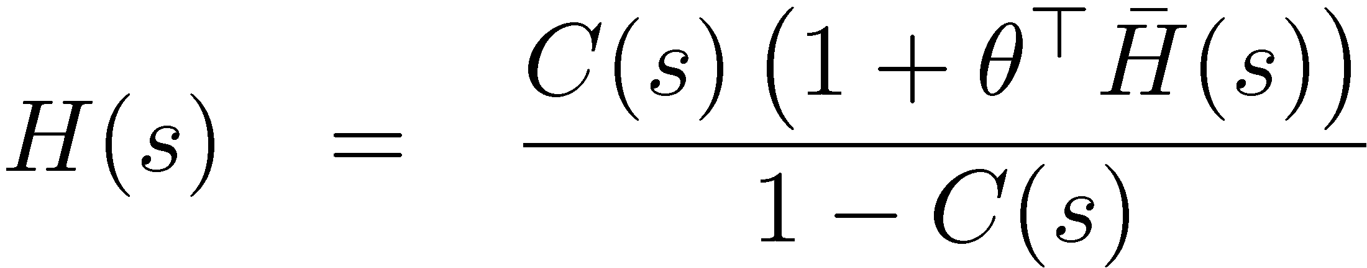
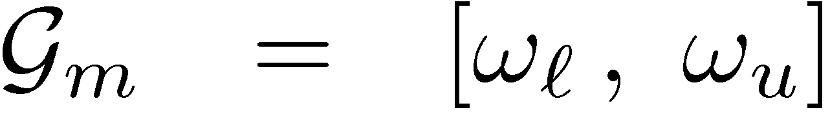
Time-Delay Margin and Gain Margin
Time-delay margin:
Gain margin:
×
Point Time-delay occurs
Plant
Lower bound for the time-delay margin
where
Projection defines
the gain margin

Slide 61
Application of general theory to a simple system
Simplest problem:
Theoretical results:

Slide 62
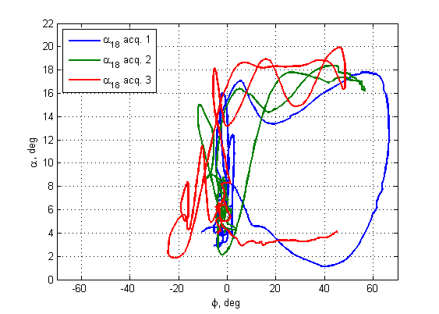
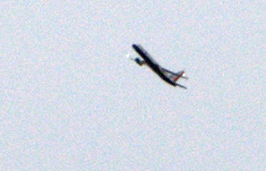
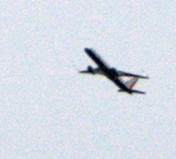








L1 Adaptive FCL – Post-stall, High AOA Flight
  Open-loop aircraft tends to aggressively roll off between 13deg and 15deg AOA and exhibits significant degradation in pitch stability
  L1 controller significantly improved pilot’s ability to fly the aircraft at high angles of attack and decreased his workload
  Robust to control deflection saturation
Stick to surface
Normal flight
FQ Level I A/C
Aggressive roll off
Bank exceeds 45deg
All 3 stick-to-surface attempts to reach and maintain controlled flight at AOA=18deg violated φ< 45 deg
L1 AFCS
Repeatable results
Two AOA=18deg acquisitions
with L1 AFCS

Slide 63
L1 Supports Large Flight Envelope Modeling
FLIGHTS 54, 55, 58
AOA Stall

