Slide 1
Study of DC motor and its speed control by pulse width modulation (PWM)
Guided By:
S. Joseph Winston
SO/G
&
Joel Jose
SO/D
RHS/RIRD/MMG
Indira Gandhi Centre for Atomic Research, Kalpakkam, Tamil Nadu-603102, India
Govt. of India
Submitted By:
Anand Kumar Singh
B.Tech 2nd Year/IV Sem
Department of Electrical Engineering
Enrollment No. 1413564
Giani Zail Singh Campus College Of Engineering & Technology
Punjab Technical University (PTU)
Govt. of Punjab

Slide 2
Outlook
Objective
Introduction to DC Motor
Why Speed Control
Literature survey
PWM
Speed Control by PWM
Comparison
Conclusion

Slide 3
Objective
Study of DC motor
Operating principle
Speed control of DC motor by pulse width modulation (PWM)

Slide 4
Introduction to DC motor
A motor is a class of electrical machines that converts electrical power to mechanical power
A DC motor uses direct current for conversion of electrical energy to mechanical energy
It is also known as Permanent magnet direct current (PMDC) machine
Stator consist of a pair of fixed permanent magnets producing a uniform and stationary magnetic flux inside the motor and hence the name of “permanent-magnet direct-current” (PMDC) motors

Slide 5
Operating principle of DC motor
When a current carrying conductor is placed in a magnetic field it experiences a force/torque and has a tendency to move
This is known as motoring action
The magnitude of the force is given by F=ilB
B:magnetic field, i:current,l:length of conductor
If the direction of current in the wire is reversed, the direction of rotation also reverses
When magnetic field and electric field interact they produce a mechanical force

Slide 6
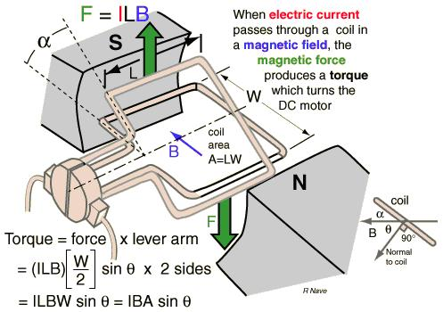
Operating principle of dc motor by graphical method

Slide 7
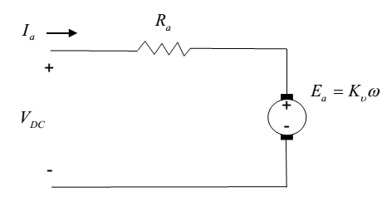
Equivalent circuit diagram of DC motor
The equivalent circuit diagram of dc motor
The mathematical expression of voltage is given by:
V_{dc} = I_{a}R_{a}+ E_{a} (Using KVL)
Ia: armature current
Ra: armature resistance
Vdc: dc supply voltage
Ea : back emf
E_{a} /E_{b} is back emf

Slide 8
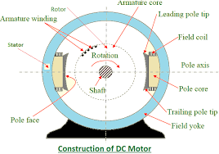
Construction of DC Motor
Every DC motor consist of 6 parts
Stator, field magnet, Rotor, Commutator, Field windings, Brushes

Slide 9
Why speed control of DC Motor is necessary
The speed of the motor should never be more than rated speed
Textile industries require a variable speed for their operation
Therefore it is necessary to control the speed of the motor by changing the magnetic flux

Slide 10
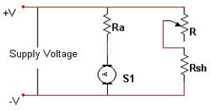
Literature survey
From the literature survey it has been found that speed of a DC motor can be controlled by:
1. FLUX CONTROL:
Magnetic field depends upon current flowing through the field winding
B α I
And flux varies with field current
ф α I
Current can be varied by introducing a series resistance with field winding
I α 1/R
Speed (N) α 1/ ф
Demerit: Only speed above base speed can be controlled

Slide 11
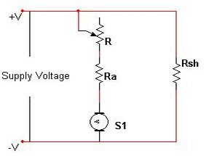
2. ARMATURE VOLTAGE CONTROL
Insert a variable resistor (R) in series with the armature
When resistance (R) is gradually increased, the voltage across the armature decreases
and we know that
Speed of DC motor is proportional to voltage drop across the armature
N α V (N=K(V-I_{a}R_{a})/ф)
Hence, the Speed of a DC motor also decreases
Demerit: Huge power loss due to extra resistance

Slide 12
3. SUPPLY VOLTAGE CONTROL
Pulse Width Modulation (PWM)
Both the above mentioned methods cannot provide speed control in the desirable range
Whereas the armature control method involves huge power loss due to its usage of resistor in series with the armature
Therefore, a different method is often desirable – the one that controls the supply voltage to control the motor speed is PWM
Merit: Effective speed control in desired range

Slide 13
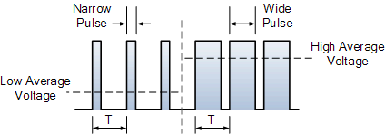
Pulse Width Modulation (PWM)
This is an effective method to control the o/p voltage with constant frequency
This is a modulation of pulses by varying the duty cycle
Duty cycle (α) is a ratio of T_{on} /(T_{on} +T_{off} )
The width of pulses (T) determines the amount of avg. voltage applied to motor terminals.
Height of pulse gives Average voltage

Slide 14
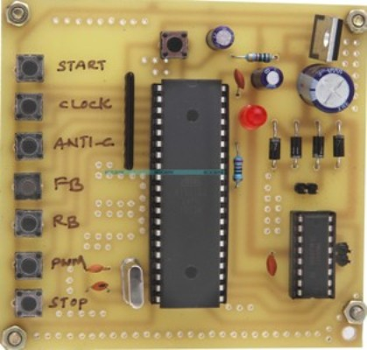
PWM generation
There are two ways to generate pulse width modulation with variable duty cycle
Using analog electronics
(operational amplifier, comparator and saw tooth generator)
Using digital electronics
(microprocessor and dedicated PWM controller)
Practical circuit

Slide 15
Speed Control by PWM
Pulse Width Modulation (PWM) is a method for binary signals generation
It has 2 signal periods (high and low).
The width (W) of each pulse varies between 0 and the period (T).
The main principle is control of power by varying the duty cycle.
The average voltage at output is given by
V_{a} = α V_{max}
Where, α= T_{on} /(T_{on} +T_{Off} )
T_{ON} =Time period for Pulse ON,T_{OFF} =Time period for Pulse OFF

Slide 16
Benefit of Pulse Width Modulation (PWM)
Power efficiency : The power efficiency is very high
Speed control behaviour : A precise speed control is achieved
Control circuit: Since it uses electronic components it is compact
Harmonics: It reduces the harmonics of output

Slide 17
Comparison of flux control, armature control & pulse width modulation(PWM)
PARAMETERS | FLUX CONTROL METHOD | ARMATURE CONTROL METHOD | PULSE WIDTH MODULATION
POWER EFFICENCY | Good | High power loss | The power efficiency is high
SPEED CONTROL BEHAVIOUR | Only speed above base speed can be controlled | Speed control is possible | A precise speed control is achieved
CONTROL CIRCUIT | Very large | Very large | Since it uses electronic ckt.,it is compact
HARMONICS | No harmonics | No harmonics | It reduces the harmonics of output

Slide 18
Conclusion
A detailed study of DC motor has been done
Speed control of DC motor has been done by different types of speed control methods
Among these PWM wins the race
Precise control of dc motor speed can be achieved

Slide 19
THIS PROJECT IS DEDICATED TO MY GUIDE
S.Joseph Winston Joel Jose
SO/G SO/D

Slide 20
Thank you

