Slide 1
Optical Amplifiers
By: Ryan Galloway

Slide 2
The Goal
Amplify a signal.
Generate extremely high peak powers in ultrashort pulses
Amplify weak signals before photo detection to reduce noise
Regenerate signals in long distance optical communication

Slide 3
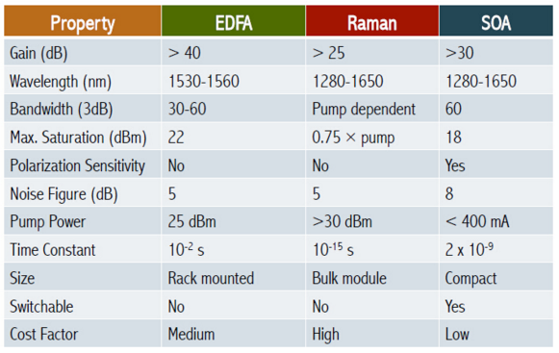
General Types
Doped fiber amplifiers
EDFA, TDFA, YDFA, PDFA
Semiconductor Optical Amplifiers (SOA)
Tapered Amplifiers
BoosTA
Vertical Cavity SOA
Raman Amplifier
Chirped Pulse Amplification

Slide 4
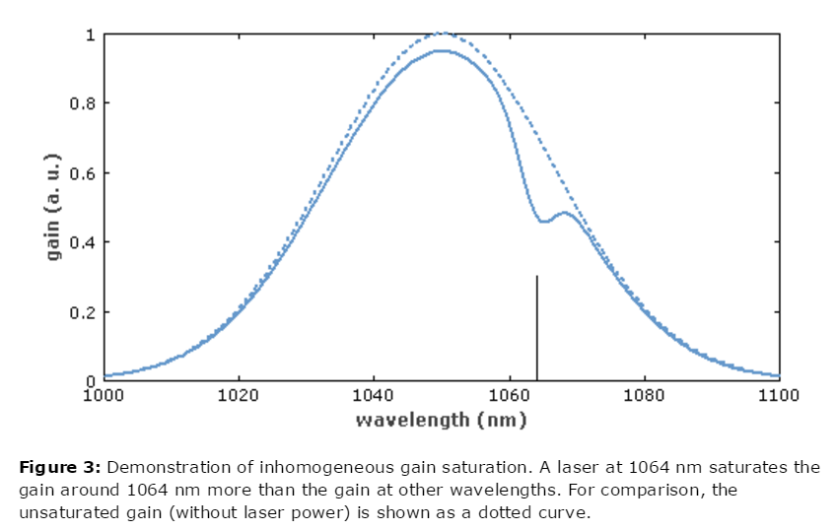
Parameters to keep in mind
Maximum gain in dB
Gain Saturation
Saturation power and gain efficiency
Power efficiency
Upper state lifetime
Gain bandwidth
Noise
Sensitivity to back reflections

Slide 5
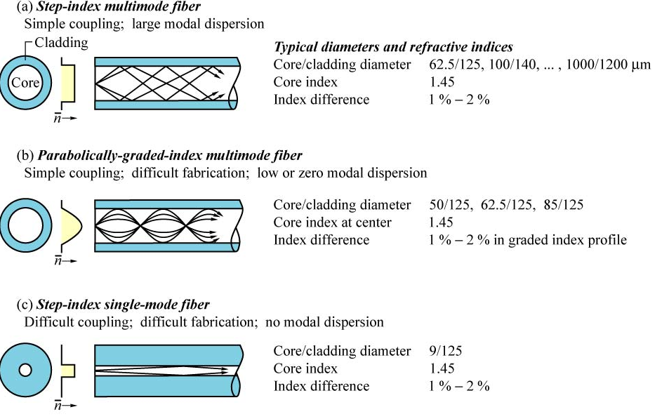
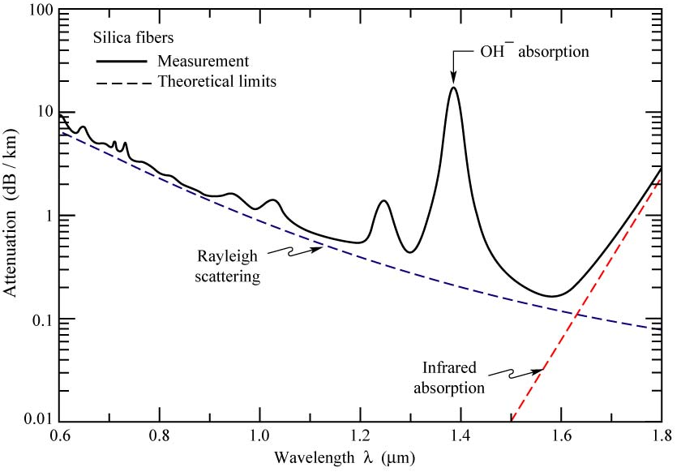
Doped Fiber Background Info
Driven by the Telecom Industry

Slide 6
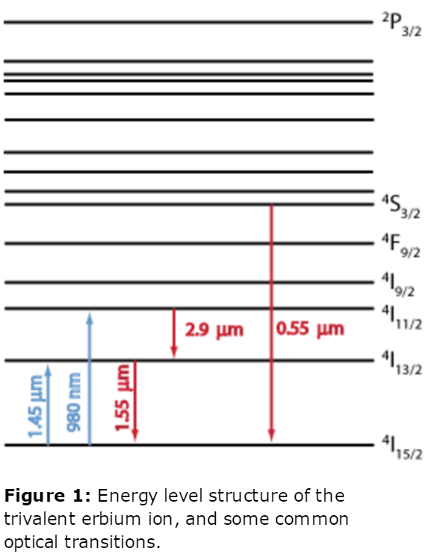
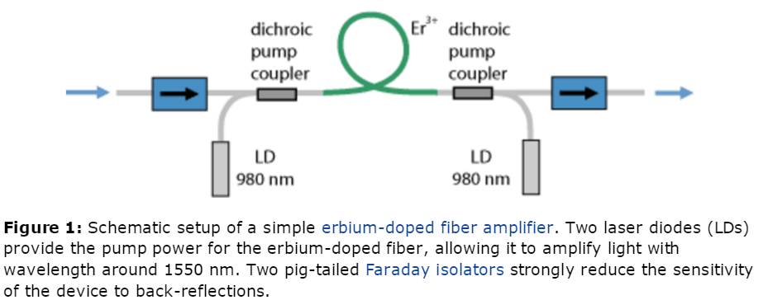
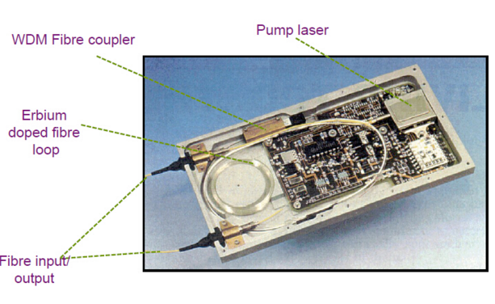
Erbium Doped Fiber Amplifier
Erbium is pumped with 980nm(for low noise) or 1.45um (higher power)
Gain in the 1550nm region
Stimulated emission of erbium ions, at signal wavelength
~30nm gain spectrum due to broadening mechanisms
Pump beam and signal must be at different wavelengths
Optical isolators are used at the output, the EDFA is a high gain amplifier

Slide 7
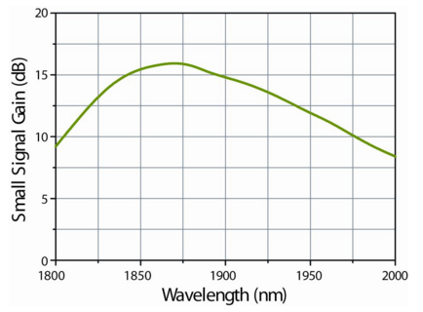
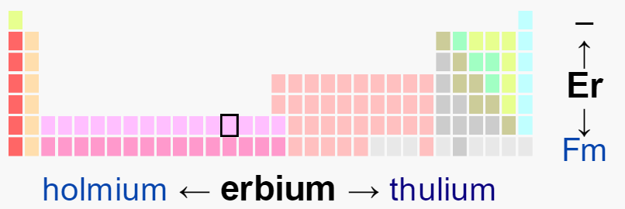
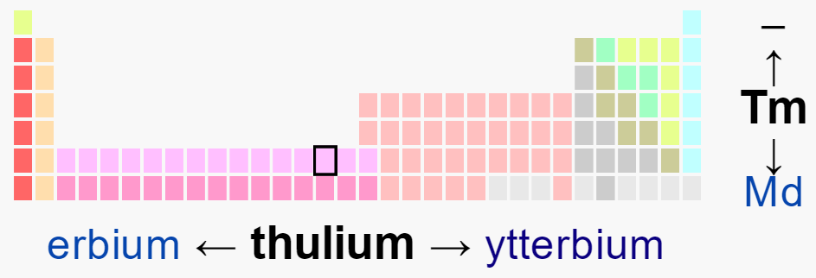
Other Rare Earth Amplifiers
Same principle as EDFA
Thulium doped fluoride fiber amplifiers (TDFA)
Pumped at 1047 or 1400nm
1460-1530nm or 1800-2000nm range
Praseodymium doped amplifiers
1300nm range
Ytterbium doped amplifiers
1um range
Used for industrial processing with very high output power

Slide 8
Design Issues with Doped Fibers
Nonlinear effects:
Kerr Effect:
Change in effective index of refraction from high intensity light
Raman gain via Stokes wave generation
Stimulated Brillouin scattering
Losses when no pump beam is present
Doping concentration and quenching

Slide 9
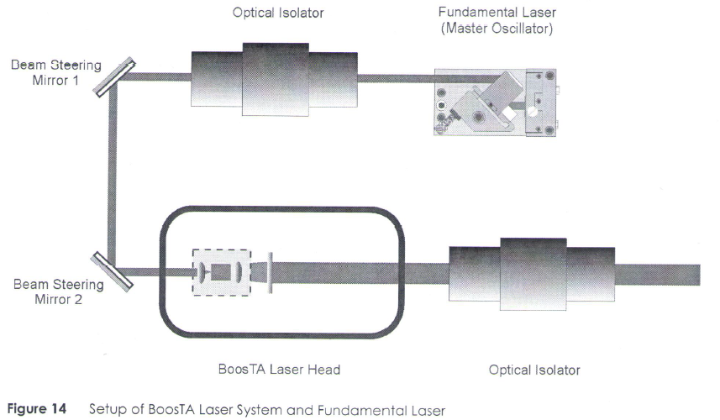
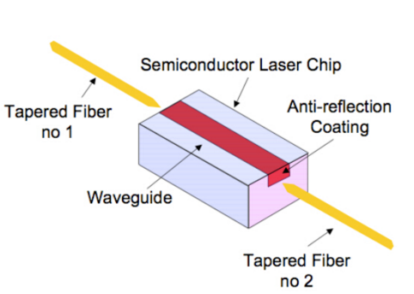
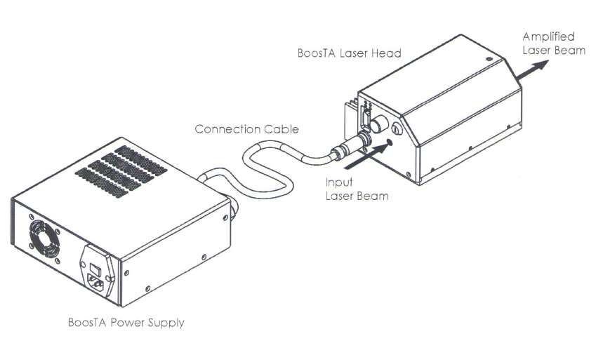
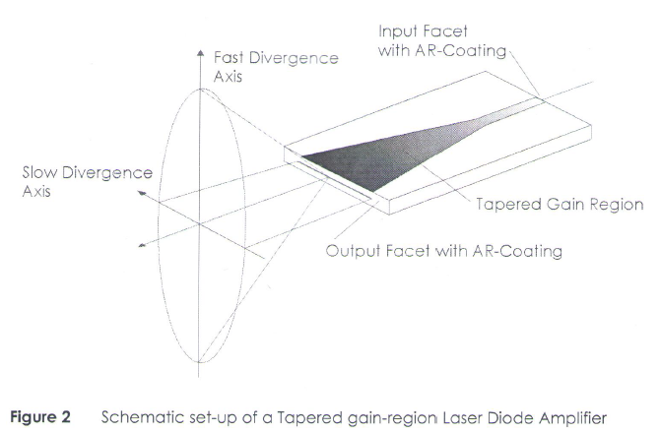
Semiconductor Amplifiers
Specs:
wavelength range: 633 to 1480 nm
input power: 10 to 50 mW
output power: up to 3 Watt ~30dB gain
Tunable +/- 20nm
~nanosecond upper state lifetime
Fast response to pump
Typically from group III-V
Advantages:
Smaller and Less expensive than EDFA
Electrically pumped
High optical Nonlinearity
Attractive for signal processing
Can create all four nonlinear operations
cross gain modulation
cross phase modulation
wavelength conversion
four wave mixing

Slide 10
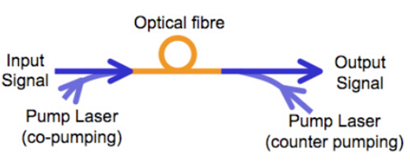
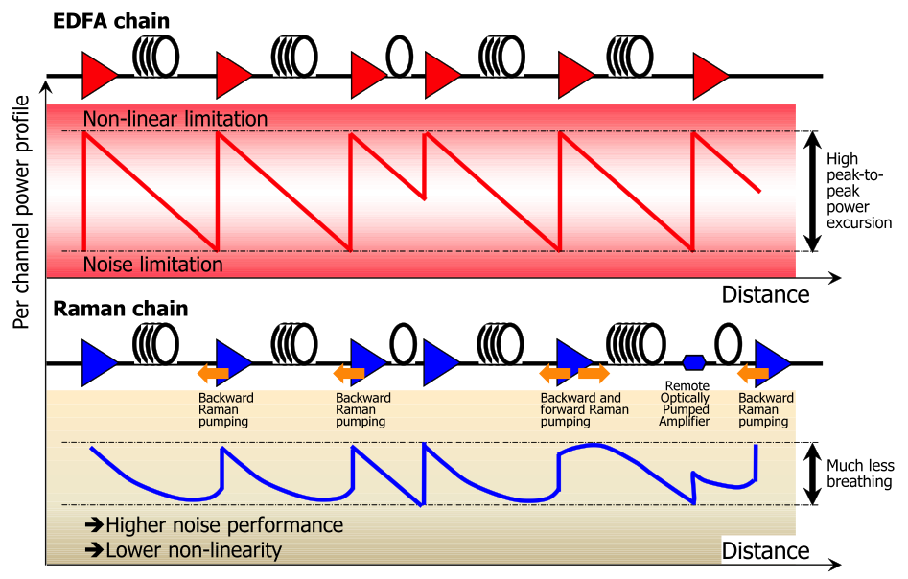
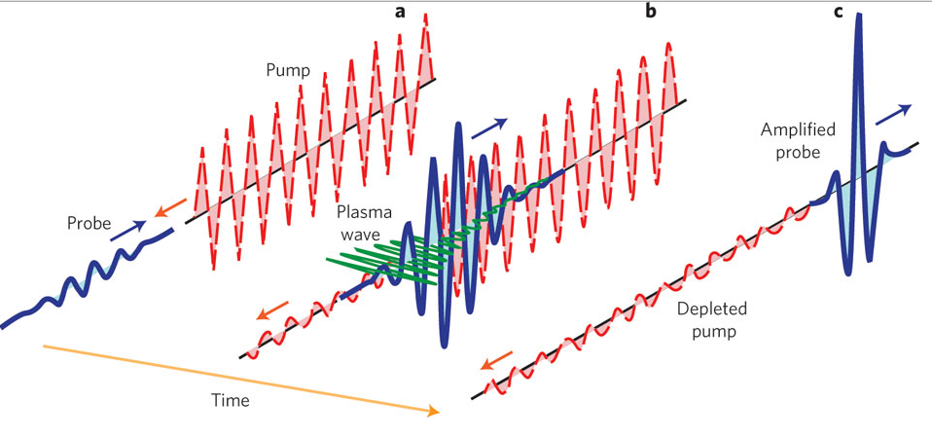
Raman Amplifiers
Most of the time photons scatter elastically (Rayliegh Scattering)
Some photons will scatter inelastically and lose energy
Working Principles:
Nonlinear process: Stimulated Raman Scattering
Incident photon excites electron to virtual state
Electron de-excites down to the vibrational state
Advantages
Any single mode fiber can be used
Lower cross talk between signals
Very broadband operation
Disadvantages
High optical pump power
Low Gain ~ 10 dB
Long length of fiber required

Slide 11
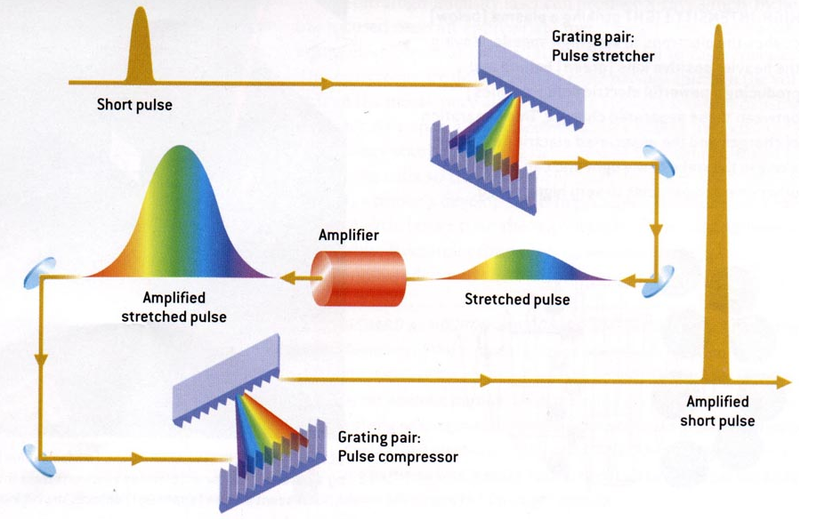
Chirped Pulse Amplification
How does one make extremely intense ultrashort pulses without any nonlinear distortion or damage to equipment?
Make a short pulse, spread it out, amplify it, compress it.

Slide 12
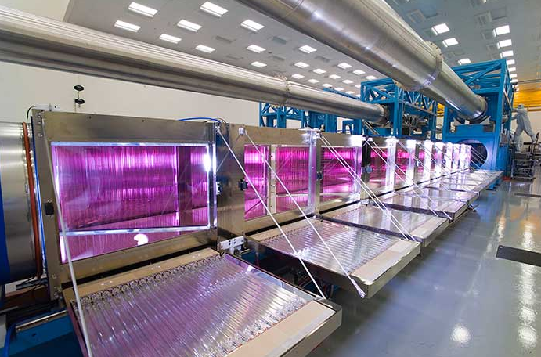
National Ignition Facility
192 beams with .4 meter diameter focused in an attempt to create fusion.
https://www.youtube.com/watch?v=4Cb7iqaN91c

Slide 13
Bibliography
Ultra-intense lasers: Beyond a petawatt, http://www.nature.com/nphys/journal/v7/n1/full/nphys1897.html
http://www.ecse.rpi.edu/~schubert/Light-Emitting-Diodes-dot-org/chap22/chap22.htm
R. Paschotta, article on 'fiber amplifiers' in the Encyclopedia of Laser Physics and Technology, accessed on 2015-10-08
R. Paschotta, article on 'Raman scattering' in the Encyclopedia of Laser Physics and Technology, accessed on 2015-10-08
https://en.wikipedia.org/wiki/Chirped_pulse_amplification
https://en.wikipedia.org/wiki/Optical_amplifier#Laser_amplifiers
http://www.fiber-optic-tutorial.com/comparison-of-different-optical-amplifiers.html
https://lasers.llnl.gov/about/how-nif-works/beamline/amplifiers
http://www.hanel-photonics.com/tapered_amplifier.html
R. Paschotta, article on 'amplifiers' in the Encyclopedia of Laser Physics and Technology, 1. edition October 2008, Wiley-VCH, ISBN 978-3-527-40828-3

