Slide 1
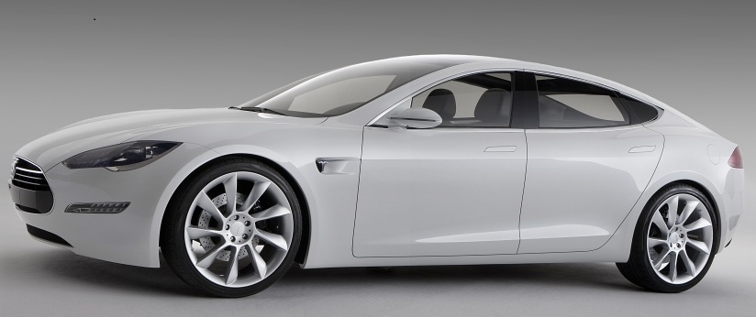
How Electric Vehicles Can Improve Your Transportation, Cut Your Costs, Benefit the Nation, and Help Save The Planet
Tesla “S” EV:

Slide 2
Why Are EVs So Good?
EVs are far more efficient than gas engine vehicles: typically 75% battery-to-wheels versus 20% for gas tank-to-wheels. (Ref)
EVs require much less maintenance and have potentially much longer lives (far fewer moving parts , and all parts are sealed off from dirt and moisture) than gas engine vehicles thus greatly reducing turnover and energy and material consumption. (Ref)
EVs can get their energy from a wide variety of sources, from sunlight to sewage, including clean renewable energy, thus reducing shortages, costs, and impacts
4 EVs can be scaled down without loss of efficiency or desirable characteristics thus making smaller vehicles more practical where circumstances allow.

Slide 3
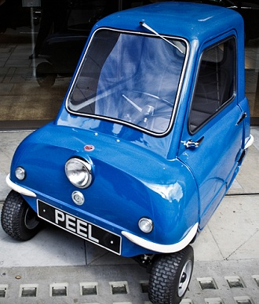
Small Gas Vehicles: Very Inefficient!
What happens when you downsize a gas car? Consider the Peel P50 (Ref), a one passenger gas car that weighs 130 lbs, 20 times smaller than a Toyota Prius, but at 83 mpg, less than twice the efficiency!
But a small 2-person 200 lb weatherproof electric micro car would
get the equivalent of 600 mpg.

Slide 4
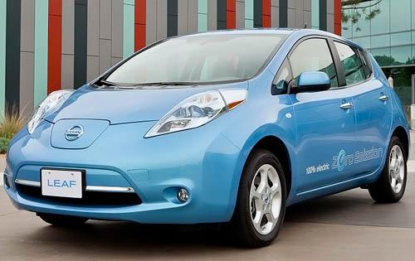
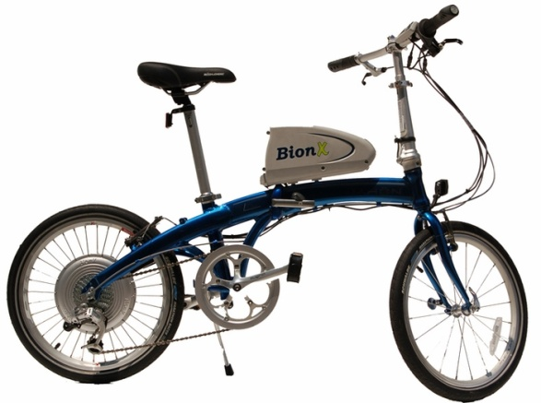
EVs You Can Buy This Year
Tesla S: large, 7-passenger, high
performance (0-60 in 5.6 sec), luxury
sedan for $50,000-$70,000: up to
300 mile range (Ref)
Nissan Leaf: 5-passenger, good
performance (90 mph) hatchback
for $35,200 minus $7,500 tax credit:
60-100 mile range (Ref)
Dahon/BIONX: lightweight, 44 lb.,
folding, excellent hill climbing
electric bike, for $2750: 20 mile
Range) (Ref)

Slide 5
Buying an Electric Car
New electric cars are equal or superior to gas engine cars in nearly every way except for initial cost, range, and charging time.
The initial cost is high: $35,200 (minus a $7500 tax credit) for the Nissan Leaf, which is equivalent to a $24,000 gas engine car in performance, safety, comfort, etc.
But direct operating cost is very low: 5 ½ cents/mile (Ref) versus 18 cents/mile for a gas engine car (Ref). At 12,000 miles/year, you save $1500 /year
So payback can be very fast: 2 ½ years if you get the full tax credit

Slide 6
Why the Initial High Cost? It’s the Battery, Stupid!
The battery is the only reason for the high initial cost of an EV, but we can significantly reduce its cost in the near future:
The 1st generation of EVs are built on gas engine platforms and are not very streamlined, but 2nd generation EVs will be much more so, allowing longer ranges or smaller batteries
The cost of Lithium batteries has been declining at 7.5% per year (Ref) and will likely do so for a few more years
Batteries will last much longer: the Toshiba SCiB Lithium battery (Ref) will power the EV version of the Honda FIT this Summer (2012) and should last 20+ years and 250,000-300,000 miles

Slide 7
Right Now, Ranges are Rather Limited
The range of an EV is limited right now mainly by the cost of the battery. For the Nissan Leaf it is about 90 miles at city speeds (mostly less than 45 mph), without heating or air conditioning.
But heating, air conditioning, and freeway speed can cut this to 60-70 miles (however, there are near term solutions to providing heat in cold weather without reducing range).
Given that 95% all round trips, and 95% of all round trips specifically for commuting to work, are less than 80 miles (Ref), a car like the Nissan Leaf should handle 90% of all trips that Americans make in their cars.

Slide 8
But Fairly Soon, Range Will Be Better
Many people assume that an EV needs a range of over 300 miles to make long trips. But if these three elements are present:
A realistic freeway range of 150 miles
A battery that can be recharged to 95% in less than 20 minutes (note: the aforementioned Toshiba SCiB battery can do this now: 95% charge in 18 minutes) (Ref))
High speed charging stations every 50 miles or so on major roads,
then 500 mile trips are practical. It only takes three 20 minute stops, roughly every 125 miles, to make a 500 mile journey. You would have to stop at least once in a gas engine car for the same trip, and more if you have kids or get tired.

Slide 9
How Efficient Are EVs?
Lets compare the efficiency of EVs vs gas engine cars based on 12,000 miles/yr driving. And lets use a single standard measure for efficiency: kilowatt-hour (kWh) where 1 kW = 1.3 HP (an average house consumes 11,000 kWh energy/yr).
The average car consumes about 18,000 kWh/yr, given 25 mpg at 12,000 miles (Ref).
But at 4 miles/kWh (such as the Honda FIT EV), an EV only directly consumes about 3000 kWh/yr, at 12,000 miles.
If you get your electricity from the grid, whose overall efficiency is about 20% (Ref), then the overall efficiency is not as good, but at 15,000 kWh it is still better than 18,000 kWh for gas engine cars.
But if you get your power from a solar panel on your roof, the losses are much less (Ref), and your EV uses only 4000 kWh/yr, or less than ¼ of the energy of a gas engine car.

Slide 10
Don’t EVs Just Shift the Pollution?
Surely, electricity from a coal plant can’t be very clean!
But, nationwide we only get 45% of our electricity from coal and an average EV is 40% cleaner than a gas engine car
The electrical grid is getting cleaner all the time and EVs will get more efficient
Getting your electricity from a ~4kW solar panel on your roof ($25,000 in Seattle or $13,000 w/ subsidies (Ref)), would power you car for the next 30-40 years and is the ultimate in clean (gasoline would cost ~$70,000 over 30 years).

Slide 11
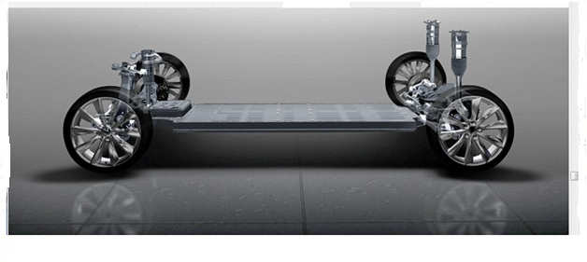
There is More to an EV Than No Gas
We have talked about EVs in terms of energy, cost, and the environment, but what if an EV is also a greatly superior vehicle? Look at the internals of the Tesla S below:
Note the flat battery box. In the near future, many cars will have
the motors inside the wheels, yielding an even simpler drive train
(no drive shaft, differential, CV boots, etc) that takes up virtually
no space in the car, with much better stability, handling, and
4 wheel drive with a vengeance.

Slide 12
But What If I Only Have One Car?
In the fairly near future, electric cars will be capable of long trips, but for now range is limited. If you only have one car here are some options:
Rental cars, such as ZIP cars, might suffice if you only have occasional need for long trips
Plug-in hybrids, such as the Chevy Volt (available now), or the plug-in versions of the Toyota Prius or the Ford Max-C Energi, both of which are available later this year (2012), offer partial electric driving and provide efficiencies of 80-200 mpg.

Slide 13
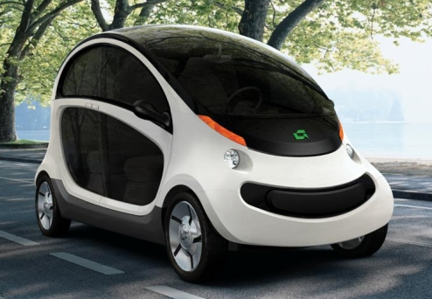
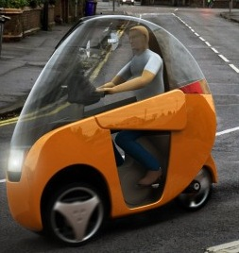
But, Electric Cars are Not the Only Type of EV
Sure, electric cars will largely solve our oil problems, and reduce our energy needs, and help the environment, but what about traffic congestion, parking fees, land use, and material shortages?
Earlier we noted that EVs downsize very nicely, unlike gas engine vehicles. There are a number of proposed micro cars that should get about 15-20 miles/kWh (4-5 times better than electric cars), and are 5-15 times smaller and lighter than cars. Here are some examples, but none are yet in production:
Gem-Peapod,
(Ref)

Slide 14
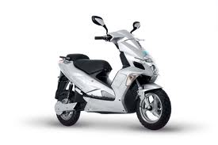
However, Electric Scooters Are Here Now
For between $2900 and $4000 you can buy electric scooters that travel 30 mph with ranges of 20-60 miles that get 12-15 miles/kWh, and are 15-20 times smaller and lighter than cars.
Helium Evolve: $2900
(Ref)
BOXX scooter: $4000,
35 mph, 30-60 mile range
(Ref)

Slide 15
But for Small Size, Cost, Efficiency, and Fun, You Can’t Beat an E-bike !
Conventional bikes may never play a major role in transportation; the barriers are too high. But E-bikes are different:
On the one hand, they overcome the problems of hills, headwinds, sweat, fatigue, age, infirmity, headaches, etc
On the other hand, they operate almost entirely within the same physical and legal domains of regular bikes: the same or similar in size, appearance, usage, noise, speed, legal requirements, parking, etc.
The main difference is that they are 15-25 lbs heavier

Slide 16
And E-bikes Are Very Efficient and Safe
E-bikes, which typically cost between $1000 and $3000, are very efficient (50-100 less energy than a gas engine car), run at speeds of 15-20 mph, and ranges of 20 miles, and are safer than conventional bikes:
You ride straight up steep hills with no wavering
You can press the throttle to escape from a jam
You can ride fully upright, improving your own visibility, and making yourself more visible to others
You are no longer forced to conserve momentum and so are not tempted to blow through stop signs or stoplights

Slide 17
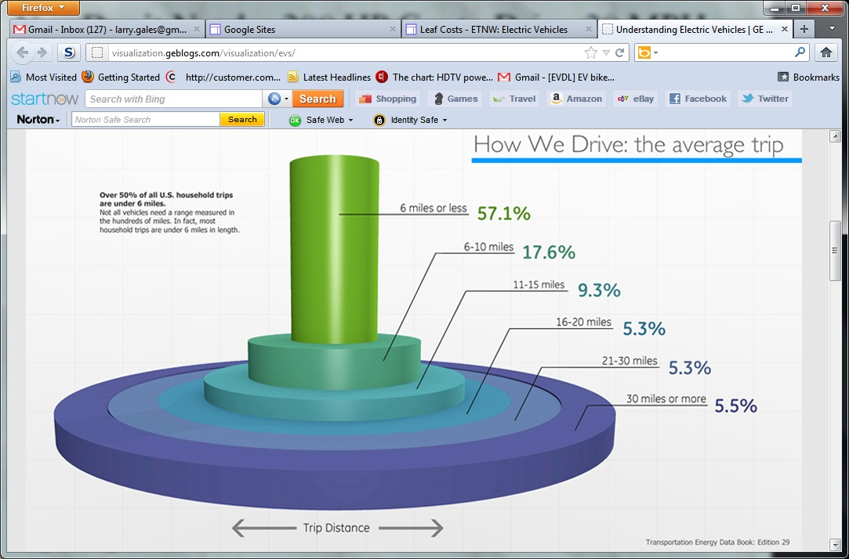
You Don’t Always Need 200 HP to Drive 20 Miles
Below is a part is a graphic (for the full one see Ref) that
shows just how far most people drive per day. You can see that
nearly 75% of trips are within E-bike range, nearly 90% are
within E-scooter range, and 95% are in Nissan Leaf range

Slide 18
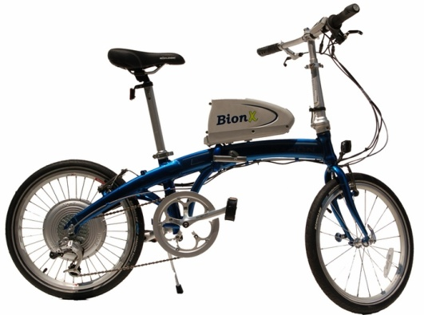
One Size Need Not Fit All
Because EVs downsize so nicely, instead of using one large vehicle for everything, consider a 40-40-20 split: 40% of the time we use an electric car, 40% a micro EV or E-scooter, and 20% an E-bike.
We not only cut our energy consumption in half, but we address a whole host of other problems such as noise, parking, traffic congestion, land use, and energy and material shortages.

Slide 19
Conclusion
Electric cars and bicycles are available now, and attractive micro cars may be available soon. Buying and using an EV is one of the best things you can do to wean us off fossil fuels, benefit the nation, and preserve the environment.

Slide 20
Links to More Information
EVs save even if gas engine cars become much more efficient (Ref)
Solar panels and EVs are a perfect match, even in the Seattle area (Ref)
EVs offer much more than the elimination of gasoline (Ref)
EVs can become much more efficient than they are today (Ref)

