Slide 1
Adaptation of Electric Vehicles into Society: What Needs To Happen?
By Julian Shockley, Marcus Spring, and David Levine

Slide 2
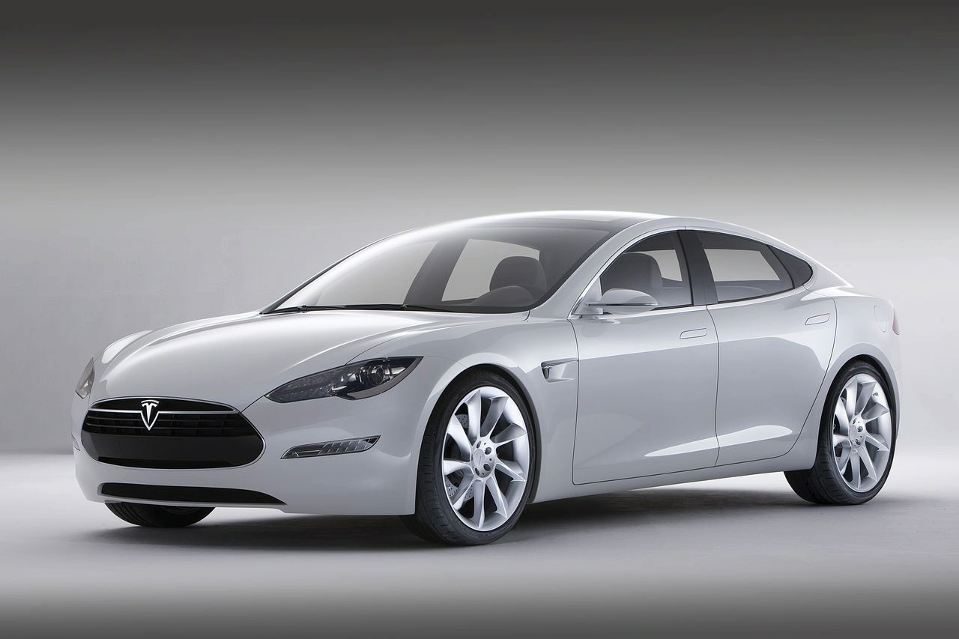
Background of Electric Vehicles
What are they?
Vehicles that are powered by electricity!
Why are they important?
Help reduce greenhouse gas emissions.
Crucial to improving issues pertaining to global warming.
Reduce dependency on nonrenewable energy sources for transportation.
Autostream: http://www.autostream.org/2011/03/sales-tesla-model-s-started.html

Slide 3
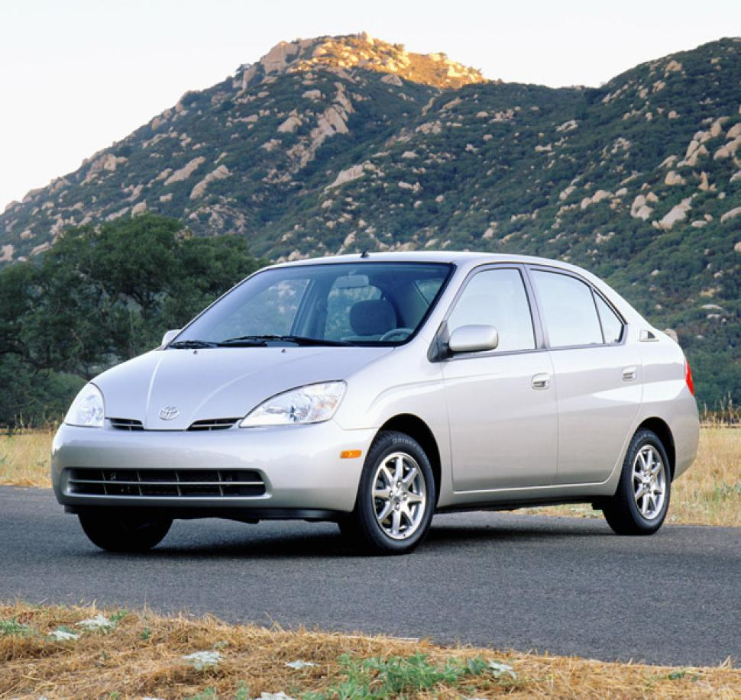
The History of Electric Vehicles
In 1889, the first electric vehicle was released in the U.S.¹
In 1908, the Model T release caused a decline in sales.¹
In 1997, Toyota releases first mass produced hybrid—Toyota Prius.¹
In 2006, Tesla motors announces the production of an electric vehicle that can travel over 200 miles.¹
NY Daily News
http://www.nydailynews.com/autos/toyota-prius-turns-16-hot-hybrid-changed-years-article-1.1385087#
Matulka, R. (2014, September 15). Timeline: History of the Electric Car. Retrieved October 5, 2015, from http://energy.gov/articles/history-electric-car

Slide 4
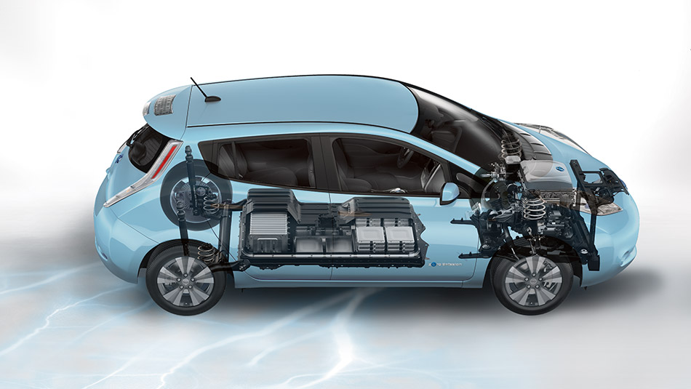
The History of Electric Vehicles (cont.)
During 2009-2013, the department of Energy starts developing EV infrastructure.¹
In 2010, the Nissan Leaf was released.¹
In 2013, the cost of batteries dropped 50% over four years.¹
Nissan:
http://www.nissanusa.com/content/dam/nissan/vehicles/2015/leaf/colors-photos/exterior-photos/005-large.jpg
Matulka, R. (2014, September 15). Timeline: History of the Electric Car. Retrieved October 5, 2015, from http://energy.gov/articles/history-electric-car

Slide 5
Challenges of implementing electric cars into society
Charging Infrastructure:
Who will invest?
How do you avoid monopolies?
Utilities in California are attempting to create this infrastructure.²
Range Anxiety:
Electric Vehicle range is too constrictive.
How can we improve range?
Is range anxiety a real concern?
Exceptional use vs. average use: do you need a vehicle for every situation?³
Reve:
http://www.evwind.es/wp-content/uploads/2012/08/ev-charger-672x372.jpg
2. N.A. (2015). Who Should Invest In Electric Vehicles' Charging Infrastructure? The Electricity Journal, 28(3), 3-6. doi: 10.1016/j.tej.2015.03.013
3. Murray, C. (2013). Is range anxiety real? The answer depends on whether you need a car for average use or exceptional use. Design News, 68(18), 20-20. Retrieved from http://go.galegroup.com/ps/i.do?id=GALE%7CA368956782&v=2.1&u=colu44332&it=r&p=AONE&sw=w&asid=646e35454f0ccd4b3640ab7903ec64c6

Slide 6
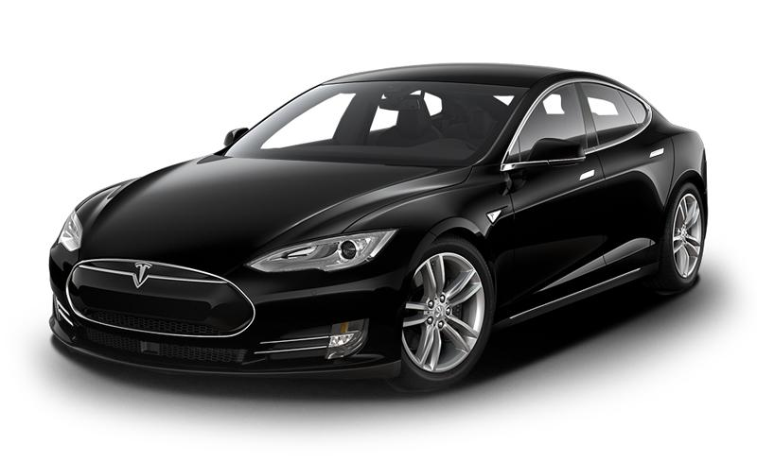
Challenges of implementing electric cars into society (cont.)
Vehicle Popularity:
What types of consumers buy these cars?
German study: five percent of participants would buy an electric car.⁴
If price or vehicle range was most important, a consumer was not likely to buy an electric car.⁴
Car and driver:
http://www.caranddriver.com/photo-gallery/2015-tesla-model-s-70d-instrumented-test-review
4. Lieven, T., Mühlmeier, S., Henkel, S., & Waller, J. (2011). Who will buy electric cars? An empirical study in Germany. Transportation Research Part D: Transport and Environment, 16(3), 236-243. doi: 10.1016/j.trd.2010.12.001

Slide 7
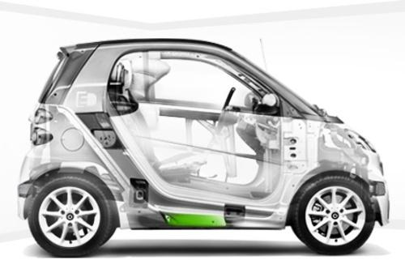
Expected Future Product Improvements
Battery Innovations:
Excess sulfur from gasoline can be used to make lighter, better batteries.⁵
Elemental sulfur can improve the battery cathode.⁵
Creates a longer lasting battery.⁵
Making the Car More Affordable
Decreasing the costs of the solar panels on the electric car.⁶
Improving the weight/mass of the car itself to improve gas mileage.⁵
Enabling faster battery charging times to make the vehicle less reliant on fossil fuels.⁶
Use less rare earth materials.⁵
Torque News:
http://www.torquenews.com/sites/default/files/image-1075/%5Btitle-raw%5D/skeletal.jpg
5. Gotcha, A. (2014, May 22). Lithium–sulfur batteries may drive electric cars into the mainstream. Retrieved October 8, 2015, from http://ceramics.org/ceramic-tech-today/video-lithium-sulfur-batteries-may-drive-electric-cars-into-the-mainstream
6. Fisher, R. (2015, August 11). Why are electric cars not becoming popular if they are superior to gasoline cars in every respect? Retrieved October 3, 2015, from https://www.quora.com/Why-are-electric-cars-not-becoming-popular-if-they-are-superior-to-gasoline-cars-in-every-respect

Slide 8
Questions?

