Slide 1
Lithium-ion batteries in PSOC operation
Jim McDowall
PE/SB Tech Sessions January 10, 2016

Slide 2
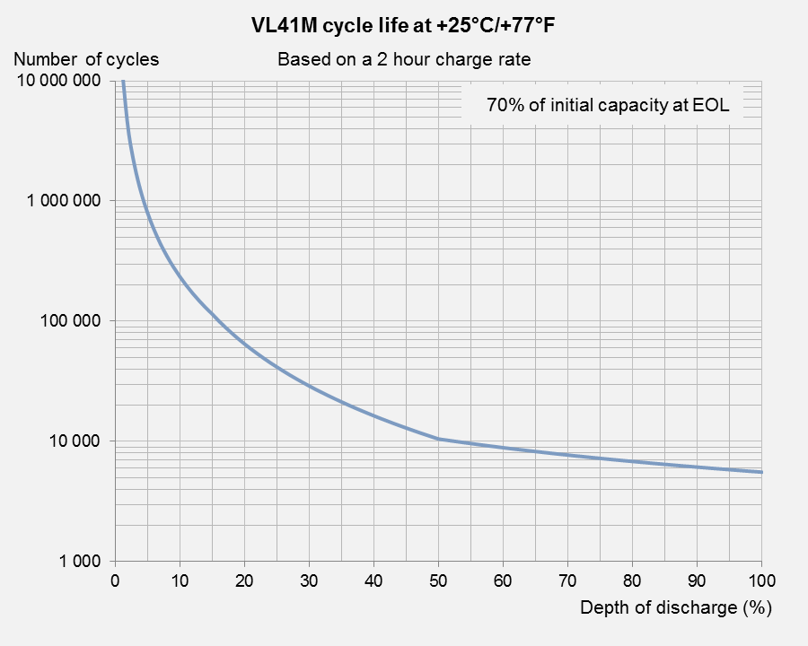
Cycle-life curves
1M cycles of 4% DOD
40,000 C throughput
7,500 cycles of 70% DOD
5,250 C throughput

Slide 3
Recap of Li-ion basics
Charge
e–
Discharge
e–
Oxygen
Charge
Lithium Ion
Metal Ion
Carbon
Discharge
Separator
SEI
POSITIVE
NEGATIVE

Slide 4
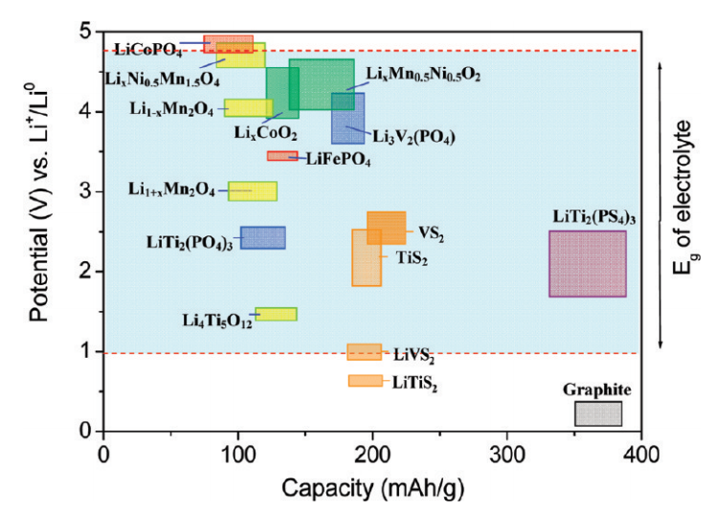
Li-ion technology choices
Family of electrochemical systems
Positive electrode
Metal-oxides (e.g. NMC, NCA)
Phosphates (e.g. LFP)
Negative electrode
Graphite & other carbons
Lithium-titanate

Slide 5
Li-ion technology choices
High cell
voltage
Low cell
voltage

Slide 6
Li-ion technology choices
No
SEI
Forms
SEI

Slide 7
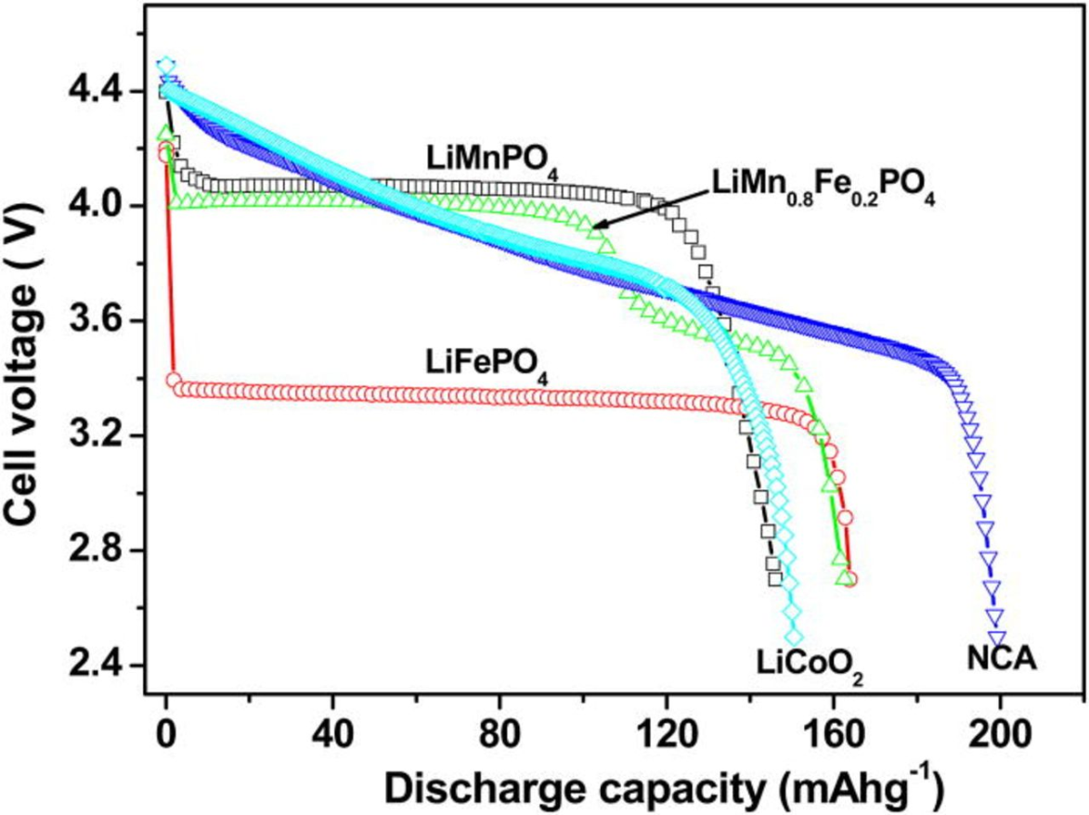
Li-ion technology choices
Height of block indicates ‘slope’
Technologies with ‘slope’
are easier to balance in PSOC operation

Slide 8
PSOC cycling application characteristics
Cell voltage (battery cost/kWh)
Slope of OCV vs SOC
Asymmetry of charge and discharge power (and whether it matters)
Power vs. energy considerations
Cycle life

Slide 9
Application analysis
PV ramp-rate control
PJM regulation signals

Slide 10
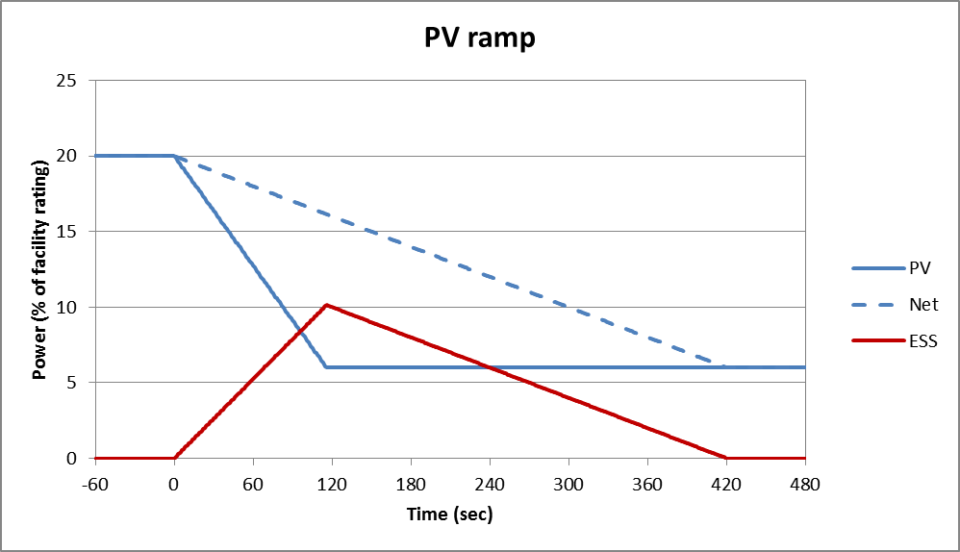
PV ramp-rate control
Anatomy of a ramp
PV grid-connection standards
Upward vs. downward ramps
Clipping of PV inverter output during upward ramps

Slide 11
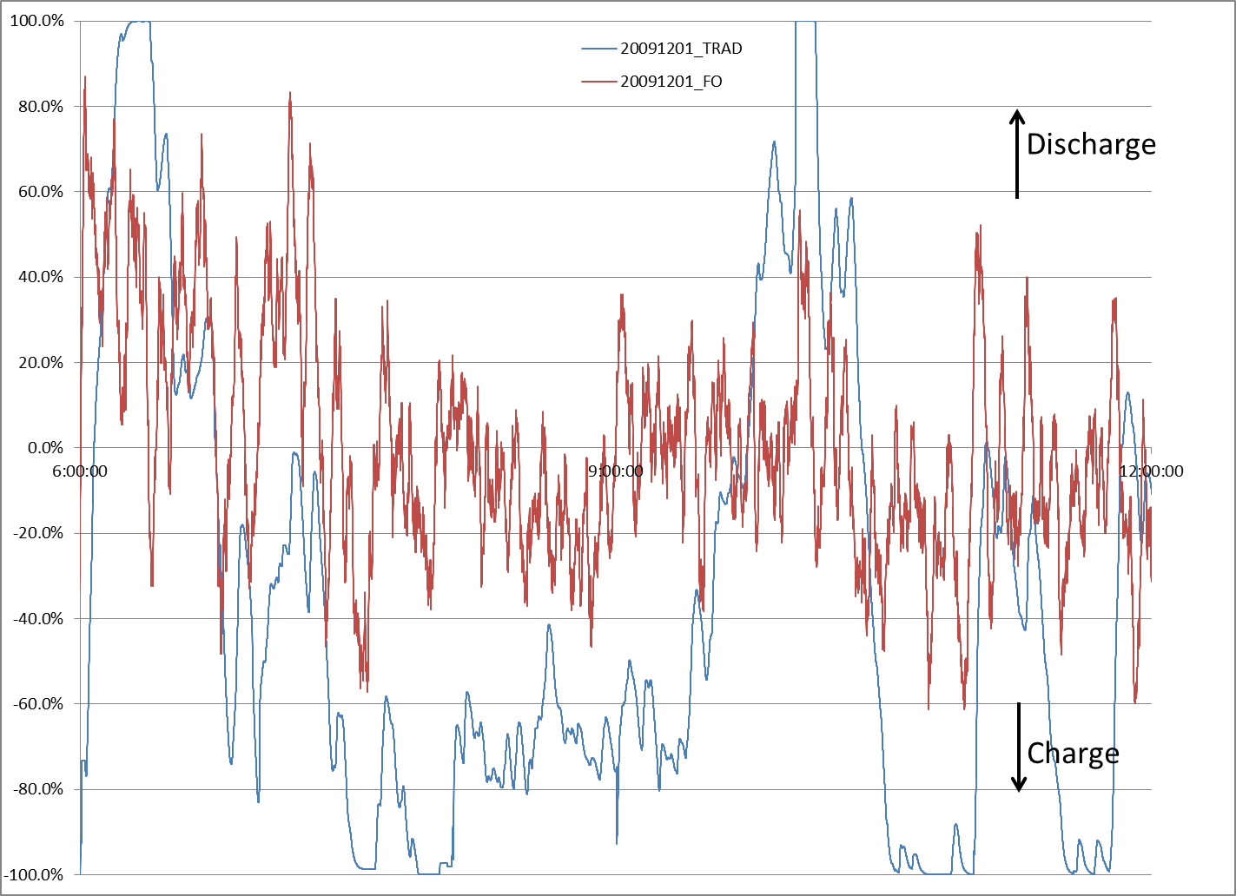
PJM regulation signals
Symmetrical operation!
RegD vs RegA
RegD fast & low energy
RegA slow & high energy
Reg purchases approx. 1% of load
<=40% RegD
ESS resources reaching saturation
Some grid events need more energy
New hybrid signal?
Fast & higher energy

Slide 12
Questions?
jim.mcdowall@saftbatteries.com

