Slide 1
Switching
Majid Asadpoor
Ref: Data Communication and Networking
by Behrouz A. Forouzan

Slide 2
Index
Circuit Switching
Packet switching (datagram switching)
Packet switching (virtual-circuit switching)
Structure of switch

Slide 3
Switching
how to connect Whenever we have multiple devices?
make a point-to-point connection between each pair of devices (a mesh topology) ?
make a connection between a central device and every other device (a star topology)?
impractical and wasteful when applied to very large networks.
The number and length of the links require too much infrastructure to be cost-efficient
the majority of those links would be idle most of the time.
A better solution is switching.
A switched network consists of a series of interlinked nodes, called switches creating temporary connections between two or more devices linked to the switch.

Slide 4
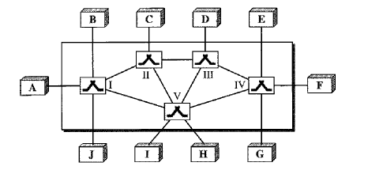
Switched Network
The end systems (communicating devices) are labeled A, B, C, D, and so on,
switches are labeled I, II, III, IV, and V

Slide 5
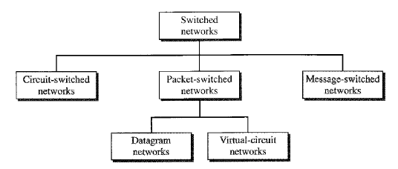
Switching Methods
Today the tendency in packet switching is to combine datagram networks and virtualcircuit networks.
Networks route the first packet based on the datagram addressing idea, but then create a virtual-circuit network for the rest of the packets coming from the same source and going to the same destination.

Slide 6
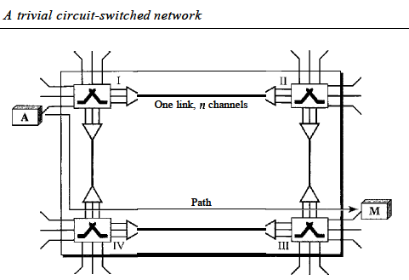
CIRCUIT-SWITCHED NETWORKS
each connection uses only one dedicated channel on each link. Each link is normally divided into n channels by using FDM or TDM

Slide 7
CIRCUIT-SWITCHED NETWORKS
Circuit switching takes place at the physical layer
Before starting communication, make a reservation for the resources ( Setup Phase )
resources, such as channels (bandwidth in FDM and time slots in TDM), switch buffers, switch processing time, …
Data transferred between the two stations are not packetized (physical layer transfer of the signal).
There is no addressing involved during data transfer. The switches route the data based on their occupied band (FDM) or time slot (TDM).
there is end-to-end addressing used during the setup phase

Slide 8
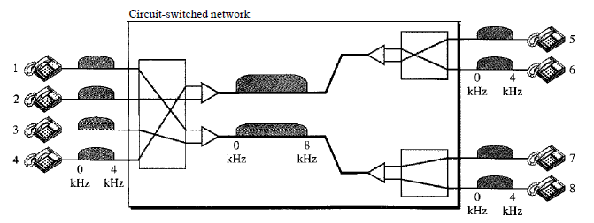
CIRCUIT-SWITCHED NETWORKS Example 1
Telephone 1 is connected to telephone 7; 2 to 5; 3 to 8; and 4 to 6
The situation may change when new connections are made

Slide 9
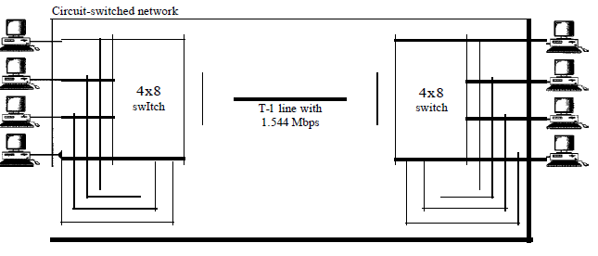
CIRCUIT-SWITCHED NETWORKS Example 2

Slide 10
CIRCUIT-SWITCHED NETWORKS
Setup Phase
Before the two parties can communicate, a dedicated circuit needs to be established.
connection setup means creating dedicated channels between the switches.
end-to-end addressing is required for creating a connection between two end systems. These can be, for example, the addresses of the computers assigned by the administrator in a TDM network, or telephone numbers in an FDM network.
Data Transfer Phase
After the establishment of the dedicated circuit (channels), the two parties can transfer data
Teardown Phase
When one of the parties needs to disconnect, a signal is sent to each switch to release the resources

Slide 11
CIRCUIT-SWITCHED NETWORKS
Efficiency
are not as efficient as the other two types of networks because resources are allocated during the entire duration of the connection and are unavailable to other connections.
Delay
the delay in this type of network is minimal

Slide 12
CIRCUIT-SWITCHED NETWORKS Delay
delay caused by the setup is the sum of four parts:
the propagation time of the source computer request (slope of the first gray box),
the request signal transfer time (height of the first gray box),
the propagation time of the acknowledgment from the destination computer (slope of the second gray box),
the signal transfer time of the acknowledgment (height of the second gray box).
The delay due to data transfer is the sum of two parts:
the propagation time (slope of the colored box)
data transfer time (height of the colored box), which can be very long.
The third box shows the time needed to tear down the circuit.
We have shown the case in which the receiver requests disconnection, which creates the maximum delay.

Slide 13
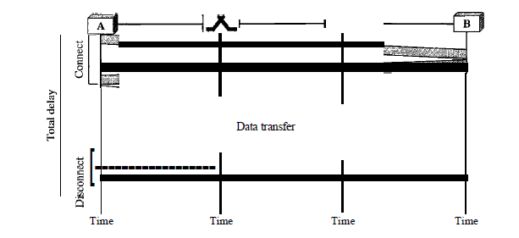
CIRCUIT-SWITCHED NETWORKS Delay

Slide 14
Circuit-Switched Technology in Telephone Networks
telephone companies usef circuit switched approach
the telephone number is used as the global address
signaling system (called SS7) is used for the setup and teardown phases.

Slide 15
DATAGRAM NETWORKS
messages needs to be divided into packets of fixed or variable size
there is no resource allocation for a packet and are allocated on demand
The allocation is done on a firstcome, first-served basis
each packet is treated independently of all others
Packets in this approach are referred to as datagrams
Datagram switching is normally done at the network layer

Slide 16
DATAGRAM NETWORKS
may travel different paths to reach their destination
out of order Transfer
different delays between the Packets
Packets may be lost or dropped
In most protocols, it is the responsibility of an upper-layer protocol to reorder the datagrams or ask for lost datagrams before passing them on to the application.
There are no setup or teardown phases (connectionless networks )

Slide 17
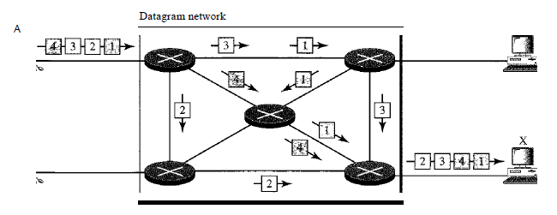
DATAGRAM NETWORKS

Slide 18
Routing Table
If there are no setup or teardown phases, how are the packets routed to their destinations in a datagram network?
each switch has a routing table which is based on the destination address
The destination addresses and the corresponding forwarding output ports are recorded in the tables
In table of a circuit switched network , each entry is created when the setup phase is completed and deleted when the teardown phase is over.

Slide 19
Routing Table
Every packet in a datagram network carries destination address of the packet.
the routing table is consulted to find the corresponding port through which the packet should be forwarded
The address remains the same during the entire journey of the packet opposite in a virtual-circuit-switched network

Slide 20
Efficiency
better than that of a circuit-switched network
resources are allocated only when there are packets to be transferred

Slide 21
Delay
May be greater delay in a datagram network than in a virtual-circuit network
each packet may experience a wait at a switch before it is forwarded
the delay is not uniform for the packets of a message

Slide 22
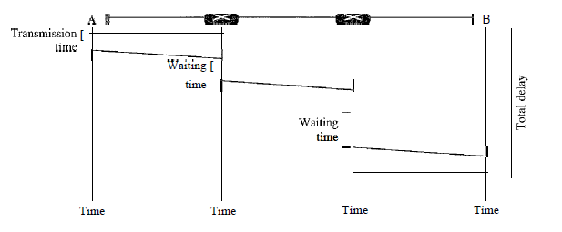
Delay
three transmission times (3T),
three propagation delays (slopes 3't of the lines),
two waiting times (WI + w2)
ignore the processing time in each switch.
The total delay is Total delay =3T + 3t + WI + W2

Slide 23
Datagram Networks in the Internet
Internet has chosen the datagram approach to switching at the network layer.
uses the universal addresses defined in the network layer to route packets from the source to the destination

Slide 24
VIRTUAL-CIRCUIT NETWORKS
is a cross between a circuit-switched network and a datagram network
As in a circuit-switched network, there are setup and teardown phases
Resources can be allocated during the setup phase, as in a circuit-switched network, or on demand, as in a datagram network.
As in a datagram network, data are packetized
each packet carries an address in the header. the address in the header has local jurisdiction. HOW?
The answer will be clear when we discuss virtual-circuit identifiers in the next section.
all packets follow the same path established during the connection.
A virtual-circuit network is normally implemented in the data link layer
circuit-switched network is implemented in the physical layer
and a datagram network in the network layer.
But this may change in the future.

Slide 25
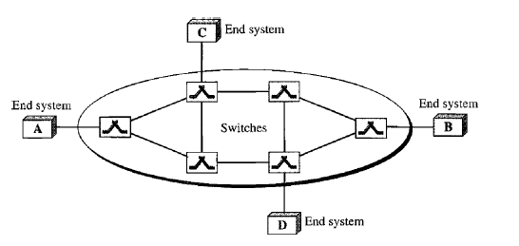
VIRTUAL-CIRCUIT NETWORKS

Slide 26
VIRTUAL-CIRCUIT NETWORKS
Addressing
global Addressing
Local Addressing
Global Addressing
A source or a destination needs to have a global address that can be unique and is used only to create a virtual-circuit identifier
Virtual-Circuit Identifier
The identifier that is actually used for data (VCI)
VCI does not need to be a large since each switch can use its own unique set of VCls

Slide 27
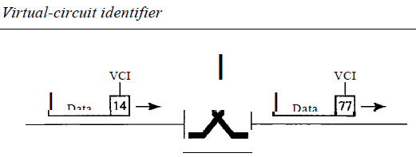
VIRTUAL-CIRCUIT Identifier

Slide 28
Three Phases
Setup phase
the source and destination use their global addresses to help switches make table entries for the connection
data transfer phase
We discuss first in the next section
Teardown phase
the source and destination inform the switches to delete the corresponding entry

Slide 29
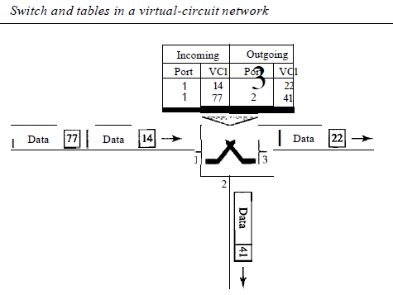
Data Transfer Phase
switch holds four pieces of information for each virtual circuit that is already set up

Slide 30
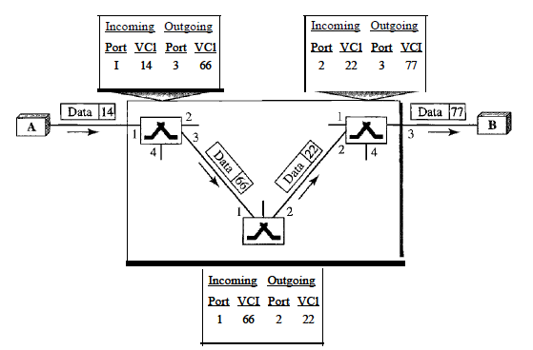
Data Transfer Phase

Slide 31
Setup Phase
setup request
Source A sends a setup frame to switch 1.
Switch 1 receives the setup request frame. It knows that a frame going from A to B goes out through port 3. How? The switch, in the setup phase, acts as a packet switch so through routing table .The switch creates an entry in its table for this virtual circuit, but fill three of the four columns. The switch assigns the incoming port (1) and chooses an available incoming VCI (14) and the outgoing port (3). It does not yet know the outgoing VCI, which will be found during the acknowledgment step. The switch then forwards the frame through port 3 to switch 2.
Switch 2 receives the setup request frame. The same events happen here as at switch 1;
…
Destination B receives the setup frame, and if it is ready to receive frames from A, it assigns a VCI to the incoming frames that come from A, in this case 77. This VCI lets the destination know that the frames come from A, and not other sources acknowledgment

Slide 32
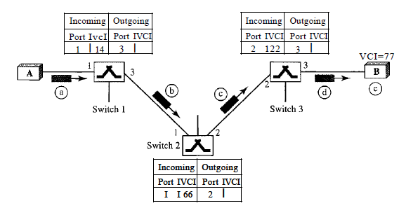
Setup Phase/Request

Slide 33
Setup Phase/Acknowledge
The destination sends an acknowledgment to switch 3. The acknowledgment carries the global source and destination addresses. The frame also carries VCI 77, chosen by the destination as the incoming VCI for frames from A. Switch 3 uses this VCI to complete the outgoing VCI column for this entry. Note that 77 is the incoming VCI for destination B, but the outgoing VCI for switch 3.
Switch 3 sends an acknowledgment to switch 2 that contains its incoming VCI in the table, chosen in the previous step. Switch 2 uses this as the outgoing VCI in the table.
Switch 2 sends an acknowledgment to switch 1 that contains its incoming VCI in the table, chosen in the previous step. Switch 1 uses this as the outgoing VCI in the table.
Finally switch 1 sends an acknowledgment to source A that contains its incoming VCI in the table, chosen in the previous step.
The source uses this as the outgoing VCI for the data frames to be sent to destination B.

Slide 34
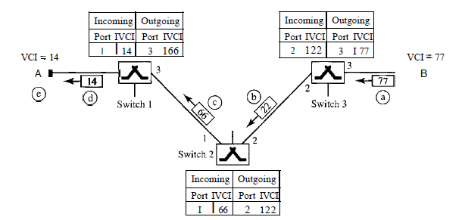
Setup Phase/Acknowledge

Slide 35
Teardown Phase
source A, after sending all frames to B, sends a special frame called a teardown request
Destination B responds with a teardown confirmation frame
switches delete the corresponding entry from their tables

Slide 36
Efficiency
resource reservation in a virtual-circuit network can be made during the setup or on-demand during the data transfer phase
In first case, the delay for each packet is the same
in second case, each packet may encounter different delays
big advantage: even if resource allocation is on demand, The source can check the availability of the resources

Slide 37
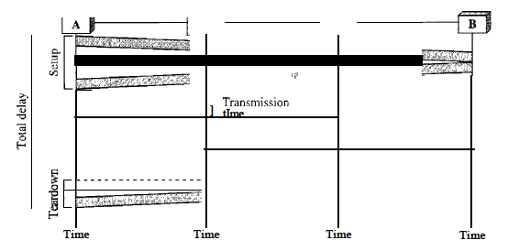
Delay in Virtual-Circuit Networks
one-time delay for setup (in two direction)
one-time delay for teardown (in one direction)
If resources are allocated during setup phase, there is no wait time for individual packets.
Total delay =
3T+ 3t + setup delay + teardown delay
ignore the processing time in each switch

Slide 38
Virtual Circuit-Switched Technology in WANs
Frame Relay and ATM networks
Implemented in data link layer

Slide 39
Structure of Circuit Switches
space-division switch
Crossbar Switch
Multistage Switch
time-division switch
Time-Division Switch
Time- and Space-Division Switch Combinations

Slide 40
Space-Division Switch
the paths in the circuit are separated from one another spatially
used in both analog and digital networks

Slide 41
Circuit Switch
A crossbar switch connects n inputs to m outputs in a grid, using electronic microswitches (transistors) at each crosspoint
The major limitation of this design is the number of crosspoints required
inefficient because statistics show that, in practice, fewer than 25 percent of the crosspoints are in use at any given time.

Slide 42
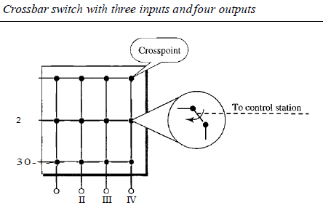
Circuit Switch

Slide 43
Multistage Switch
combines crossbar switches in several (normally three) stages
N*N crosspoint in a single crossbar, but at a time one row or column is active for any connection
First stage: N/n crossbar each n * k crosspoint
Second stage: k crossbar each N/n * N/n crosspoint
Third stage: N/n crossbars, each k x n crosspoint

Slide 44
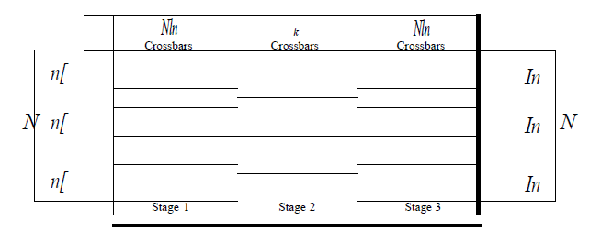
Multistage Switch
Total Number of crosspoint = N/n(n*k) + k(N/n * N/n) + N/n(k*n) = 2kn + k(N/n)^2 << N^2

Slide 45
Multistage Switch/ Example1
Design a three-stage, 200 x 200 switch , k =4 and n =20
First stage:
N/n or 10 crossbars, each of size 20 x 4.
Second Stage:
4 crossbars, each of size 10 x 10.
Third Stage:
10 crossbars, each of size 4 x 20.
The total number of crosspoints:
2000 crosspoints. This is 5 percent of the number of crosspoints in a single-stage switch (200 x 200 = 40,000).

Slide 46
Blocking in multiStage Switch
The multistage switch has one drawback:
blocking during periods
multistage switching is to share the crosspoints in the middle-stage crossbars
In a single-stage switch, there is always a path
only 4 of the second 20 inputs can use the switch at a time (every n user can just have k simultaneous connection)
The small number of crossbars at the middle
stage creates blocking.
In large systems, the number of stages can be increased to cut down on the number of crosspoints required. As the number of stages increases, possible blocking increases as well

Slide 47
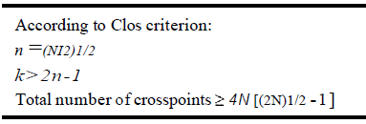
multiStage non-blocking Switch
Clos rule: In a nonblocking switch, (k>> 2n-1)
number of crosspoints is still smaller than that in a single-stage switch
minimize the number of crosspoints with a fixed N by using the Clos criteria. We can take the derivative of the equation with respect to n (the only variable) and find the value of n that makes the result zero

Slide 48
Multistage Switch/ Example2
Redesign the previous three-stage, 200 x 200 switch, using the Clos criteria with a minimum number of crosspoints
n = (200/2)1/2, or n = 10.
k = 2n - 1 = 19.
total number of crosspoints is 20(10 X 19) + 19(10 X 10) + 20(19 XlO) = 9500. 24 percent that of a single-stage switch
single-stage switch, we need 200 X 200 =40,000 crosspoints
Close non-blocking rule: if a telephone company needs to provide a switch to connect 100,000 telephones in a city, it needs 200 million crosspoints!!!!!!!!!
So we accept blocking

Slide 49
Time-Division Switch
Today, telephone companies use time-division switching or a combination of space- and time-division switches
Time-division switching uses time-division multiplexing (TDM) inside a switch
most popular technology is called the time-slot interchange (TSI).

Slide 50
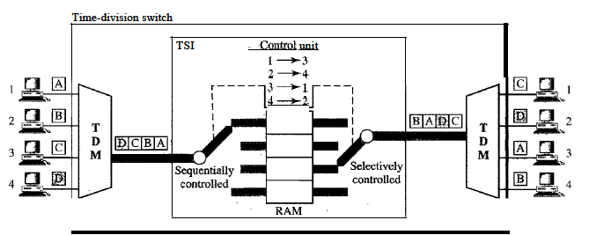
Time-Division Switch

Slide 51
Time- and Space-Division Switch Combinations
Space-division
Advantage: it is instantaneous
Disadvantage: is blocking
time-division switching
Advantage: it needs no crosspoints
Disadvantage: in the case of TSI, Each time slot must be stored by the RAM, then retrieved and passed on. Creates Delay
combine space and time-division technologies
switches that are optimized both physically (the number of crosspoints) and temporally (the amount of delay).

Slide 52
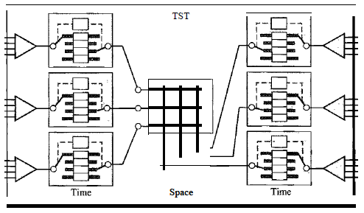
Time- and Space-Division Switch Combinations
two time stages and one space stage and has 12 inputs and 12 outputs.
The result is , average delay is one-third
The middle stage is a spacedivision switch

Slide 53
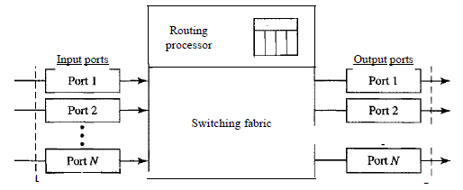
Structure of Packet Switches
Input Ports
Output Ports
Routing Processor
Switching Fabric

Slide 54
Input Port
performs the physical and data link functions of the packet switch
The packet is decapsulated from the frame.
Errors are detected and corrected
the input port has buffers to hold the packet before it is directed to the switching fabric

Slide 55
Output Port
outgoing packets are queued, then the packet is encapsulated in a frame
physical layer functions are applied to the frame to create the signal

Slide 56
ROuting Processor
performs the functions of the network layer
The destination address is used to find the address of the next hop and the output port based on Routing Table
In the newer packet switches, this function of the routing processor is being moved to the input ports to facilitate and expedite the process.

Slide 57
Switching Fabrics
Crossbar Switch with
Banyan Switch
Batcher-Banyan Switch

Slide 58
Banyan Switch
Banyan Switch is a multistage switch with microswitches at each stage that route the packets based on the output port represented as a binary string
For n inputs and n outputs, have (log n based 2) stages with n/2 microswitches at each stage
The first stage routes the packet based on the high-order bit of the binary string.
The second stage routes the packet based on the second high-order bit, and so on

Slide 59
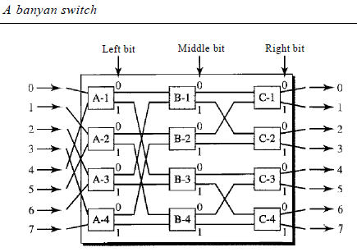
Banyan Switch

Slide 60
Batcher-Banyan Switch
The problem in banyan switch is the possibility of internal collision even when two packets are not heading for the same output port.
solve this problem by sorting the arriving packets based on their destination port
trap is added between the Batcher switch and the banyan switch
The trap module prevents packets with the same output destination from passing to the banyan switch simultaneously
if there is more than one, they wait for the next tick

Slide 61
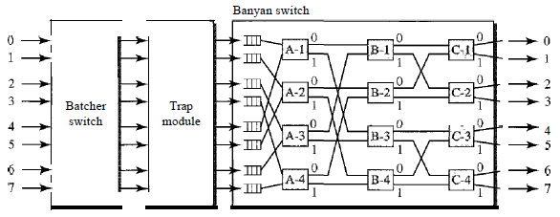
Batcher-Banyan Switch

