Slide 1
Rotor balancing
May 21, 2012

Slide 2
Outline
What is Imbalance
Complex Rotor System
Balancing
Classification of Rotors
Different Methods of Balancing
Influence Co-efficient Method
Application
Live Demo

Slide 3
What is imbalance ?
I
C
a
r
I - Center of mass
C - Geometric center
a - Eccentricity
r - Radius of rotor
Correction mass =
M - Mass of disc

Slide 4
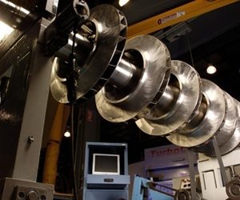
Complex Rotor System
Rotor2
Rotor4
Rotor1
Rotor3
Rotor5
Left End
Right End

Slide 5
Balancing
Balancing is the method to eliminate the imbalance.
Static balancing:
Single rotor system placed on two parallel horizontal knife edges
Allowed to roll freely until it comes to rest
Static imbalance is signified by the rotor settling to rest at the same location
Mass can be added or removed to removed the imbalance
Flexible balancing:
Rotating machines consist of long, slender and hence flexible shafts
The imbalance is distributed along the length of the rotor
Static balancing is insufficient in such cases
The shaft also deflects and the deflection varies with speed
The problem is also complex when operating near critical speeds

Slide 6
Classification of ROTORS
Class 1: Rigid rotors
A rotor is considered rigid, when it can be corrected in any two arbitrary planes and after correction, its unbalance does not significantly change at any speed up to the maximum operating speed.
Class 2: Quasi flexible rotors
Rotors that cannot be considered rigid but can be balanced adequately in a low speed balancing machine.
Class 3: Flexible rotors
Rotors that cannot be balanced in a low speed balancing machine and that require balancing by some special flexible rotor balancing technique.
Class 4: Flexible attachment rotors
Rotors that could fall into categories 1 or 2 but have in addition one or more components that are themselves flexible or are flexibly attached.
Class 5: Single speed flexible rotors
Rotors that could fall into category 3, but for some reason, e.g., economy, are balanced only for one speed of operation.

Slide 7
Different methods of balancing
Modal balancing
Influence coefficient method

Slide 8
Influence co-efficient method
Controlled speed of the rotor system
Initial Response from the measurement planes
Adding known trial mass at balance plane ‘1’
Response from the measurement planes
Repeat the steps 3,4, 5 for ‘p’ balancing planes
Repeat above steps for ‘n’ rotor speeds. n= p/2 if p is even, n=(p+1)/2 if p is odd
Remove trial mass
Calculate Influence co-efficient from measurement data
Calculate correction masses

Slide 9
Influence co-efficient method
Balancing
plane
Balancing
plane
Measurement
plane
Measurement
plane
L
R
a
b
L1
αaR
R1
L2
αbR
αaR
R2
αbR
L1, R1 - Initial response measured at ‘a’ and ‘b’ respectively
L2, R2 - Response measured at ‘a’ and ‘b’ respectively after adding trial mass ‘TR’
at balancing plane ‘R’
αaR, αbR - Influence coefficients (αaR = (L2-L1)/TR, αbR = (R2-R1)/TR )

Slide 10
Influence co-efficient method
Balancing
plane
Balancing
plane
Measurement
plane
Measurement
plane
L
R
a
b
L1
αbL
αaL
R1
L3
R3
αaL
αbL
L1, R1 - Initial response measured at ‘a’ and ‘b’ respectively
L3, R3 - Response measured at ‘a’ and ‘b’ respectively after adding trial mass ‘TL’
at balancing plane ‘L’
αaL, αbL - Influence coefficients (αaL = (L3-L1)/TL, αbL = (R3-R1)/TL )

Slide 11
Influence co-efficient method
R1
αbR
αbL
WR
L1
αaR
αaL
WL
Initial response
vector
Co-efficient matrix
Balance mass vector
WR, WL - Correct balance masses in balancing planes ‘R’ and ‘L’ respectively
L1, R1 - Initial response measured at ‘a’ and ‘b’ respectively
αaR, αbR - Influence coefficients (αaR = (L2-L1)/TR, αbR = (R2-R1)/TR )
αaL, αbL - Influence coefficients (αaL = (L3-L1)/TL, αbL = (R3-R1)/TL )

Slide 12
Application Demonstration
Rotor2
Rotor4
Rotor3
Rotor1
Rotor5
Compressor
End
Turbine
End
Example Rotor system

Slide 13
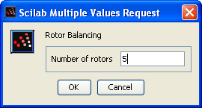
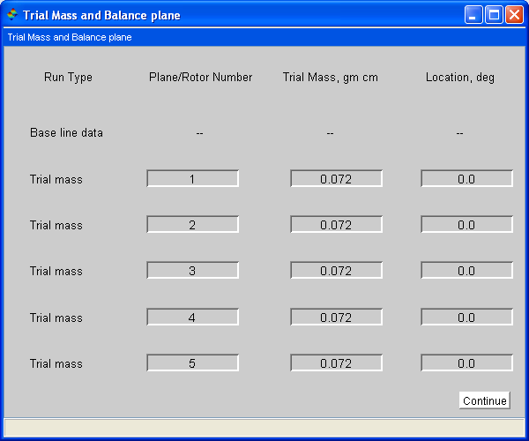
Rotor Balancing Application Program

Slide 14
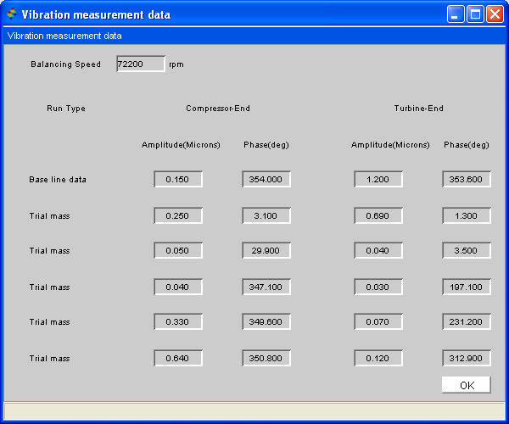
Rotor Balancing Application Program

Slide 15
Rotor Balancing Application Program

Slide 16
Rotor Balancing Application Program

Slide 17
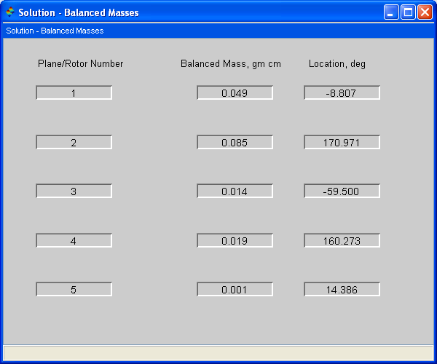
Rotor Balancing Application Program

Slide 18
reference
ROTOR DYNAMICS by J.S.RAO
Edition: Third Edition
Publisher: New age international (P) limited
ISBN: 81-224-0977-6

