Slide 1
Analysis of Deterministic Model of Electric Arc Furnace
Dariusz Grabowski
Janusz Walczak
Silesian University of Technology, Poland

Slide 2
OUTLINE
Introduction
Electric arc furnace
structure
melt cycle
models
Deterministic model developed using power balance equation
Solution to the arc equation in a closed form
Example
Conclusions and further research

Slide 3
Introduction
The electric arc furnaces are more and more important for reasons of environmental protection – they enable recycling of steel.
However, at the same time they are highly nonlinear loads and so cause such negative phenomena as:
voltage flicker,
waveform distortion.
In order to analyze power quality problems it is important to develop a realistic arc model.

Slide 4
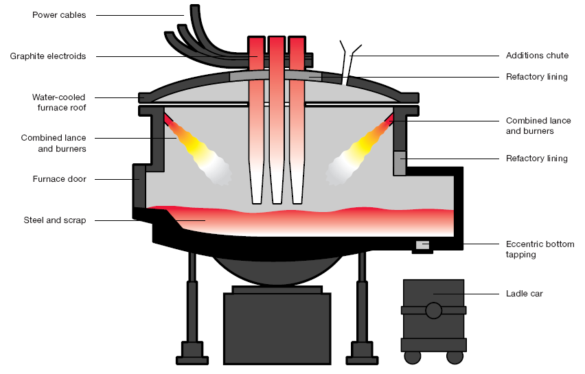
Electric arc furnace – structure*
* „Making and rolling steel” - www.corusgroup.com

Slide 5
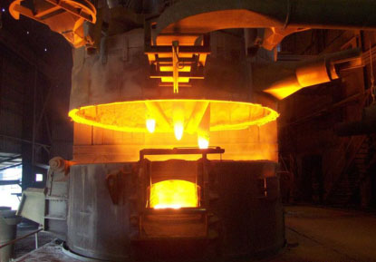
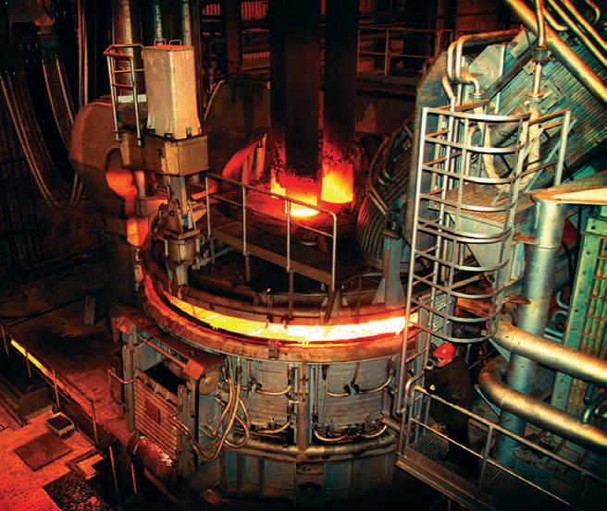
Electric arc furnace – melt cycle*

Slide 6
deterministic models
nonlinear ODE
piece-wise linear approximation
mixed exponential and linear approximation
approximation using shifted and amplified step function
neural network black-box model

Slide 7
time-varying model
Deterministic model
chaotic component
stochastic component
deterministic modulated component
Time-varying model

Slide 8
deterministic model - power balance equation
Power transmitted as heat to the external environment
Power which increases the internal arc energy
Total instantaneous power delivered to the arc

Slide 9
deterministic model - power balance equation
Power transmitted as heat to the external environment
it is a function of the arc radius r(t) and the arc temperature
three cases can be considered n=0, 1 and 2
Power which increases the internal arc energy
proportional to the derivative of the energy inside the arc
Total instantaneous power delivered to the arc
product of the arc current and voltage
the resistivity of the arc column is assumed to be inversely proportional to r ^{m}
energy on the other hand is proportional to the square of the arc radius
three cases can be considered m=0, 1 and 2 - to reflect the fact that if the arc has a larger radius then it may be hotter in the interior

Slide 10
deterministic model - power balance equation
n
n = 0 cooling of the arc does not depend on its radius
n = 1 cooling of the arc is mainly by its surface
n = 2 cooling is proportional to the arc cross-section
m
m = 0
g = r ² / k₃
m = 1
g = r ³ / k₃
m = 2
g = r ⁴ / k₃
conditions of cooling
variations of the resistivity with temperature

Slide 11
electric ARC FURNACE MODEL
Nonlinear ODE
Substitution
Linear ODE
where:

Slide 12
solution to ARC FURNACE equation General case
Arc radius
Arc conductance
Arc voltage
Arc current

Slide 13
solution to ARC FURNACE equation periodic case
Arc current
Arc radius
Arc voltage
where:

Slide 14
Example – input data
The constants of proportionality take the following values [4]:
k₁=3000,
k₂ = 1,
k₃ = 12.5.
The current waveform i(t) is periodic - the only nonzero harmonics are 3rd, 5th and 7th. The percent of fundamental for these harmonics is equal to 5%, 4.5% and 1%, respectively [13].

Slide 15
Example
ODE solution
Arc current waveform
Arc radius waveform

Slide 16
Example
Arc conductance waveform
Arc voltage waveform

Slide 17
Example
V-I characteristic of the arc model
V-I characteristic of the arc model for the sinusoidal (red line) and the distorted currents (blue and green lines)

Slide 18
selected References
A. A. Gomez, J.J.M. Durango and A. E. Mejia, “Electric arc furnace modeling for power quality analysis”. Proc. of the IEEE ANDESCON Conf., 14-17 Sept., Bogota, pp. 1-6, 2010.
M.A. Golkar and S. Meschi, “MATLAB modeling of arc furnace for flicker study”. Proc. of the IEEE Int. Conf. on Industrial Technology, 21-24 April, Chengdu, pp. 1-6, 2008.
P.F. Ribeiro and C.A. Duque, “Probability distribution and spectral analysis of nonstationary random processes” in Time-Varying Waveform Distortions in Power Systems, P.F. Ribeiro, Ed. New York: J. Wiley &Sons, 2009, pp. 19-24.
Wang Yongning, Li Heming, Xu Boqiang and Sun Lilhg, “Simulation research of harmonics in electric system of arc furnace”. Proc. of the Int. Conf. on Power System Technology POWERCON, 21-24 Nov., Singapore, pp. 902-906, 2004.
Burch, R.F., "Thoughts on improving the electric arc furnace model". Power and Energy Society General Meeting - Conversion and Delivery of Electrical Energy in the 21st Century, 2008 IEEE, pp. 1 - 5, 2008.

Slide 19
conclusions
The closed form of the solution to a differential equation describing the electric arc has been given in the paper.
It can be used for direct calculation of the arc radius, conductance and voltage.
The proposed approach facilitates calculation of the arc characteristic.
The computational results obtained so far agree with existing numerical solutions and measurements.
The arc model can be used to evaluate the impact of arc furnaces on power quality during the planning stage of new plants.

Slide 20
Further research
Closed form of the solution for n=2, m=0
(EEEIC 2011)
Closed form of the solution for n=0,1, 2 and m=0, 1, 2
Application of new methods used for extension of the model in order to reflect its stochastic behavior

Slide 21
Thank you for attention

