Slide 1
Power Quality 101
Jason Pause
Electric Distribution Systems
December 2013
Notes:
Good Morning, my name is Jason Pause and I am an electrical engineer in the Electric Distribution Systems section here at the Department of Public Service. I was asked to put together a brief presentation on the basics of power quality. My goal here is to just touch on some of the major concepts and terms associated with power quality on the electrical system as an introduction to some of the discussions we will hear throughout today’s technical conference. I fully expect some of our other presenters and speakers to get more in-depth and technical in terms of power quality and associated issues being experienced, and hopefully this presentation will help build up to those discussions.

Slide 2
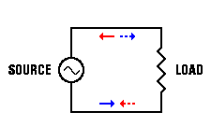
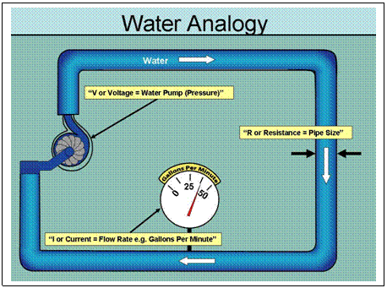
Basic Electric Circuits
Voltage
Represents an energy source with the potential to cause current to go through a conductor or customer load. Measured in Volts (V)
Similar to the Water Pump (source) that creates pressure to push water through pipes.
Current
Flow of an electrical charge through a conductor (power line) or customer load. Measured in Amperes or Amps (I)
Similar to flow rate of water through a pipe.
I
V

Slide 3
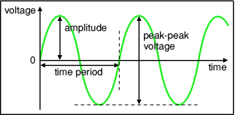
Basics of AC Systems The Sine Wave
AC
In an AC (alternating current) system, both voltage and current increase and decrease in the shape of a sine wave (Ex: Ocean Wave)
One complete wave takes 1/60th of a second to complete one up and down cycle
So (in the US) we have 60 waves per second or 60 cycles per second
60 cycles per second = 60 Hertz
AC Sine Wave

Slide 4
Basics of Power Quality
Power Quality determines the quality of the voltage in an electrical circuit or the fitness of electrical power to consumer devices.
ANSI C84.1 – Voltage Standards
Steady-state (continuous) voltage remains within a +/- range of 5%
Based on a service voltage of 120 volts, this ranges from 114 volts to 126 volts
Voltage Wave Frequency
60 Hz +/- 0.05 Hz (59.95 Hz – 60.05 Hz)
Average Frequency must = 60.000… Hz
Typical Power Quality Disturbances
Transients
Voltage Sags & Swells
Harmonics

Slide 5
Power Quality - Issues
Transients:
Temporary short duration voltage disturbances in which there is a high amplitude voltage change.
Causes – lightning, faults (utility or facility), capacitor switching, switching of large inductive loads (motors).
Effects – Unexpected fuse operation, tripping of motor drives, computer system issues, microprocessor control errors, damage to electronic equipment, damage to electrical contactors.

Slide 6
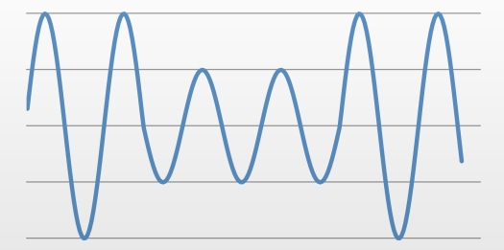
Power Quality - Issues
Voltage Sags & Swells:
Disturbance where the voltage increases or decreases for a period up to 2 seconds.
Causes – lightning, faults (utility or facility), capacitor switching, starting of large electrical loads, overloaded wiring, transformers, and switchgear.
Effects – Failure of motors / transformers, light flicker, tripping of motor drives, motor overloads, computer system issues, damage to electrical contactors, damage to pf correction capacitors.
Voltage Sags & Swells

Slide 7
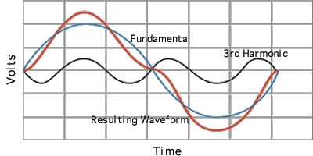
Power Quality - Issues
Harmonics:
Deviation of the voltage sine wave from a true sinusoidal shape. Harmonic is an integer multiple of the fundamental frequency of 60 Hz. (Ex: 2nd harmonic is 120 Hz and 3rd harmonic is 180 Hz…)
Causes - Non-linear electrical loads on the system such as: motor drives, computers and electronics, electronic ballasts, battery chargers, etc...
Effects – degrades the overall performance of the electrical system by increasing losses and temperatures in electrical components such as cables, transformers, and motors.

