Slide 1
Solar Photovoltaic with Energy Storage
Liang Meng

Slide 2
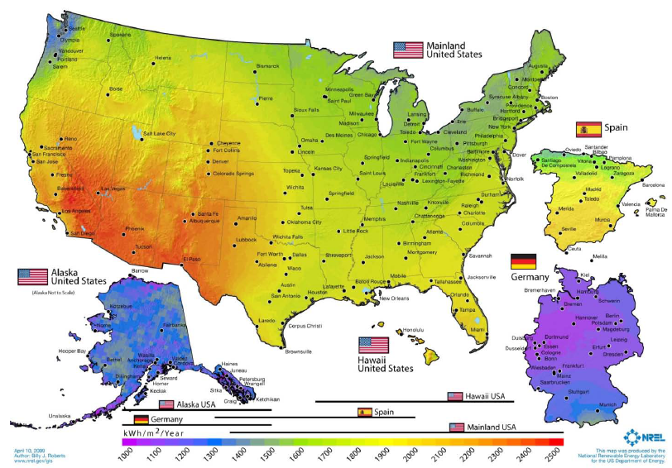
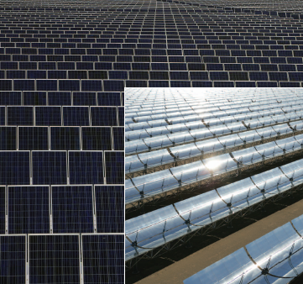

Slide 3
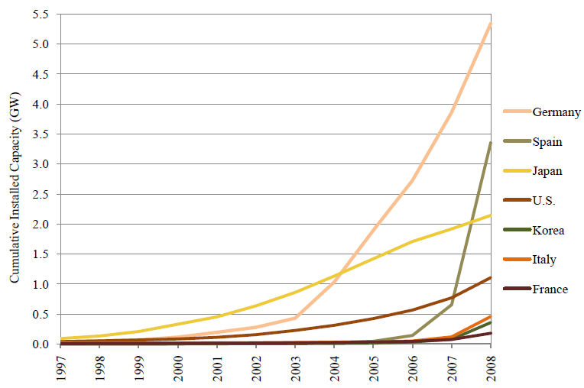

Increasing installed capacity of PV

Slide 4
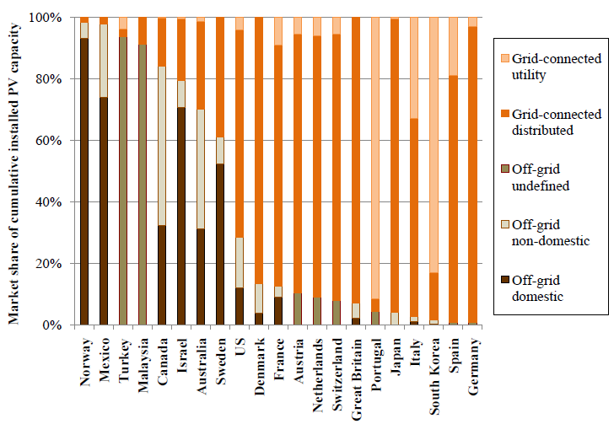
Grid-connected vs. off-grid

Slide 5
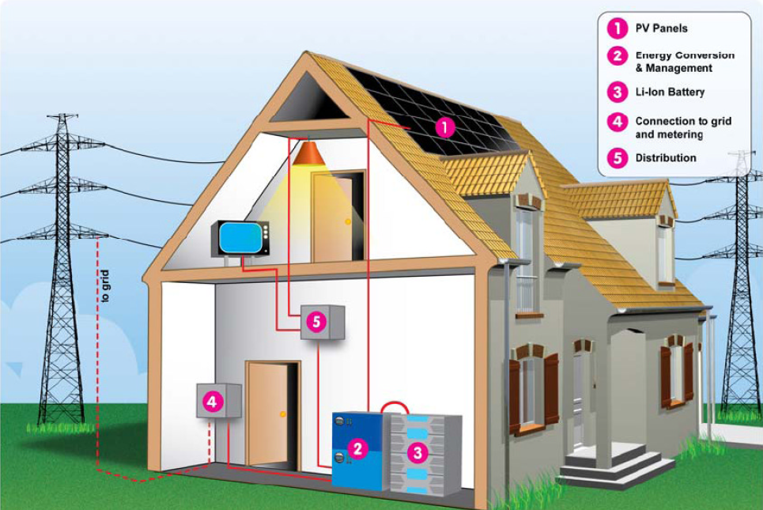
Grid-connected PV with battery
Inverter
Battery
Charge controller- to regulate the voltage entering batteries to avoid overcharging the batteries

Slide 6
Install a roof-PV?
Factors to be considered
  Enough solar resource
  Environmental benefits (reduce dependence on fossil fuels and greenhouse gas emissions)
  living in the mountain area (off-grid PV)
  No electricity bill for 10-20 years
  Price of the electricity from PV vs. from grid
    A large investment at the beginning
    Price of the solar cells, inverter, battery, net meter, other installation fees, etc.
    Tax incentives
    The trend of these two
  Life time of the PV device
    Battery?
  Maintenance
  Safety
Impact to the grid
  Problems (intermittent and unreliable)

Slide 7
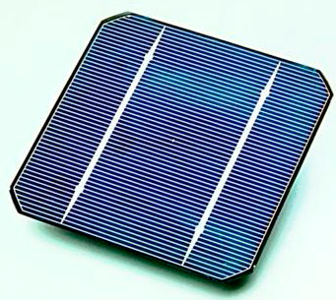
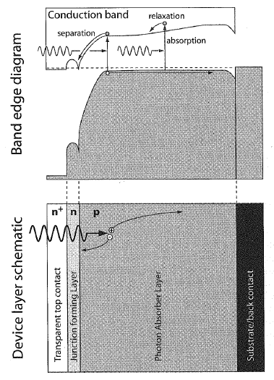
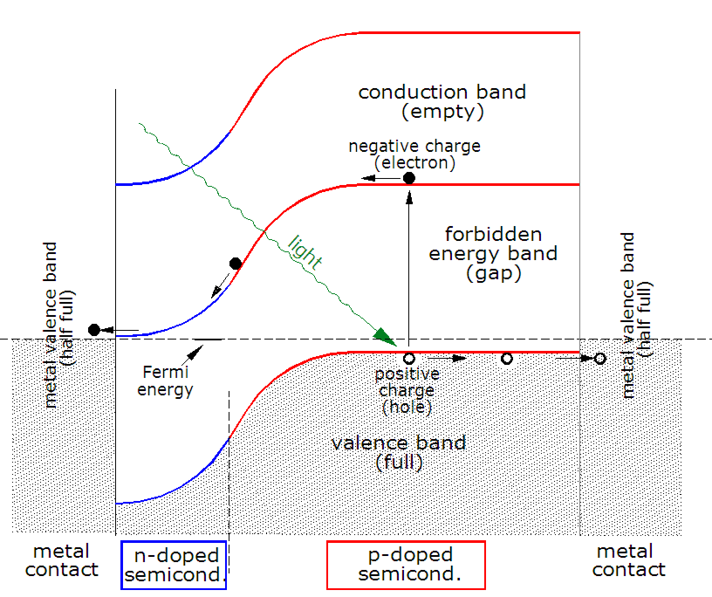
PV subsystem - Solar cells/Photovoltaics
Transparent conductive oxide
Crystalline silicon- based
Thin film cell, CIGS

Slide 8
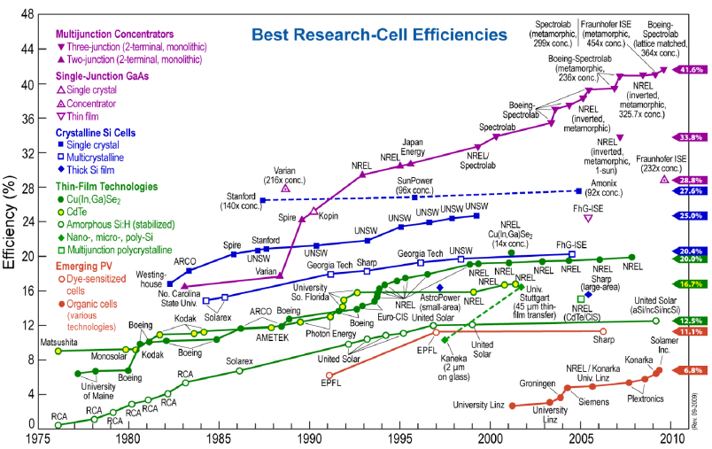
Solar cell efficieny

Slide 9
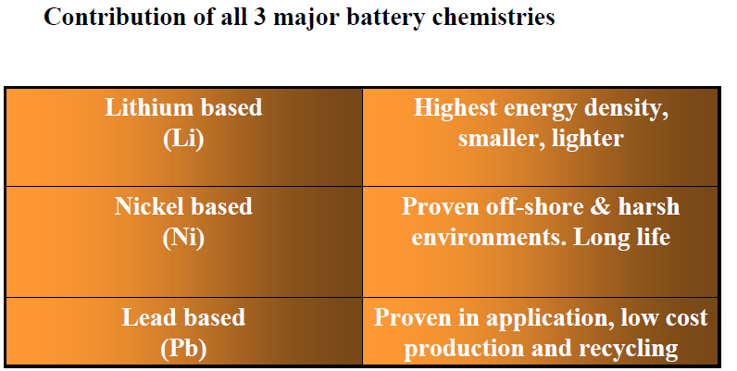
PV/Battery
Storing energy when the sun is not shining.
Car batteries are not suitable as they can not handle the deep discharges
Being developed
Costly, difficult to measure the depth of discharge
Mainly used now. Deep cycle. Medium energy density, 5-7 years.

Slide 10
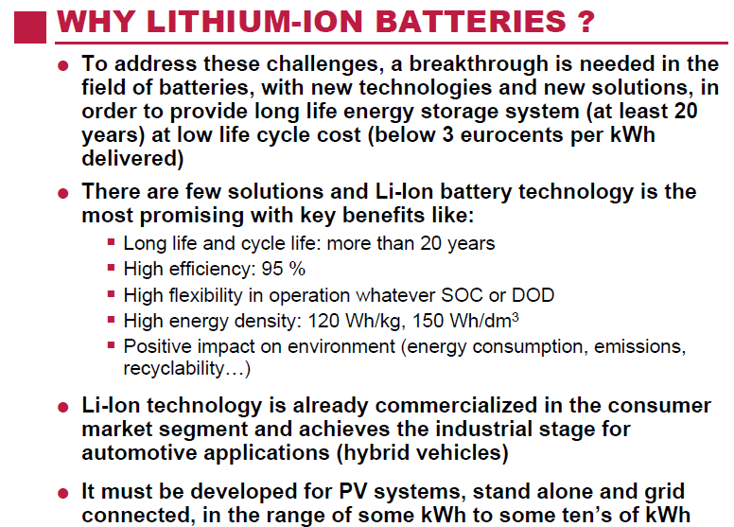

Slide 11
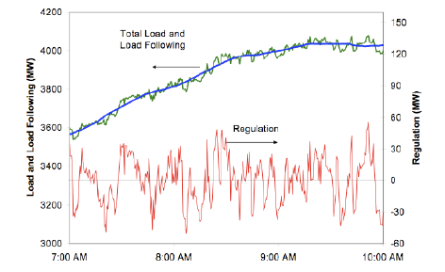
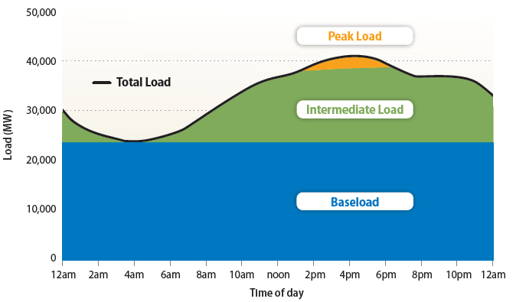
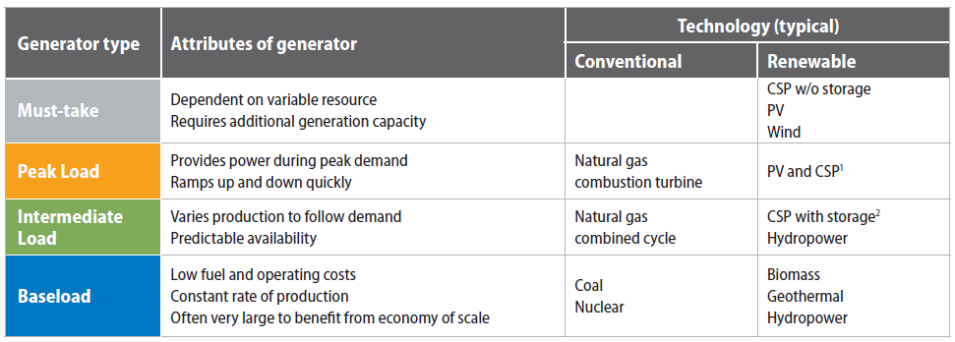
Operation of the electric grid
Peakload/
Regulation
online and “spinning” reserves

Slide 12
Storage is useful but not a required component of the existing grid

Slide 13
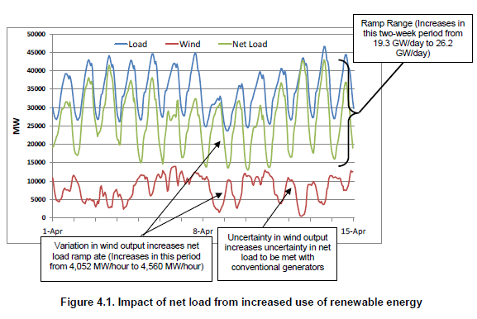
Renewable energy’s impact on the grid

Slide 14
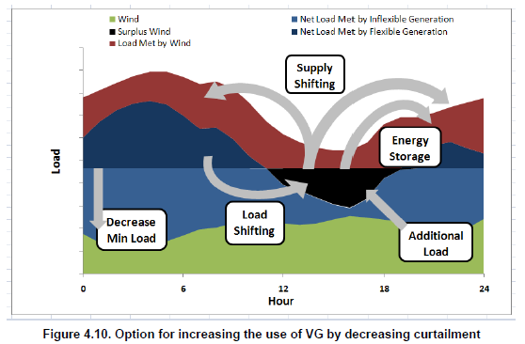
Wind/Solar energy needs to be smoothened and peak shifted

Slide 15
PV Coincidence With Load - Summer
PV Coincidence With Load - Spring
2000 Normal Min Load
California: 16 GW simulated PV system providing 11% of system’s energy
Potentially curtailed PV

Slide 16
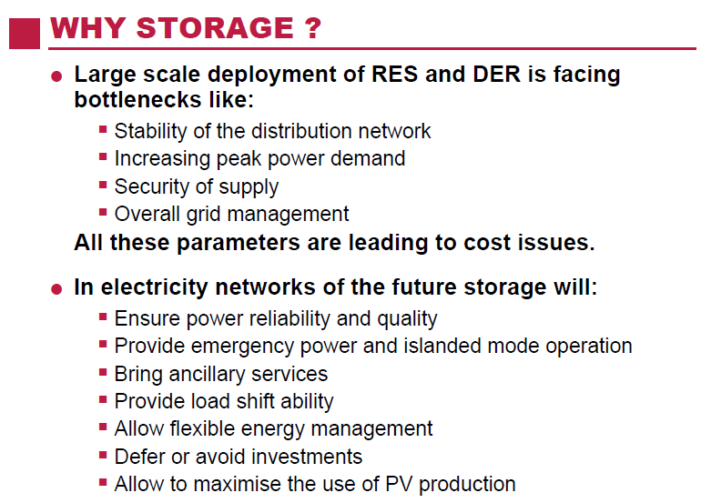

Slide 17
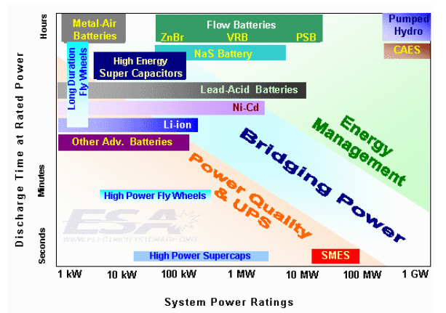
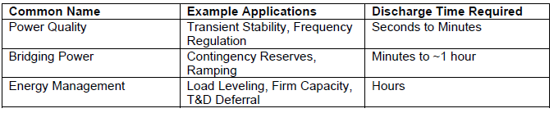

Slide 18
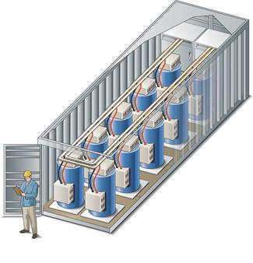
Short-term Devices
(30 min or less)
Devices that can provide frequency regulation and spinning reserve
Flywheels, batteries & capacitors
Beacon Flywheel for Frequency Regulation

Slide 19
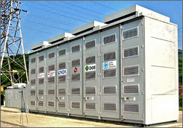
Distributed Storage
(<10 MW or so)
Provide both capacity and energy services
Local T&D appears to be a primary application
Primarily batteries
  Flow batteries
  NaS
  Other battery chemistries?

Slide 20
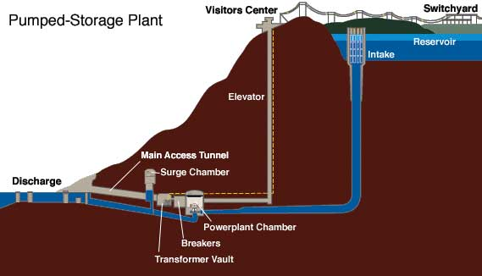
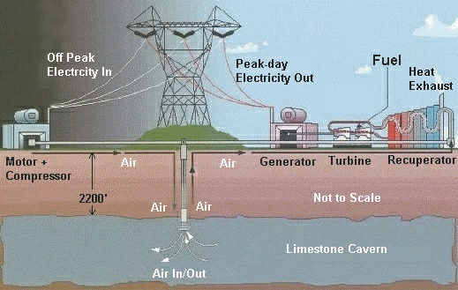
Bulk Energy Storage
Limited growth opportunities for PHS
(Courtesy of TVA)
Compressed Air Energy Storage (CAES)

Slide 21
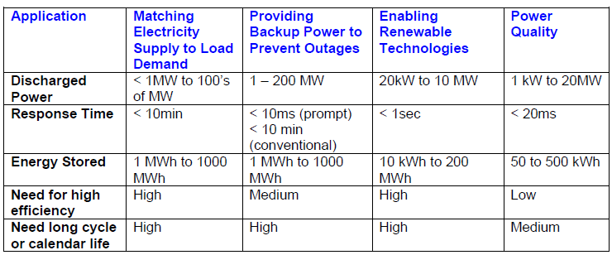
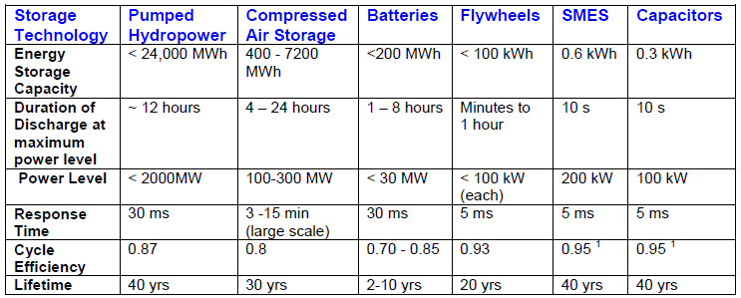

Slide 22
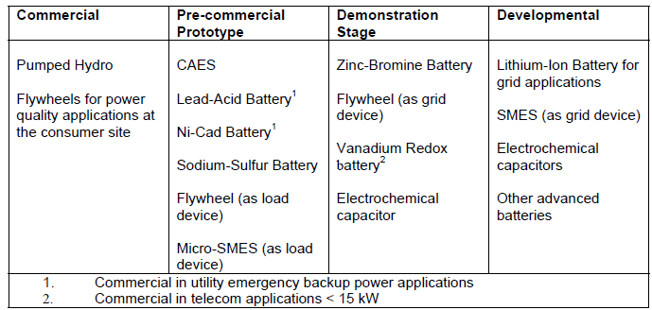

Slide 23
References
“2008 SOLAR TECHNOLOGIES MARKET REPORT, U.S. Department of Energy”, 2010
“The Materials Science of Semiconductors”, Angus Rockett, Springer Science, New York, NY, 2008
“Advanced PV Energy Storage System with Lithium-Ion Batteries”, Saft, EUROSOLAR Conference, 31st October 2006
“The Role of Energy Storage in the Modern Low-Carbon Grid”, Paul Denholm, National Renewable Energy Laboratory, June 12, 2008
“Adding value to the future electricity grid: The Role of Energy Storage”, Eurobat, EPIA Industry Forum, 2009
“The Role of Energy Storage with Renewable Electricity Generation”, Technical report, NREL/TP-6A2-47187, January 2010
“Storage Devices in PV System: Latest Developments, Technology and Integration Problems”, John M. Hawkins, Solar Photovoltaic Energy Workshop, 1998

Slide 24
Steps for sizing the battery bank:
Divide the “Daily Energy Use” (derived from using the Chart on page 6) by the voltage of the battery (typically 12 volts). The result is amp-hours which is the common manner of measuring battery capacity. For example, if the “Daily Energy Use” is 2,000 (watt-hours), divide 2,000 by 12 to get 167 (amp-hours).
Multiply the daily amp-hours by the number of days that you want to have power in storage in case the sun is not shining adequately. Three to five days is recommended. For this example, we will choose four days. Multiply 167 amp-hours per day times 4 days to get 668 amp-hours.
Batteries should not be discharged excessively. A deep cycle lead-acid battery (the main battery option) will last longest if it is discharged only 50%. By dividing the total amp-hours from Step 2 (668) by .50, the optimal battery capacity is determined; 668/.50 = 1336 amp-hours at 12 volts.

Slide 25
