Slide 1
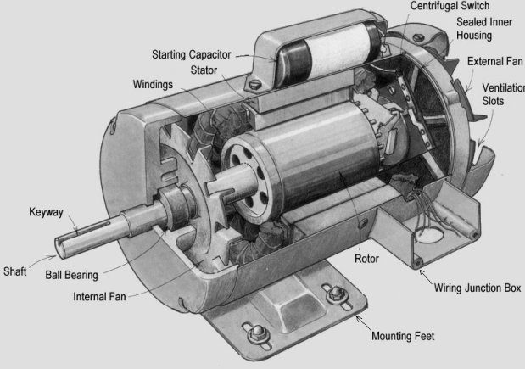
Induction Motors By Kevin Tesch, Jason Brosler

Slide 2
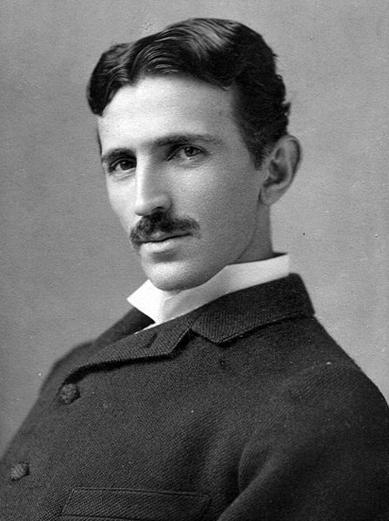
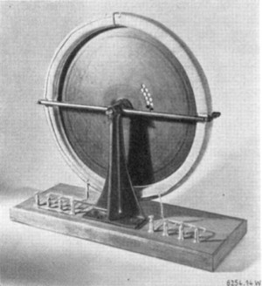
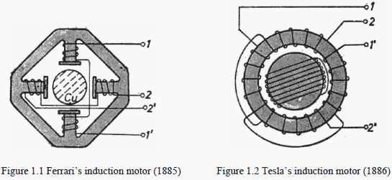
History
Invented by Nicola Tesla in 1888
Michael Dolivo-Dobrowski around 1891, constructs three-phase cage induction motor that is still seen in applications today
Induction motors lost popularity until around 1985
Development of the IGBT PWM inverter for frequency alteration

Slide 3
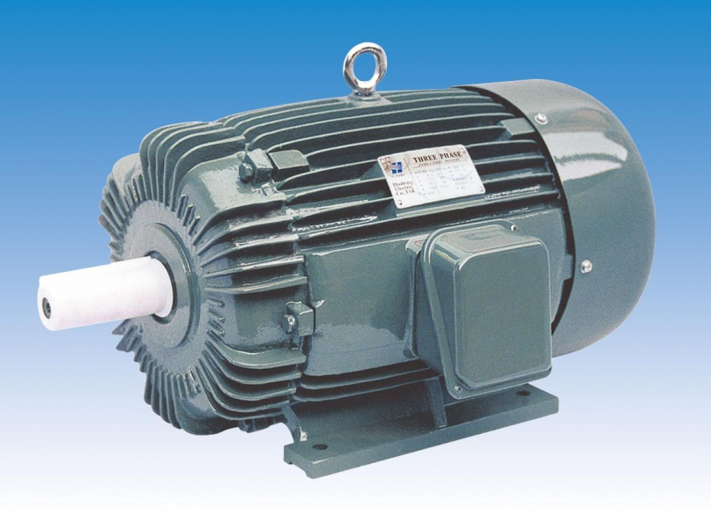
Design Considerations
Advantages
Simple and rugged in construction
Generally cheaper due to absence of brushes, commutators and slip rings
Lower maintenance
Can safely be operated in hazardous environments
Rpm can be changed without gear box
Disadvantages
Draws a lot of current at start
Low starting torque
Harder to control
Notes:
Simple and rugged in construction
Generally cheaper due to absence of brushes, commutators and slip rings
Easier to maintain: no need to replace brushes or worn out commutators

Slide 4
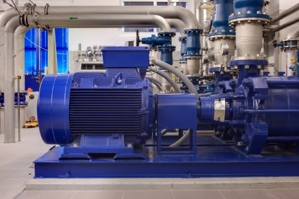
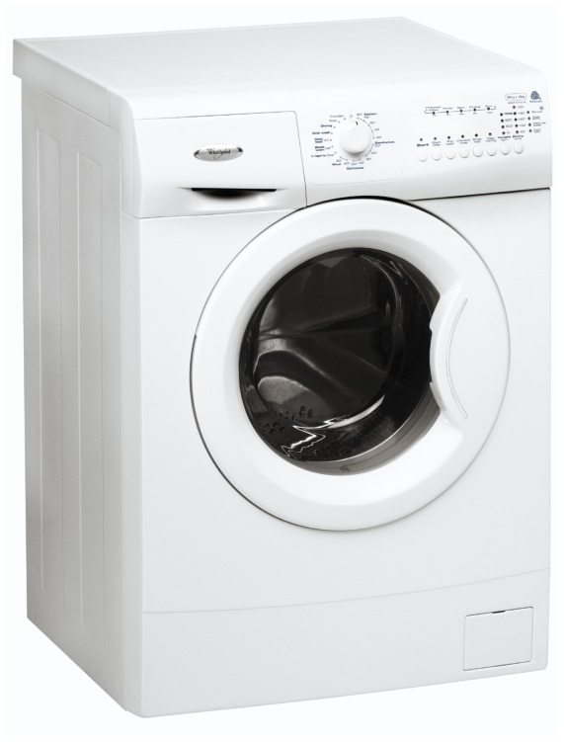
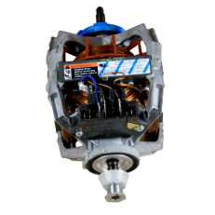
Applications
Commonly available in single-phase household varieties or 3- phase motors designed for industrial applications
Hazardous Environments
Generator/Alternator
Industrial Machines

Slide 5
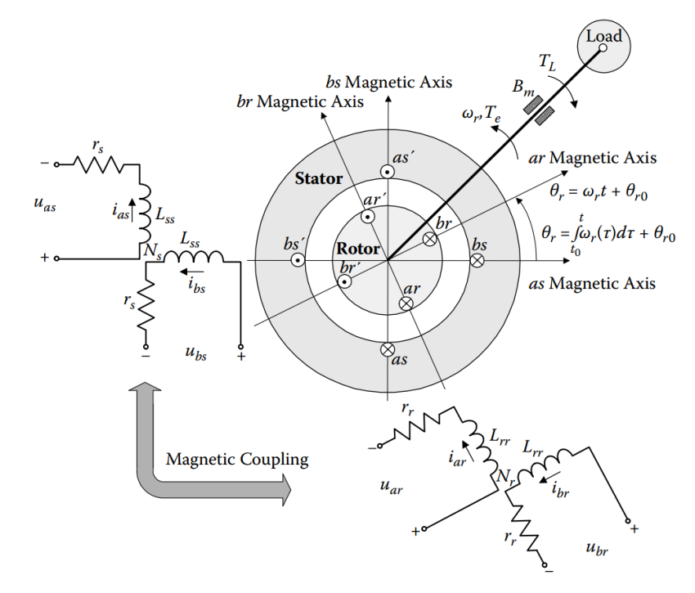
Equations
RPM
$$ω_{e}=\frac{4πf}{P}$$
2 Phase Potential Energy
$$u_{as}=r_{s}i_{as}+\frac{{dφ}_{as}}{dt}$$
$$u_{bs}=r_{s}i_{bs}+\frac{{dφ}_{bs}}{dt}$$
$$u_{ar}=r_{r}i_{ar}+\frac{{dφ}_{ar}}{dt}$$
$$u_{br}=r_{r}i_{br}+\frac{{dφ}_{br}}{dt}$$
Flux Linkages
$$φ_{as}=L_{asas}i_{as}+L_{asbs}i_{bs}+L_{asar}i_{ar}+L_{asbr}i_{br}$$
$$φ_{bs}=L_{bsas}i_{as}+L_{bsbs}i_{bs}+L_{bsar}i_{ar}+L_{bsbr}i_{br}$$
$$φ_{ar}=L_{aras}i_{as}+L_{arbs}i_{bs}+L_{arar}i_{ar}+L_{arbr}i_{br}$$
$$φ_{br}=L_{bras}i_{as}+L_{brbs}i_{bs}+L_{brar}i_{ar}+L_{brbr}i_{br}$$

Slide 6
Equations Cont.
Mutual Inductances
Stator-Rotor Inductance Mapping
$$L_{asas}=L_{bsbs}=L_{ss} L_{arar}=L_{brbr}=L_{rr}$$
$$and$$
$$L_{asbs}=L_{bsas}=0 L_{arbr}=L_{brar}=0$$
$$L_{asar}=L_{aras}=L_{sr}cosθ_{r} L_{asbr}=L_{bras}=−L_{sr}sinθ_{r}$$
$$and$$
$$L_{bsar}=L_{arbs}=L_{sr}sinθ_{r} L_{bsbr}=L_{brbs}=L_{sr}cosθ_{r}$$
$$\left[\begin{matrix}φ_{as} \\ φ_{bs} \\ {φ′}_{ar} \\ {φ′}_{br}\end{matrix}\right]=\left[\begin{matrix}\begin{matrix}\begin{matrix}L_{ss} \\ 0\end{matrix} & \begin{matrix}0 \\ L_{ss}\end{matrix}\end{matrix} & \begin{matrix}\begin{matrix}L_{ms}cosθ_{r} \\ L_{ms}sinθ_{r}\end{matrix} & \begin{matrix}{−L}_{ms}sinθ_{r} \\ L_{ms}cosθ_{r}\end{matrix}\end{matrix} \\ \begin{matrix}\begin{matrix}L_{ms}cosθ_{r} \\ −L_{ms}sinθ_{r}\end{matrix} & \begin{matrix}L_{ms}sinθ_{r} \\ L_{ms}cosθ_{r}\end{matrix}\end{matrix} & \begin{matrix}\begin{matrix}{L′}_{rr} \\ 0\end{matrix} & \begin{matrix}0 \\ {L′}_{rr}\end{matrix}\end{matrix}\end{matrix}\right]∗\left[\begin{matrix}i_{as} \\ i_{bs} \\ {i′}_{ar} \\ {i′}_{br}\end{matrix}\right]$$
Electromotive Force
$$emf= \oint_{l}{\vec{E}}∙\vec{dl}={\left(\oint_{l}{\left(\vec{υ}×\vec{B}\right)∙\vec{dl}}\right)}_{1}−{\left(\oint_{l}{\frac{∂\vec{B}}{∂t}}\right)}_{2}$$
$${( )}_{1}≜motional induction \left(generation\right)$$
$${( )}_{2}≜transformer induction$$
$${emf}_{ar}=−L_{ms}\frac{d\left(i_{as}cosθ_{r}\right)}{dt}−L_{ms}\frac{d\left(i_{bs}sinθ_{r}\right)}{dt}−{L^{′}}_{rr}\frac{d{i′}_{ar}}{dt}$$
$$and {emf}_{br}=L_{ms}\frac{d\left(i_{as}sinθ_{r}\right)}{dt}−L_{ms}\frac{d\left(i_{bs}cosθ_{r}\right)}{dt}−{L^{′}}_{rr}\frac{d{i′}_{br}}{dt}$$
$${emf}_{arω}=L_{ms}\left(i_{as}sinθ_{r}−i_{bs}cosθ_{r}\right)ω_{r}$$
$$and {emf}_{brω}=L_{ms}\left(i_{as}cosθ_{r}+i_{bs}sinθ_{r}\right)ω_{r}$$
$$steady−state motional emf$$
$$L_{ms}=\frac{N_{s}^{2}}{ℜ_{m}} ;N_{s}≜ \# of stator windings$$
$$ℜ_{m}≜reluctance$$
$$L_{mr}=\frac{N_{r}^{2}}{ℜ_{m}} ;N_{r}≜\# of rotor windings$$
$$L_{sr}=\frac{{N_{s}N}_{r}}{ℜ_{m}}$$
$${i^{′}}_{abr}=\frac{N_{r}}{N_{s}}∗i_{abr} , {u^{′}}_{abr}=\frac{N_{s}}{N_{r}}∗u_{abr} , and {φ^{′}}_{abr}=\frac{N_{s}}{N_{r}}∗φ_{abr}$$
$${L^{′}}_{rr}={L^{′}}_{lr}+{L^{′}}_{mr} , L_{ms}=\frac{N_{s}}{N_{r}}∗L_{sr} , {L^{′}}_{mr}={\left(\frac{N_{s}}{N_{r}}\right)}^{2}∗L_{mr}$$
$$L_{ms}={L′}_{mr}=\frac{N_{s}}{N_{r}}∗L_{sr} , and {L^{′}}_{rr}={L^{′}}_{lr}+L_{ms}$$

Slide 7
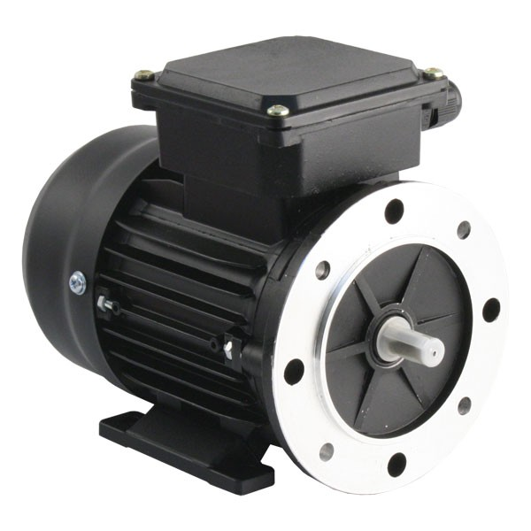
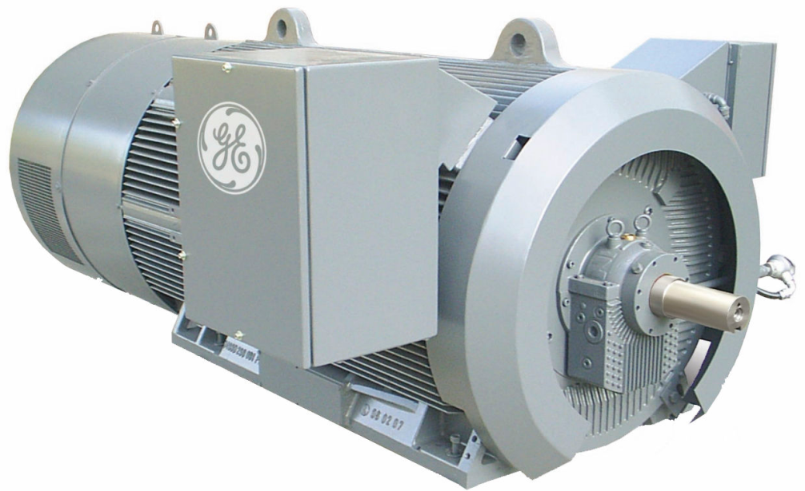
Equations Cont.
Torque
$$\sum{T}=T_{e}−B_{m} ω_{rm}−T_{L}$$
$$T_{e}= −\frac{∂W_{c}}{∂θ_{r}}=\frac{P}{2}L_{ms}\left[i_{as} i_{bs}\right]\left[\begin{matrix}−sinθ_{r} & −cosθ_{r} \\ cosθ_{r} & −sinθ_{r}\end{matrix}\right]\left[\begin{matrix}{i^{′}}_{ar} \\ {i^{′}}_{br}\end{matrix}\right]$$
$$T_{e}=−\frac{P}{2}L_{ms}\left[\left(i_{as}i_{ar}^{′}+i_{bs}i_{br}^{′}\right)sinθ_{r}+\left(i_{as}i_{br}^{′}−i_{bs}i_{ar}^{′}\right)cosθ_{r}\right]$$

Slide 8
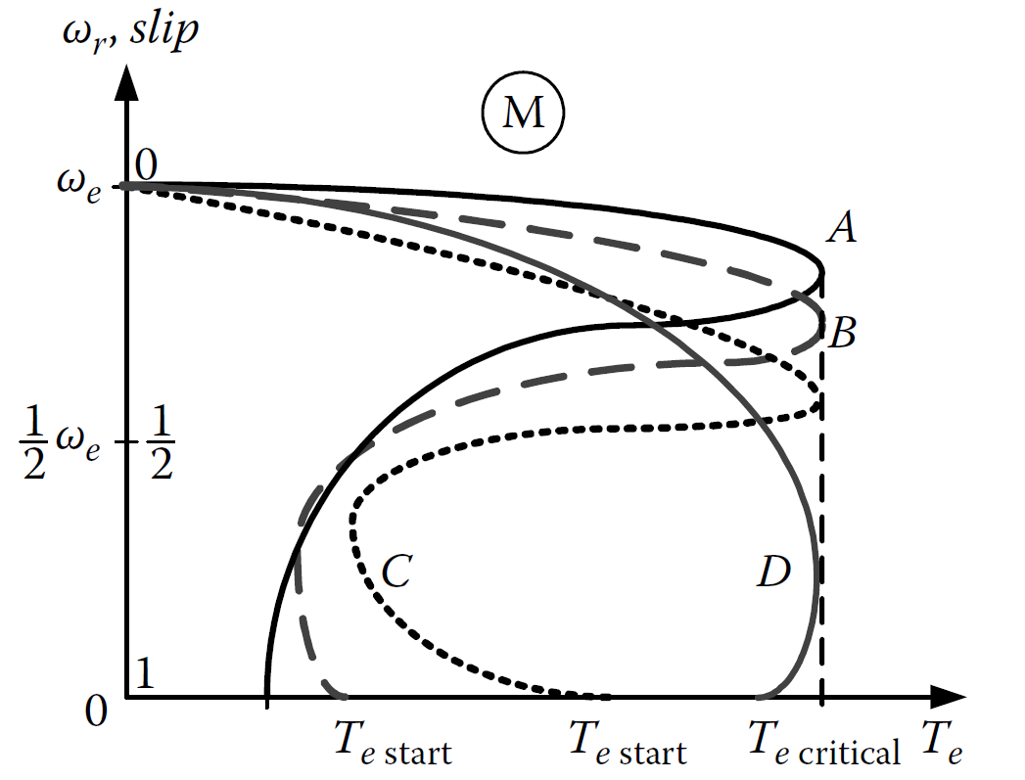
Torque Characteristics
A and B classes are commonly used for industrial applications
D classes are commonly used for homeowner applications

Slide 9
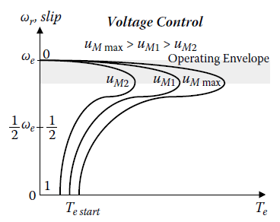
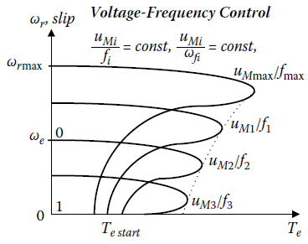
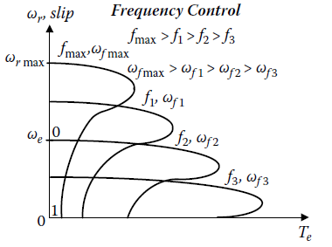
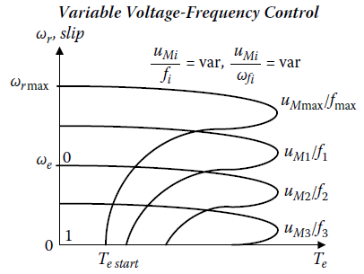
Control

Slide 10
Thank you
Bibliography
http://4.bp.blogspot.com/_0pgK8uZSYtM/TNh4rr_5FMI/AAAAAAAAAAM/atjmT-r8x9Q/s1600/motor1.jpg
http://myelectrical.com/Portals/0/SunBlogNuke/2/WindowsLiveWriter/MotorStartingIntroduction_BC07/electricMotorPumpSet_2.jpg
http://www.pwslaundry.com/i-7800475-whirlpool-279827-dryer-motor-drve.html
http://electricalquestionsguide.blogspot.com/2011/12/induction-motor-advantages.html
http://www.alibaba.com/product-detail/Three-Phase-Induction-Motor_315087147.html
http://electrical-engineering-portal.com/induction-machines-historical-touch.
http://ieeexplore.ieee.org/stamp/stamp.jsp?arnumber=01454598
Electromechanical Systems and Devices by Sergey E. Lyshevski

