Slide 1
Smart Grid & Microgrid R&D
Steve Bossart
Senior Energy Analyst
U.S. Department of Energy
National Energy Technology Laboratory
Military Smart Grids & Microgrids Conference
May 1-2, 2012
Notes:
Smart Grid R&D Needs

Slide 2

Smart Grid & Microgrid R&D Topics
Vision and goals
Background
Research needs
  Standards and best practices
  Technology development
  Modeling
  Analysis
  Evaluation and demonstration
  Microgrid
Notes:
List of topics
Vision and goals of OE and its R&D program
Background on creation of the R&D needs
Specific R&D needs aligned by these five areas.
Standards and best practices to ensure interoperability and cyber protection
-Technology development
Modeling, simulation, visualization
Analytical work - cost and benefits, sensing and control, protection
-Evaluation and demonstration – integration of technologies into a smart grid

Slide 3
Vision and Goals

Slide 4
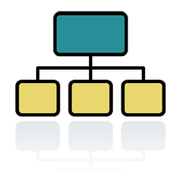
DOE OE Mission
Mission of Office of Electricity Delivery and Energy Reliability
Lead national efforts to modernize the electric grid;
Enhance security and reliability of the infrastructure; and
Facilitate recovery from disruptions to energy supply
Accelerate the deployment and integration of advanced communication, control, and information technologies that are needed to modernize the nation‘s electric delivery network
Notes:
Three divisions in OE
R&D – modernize grid
Permitting, Siting, and Analysis – ensure reliability and security
Infrastructure Security and Energy Restoration – restore energy supply
Goal of R&D is to accelerate the transition to a smart grid by integrating grid data, communications and controls.

Slide 5
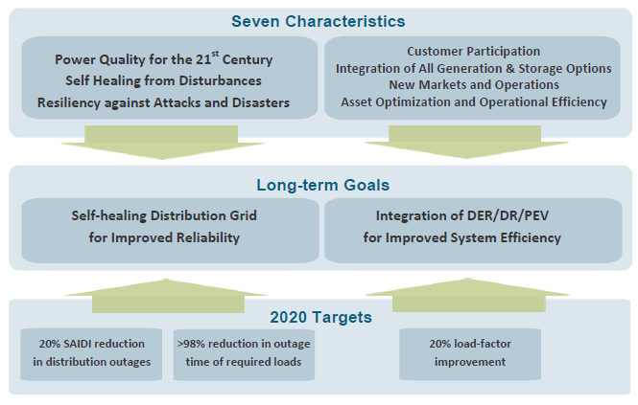
Grid Modernization Goals
Notes:
The seven functional characteristics lead to achievement of long-term goals of creating a self-healing distribution system for improved reliability and integration of distributed assets including generation and storage, smart appliances enabling demand response, and electric vehicles. About 80-90% of outages are caused by problems in distribution system.
2020 targets are 20% improvement in SAIDI (system reliability),
over 98% reduction in outage time for critical loads, and
Over 20% load factor improvement (Average-to-Peak ratio)

Slide 6
Background

Slide 7
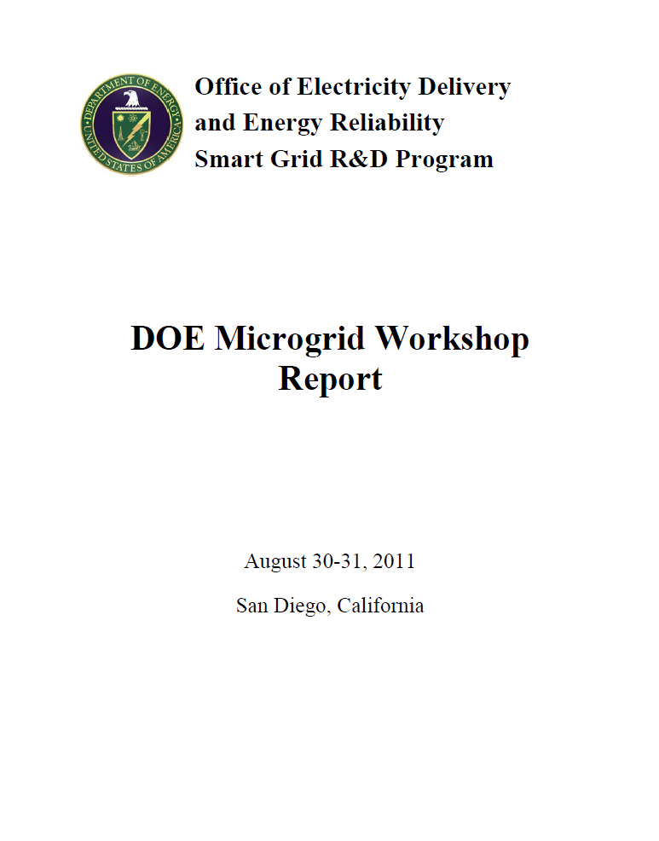
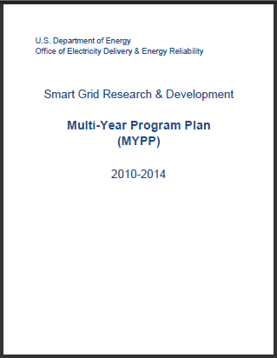
Smart Grid & Microgrid R&D Sources
Notes:
Much of this presentation is derived from the DOE OE multiyear R&D plan covering 2010-2014. It was originally published in 2010 and an update is under review prior to release.
The original smart grid R&D plan was created from discussions held at a smart grid roundtable meeting in December 2009 that included multiple types of stakeholders (e.g., national laboratories, utility commissioners, utilities, vendors). Stakeholders were divided into five R&D groups to focus on particular topics.
Guides R&D solicitations
Sets priorities
Sets interim goals
Measures progress

Slide 8
Smart Grid R&D
Multi-Year Program Plan 2010-2014
Originally published in 2010
  Smart Grid Roundtable Meeting in December, 2009
  Multiple stakeholders
  R&D Groups
September 2011 update
Notes:
Much of this presentation is derived from the DOE OE multiyear R&D plan covering 2010-2014. It was originally published in 2010 and an update is under review prior to release.
The original smart grid R&D plan was created from discussions held at a smart grid roundtable meeting in December 2009 that included multiple types of stakeholders (e.g., national laboratories, utility commissioners, utilities, vendors). Stakeholders were divided into five R&D groups to focus on particular topics.
Guides R&D solicitations
Sets priorities
Sets interim goals
Measures progress

Slide 9

Criteria for DOE Smart Grid R&D Plan
Hindered by lack of standards or conflict with standards
Not being addressed by industry or Federal R&D
Longer-term, high-risk
Transformative, high-payoff
Feasible within likely Federal budget
Long-term, high-risk R&D in high-impact technologies
Notes:
For an R&D need to be included in the DOE OE R&D plan it needs to meet these criteria.
Technology that is hindered by lack of standards or conflict with existing standards
Not being addressed already by industry or Federal R&D
Focus of Federal R&D is longer term than industry and higher risk
Results are R&D are expected to be transformative with a high payoff , if successful
Feasible within budget limitations
Theme is long-term, high-risk R&D on high-impact technologies
Minimize risk of stakeholders in adopting new technologies (utilities, vendors, consumers)
Results in transformative changes to the grid
- Unlikely to be funded by private sector

Slide 10
DOE Planning Process for Microgrid R&D
    Assembled planning committee with national lab representatives (LBNL, NREL, ORNL, SNL)
    Formulated microgrid technical
    performance and cost targets
    Identified key microgrid components
    that could benefit from additional R&D
    Conducted preliminary analysis to determine the baseline and potential research areas

Slide 11
Major Cost Components of a Microgrid
Energy Resources (30-40%) | Switchgear Protection & Transformers (20%) | Smart Grid Communications & Controls (10-20%) | Site Engineering & Construction (30%) | Operations & Markets
Energy storage; controllable loads; DG; renewable generation; CHP | Switchgear utility interconnection (incl. low-cost switches, interconnection study, protection schemes, and protection studies) | Standards & protocols; Control & protection technologies; Real-time signals (openADR); Local SCADA access; Power electronics (Smart Inverters, DC bus) | A&E (System design and analysis); System integration, testing, & validation | O&M; Market (utility) acceptance
Notes:
Percents in parentheses indicate approximate contribution to the overall microgrid costs.
Sub-components highlighted in red and blue were identified as fitting to the OE mission areas and having potential for significant cost reduction by OE Smart Grid R&D Program efforts. The sub-component areas in blue were organized as the three Technical Sessions in breakout group 1 of the DOE Microgrid Workshop; and those in red were organized as the three Technical Sessions in breakout group 2.

Slide 12
Development of Microgrid R&D Needs
    Stakeholder Engagement
    Convened a Workshop to further define:
    Baseline performance
    Areas of research needs
    End goals (technical/cost targets and their significance)
    Actionable plan to reach the targets (scope, schedule, participants, milestones)
    Workshop Details
    August 30-31, 2011
    University of CA, San Diego
    73 participants
    Vendors, electric utilities, national labs, universities, research institutes, end users (including military bases, municipalities, and data centers), and consultants

Slide 13
Smart Grid R&D Needs

Slide 14
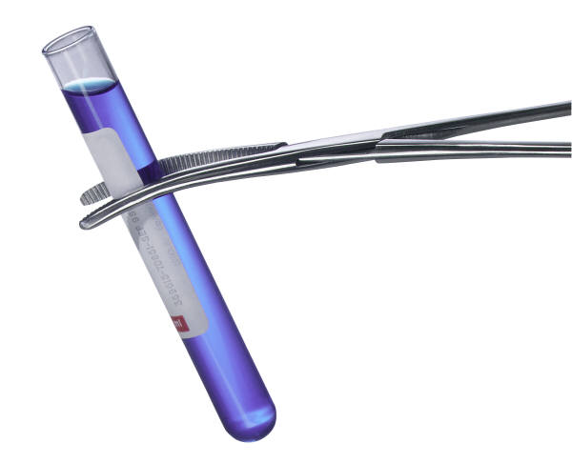
R&D Topics
Standards & Best Practices
Technology Development
Modeling
Analysis
Evaluation & Demonstrations
Notes:
Distribution and consumer systems and their integration with generation and transmission systems
Standards & Best Practices for electrical and communications interconnection, integration, interoperability, conformance test procedures, and operating practices.
Technology Development in advanced sensing and measurement, integrated communications and security, advanced components and subsystems, advanced control methods and system topologies, and decision and operations support.
Modeling accurately the behavior, performance, and cost of distribution-level smart grid assets and their impacts at all levels of grid operations from generation to transmission and distribution.
Analysis of measured data and simulations to better understand the impacts and benefits concerning capacity usage, power quality and reliability, energy efficiency, operational efficiency, and clean technology, as well as economic/business environment and crosscutting goals.
Evaluation & Demonstrations of new technologies and methods in terms of performance and conformance

Slide 15
Standards & Best Practices
Developing, maintaining, and harmonizing national and international standards
  Interconnection, interoperability, integration, and cyber security
Legacy and advanced distribution system protection, operations and automation
Defining reliability and ancillary service requirements
Define roles of load serving entities, EMS, aggregators, and ISO/RTOs in market
Developing best practices to manage PEV charging including “roaming” locations
Notes:
Developing, maintaining, and harmonizing national and international standards on interconnection, integration, interoperability, and cyber security requirements and conformance test procedures for distributed energy resources.
Developing and maintaining legacy and advanced distribution system protection, operations, and automation best practices. Integrating new and old components while ensuring connectivity and interoperability.
Developing best practices to allow for improved markets by defining reliability and ancillary service requirements
Ancillary services such as reserves, load following, voltage control and frequency regulation, VAR compensation may have different requirements and approach in smart grid environment..
Clarify roles of entities within the smart grid, such as load serving entities, aggregators, energy management systems, and independent system operators.
Developing best practices to manage PEV charging and ―roaming from one location to another.

Slide 16
Standards and Best Practices
Some Technical Tasks
Interoperability and Interconnection
  Develop use cases to identify requirements
  Develop exploratory and conformance test procedures
  Develop schemes for protection, operation, and automation
Cyber Security
  Identify security requirements for all assets
  Develop a security architecture
  Develop and validate methods for cyber secure operation
Market and Reliability
  Describe operating models for power system and market
  Develop clearly defined functional roles for entities
Notes:
Technical scope
Interoperability
Develop use cases to identify requirements; assets and their functions
Need to develop test protocols to confirm interconnection and interoperability
- Develop approaches for protection, operation, and automation
Cyber
Security requirements
- Security architecture
- Develop test protocols to validate cyber security
Market
Models to describe operations of power system and operations of market
- Define roles for grid entities (ISO/RTO, distribution operators, DR aggregators)

Slide 17
Technology Development
Sensing & measurement
  Weather, equipment health, customer devices, …
Communications and security
  Wireless, power line carrier, internet, …
Advanced components
  Power electronics, intelligent loads, V2G, G2V, e-storage..
Control methods
  Distributed control, DA, mixed AC/DC, adaptive protection
Decision and operations support
  Visualization, diagnostic & operations, data processing
Notes:
Sensing and measurement – Support faster and more accurate sensors to participate in remote monitoring and dynamic pricing
Weather monitors, smart meters and AMI
Customer – low cost and low power; energy usage and power quality
Distribution - current, voltage, phase angle, real and reactive power flow, GIS
Equipment health sensors
Temperature sensors for dynamic load rating
Communications and security
wireless, power line communications, microwave, optical, cellular, internet
cyber security
Advanced Components
Power electronics - solid state devices (breakers, transformers, switches, tap changers, relays, reclosers)
Intelligent loads; V2G, G2V; E-storage controls
Control methods
Decentralized control, distribution automation, mixed AC/DC systems, adaptive protection and control
Decision and operations support
Visualization, diagnostics and operations support, information processing, customer systems

Slide 18
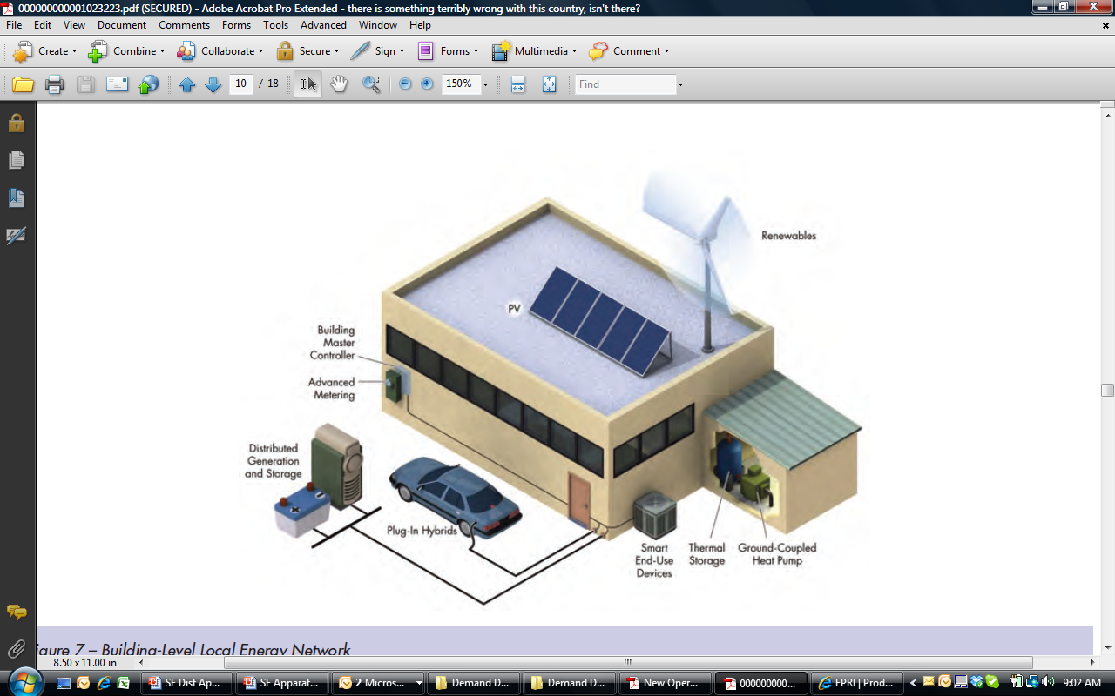
Technology Development
“Integration”
Integration of DER and DR to reduce peak load and improve efficiency
Smart charging PEVs
Microgrid
Communications and controls
Smart inverters for renewables
EPRI
Notes:
Additional areas of technology development
- Integrate DG and E-storage with DR to reduce peak load and improve efficiency; proper balance of using assets
Smart charging PEVs in response to price signals and charging requirements
- Microgrid integration with main grid, islanding, serve critical loads, proper balance
- No single communication or control system is the “best” for all situations
- Smart inverters to convert DC to AC for intermittent renewables ; integrate with primary grid

Slide 19
Modeling

Slide 20
Modeling
Modeling, simulation, and visualization
Planning, design and operations
Behavior, performance, and cost of smart grid assets
Impact on generation and T&D
operations
Notes:
Area of modeling covers development of analytical tools, simulation tools, and visualization tools.
Covers GT&D planning, detailed design, and grid operations
Covers the behavior, performance and cost of smart grid and contribution of specific assets
And their impact of generation and T&D operations.

Slide 21
Modeling
Create public library of smart grid software (components, controls)
Establish benchmark test cases to validate models and software tools
Develop fast computational algorithms and parallel computing capabilities
Develop capability to model impact of smart grid on entire grid
Develop dynamic response models
Continuous update of distribution system
Link distributed engineering, work order, outage management, and automated mapping models
Integrate communications, markets, and renewable resource models
Open standards to describe distribution, smart grid, and consumer assets
Notes:
Create a public library of smart grid component models, controls, operating strategies, and test cases for the vendor community and utilities
Establish benchmark test cases to validate smart grid models and software tools.
Expand IEEE distribution test cases (to include smart grid assets and operations.
Develop fast computational algorithms and parallel computing capabilities to increase the speed of smart grid models so that they can be embedded in real-time controls and decision support tools.
Develop the capability to model impacts of smart grid operations on the entire grid. Develop models of dynamic response of a smart grid on the transmission and generation system.
Continuous updates of the distribution system model in distribution engineering tools so that they accurately reflect the current configuration, which will be increasingly dynamic as smart grid technology is deployed.
Link distribution engineering models with the work order, outage management, and automated mapping/facilities management/geographic information systems.
Develop techniques for integrating communication network models, wholesale market models, and renewable resource models
Support development of open standards for describing distribution systems, customer loads, and smart grid components.

Slide 22
Analysis

Slide 23
Analysis
Progress and impact of smart grid investments
Support effective cyber security, privacy, and interoperability practices
Impact on outage number, duration & extent
Impact on power quality and reliability
Impact on power system planning
Impact of T&D automation on variable renewable integration
Potential capacity from DR, DG, and e-storage
Consumer studies on acceptance of DR, PEV, storage, energy efficiency, & local generation
Evaluate benefits and cost
Business case
Notes:
Assess the progress of smart grid deployments and investments.
Understanding the issues and potential remedies to support effective cyber security, information privacy, and interoperability practices and their acceptance by industry.
Provide an analytic basis for the delivery of appropriate levels of power quality and reliability at the various levels of ―smart‖ distribution infrastructure and end-use systems, recognizing the differentiated costs and benefits.
Assess the impact of a smart grid on the number, duration, and extent of electricity outages, including cascading events.
Evaluate the energy efficiency impact of energy management devices in consumer facilities.
Analyzie the ramifications of smart grid capabilities on distribution, transmission, and generation planning.
Analyze the impact of transmission & distribution automation on integrating high penetration of variable renewable resources.
Determine potential smart grid-facilitated capacity amounts from DR, distributed generation, and improved asset utilization.
Conduct consumer studies regarding acceptance of DR, on-site generation, PEVs, storage, and energy efficiency programs.
Examine the business case; benefits streams and cost; benefits to utilities, consumers, and society

Slide 24
Evaluation and Demonstration

Slide 25
Evaluation and Demonstration
Gaps in smart grid functionality
Gaps in technology performance
Protocols in evaluating new components
Performance and conformance with emerging standards
Notes:
New technologies and methods are needed to evaluate and demonstrate performance and compliance with emerging standards and best practices and interoperability requirements. R&D will focus on
Identifying any gaps in smart grid functionality or gaps in performance of existing technologies.
Develop protocols to test and evaluate new components and systems
Evaluate testing capabilities in industry, government, and laboratories.

Slide 26
Microgrid R&D

Slide 27
List of High-Priority R&D Projects from the DOE Microgrid Workshop
Impactful R&D Areas | High-priority R&D Projects
Standards and Protocols | Universal Microgrid Communications and Control Standards
 | Microgrid Protection, Coordination, and Safety
Systems Design and Economic Analysis | Microgrid Multi-objective Optimization Framework
System Integration | Common Integration Framework for Cyber Security/Control/Physical Architectures
Switch Technologies | Legacy Grid-Connection Technologies to Enable Connect/Disconnect from Grid
 | Requirements based on Customer and Utility Needs
Control and Protection Technologies | Best Practices and Specifications for Protection and Controls
 | Reliable, Low-cost Protection
Inverters/Converters | Topologies & Control Algorithms for Multiple Inverters to Operate in a Microgrid
 | Advanced Power Electronics Technologies
Notes:
These will be the areas that guide future microgrid R&D FOA.

Slide 28

Contact Information
Steve Bossart
(304) 285-4643
Steven.Bossart@netl.doe.gov
Smart Grid Implementation Strategy
www.netl.doe.gov/smartgrid/index.html
Federal Smart Grid Website
www.smartgrid.gov
Smart Grid Clearinghouse
www.sgiclearinghouse.org/

