Slide 1
Schizo phrenia
Presented by:

Slide 2
Summary
The following presentation is a brief compendium of images and information concerning Schizophrenia.
We will first look at what is Schizophrenia and its symptoms followed by its anatomical and biological criteria.
The presentation will conclude by looking at Diagnosis, Demographics, Treatment, and Research.
It was first classified by Dr. Emile Kraepelin in 1890, although historical documents have identified schizophrenia as far back as Pharaonic Egypt. At that time it was believed to be an illness of the heart and uterus.

Slide 3
What is Schizophrenia?
Schizophrenia: a long-term mental disorder of a type involving a breakdown in the relation between thought, emotion, and behavior, leading to faulty perception, inappropriate actions and feelings, withdrawal from reality and personal relationships into fantasy and delusion, and a sense of mental fragmentation.
General: a mentality or approach characterized by inconsistent or contradictory elements
Greek Roots: schizo (split) + phrene (brain)

Slide 4
Symptoms & Clinical Presentation
Hallucinations
Audio and Visual
Delusions
Contradictory fantasies
Disorganized thought
Leading to impaired speech
Impaired judgment
Social Withdrawal
Emotional Difficulty
Can’t read emotions
Memory impairment
No percieved self control
Schizophrenic Self Portrait demonstrating feeling of no self control

Slide 5
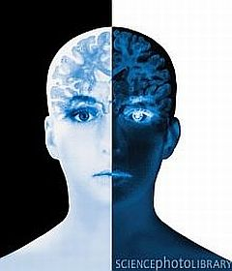
Schizophrenia Classifications
A. Paranoid Schizophrenia
Most common type. Normally hear threatening voices and have frightening thoughts. Tends to develop later in life than other forms and also gets better with treatment
B. Disorganized Schizophrenia
The rarest but most serious form of
Schizophrenia. Patients with this form
have unpredictable and sometimes
dangerous behavior. They often make
up words and sentences. Also called
Hebephrenic Schizophrenia
C. Catatonic Schizophrenia
Rare in which the patient stands or sits still for extended periods of time called a catatonic stupor. This is followed by meaningless intense activity called catanoic excitement.
D. Undifferentiated Schizophrenia
E. Residual Schizophrenia

Slide 6
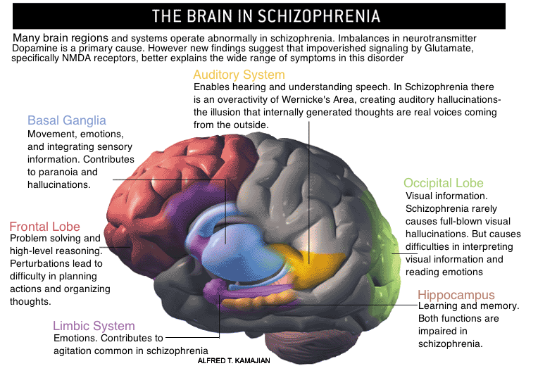

Slide 7
Gray Matter Deficits, UCLA Laboratory of Neuroscience MRI
Created by repeatedly scanning 12 patients and 12 matched controls during the same intervals over a five year course period. STG is the superior temporal gyrus, while DLPFC is the dosolateral prefrontal cortex.

Slide 8
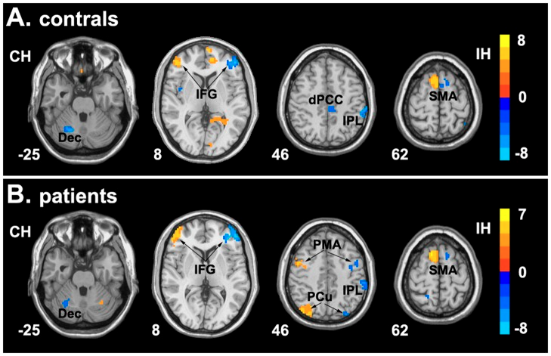
Clinical Diagnosis
American Psychiatric Association’s
Diagnostic and Statistical Manual of
Mental Disorders.
World Health Organization’s International Statistical Classification of Disease and Related Health Problems.
Criteria: Delusions, Hallucinations, Disorganized thoughts due to Formal Thought Disorder, disorganized or catatonic Behavior, and Negative Symptoms.

Slide 9
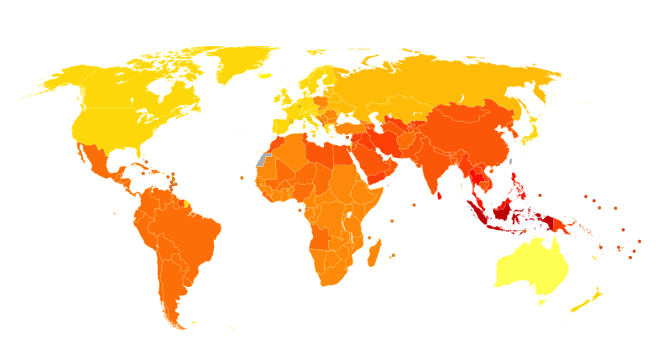
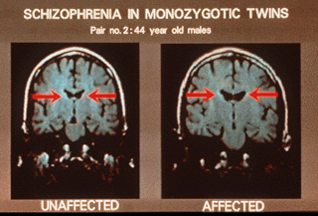
Risk & Demographics
0.3 – 0.7% of people or 24 million people worldwide
1.4 times more frequent in Males than Females
Peak age onset age is 20 – 28 years in Males and 26 – 32 years in Females. Childhood or middle age is much rarer.
Hereditary. A first degree relative increases the risk up to 46%.
Urban environment
Drug uses, 2x risk.
Winter or spring births, possibly due to utero viral exposures
Above image is of two Monozygotic twins who are 44 years old. The image on the right shows the unaffected twins smaller ventricle, while on the left, the enlarged ventricles can clearly be seen. http://www.schizophrenia.com/family/disease.htm

Slide 10
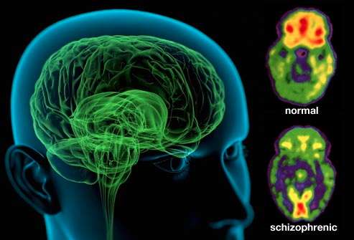
Treatment
Typical: older antipsychotics
Chlorpromazine (Thorazine)
Haloperidol (Haldol)
Perphenazine (Etrafon, Trilafon)
Fluphenazine (Prolixin).
Atypical: second generation antipsychotic drugs
Risperidone (Risperdal)
Olanzapine (Zyprexa)
Quetiapine (Seroquel)
Ziprasidone (Geodon)
Aripiprazole (Abilify)
Paliperidone (Invega)
Side effects: severe enough that many pateints refuse to take the drugs.
Drowsiness
Dizziness
Blurred vision
Rapid heartbeat
Sensitivity to the sun
Skin rashes
Menstrual problems for women

Slide 11
Research- SIRS
UTHSC Cell Transplant Treatment: instead of patients taking antipsychotic drugs, researchers are looking into cell transplants which would replace damaged cells of schizophrenia via stem cells.
Early Diagnosis: early intervention is essential in improving prognosis. This primarily means looking at the disease during the Prodormal phase. Research is looking into ways of diagnosing Schizophrenia by definitive clinical testing via biological markers as well as ways of identifying prodromal symptoms.
Schizophrenic medications currently in Phase III trials:
Asenapine (for positive/negative symptoms)
Bifeprunox (positive, negative, cognitive symptoms; relieve side effects)
Iloperidone/Zomaril (positive, negative, cognitive symptoms)
Lamictal (adjunct therapy; may improve positive symptoms)
Osanetant (for movement side-effects caused by traditional neuroleptics)
Paliperidone (for treatment-refractory patients)
RG1068 (for autistic-type symptoms in schizophrenia patients)
Seromycin/d-cycloserine (adjunct treatment, for negative symptoms)

Slide 12
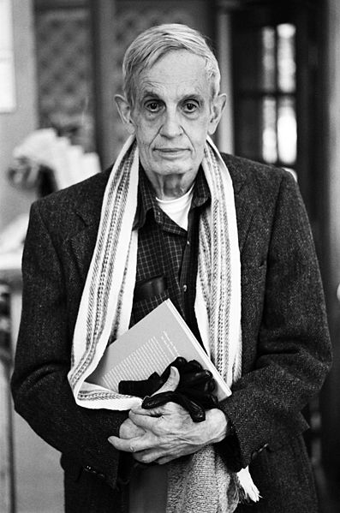
Concluding Statement
In conclusion we looked at the classifications, symptoms, effects, treatments and research of Schizophrenia.
Although Schizophrenia is a horrible disorder it is important to note the success stories of people like John Forbes Nash. He was an American mathematician and economist of Princeton University and is also the recipient of the 1994 Nobel Memorial Prize. He accomplished so much even tho was diagnosed as Schizophrenic. His life is the subject of the 2001 film A Beautiful Mind

Slide 13
References
http://en.wikipedia.org/wiki/File:Artistic_view_of_how_the_world_feels_like_with_schizophrenia_-_journal.pmed.0020146.g001.jpg
http://en.wikipedia.org/wiki/Schizophrenia
http://www.schizophrenia.com/schizpictures.html#
http://en.wikipedia.org/wiki/Schizophrenia
http://www.schizophrenia.com/family/disease.htm
http://www.nimh.nih.gov/health/publications/schizophrenia/index.shtml
http://bionews-tx.com/news/2013/09/10/uthsc-researcher-reveals-cell-transplants-as-possible-novel-schizophrenia-treatment/
http://www.psychiatrictimes.com/articles/biological-markers-and-future-early-diagnosis-and-treatment-schizophrenia
http://www.webmd.com/schizophrenia/classification-of-schizophrenia
http://en.wikipedia.org/wiki/File:John_Forbes_Nash,_Jr._by_Peter_Badge.jpg

