Slide 1
Leishmaniasis
Presented By:
Dr.Shaymaa Abdalal
Demonstrator in Medical Parasitology Department

Slide 2
The Parasite
Phylum
Order
Family
Genus
Sarcomastigophora
Kinetoplastida
Trypanosomatidae
Leishmania

Slide 3
Leishmaniasis
Disease:
Cutaneous leishmaniasis
Mucocutaneous leishmaniasis
Visceral leishmaniasis

Slide 4
Leishmaniasis
Mucocutaneous leishmaniasis
Leishmania braziliensis
Leishmania tropica*
Cutaneous Leishmaniasis
Leishmania major*
Leishmania aethiopica
Leishmania mexicana
Visceral Leishmaniasis
Leishmania donovani*
Leishmania infantum*
Leishmania chagasi
Endemic in Saudi Arabia

Slide 5
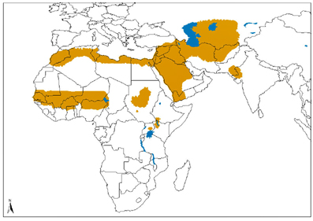
Leishmaniasis
Distribution:

Slide 6
Leishmaniasis
Definitive host : man
Vector : Sand Fly
Reservoir host: Dogs and rodent
Habitat: macrophages of the host
Infective stage :promastigotes

Slide 7
Mode of infection
transmitted by the bite of infected female phlebotomine sand flies. The sand flies inject the infective stage (i.e., promastigotes) during blood meals

Slide 8
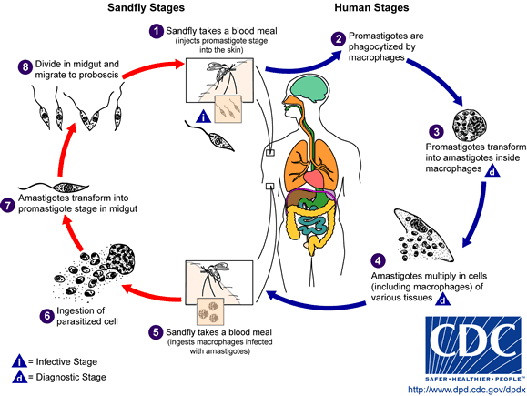
Leishmania Life cycle

Slide 9
Leishmaniasis
Morphology

Slide 10
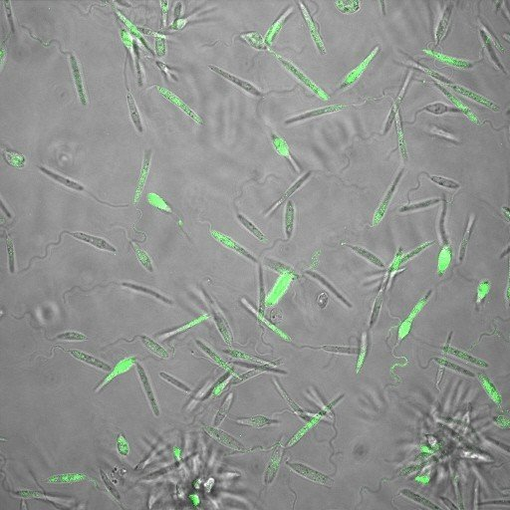
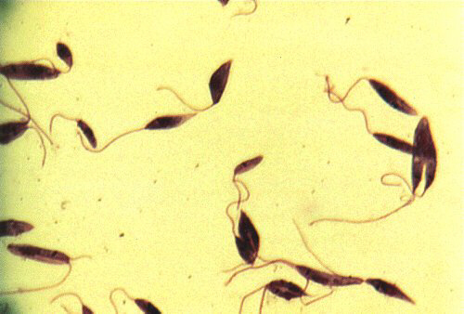
Leishmania Promastigoate
Morphology
Size: 14 - 20 µm X 1.5 - 4 µm
Long and thin.
central nucleus.
a kinetoplast.
an anterior flagellum.

Slide 11
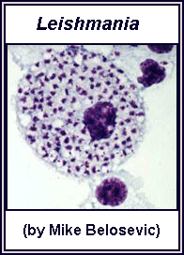
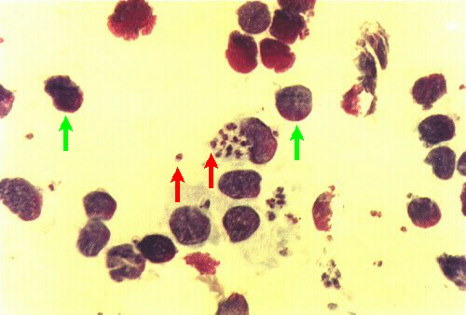
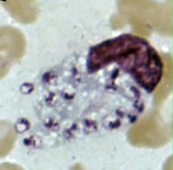
Leishmania Amastigoate
Morphology
a nucleus.
Kinetoplast.
internal flagellum
oval Shape.
Size:2-5 µm X 1 - 3 µm.

Slide 12
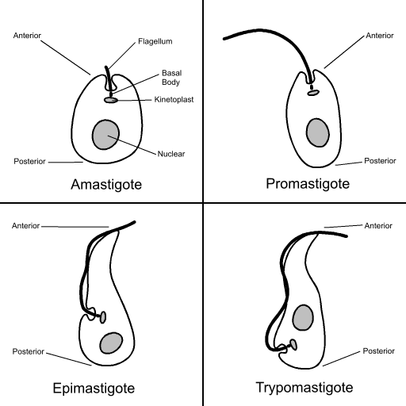
Leishmania Morphology

Slide 13
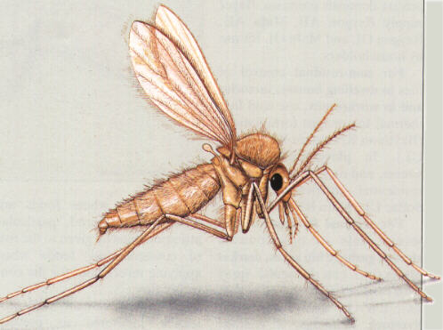
Vectors Sand Fly
Female.
Size: 1.5–3 mm.
yellowish in colour.
black eyes.
hairy body.
The oval lanceolate wings are carried erect on the humped thorax

Slide 14
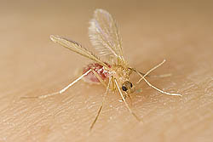
Vectors Sand Fly
Phlebotomus spp.Transmit Leishmania.
Live in moist soil, stone walls, rubbish heaps, etc.
Only females suck blood.
Adults live about 2 weeks.
Take 2-3 blood meals during
lifespan.
Typically feed at night.
Weak fliers (“hop”).

Slide 15
Clinical Disease
Visceral
Fatal (90% untreated)
Liver
Spleen
Bone marrow
Cutaneous
Generally Self- healing
Skin
Mucous membranes
SPECTRUM OF DISEASE

Slide 16
Initial Infection
Similar in all species
Inoculation of promastigotes
Inflammation & chemotaxis
Receptor mediated phagocytosis
Promastigote Amasitgote
Transformation

Slide 17
Parasite Spread
Macrophage lysis & parasite release
Lymphatic spread
Blood spread
Target organs
Skin/lymph nodes/spleen/liver/
bone marrow

Slide 18
Diagnosis

Slide 19
cutaneous leishmaniasis
Diagnosis
Smear: Giemsa stain – microscopy for (amastigotes)
Biopsy: microscopy for culture in NNN medium for promastigotes

Slide 20
Visceral leishmaniasis
Diagnosis
Parasitological diagnosis: METHOD
Bone marrow aspirate 1. microscopy
Splenic aspirate 2. culture in NNN medium
Lymph node
Tissue biopsy

Slide 21
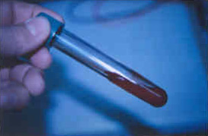
NNN medium

Slide 22
(2) Immunological Diagnosis:
Specific serologic tests: Direct Agglutination Test (DAT), ELISA, IFAT
Skin test (leishmanin test) for survey of populations and follow-up after treatment.
Non specific detection of hypergammaglobulinaem by formaldehyde (formol-gel) test or by electrophoresis.

Slide 23
THANK YOU

