Slide 1
Hormones

Slide 2
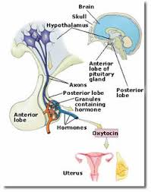
Oxytocin/Prolactin
Origin
Oxytocin- Posterior Pituitary
Prolactin- Anterior Pituitary
Target Tissue
Oxytocin- Uterus and Breast Muscle
Prolactin- mammary glands of the breast
Effect
Oxytocin causes muscle contraction to expel the baby and expel milk in the breast
Prolactin stimulates milk production

Slide 3
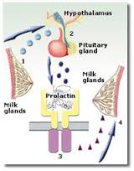
Oxytocin/Prolactin
What is being controlled
Birth and breast feeding
Antagonistic/Synergistic/Neither
Synergistic (they both work at birth)
Animal or Plant
animal

Slide 4
Antidiuretic Hormone (ADH) & Atrial Nutriuretic (ANF)
Origin
ADH- posterior pituitary
ANF- Right Atrium of the heart
Target Tissue
Both in the distal tubule and collecting duct of nephrons in the kidney
Effect
ADH reduces urine production by reabsorbing the water because the body is dehydrated
ANF increase urine production by causing less water reabsorption because the blood pressure is too high due to the extra water

Slide 5
What is being controlled
Osmoregulation (water control)
Antagonistic/Synergistic/Neither
Antagonistic, they work against each other to control water levels
Animal/Plant
animals

Slide 6
Thyroid Stimulating (TSH) and Parathyroid Hormone (PTH)
Origin
TSH- anterior pituitary
PTH- thyroid gland
Target Tissue
TSH- thyroid gland
PTH- bones
Effect
TSH helps to control metabolism rates using T3 and T4 hormones and calcium levels using Calcitonin (lowers Ca levels by making bone cells take it up by building bone)
T3 active form increases cellular respiration
T4 inactive form, causes movement in the blood to the cells
PTH
PTH raises blood Ca levels by causing bone cells to break down bone

Slide 7
What is being controlled
Metabolism (TSH) and blood calcium levels (PTH)
Antagonistic/Synergistic/Neither
Antagonistic on blood calcium levels
Animal/Plant
animals

Slide 8
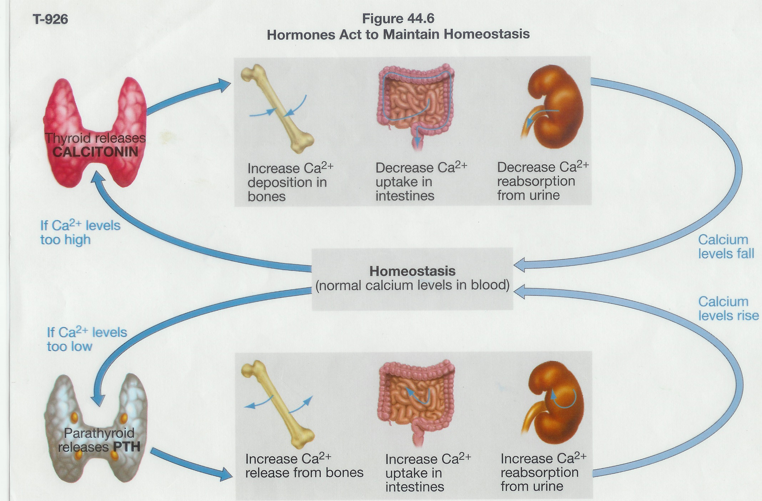

Slide 9
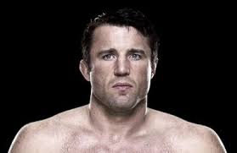
Human Growth Hormone (HGH) and Erythropoietin (EPO)
Origin
HGH- Anterior Pituitary
EPO- kidneys
Target Tissue
HGH- liver and muscle tissue
EPO- bone marrow
Effect
HGH makes muscle cells grow and divide and causes the liver to release Insulin Growth Factors (IGF), which makes bone and cartilage grow to support greater muscle mass
EPO stimulates RBC production to increase oxygen transportation levels

Slide 10
What is being controlled
HGH- bodily growth
EPO- oxygen levels in the blood
Antagonistic/Synergistic/Neither
Neither, they are not related
Animal or Plant
Found in animals

Slide 11
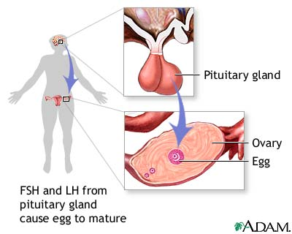
Follicle Stimulating Hormone (FSH) and Luteinizing Hormone (LH)
Origin
Both are found in the anterior pituitary
Target Tissue
Ovaries in females and testes in males
Effect
FSH stimulates follicles to mature in the ovaries and causes estrogen to be released to the uterus to begin endometrial proliferation. In males it stimulates sperm production and release of testosterone. (Estrogen and testosterone both stimulate sexual maturation)
LH stimulates a mature follicle to be released (ovulation) from the ovary and release of progesterone to stimulate endometrial cells to produce large quantities for sugar for nutritional need of possible implant by a fertilized zygote (blastula stage).

Slide 12
What is being controlled
Reproductive cycles and sexual maturation
Antagonistic/synergistic/neither
They are synergistic, because they help control the reproductive cycle
Animal or Plant
They are animal hormones

Slide 13
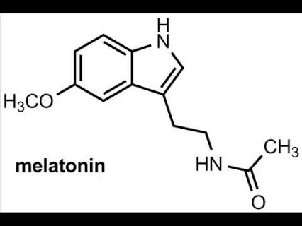
Melanocyte Stimulating Hormone (MSH) & Melatonin
Origin
MSH- anterior pituitary
Melatonin- Pineal gland of the brain
Target Tissue
MSH- skin cells
Melatonin- suprachiasmatic nuclei (SCN) of the brain stem
Effect
MSH stimulates skin cells to begin producing melanin protein pigments to try and absorb harmful UV radiation (tanning response)
Melatonin stimulates sleeps

Slide 14
What is being controlled
MSH- tanning response to avoid UV damage from the sun
Melatonin- sleep and awareness cycles
Antagonistic/Synergistic/Neither
Neither, not related
Animal or Plant Hormones
Both are animal

Slide 15
Insulin and Glucagon
Origin
Insulin- beta cells of the islets of Langerhans in the pancreas
Glucagon- alpha cells of the islets of Langerhans in the pancreas
Target tissue
Insulin- liver and body cells
Glucagon- liver and body cells
Effect
Insulin stimulates cells to take up excess sugar in the blood to lower blood sugar levels and helps raise cellular rates
Glucagon raises blood sugar levels by causing the liver to break down glycogen to glucose and put it in the blood

Slide 16
What is being controlled
Blood glucose levels associated with eating
Antagonistic/Synergistic/Neither
Antagonistic to control blood glucose levels
Animal/Plant
animals

Slide 17
Epinephrine/Norepinephrine
Origin
Epinephrine- Medulla of the adrenal gland and neurons
Norepinephrine- Medulla of the adrenal gland and neurons
Target Tissue
Muscle cells and liver
Effect
Both increase cellular respiration rates, conversion of glycogen, lipids, and proteins to energy, breathing and oxygen uptake, increase in blood pressure

Slide 18
What is being controlled
Energy production in stressful times (fight or flight response)
Antagonistic/Synergistic/Neither
Synergistic to control energy production
Animal/Plant
animal

Slide 19
RAAS (Renin-Angiostenin-Aldosterone System)
Origin
Renin- afferent ateriole of the glomerulus
Angiotensin- blood
Aldosterone- adrenal gland
Target Tissue
Renin- blood
Angiotensin- blood
Aldosterone- distal tubules and collecting ducts of nephons in the kidneys

Slide 20
Effect
Renin activates the blood enzyme angiotensinogen to become angiotensin
Angiotensin causes the adrenal gland to release aldosterone and make the arterioles constrict to reduce blood flow
Aldosterone causes water reabsorption within the distil tubule and collecting duct to increase blood volume
What is being controlled
The RAAS system is an emergency mechanism of the body to rapidly increase blood volume in an attempt to keep blood pressure up, and avoid heart failure, because there is a wound causing large amounts of blood loss
Antagonistic/Synergistic/Neither
Synergistic, they work together to increase blood volume
Animal/Plant
animal

Slide 21
Auxin (IAA) and Cytokinins
Origin
IAA- apical meristem of shoots
Cytokinins- apical meristem of roots
Target Tissue
IAA- stems, trunk, and roots
Cytokinins- stems and trunk
Effect
IAA- causes apical dominance in shoots, lateral root growth, phototrophism, cell elongation, and fruit devlopment from an ovary of a flower
cytokinins cause apical dominance in roots, lateral stem elongatin, cell differentiation, slowing aging

Slide 22
What is being controlled
Growth and development of plants and fruits
Antagonistic/Synergistic/Neither
Antagonistic, to help ensure proper plant growth tall and wide
Animal/Plant
plant

Slide 23
Gibberellins & Ethylene Gas
Origin
Gibberellins- seeds
Ethylene gas- seedlings and fruit
Target Tissue
Gibberellins- fruits and seedlings
Ethylene gas- fruit and apical meristem of the seedling shoot
Effect
Gibberellins break seed dormancy in the spring, seedling, growth (bolting), fruit size growth (promotes gigantic fruit)
Ethylene gas assists in fruit maturation, triple response in seedlings to grow around barriers while in the ground, apoptosis in xylem and leaves

Slide 24
What is being controlled
Growth and development in plants and fruits
Antagonistic/Synergistic/Neither
Neither, not related
Animal/Plant
plant

