Slide 1
Understanding the business of the hospital
Prepared by (15pt Arial) [Insert name of presenter 15pt Arial Bold]
[Insert title]
[Insert Hospital name]
Month 200X (12pt Arial Bold)

Slide 2
Purpose of business of the hospital diagnostic
Understand the performance of the hospital
Understand demand for hospital resources – inpatient beds, ED beds/treatment spaces
Understand capacity of hospital and existing capacity constraints
Understand where there is a mismatch in demand and capacity
Identify areas for drilldown analysis
Build understanding of the underlying issues and quantify the impact
Identify delays and reasons for delay

Slide 3
Emergency Department business
Metrics | Analysis | Data sources
Presentations % admitted NEAT all NEAT admitted to inpatient ward NEAT admit and discharge from ED NEAT non-admitted Representations within 24 hours Average length of stay Did not Wait LOS in ED >24 hours | Activity Monthly trend By hour of day By day of week | ED system – FirstNet, EDIS HIE – ED visit table

Slide 4
NEAT Performance

Slide 5
Length of Stay by Disposition

Slide 6
Patients with ED LOS > 24 hours
Notes:
Between 1- 4 patients per day are staying in ED treatment spaces longer than 24 hours
Also look at patients under inpatient teams who are in EMU or other Emergency department spaces for longer than 12 and 24 hours waiting for a bed

Slide 7
ED Length of stay increased in May
Data source HIE edvisit table 1/9/2012 – 31/7/2013

Slide 8
Admitted and non-admitted LOS in ED
Data source HIE edvisit table 1/9/2012 – 31/7/2013

Slide 9
Where do patients admitted from ED go next?
Notes:
Between 1- 4 patients per day are staying in ED treatment spaces longer than 24 hours
Also look at patients under inpatient teams who are in EMU or other Emergency department spaces for longer than 12 and 24 hours waiting for a bed

Slide 10
Patients staying in ED longer than 1 or 2 days

Slide 11
Map the patient journey

Slide 12
Understanding particular patient cohorts

Slide 13
 | Metrics | Analysis | Data sources
Third door and other urgent admissions | Admissions Source of admission Delays | Activity Monthly trend By day of week Reason for delay | PAS Bed management
Elective surgery | DOSA rate Day surgery rate Cancellation on day of surgery NEST | Activity Monthly trend Pareto reasons for cancellation on day of surgery | ED system – FirstNet, EDIS HIE – ED visit table
Planned medical admissions | Admissions Day procedure rate Waiting list – longest wait | Activity Monthly trend | PAS Bed management
Inter-hospital transfers | Admissions % via ED Delays | Activity Monthly trend | FirstNet, EDIS, PAS HIE – ED visit & Episode table

Slide 14
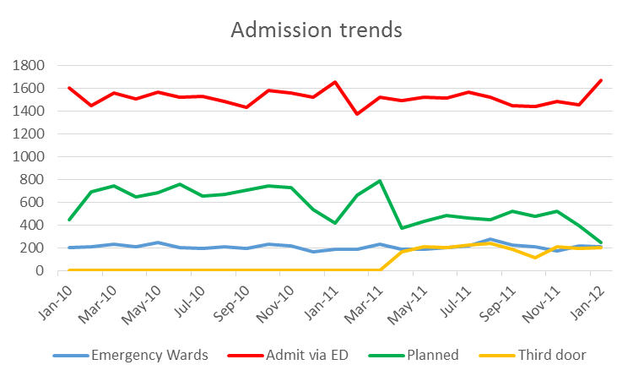
Pathways to Admission
Notes:
Describe at a high level trends in inpatient activity. Also show the split of overnight to day only
Translate this into average and/or median overnight admissions per day
Split inter-hospital transfers from third door admissions if volumes are significant

Slide 15
 | Metrics | Analysis | Data sources
Admitted patient | Day only Overnight Average length of stay RSI | Activity Monthly trend Comparison to peer average and/or HRT benchmark | PAS HIE –Episode Health Roundtable
Specialty unit | NEAT by specialty Average expected admits Average daily discharges Average length of stay Patients with LOS >=21 days RSI Unplanned readmissions Time from consult request to patient review and report | Monthly trend By day of week Discharges by hour of day | PAS HIE –Episode eMR Medical record review

Slide 16
Notes:
Separate out the overnight activity. Calculate your ALOS and trends over 2+ years. Eg The overnight average length of stay is trending down

Slide 17
Long Stay Patients
Notes:
Know how many long stay patient you have and the per cent of your bed base they occupy
Investigate to understand why they stay for long periods (very rarely due predominately to sub-acute and Nursing home access block).

Slide 18
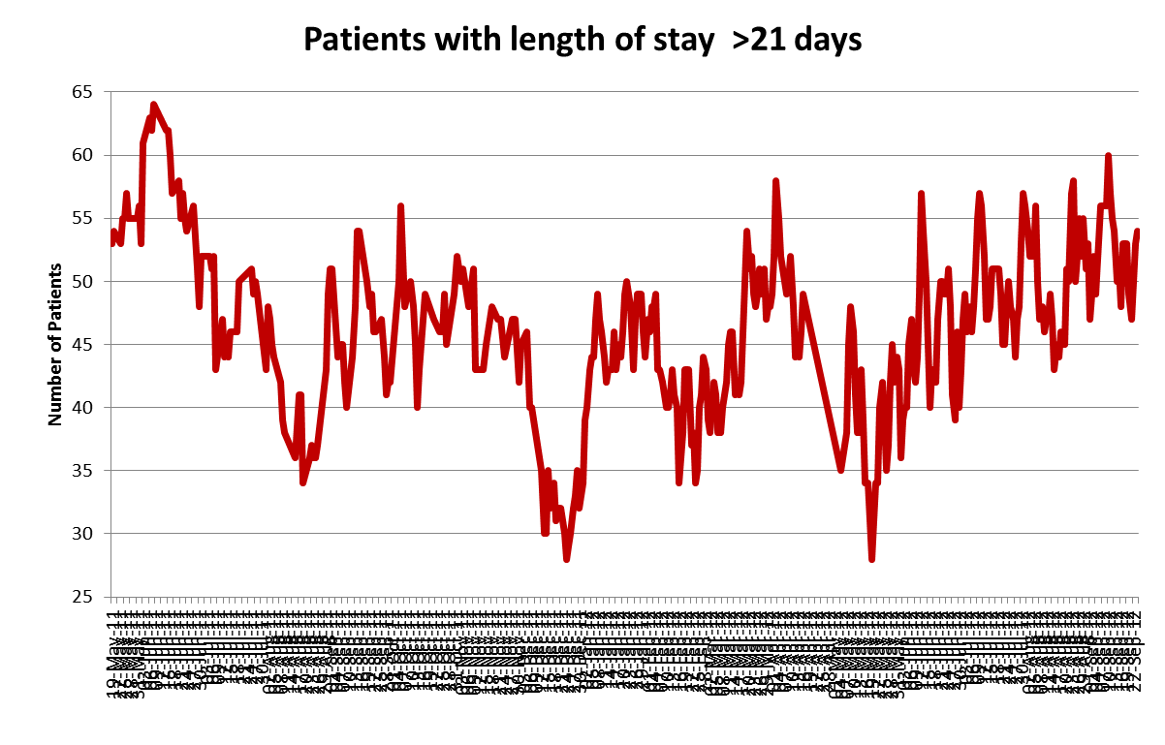
Notes:
Know how many long stay patient you have and the per cent of your bed base they occupy
Investigate to understand why they stay for long periods (very rarely due predominately to sub-acute and Nursing home access block).

Slide 19
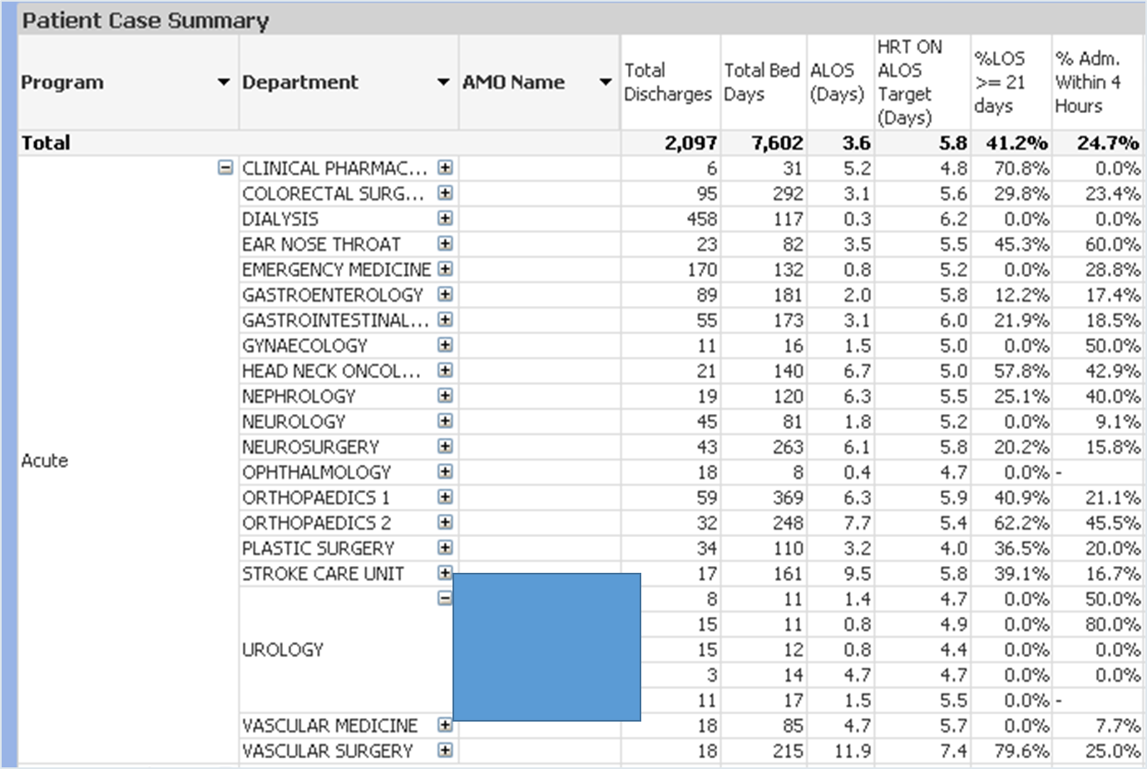
Performance – specialty units

Slide 20
Interface with inpatient teams
Triage
Into ED
S/B RMO/Nurse
Referral to Snr
Patient transfer
First test request
Referral specialty team
Bed request
Specialty team r/v
Delays in inpatient teams coming to ED to review patients following referral by ED
Median
Mean
0:14
0:54
0:39
1:18
0:42
1:27
2:01
2:54
2:03
2:45
3:55
4:22
4:00
4:52
7:18
10:00

Slide 21
 | Metrics | Analysis | Data sources
Wards | NEAT by ward Average expected admits Average daily discharges % outliers Average number of in ward bed moves Average length of stay Patients with LOS >=21 days | Monthly trend By day of week Discharges by hour of day | PAS Bed management HIE –Episode and Ward episode tables
ICU | Average expected admits Average daily transfers out Theatre cancellations due to no ICU bed | Monthly trend By day of week Transfers out | HIE –Episode and Ward episode tables Operating Theatre Management system
EMU | Admissions Average length of stay Beds occupied % NEAT | Under Emergency medicine Under other specialties | HIE –ED Visit, Episode and Ward episode tables

Slide 22
Time to bed request & depart by destination ward
Notes:
Notes: Data integrity issues with bed request time N=12,960 records, 276 excluded no bed request time and 1405 records excluded due to bed request time >departure time.
All specialties
Arrival to bed request
- Median 4.1 hrs
Bed request to depart
Median 2.18 hrs
Mean 5.4 hrs

Slide 23
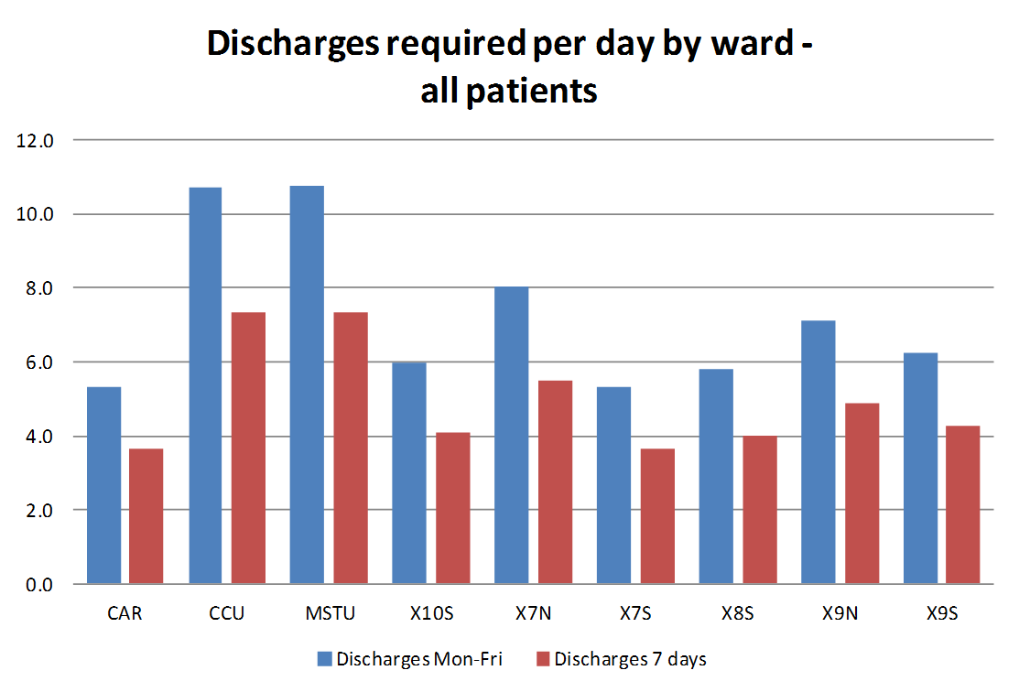
Understanding daily demand
Ward A Ward B Ward C Ward D Ward E Ward F Ward G Ward H Ward I

Slide 24
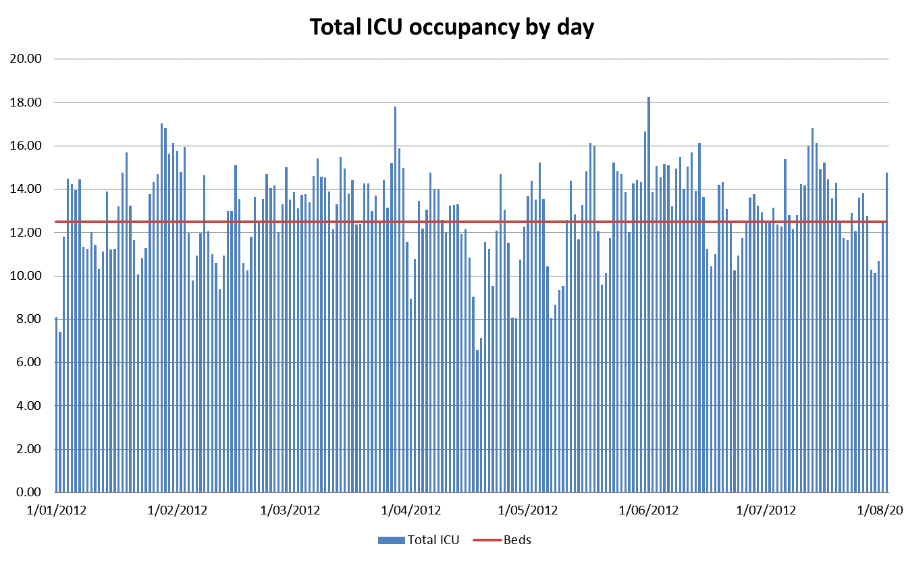
Notes:
Understand the LOS and throughput of key flow wards – these include short stay wards that service the emergency department or act as flow enablers
A range of analyses may be useful in understanding bottlenecks, delays and in developing solutions to improve matching demand and capacity

Slide 25
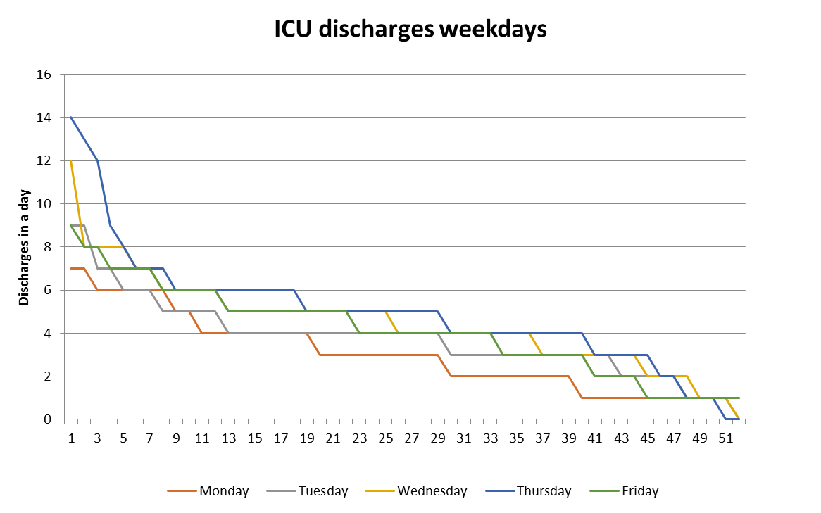
Notes:
Understand the LOS and throughput of key flow wards – these include short stay wards that service the emergency department or act as flow enablers
A range of analyses may be useful in understanding bottlenecks, delays and in developing solutions to improve matching demand and capacity

Slide 26
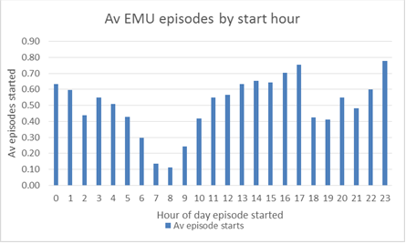
EMU
Top 10 EMU Admitting Specialty | EMU patients |  | EMU ALOS Hrs
EMERGENCY MEDICINE | 1024 | 30% | 14.5
COLORECTAL SURGERY | 316 | 9% | 19.8
GASTROINTESTINAL SURGERY | 311 | 9% | 20.3
ORTHOPAEDICS 1 | 240 | 7% | 15.6
UROLOGY | 190 | 6% | 18.8
HEAD NECK ONCOLOGY | 185 | 5% | 17.8
NEUROSURGERY | 166 | 5% | 29.9
GASTROENTEROLOGY | 121 | 4% | 23.3
ORTHOPAEDICS 2 | 119 | 3% | 15.7
NEUROLOGY | 95 | 3% | 30.9
Notes:
Only 30% of EMU admissions are under Emergency Medicine
ALOS for Emergency Medicine is 14.5 hours
ALOS for inpatient specialties 21.7 hours
Surgical patients are a major blocker of EMU beds and prevents EMU from functioning as designed

Slide 27
 | Metrics | Analysis | Data sources
Radiology | Time to first available Turn around times (image available) Report available Plain X Ray CT MRI Ultrasound | Activity Emergency department Ward inpatients In hours Out of hours | Radiology information system
Pathology | Turnaround times for key tests Troponin FBC UEC | Emergency department patients Ward inpatients In hours, Out of hours | Pathology information system
Theatre | Cancellations Demand in hours Late starts Bed days taken by patient waiting theatre (also see Elective surgery section) | Activity Monthly trend Emergency / Elective Specialty , Doctor Day of week Hour of day | Operating Theatre Management system, SurgiNet
Discharge | Discharges Discharge delay reasons | Day of week Hour of day Pareto delay reasons | Bed Board Why am I still here Study?
Cost | High volume above NEP by DRG High cost low volume above NEP by DRG | Variance Specialty , Doctor DRG | Casemix costing data

Slide 28
Delays to imaging

Slide 29
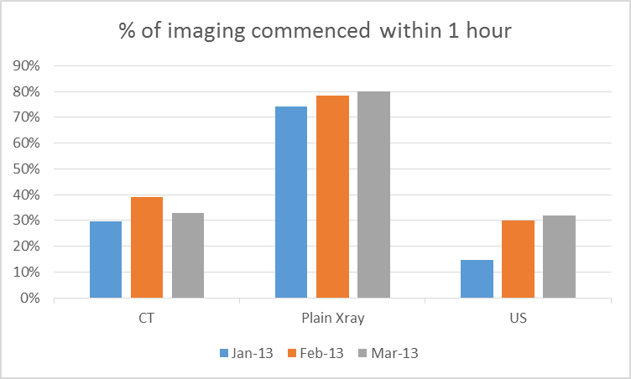
Radiology Data

Slide 30
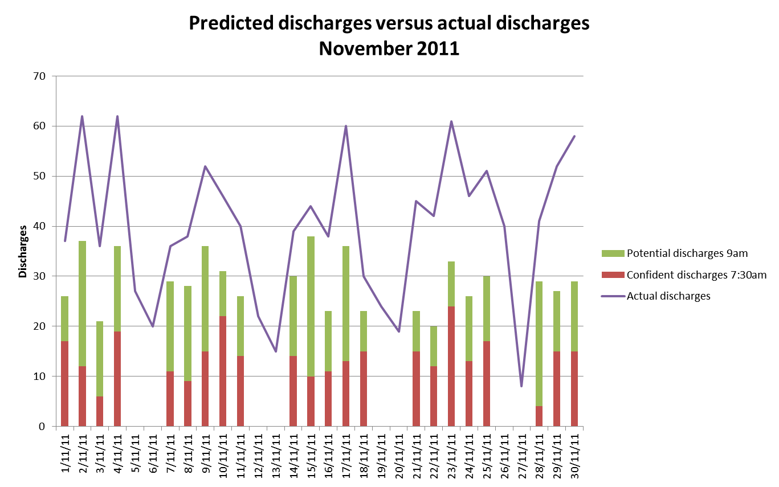
Data source: HIE 1/1/2011 – 31/12/2011 Episode
Notes:
Impending discharges are not consistently communicated making planned flow of patients to wards a challenge
Discharges are not predicted

Slide 31
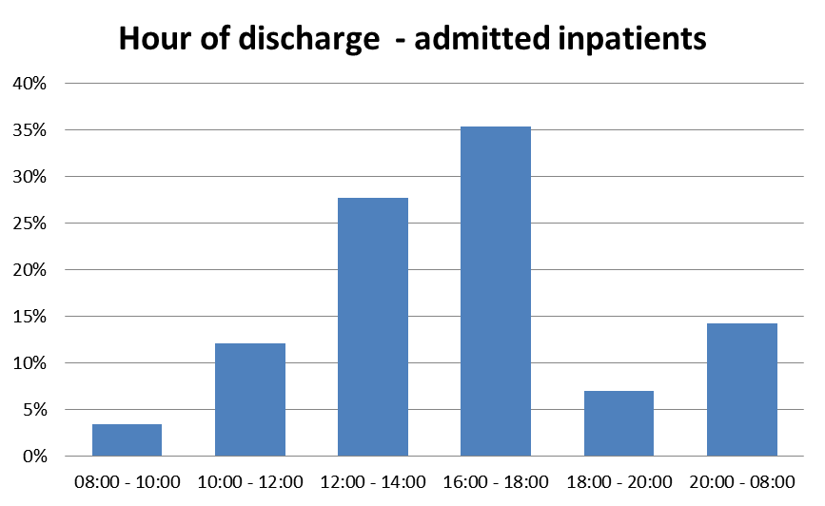
Notes:
Discharges occur late in the day preventing emergency patients from accessing inpatient ward beds

Slide 32
Theatre business
Metrics | Analysis | Data sources
Cancellations Demand in hours -Operating time Elective theatre schedule capacity Emergency theatre schedule capacity On time starts Time from triage to theatre for all emergency and non DOSA surgery Surgery team overtime Elective wait lists, not, ready for care, cases on per month and cases completed per month, cases removed (not operated on) (also see Elective surgery section) | Activity Monthly trend Emergency / Elective Specialty , Doctor Day of week Hour of day | Operating Theatre Management system, SurgiNet

Slide 33
Notes:
Describe overall surgical activity and planned/emergency split
Calculate emergency and planned demand by day of week – this becomes the target number for volume of discharges

Slide 34
Notes:
19.2 hrs emergency capacity required to cover 80% of days

Slide 35

Voice of the Patient
Why do I have to keep telling my story?
ED
Imaging department
Pathology
Consultant Physicians
Patient Flow
Theatres
Wards
Allied health
Clinics
Community Health
Patient
Journey

Slide 36
Planning diagnostics
Start high level
Identify areas of focus
Emergency elective demand and capacity
Drilldown by Specialty unit, ward
Demand and capacity variances
  Time of day
  Day of week
Substantiate and quantify root causes of issues
Source the data
Source the analysis expertise
Data management plan

