Slide 1
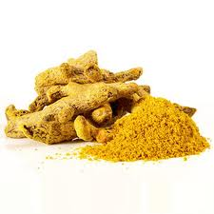
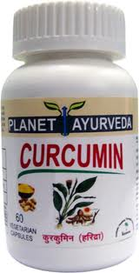
PLANET AYURVEDA
CURCUMIN CAPSULES
Anti-inflammatory
Anti-Allergic
Anti-Cancer
Anti-diabetic
Anti-histaminic
Anti-biotic
Anti-septic
Anti-acne
Blood Cleanser
Skin Cleanser
PLANET AYURVEDA CURCUMIN CAPSULES
Best Anti-Cancer

Slide 2
* US-FDA registered herbal company
* Exporting natural products and supplements to US,
Europe, Singapore, Malaysia, Australia, Japan, Africa
* A GMP certified manufacturing unit located near
Shivalik range of Himalayan mountains.
* Headed by MD (Ayurveda- herbal pharmacology
expert doctor)
Website – www.planetayurveda.com

Slide 3
Why Cancer incidence is still low in India as compared to Europe and USA
Recent study concluded the reasons of incidence of cancer in the world –Study available at - http://www.indox.org.uk and data at www.nationmaster.com
Highest Cancer rates are in Western Europe, North America, UK, Australia, Central Europe
Least Cancer rates are in South Asia ( India, Pakistan, Srilanka, Thailand) and in Eastern Africa
The study clearly indicates that there is something in these countries which is protecting its citizens from this deadly disease
The social lifestyle
Level of Stress
Vegetarianism
Less use of Hormonal Replacement therapies and chemical based drugs
Use of Spices like Turmeric in the food

Slide 4
Use of Turmeric in the Food ?
Turmeric is also known as Curry spice but Curry is
technically a mixture of various spices and not only Turmeric.
Turmeric is used traditionally in Indian subcontinent as household Spice and virtually mixed in every Indian dish.
It is also named as Saffron as the color resembles with Saffron
It is a household remedy for common cold, sore throat, joint pains, swelling around joints, morning stiffness in muscles, muscle sprains, urinary tract infections, gastro-intestinal infections.

Slide 5
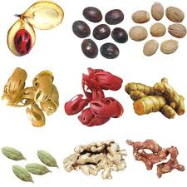
Spices – A boon for health
* Spices grow only in the tropical climate and are a
major reason for attraction for westerners.
* According to Ayurveda, Spices lit up digestive fire,
which helps to remove toxins (Ama) formation which
leads to deadly diseases.
* Spices help to reduce weight,
improve metabolism, clear toxins,
Clear the blocked arteries, reduce
Cholesterol.
* Ginger, Garlic, Cinnamon, Turmeric
are all known to have excellent healing properties

Slide 6
What is CURCUMIN ?
Curcumin is the most important curcuminoid
in most popular Indian spice- turmeric
Curcuminoids are Polyphenols and are accountable for the yellow colour of turmeric.
It is well documented that cancer rates in India are lower than those seen in Western countries.
In a study conducted by the United States National Cancer Institute, the researchers noted, "Of particular interest for cancer prevention is the role of turmeric (Curcumin), an ingredient in common Indian curry spice.

Slide 7
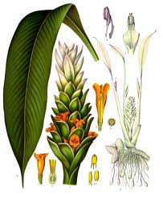
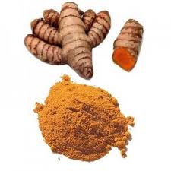
Use of Turmeric
ANTI-INFLAMMATORY
ANTI-CANCER
ANTI- ALLERGIC
ANTI-BIOTIC
ANTI-SEPTIC
ANTI-DIABETIC
ANTI-AGING
PROMOTES WOUND HEALING
STABILIZES MAST CELLS
ANTI-WRINKLES
BLOOD CLEANSER
ANTI-ACNE
ANTI-VIRAL
ANTI-FLU
ANTI-BACTERIA
HELPS IN ALZHEIMER’S
NATURAL FOOD PRESERVATIVE
NATURAL FOOD ADDITIVE
NATURAL TASTE MASKER
ANTI-TUMOR
ANTI-OXIDANT

Slide 8
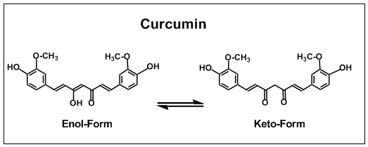
Structure of Curcumin I , II , III
Curcuminoids are found in turmeric and the predominant compound is
Curcumin I – 77 %
Demethoxycurcumin (Curcumin II ) – 17 %
Bis-demethoxycurcumin ( Curcumin III ) – 3 %

Slide 9
Protection of Cancer by Curcumin
Curcumin helps to fight cancer at all stages
Normal Cells transformation to tumor cells
Tumor cells growth called Proliferation
Tumor cells metastasis called invasion
NORMAL CELLS ------TRANSFORMATION ---- PROLIFERATION ------------ INVASION
NORMAL CELLS ----- TUMOR CELLS ----- TUMOR GROWTH -------- TUMOR SPREAD

Slide 10
SOME TECHNICAL ASPECTS – ONLY FOR DOCTORS / ONCOLOGISTS
Curcumin helps to fight cancer at all stages
NEXT FEW SLIDS ARE FOR DOCTORS – CANCER SPEICALISTS & OTHERS CAN CLOSE THEIR EYES OR WAIT FOR A WHILE ☺ - See you at slide # 18

Slide 11
CURCUMIN HELPS TO FIGHT CANCER AT ALL STAGES
Stops over expression of Oncogenes
Stops Activation of Transcription factors like NF-kB
Stops over expression of Protein Kinases
Stops over expression of Matrix Metalloproteases
Stops over expression of Cyclooxygenase – 2
Stops over expression of Chemokines ( Leucotriens) and TNF
Helps to improve the process of Apoptosis
CURCUMIN WORKS AT ALL LEVELS OF
CELL TRANSFORMATION FROM NORMAL TO CANCER CELLS
PROLIFERATION AND GROWTH OF CANCER CELLS
METASTASIS - SPREAD OF CANCER CELLS

Slide 12
WHAT IS NF-kB
NF-κB (nuclear factor kappa-light-chain-enhancer of activated B cells) is a protein complex that controls the transcription of DNA.
NF-κB is found in almost all animal cells and is involved in cellular responses to stimuli such as stress, cytokines, free radicals, UV irradiation, oxidized LDL, and bacterial or viral antigens.
NF-κB plays a key role in regulating the immune response to infection (kappa light chains are critical components of immunoglobulins)
NF-κB has been linked to cancer, inflammatory and autoimmune diseases, septic shock, viral infection, and improper immune development.
NF-κB has also been implicated in processes of synaptic plasticity and memory.

Slide 13
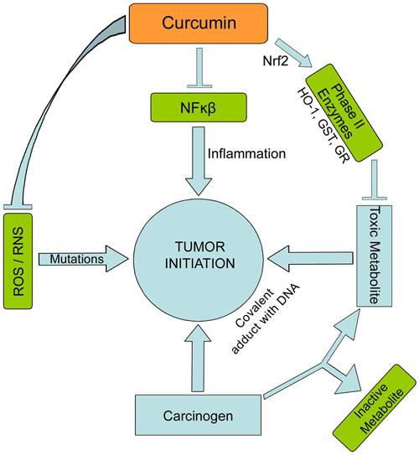
SUPPRESSION OF NF Kappa-B by Curcumin
Nuclear factor Kappa- B is known
for transformation of normal cells
into tumor cells.
NF-kB is responsible for
Tumor promotion -COX-2
Anti-apopotosis - Anti-Survivin
Proliferation - TNF, IL-1 & IL-6
Inflammation - TNF, IL-1,Chemokines
Metastasis - ICAM-1 , VCAM-1, ELAM-1

Slide 14
Role of NF-kB in Cancer Growth and Proliferation
NF-kB is involved in the following activities through following pathways
Tumor promotion – COX – 2, iNOS,MMP-9,uPA
Proliferation – TNF, IL-1, IL-6
Metastasis – ICAM – 1, VCAM-1, ELAM-1
Angiogenesis – VEGF, TNF, IL-1, IL-8
Inflammation – IL-1, TNF, Chemokines
Curcumin stops Activation of Transcription factors like NF-kB

Slide 15
WHAT ARE CYTOKINES
Cytokines – ( Cell- Movement) These are small protein molecules, having messenger and signaling functions and extensively involved in intracellular communication.
These cytokines are also having immunomodulatory functions. Main cytokines are – Interleukins and Interferons
All endothelial, Epithelial cells are producers of IL-1, IL-6, and TNF-α, Immunoglobulins during the process of injury, infection and inflammation.
Function of Cytokines -
Upregulation and/or downregulation of several genes and their transcription factors, resulting in the production of specific anti-bodies, cell growth, differentiation, inflammatory reactions and so on.
Curcumin modifies the response of transcription factors, stops inflammatory pathways and interferes in faulty cell growth and differentiation without causing side effects.

Slide 16
WHAT IS TNF
TNF-α- is a cytokine involved in systemic inflammation and is a member of a group of cytokines that stimulate the acute phase reaction. It is produced chiefly by activated macrophages.
Tumor necrosis factor (TNF) promotes the inflammatory response and is associated with conditions like rheumatoid arthritis, Ankylosing spondylitis, Crohn's disease, Psoriasis and refractory Asthma.
These disorders are sometimes treated by using a TNF inhibitors
The important side effects related to TNF blockers include: lymphoma, infections, congestive heart failure, Demyelinating disease, a lupus-like syndrome, induction of auto-antibodies.
The global market for TNF inhibitors in 2007 was $ 10 Bn and in 2008 it was $13.5Bn and $22Bn in 2009.
There are no such side effects reported with use of Curcumin even in high dosage besides its TNF blocking action.

Slide 17
WHAT ARE LEUKOTRIENS
LEUKOTRIENS – These are fatty signalling molecules, first found in Leucocytes and are produced in the body by Arachidonic acid produced by the enzyme 5 lipooxygenase , through the Arachidonic acid inflammatory pathway.
Examples of Leukotriens are - Examples of leukotrienes are LTA4, LTB4, LTC4, LTD4, LTE4, and LTF4.
Their over production is the cause of Asthma and Allergic Rhinitis.
What is Role of Curcumin
CURCUMIN stops the release of inflammatory mediators like TNF, Leukotriens, Histamine, PG’s and Cox-1 & 2, TXA2 (Thromboxane)

Slide 18
Uses of Turmeric
ANTI-INFLAMMATORY
ANTI-CANCER
ANTI- ALLERGIC
ANTI-BIOTIC
ANTI-SEPTIC
ANTI-DIABETIC
ANTI-AGING
PROMOTES WOUND HEALING
STABILIZES MAST CELLS
ANTI-WRINKLES
BLOOD CLEANSER
ANTI-ACNE
ANTI-VIRAL
ANTI-FLU
ANTI-BACTERIA
HELPS IN ALZHEIMER’S
NATURAL FOOD PRESERVATIVE
NATURAL FOOD ADDITIVE
NATURAL TASTE MASKER
ANTI-TUMOR
ANTI-OXIDANT

Slide 19
Availability of Curcumin Capsules
Planet Ayurveda Curcumin is the best quality Curcumin in the world
Contains 500 mg standardized extract of 95 % Curcuminoids
No Preservatives, Synthetic drugs, Colors, Additives or anything unnatural
100 % Pure vegetarian capsules
BUY NOW AT ! !
www.planetcurcumin.com
& www.planetayurveda.com

