Slide 1
Thromboembolism and haemorrhage in pregnancy and delivery
Petr Krepelka

Slide 2
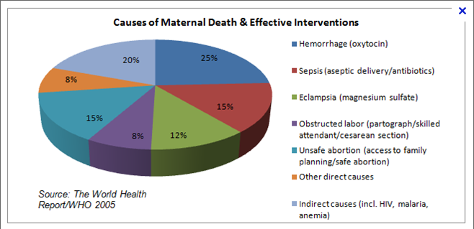

Slide 3
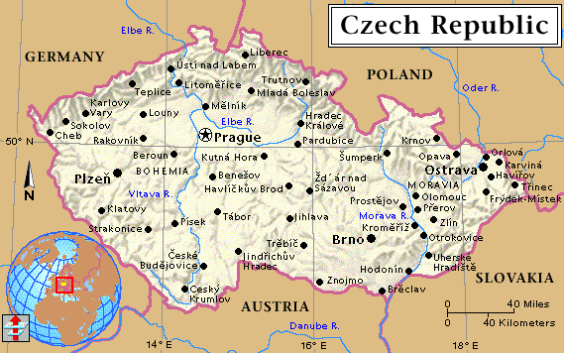
CR
22,4%
SRB,B.,VELEBIL,P. Analysis of maternal mortality in Czech republic 2000. Česká gynekologie, 2002, 9, p.268-74.

Slide 4
Deep venous thrombosis and pulmonary embolism in pregnancy

Slide 5
Epidemiology of DVT
Prevalence 0,5-2/1000 pregnancies
Mortality 1,1 deaths per 100 000 pregnancies
Pregnancy increases the risk of DVT 4-5 fold over the nonpregnant state

Slide 6
Pathophysiology
Virchow´s triad
  Hypercoagulability (↑ I, II, VII, VIII, IX, X + ↓protein C, protein S)
  Venous stasis and turbulence (venous compression by the gravid uterus, decreased mobility)
  Endothelial injury and dysfunction

Slide 7
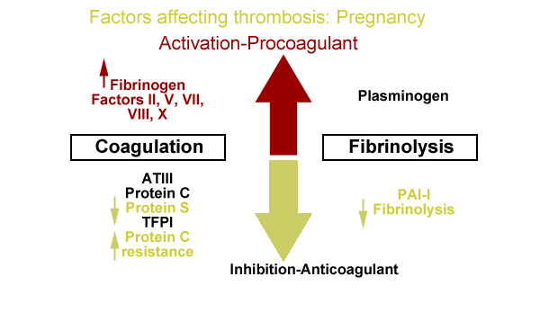

Slide 8
Risk factors
Normal physiologic alterations in pregnancy
Personal or family history of DVT-PE
Thrombophilic disorder
Cesarean delivery
Obesity
Cardiac disease
Smoking

Slide 9
Location of DVT
More likely to occur in the left leg
May-Thurner syndrome
  Left iliac vein is compressed by the right iliac artery

Slide 10
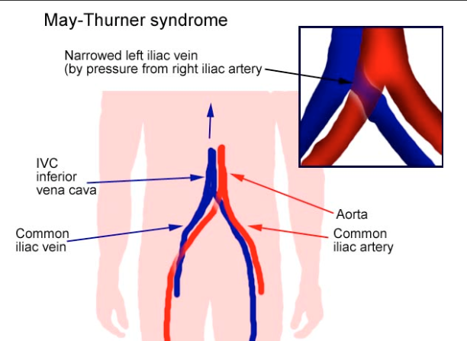

Slide 11
Sequelae of DVT
Pulmonary hypertension
Post-thrombotic syndrome (pain, cramps, heaviness, paresthesia, edema, skin induration, hyperpigmentation, venous ectasia, redness)
Venous insufficiency

Slide 12
History and physical examination DVT
Signs and symptoms are nonspecific
2 most common symptoms
  Pain
  Swelling of the lower extremity (mid-calf circumference difference of ≥2 cm)

Slide 13
History and Physical Examination PE
Signs and symptoms are nonspecific
  Dyspnea
  Chest pain
  Cough
Presenting signs
  Tachypnea
  Tachycardia
  Crackles
ECG
  Right ventricular strain
  S1Q3T3 pattern
  Nonspecific ST segment and T-wave abnormalities

Slide 14
Laboratory evaluation DVT
D-dimer
  High negative predictive value <500ng/ml=99% negative predictive value
  Pregnancy limits the usefulness of D-dimer
    D-dimer values increase with gestational age

Slide 15
Laboratory evaluation PE
Arterial blood gas
  Increase in alveolar-arterial gradient
  Mismatch in ventilation/perfusion

Slide 16
Imaging DVT
Compression ultrasound – test of choice in the evaluation of DVT – 95% sensitive for proximal lower extremity
Limitation for pelvic thrombosis

Slide 17
Imaging PE
Spiral CT pulmonary angiography (CT-PA)
  Normal chest radiograph
Ventilation-perfusion (V/Q) scan
  Abnormal chest radiograph or knonw pulmonary disease

Slide 18
Therapy
Indirect thrombin inhibitors
  unfractionated heparin
  low molecular weight heparins
  synthetic heparin pentasaccharides
  orally administered Factor Xa inhibitors (eg, rivaroxaban)
Direct thrombin inhibitors
  Argatroban
  Lepirudin
  Bivalirudin
Vitamin K antagonist
  Warfarin
Heparin (both unfractionated and low molecular weight) is the preferred drugs for management of VTE in pregnancy

Slide 19
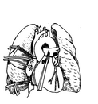
Therapy
Massive PE
  Acute embolectomy
  Lifesaving operation

Slide 20
Bleeding in pregnancy

Slide 21
First trimestr bleeding
Ectopic pregnancy
Miscarriage (threatened, inevitable, incomplete, complete)
Implantation of the pregnancy
Cervical, vaginal, or uterine pathology (eg, polyps, inflammation/infection, trophoblastic disease)

Slide 22
Second and third trimestr bleeding
Bloody show associated with cervical insufficiency or labor (by definition, labor occurs after 20 weeks)
Miscarriage (by definition, miscarriage occurs before 20 weeks)
Placenta previa
Abruptio placenta
Uterine rupture
Vasa previa
Cervical, vaginal, or uterine pathology (eg, polyps, inflammation/infection, trophoblastic disease) and non-tubal ectopic pregnancy are other etiologies

Slide 23
Placenta praevia
Presence of placental tissue that extends over or lies proximate to the internal cervical os
3.5 to 4.6 per 1000 births
Main symptom - painless vaginal bleeding (70-80%)

Slide 24
Risk factors
Previous placenta previa
Previous cesarean delivery
Multiple gestation
Multiparity
Advanced maternal age
Infertility treatment
Previous abortion
Previous intrauterine surgical procedure
Maternal smoking
Maternal cocaine use
Male fetus
Non-white race

Slide 25
Placental abruption
Partial or total placental detachment prior to delivery of the fetus
Major clinical findings
  vaginal bleeding and abdominal pain
  hypertonic uterine contractions
  uterine tenderness
  nonreassuring fetal heart rate (FHR) pattern
Incidence - 0.4 to 1% of all pregnancies

Slide 26
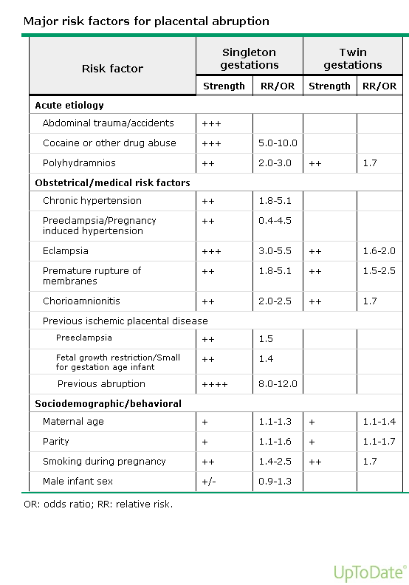

Slide 27
Primary postpartum haemorrhage

Slide 28
Epidemiology
Incidence 0,84-19,8% ???
10,5% all deliveries (13-14 000 000 women/1 year)
132 000 cases of maternal mortality
79 000 sepsis
63 000 preeclampsia
69 000 abortion
42 000 stuck of labor

Slide 29
Epidemiology
USA … 17% of all MM
Francie … 13%
Afrika … 25%
EU… 13,2% (Europeristat 2002-2004)
CR …23,7% (Velebil 2002-2007)

Slide 30
Definition of PPH
Blood loss 24 hours after birth
  >500 ml- vaginal delievery
  >1000 ml - S.C.
  Bleeding
    continues
    repeats
    destabilizes blood circulation or haemocoagulation

Slide 31
Critical bleeding
Total blood loss, or transfusion >10 U EM/24 hod. (MacPhail)
Blood loss >150 ml/min. (50% volume/20 min.)
Sudden blood loss > 1500-2000 ml (Sobiesczyk)

Slide 32
Normal blood loss
340-450 ml
<500 ml vaginal birth
<1000 ml SC
PPH
Incidence 4,7/1000 live births (0,47%)

Slide 33
Diagnosis of PPH
Clinical monitoring
Quantitative methods
Reservoir method

Slide 34
1 | 150
2 | 300
3 | 450
4 | 600
5 | 750
6 | 900
7 | 1050
8 | 1200
9 | 1350
10 | 1500
11 | 1650
12 | 1800
13 | 1950
14 | 2100
15 | 2250
16 | 2400
17 | 2550
18 | 2700
19 | 2850
20 | 3000
1
15%
2
20%
25%
3
30%
35%
40%
4

Slide 35
Clinical status
 | I | II | III | IV
% blood loss | 15 | 20-25 | 30-35 | 40
P | norm | 100 | 120 | 140
BP systol | norm | norm | 70-80 | 60
BP mean TKD+1/3(TKS-TKD) | 80-90 | 80-90 | 50-70 | 50
Tissue perfusion | Postural hypotension | Peripheral vasoconstriction | Paleness, restlessness, oliguria | Collapse, anuria, gasping breathing

Slide 36
Clinical status
 | I | II | III | IV
% blood loss | 15 | 20-25 | 30-35 | 40
P | norm | 100 | 120 | 140
BP systol | norm | norm | 70-80 | 60
BP mean TKD+1/3(TKS-TKD) | 80-90 | 80-90 | 50-70 | 50
Tissue perfusion | Postural hypotension | Peripheral vasoconstriction | Paleness, restlessness, oliguria | Collapse, anuria, gasping breathing

Slide 37
Clinical status
 | I | II | III | IV
% blood loss | 15 | 20-25 | 30-35 | 40
P | norm | 100 | 120 | 140
BP systol | norm | norm | 70-80 | 60
BP mean TKD+1/3(TKS-TKD) | 80-90 | 80-90 | 50-70 | 50
Tissue perfusion | Postural hypotension | Peripheral vasoconstriction | Paleness, restlessness, oliguria | Collapse, anuria, gasping breathing

Slide 38
Quantitative methods
Visual assessment
  Simulation
    Standardized konteiner
    Standardized drapes
Assessment of drapes weight
Changes in Hb and Htk
Hematins method - spectrophotometry

Slide 39
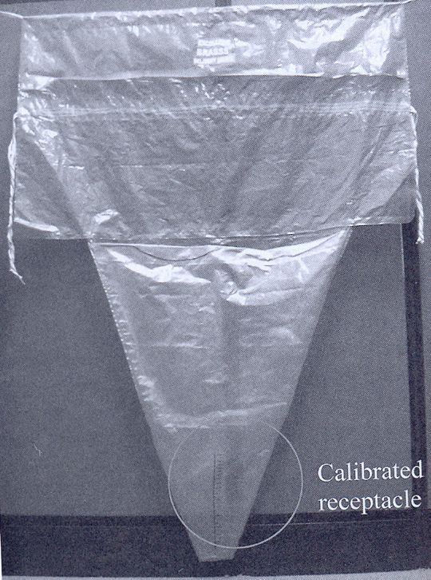
Brass-V drape
Brass
Calibrated receptacle
Measurement comparable spectrophotometry
4 times more accurate than the estimate based on visualization

Slide 40
PPH - etiology
The causes of postpartum hemorrhage can be thought of as the four Ts
  Tone
  Tissue
  Trauma
  Thrombin

Slide 41
Uterine atony
Multiple gestation
High parity
Prolonged labor
Chorioamnionitis
Augmented labor
Tocolytic agents

Slide 42
Tissue – retained uterine contents
Products of conception
Blood clots

Slide 43
Tissue – placental abnormalities
Congenital – bicorporate uterus
Location – placenta praevia
Attachment – placenta accreta
Acquired structural – previous surgery

Slide 44
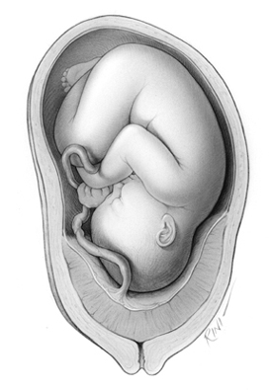

Slide 45
Trauma
Planned – SC, episiotomy
Unplaned - vaginal/cervical tear, surgical trauma

Slide 46
Thrombin – coagulation disorders
Congenital - Von Willebrand's disease
Acquired – DIC, dilutional coagulopathy, heparin

Slide 47
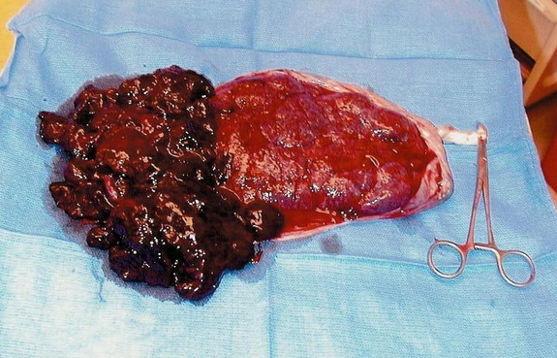
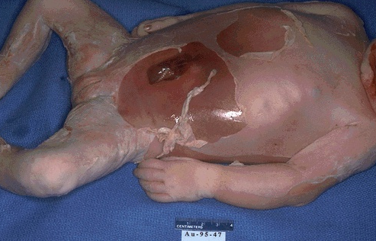
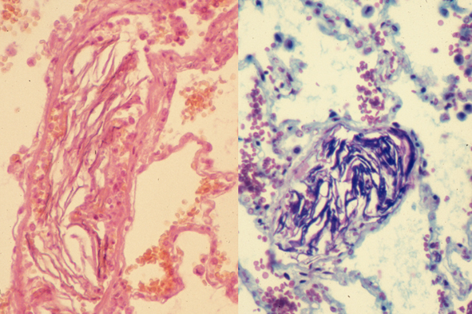

Slide 48
Prevention
Risk factors
Prophylactic oxytocics
  Prophylactic oxytocics should be offered routinely in the management of the third stage of labour as they reduce the risk of PPH by about 60%
Prevention of anemia
Coagulation studies
Imagine investigations

Slide 49
PPH - Risk factors
odds ratio for PPH | Risk Factor
13 12 5 4 | Proven abruptio placentae Known placenta praevia Multiple pregnancy Pre-eclampsia/gestational hypertension

Slide 50
odds ratio for PPH | Risk factor
9 4 5 5 2 2 2 | Delivery by emergency Caesarean section Delivery by elective Caesarean section Retained placenta Mediolateral episiotomy Operative vaginal delivery Prolonged labour (>12 hours) Big baby (>4 kg)

Slide 51
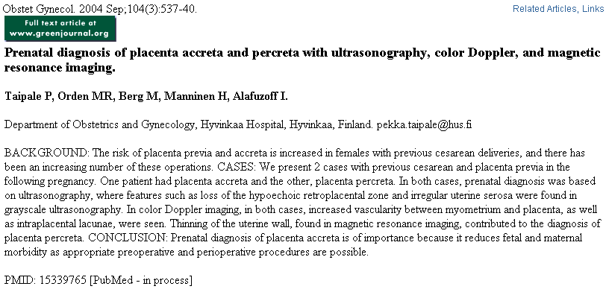
loss of the hypoechogenic retroplacental zone
irregular uterine serosa
high vascularisation between myometrium and placenta
intraplacental lacunae
thinning of uterine wall

Slide 52
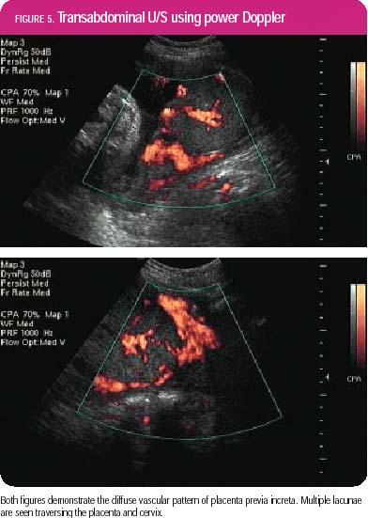
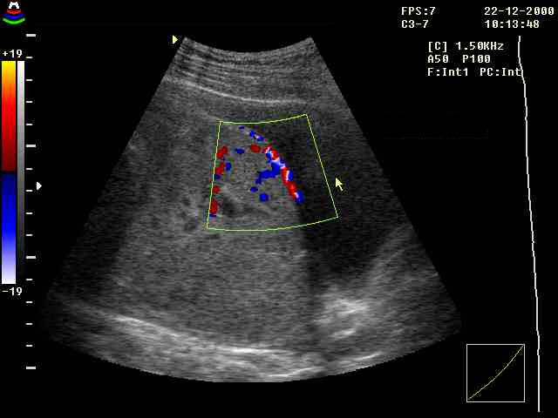
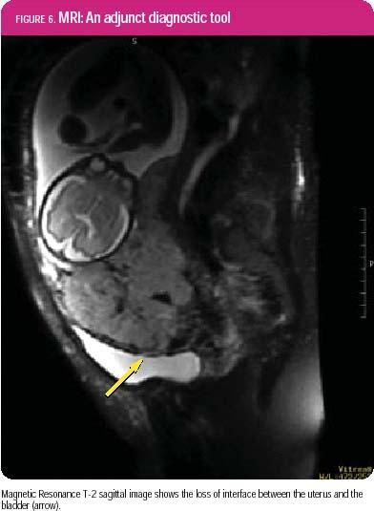

Slide 53
Management
Guidelines
  COMMUNICATE.
  RESUSCITATE.
  MONITOR / INVESTIGATE.
  STOP THE BLEEDING

Slide 54
COMMUNICATE
Call experienced midwife
Call experienced obstetrician
Call experienced anaesthesiologist
Alert haematologist
Alert Blood Transfusion Service
Call porters for delivery of specimens / blood

Slide 55
RESUSCITATE
IV access with 14 G cannula
Head down tilt
Oxygen by mask, 8 litres / min
Transfuse
Crystalloid (eg Hartmann’s)
Colloid (eg Hemacel)
once 3.5 litres infused, GIVE ‘O NEG’ If no cross-matched blood available OR give uncross-matched own-group blood, as available
Give up to 1 liter Fresh Frozen Plasma and 10 units cryoprecipitate if clinically indicated

Slide 56
MONITOR / INVESTIGATE
Cross-match 6 units
Full blood count
Clotting screen
Continuous pulse / BP /
ECG
Foley catheter: urine output
CVP monitoring
Discuss transfer to ICU

Slide 57
Stop bleeding
Exclude causes of bleeding other than uterine atony
Ensure bladder empty
Uterine compression
IV syntocinon 10 units
IV ergometrine 500 mg
Syntocinon infusion (30 units in 500 ml)
IM Carboprost (500 mg)
Surgery earlier rather than late
Hysterctomy early rather than later

Slide 58
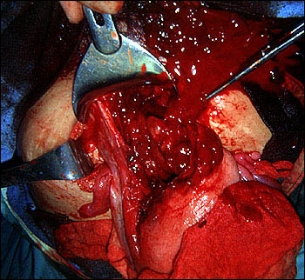
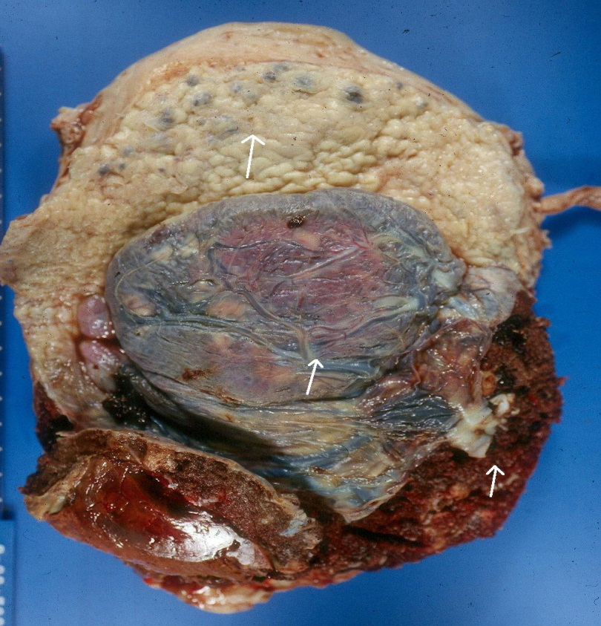
HYSTERECTOMY RATHER
SOONER THAN LATER
Uterine rupture
Placenta accreta

Slide 59
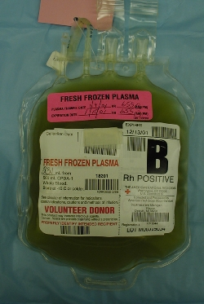
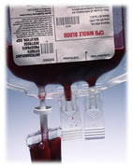
Whole blood frequently is used for rapid correction of volume loss because of its ready availability, but component therapy is ideal. A general practice has been to transfuse 1 unit of fresh-frozen plasma for every 3 to 4 units of red cells given to patients who are bleeding profusely

Slide 60
Genital tract laceration
Genital trauma always must be eliminated first if the uterus is firm

Slide 61
Uterine atony
Explore the uterine cavity.
Inspect vagina and cervix for lacerations.
If the cavity is empty, massage and give methylergometrine 0.2 mg, the dose can be repeated every 2 to 4 hours.
Rectal 800mcg. Misoprostol is beneficial (unfortunately is not accesible)
Bimanual compression

Slide 62
Retained placenta
Retained placental fragments are a leading cause of early and delayed postpartum hemorrhage
Treatment is manual removal
On rare occasions, a retained placenta is an undiagnosed placenta accreta, and massive bleeding may occur during attempted manual removal

Slide 63
Placenta accreta
Placenta accreta is defined as an abnormal implantation of the placenta in the uterine wall, of which there are three types:
  accreta vera, in which the placenta adheres to the myometrium without invasion into the muscle.
  increta, in which it invades into the myometrium.
  percreta, in which it invades the full thickness of the uterine wall and possibly other pelvic structures, most frequently the bladder

Slide 64
Placenta accreta
In a patient with a previous cesarean section and a placenta previa
  Previous one has 14% risk of placenta accreta
  Previous two has 24% risk of placenta accreta
  Previous three has 44% risk of placenta accreta

Slide 65
Uterine rupture
Rupture of the uterus is described as complete or incomplete and should be differentiated from dehiscence of a cesarean section scar
Complete rupture describes a full-thickness defect of the uterine wall and serosa resulting in direct communication between the uterine cavity and the peritoneal cavity
Incomplete rupture describes a defect of the uterine wall that is contained by the visceral peritoneum or broad ligament in patients with prior cesarean section
Dehiscence describes partial separation of the scar with minimal bleeding, with the peritoneum and fetal membranes remaining intact

Slide 66
Management
The identification or suspicion of uterine rupture must be followed by an immediate and simultaneous response from the obstetric team
Surgery should not be delayed owing to hypovolemic shock because it may not be easily reversible until the hemorrhage is controlled
Upon entering the abdomen, aortic compression can be applied to decrease bleeding
Oxytocin should be administered to effect uterine contraction to assist in vessel constriction and to decrease bleeding
Hemostasis can then be achieved by ligation of the hypogastric artery, uterine artery, or ovarian arteries

Slide 67
Management
At this point, a decision must be made to perform hysterectomy or to repair the rupture site. In most cases, hysterectomy should be performed
In selected cases, repair of the rupture can be attempted. When rupture occurs in the body of the uterus
Bladder rupture must be ruled out by clearly mobilizing and inspecting the bladder to ensure that it is intact. This avoids injury on repair of the defect as well
A lower segment lateral rupture can cause transection of the uterine vessels. The vessels can retract toward the pelvic side wall, and the site of bleeding must be isolated before placing clamps to avoid injury to the ureter and iliac vessels.
Typically, longitudinal tears, especially those in a lateral position, should be treated by hysterectomy, whereas low transverse tears may be repaired

Slide 68
Step-by-step devascularisation
Uterine artery ligation involves taking large purchases through the uterine wall to ligate the artery at the cervical isthmus above the bladder flap

Slide 69
Internal iliac artery ligation
The internal iliac artery is exposed by ligating and cutting the round ligament and incising the pelvic sidewall peritoneum cephalad, parallel to the infundibulopelvic ligament The ureter should be visualized and left attached to the medial peritoneal reflection to prevent compromising its blood supply
The hypogastric artery should be completely visualized. A blunt-tipped, right-angle clamp is gently placed around the hypogastric artery, 2.5 to 3.0 cm distal to the bifurcation of the common iliac artery. Passing the tips of the clamp from lateral to medial under the artery is crucial in preventing injuries to the underlying hypogastric vein

Slide 71
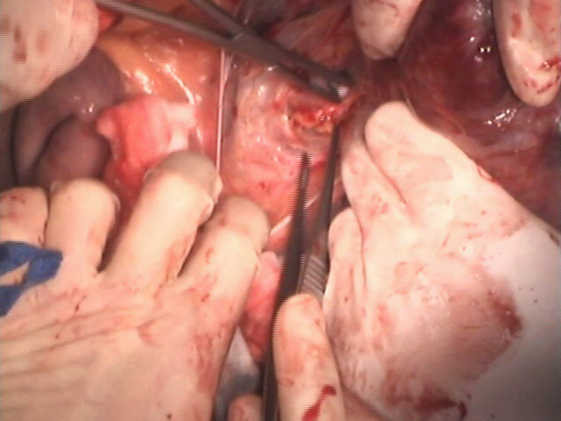

Slide 72
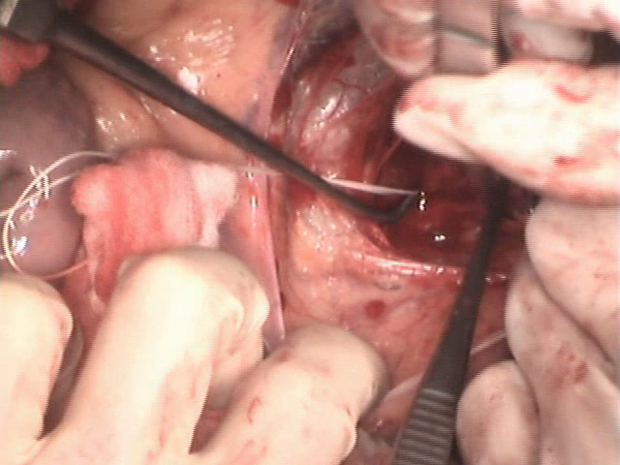

Slide 73
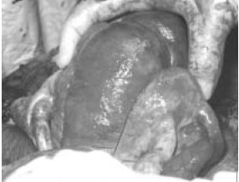
B-Lynch suture

Slide 74
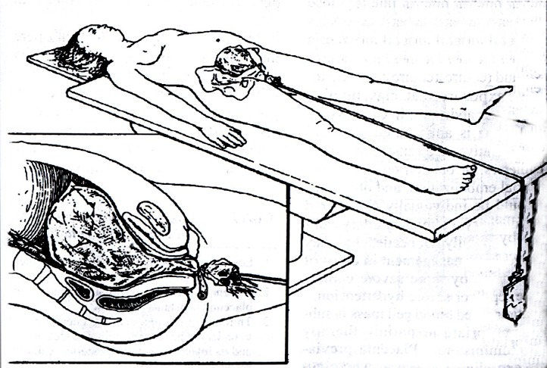
Bleeding after hysterectomy
Abdominal pelvic pressure pack

Slide 75
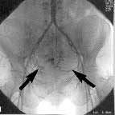
Intraarterial therapeutic embolisation
The first application - 1979
Benefits
Effectiveness 90%
Identification of the bleeding source
Distal vascular stop
Disadvantage
Time factor
Technical and personal conditions

Slide 76
Thank you for your attention … petr.krepelka@upmd.eu

