Slide 1
DNA
Deoxyribonucleic Acid
The Code of Life

Slide 2
How did scientists figure out that DNA was the genetic material and the structure of DNA?
Proteins -?genetic material because lots of them and complicated in structure.
DNA seemed too simple in structure to be able to produce and control the cells of an entire organism.

Slide 3
Frederick Griffith- 1928- Something (DNA vs. Protein) is transferred between bacteria (S. pneumonia) that transforms (transformation)a harmless bacteria into a harmful one that causes disease and death in mice. Harmful=capsule, Harmless=no capsule
Notes:
Bacteria-reproduce quickly-pneumonia vaccine

Slide 4
Oswald Avery
1944
Enzymes that digested (broke down) proteins bacteria still developed capsules and virulence.
Enzymes that broke down DNA
Bacteria did not develop capsules and virulence.
What did this support? DNA or proteins as genetic material and why?

Slide 5
Hershey-Chase (1952)
Bacteriophages
Proteins contain sulfur while DNA does not. DNA contains phosphorous. (phosphate)
http://highered.mcgraw-hill.com/olc/dl/120076/bio21.swf
Most scientists were now convinced that DNA was the genetic material.
Notes:
Cysteine and methionine have sulfur.

Slide 6
What is DNA and why do living organisms have DNA?

Slide 7
What is DNA and why do living organisms have DNA?
DNA is Deoxyribonucleic acid- genetic material –which contains instructions for the cell to make proteins for cellular functions (“How to be a cell”) and stores our genetic material in a form that can be passed on to future generations.
DNA is capable of storing, copying and transmitting the genetic information of a cell.

Slide 8
Where is DNA found in the cell?
DNA is located in the nucleus of cells.
DNA is also found in mitochondria in cells.
In cell nucleus, DNA is very thin and coiled and can be seen only with a strong electron microscope. The total length of DNA in a human nucleus is approx. 1 meter. The DNA condenses and looks like the chromosomes that we are familiar with only when the cell is undergoing mitosis or meiosis.

Slide 9
Human DNA
Every Cell nucleus *
DNA-Chromosomes (46)**
Genes (25,000)**
Nucleotides (3.3 billion pairs)**
. *except red blood cells which don’t have a nucleus. **total number in body
Notes:
Chromosome 1 has 3150 genes. Chromosome Y has 200 genes. The average gene has 3000 nucleotides. The largest gene has 2.4 million nucleotides

Slide 10
Nucleotides=smallest sub-units of DNA The building blocks of DNA

Slide 11
Nucleotides
Phosphate and sugar the same in every nucleotide.
Nitrogen bases vary.
Four different nitrogen bases provide the “letters” for the DNA code.

Slide 12
Nitrogen bases
Purines (double ring)
Adenine (A)
Guanine (G)
Pyrimidines (single ring)
Thymine (T)
Cytosine (C)

Slide 13
DNA Structure
Notes:
What do you notice about the pairing of the bases? Ladder and rungs

Slide 14
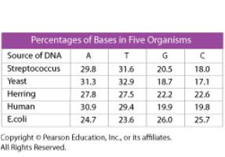
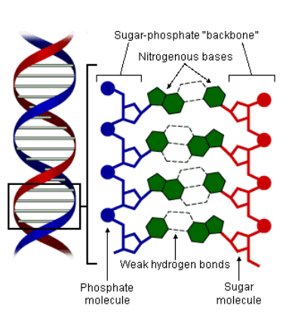
Complementary Base Pairing

Slide 15
Complementary Base Pairing
A always pairs/bonds with T , A=T
C always pairs/bonds with G, C=G
Therefore, one strand determines the base pairs on the other strand and they are said to be complementary.
A purine pairs with a pyrimidine
2 hydrogen bonds between Adenine and Thymine
3 hydrogen bonds between Guanine and Cytosine

Slide 16
What is the complementary sequence?
ATTGCGAC
TTGCAATGC

Slide 17
Structure of DNA

Slide 18
Double helical structure
The covalent bonds in the sugar-phosphate backbone provide the strength.
The bases are held together by much weaker hydrogen bonds. This is important for replication.

Slide 19
Negative charge on phosphates make DNA a polar molecule
Notes:
Polar hydrophilic – likes water

Slide 20
Two strands are anti-parallel
Notes:
Sugar-phosphate backbones run in opposite directions. 5’ refers to the fifth carbon on the sugar ring, 3’ refers to the 3rd carbon on the sugar ring.

Slide 21
What makes organisms different?
All living organisms have the same DNA structure with the deoxyribose (sugar) and phosphate backbone and the same four bases. The only thing that distinguishes the DNA of organisms is the order and number of the nitrogen bases. Human DNA differs from chimpanzees by 1.6%.
Our DNA is structurally the same as a cow, chicken, lily, corn etc.

Slide 22
What makes humans different from each other?
One percent of DNA bases, order of bases and number of copies of genes differ between humans.
Now that scientists have sequenced the entire human genome we are learning more about our DNA everyday.

Slide 23
The Race
The race began to figure out the structure of DNA.
Linus Pauling, James Watson and Francis Crick all initially felt that DNA was a triple helix.
Then came Rosalind Franklin’s x-ray of DNA.

Slide 24
Rosalind Franklin’s DNA x-ray

Slide 25
Watson and Crick
1953, James Watson and Francis Crick figured out the structure of DNA. They used all available information to develop their model.
Chargaff’s Rule- Ervin Chargaff (1949) discovered that in all DNA (that he tested) from bacteria to humans that the percentage of A(adenine) = T (thymine) and C (Cytosine) = G (guanine) in DNA.
Rosalind Franklin and Maurice Wilkins (1952) took x-ray diffraction photographs of DNA. Photo 51 taken by Franklin suggested that DNA was a tightly coiled helix composed of 2 nucleotide chains.

Slide 26
Model of DNA
Watson and Crick used cardboard and tin-and-wire models to determine what structure of DNA would conform to all of the available information including measurements. The double helix model they developed conformed with all known information and they could even see how DNA could replicate.

Slide 27
Watson and Crick, 1953

Slide 28
http://www.pbs.org/wnet/dna/episode1/index.html#

Slide 29
How does DNA replicate? How does it make a copy of itself?
Notes:
Weak hydrogen bonds- how would you test this?

Slide 30
Semi-conservative Replication
Two parent strands serve as templates for new complementary strands of DNA.
Replication occurs before a cell divides.

Slide 31
Anti-parallel strands and DNA nucleotides can only be added to a 3’ end. (5’ to 3’ direction.)

Slide 32
Terms for Replication
DNA helicases- open the double helix by breaking hydrogen bonds between the nitrogen bases.
Replication forks- the two ends where the strands have unwound forming a Y.
DNA polymerases- Many types of polymerases.
-add nucleotides to the exposed nitrogen bases(III).
- removes and replaces primer(I)
-proofreads and backtracks to correct mismatched bases.
DNA ligase- an essential enzyme that seals breaks in the phosphate-sugar backbone of DNA.

Slide 33
Replication animations
See summary of replication steps on handout
http://highered.mcgraw-hill.com/sites/0072437316/student_view0/chapter14/animations.html#

Slide 34
DNA Replication
Notes:
Helicase vs. topisomerase

Slide 35
How are mistakes in the code minimized?

Slide 36
DNA polymerase proofreads, backtracks and corrects mistakes.
Template
Only 4 bases
Slower rate with multiple forks speeding up overall replication time.

