Slide 1
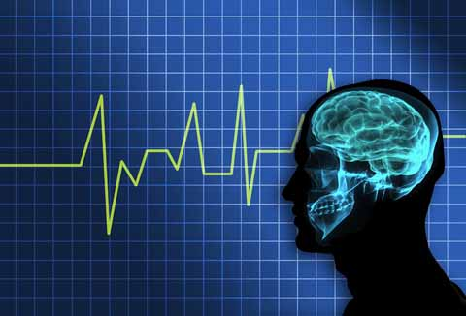
Introduction to EEG
Rachel Garvin, MD
Neurocritical Care
UTHSCSA

Slide 2
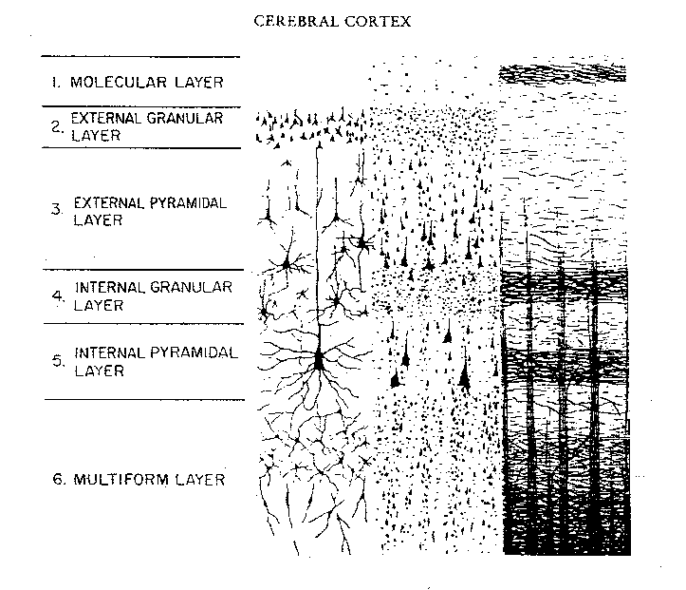
Neuronal Arrangement in Cortex

Slide 3
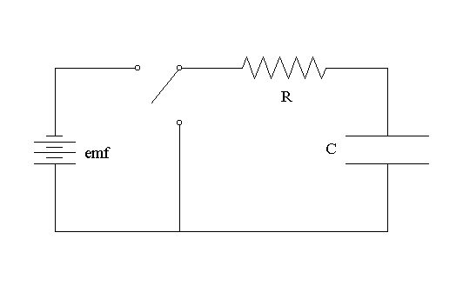
How does EEG work?
EEG sets up a circuit: lead is an electrode and plasma membrane acts a capacitor
Negative charges line up on inside of cell membrane and positive on outside → completed circuit

Slide 4
How does EEG work?
Neurons in a column in the brain behave as a group
EPSP correlate with surface negative EEG waves
IPSP correlate with surface positive EEG waves
Electrical activity of the brain ranges from 10-150microvolts

Slide 5
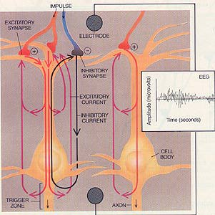

Slide 6
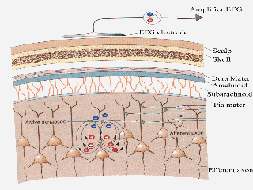

Slide 7
What areas of the brain does EEG detect
Cortex best – more superficial areas better
Does not detect deep structures such as BG, thalamus, brainstem
Also does not detect well in sulci, sylvian fissure, interhemispheric fissure or skull base area

Slide 8
Electrode Application
Electrodes must make good contact with skin
Electroconductive gel is used for low impedence of current
Max impedence of 5 Kohms – checked before EEG recording
Increased impedence = increased noise

Slide 9
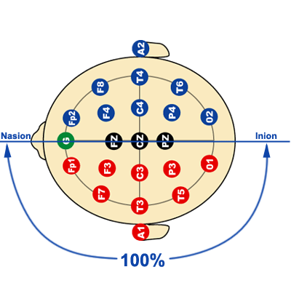
Notes:
Distributes electrodes at proportional distances across cranium

Slide 10
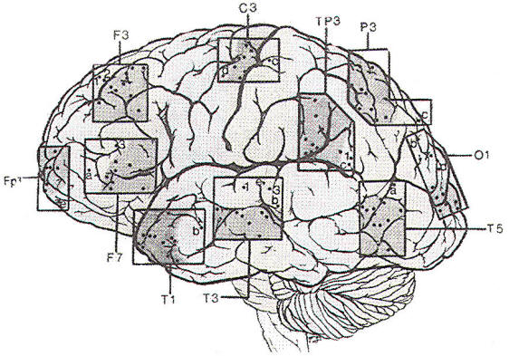
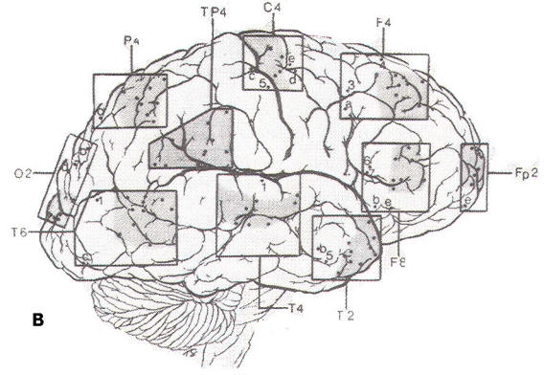
Electrode Placement
Left sided leads
Right sided leads

Slide 11
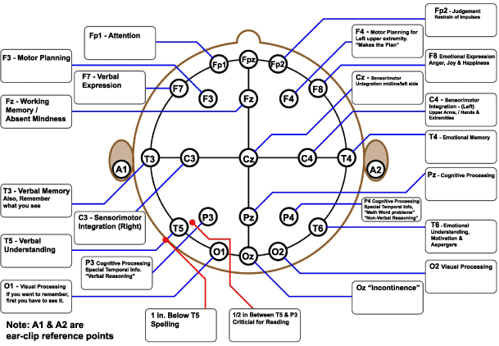

Slide 12
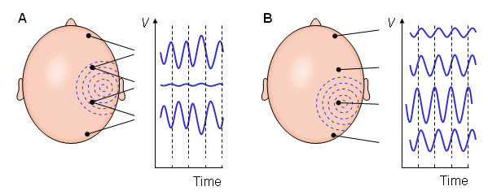
Bipolar vs Unipolar

Slide 13
EEG waveforms
Frequency = number of complete waveforms/second (Hz)
Amplitude: size of wave measured in microvolts

Slide 14
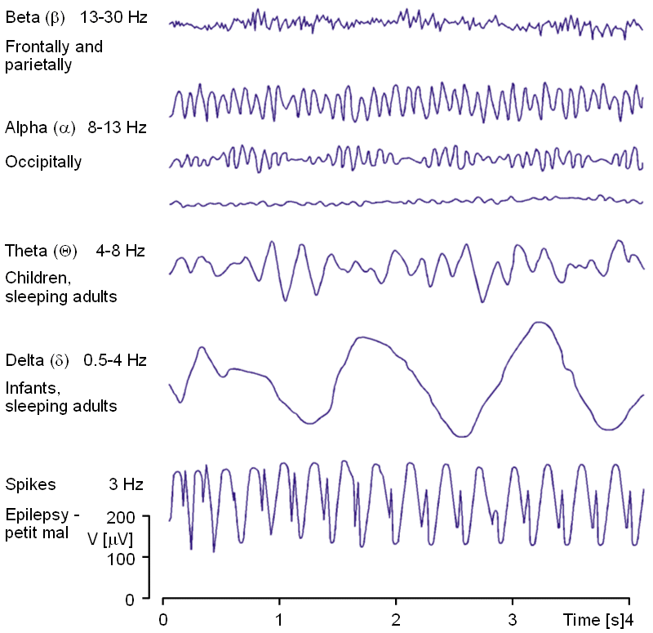

Slide 15
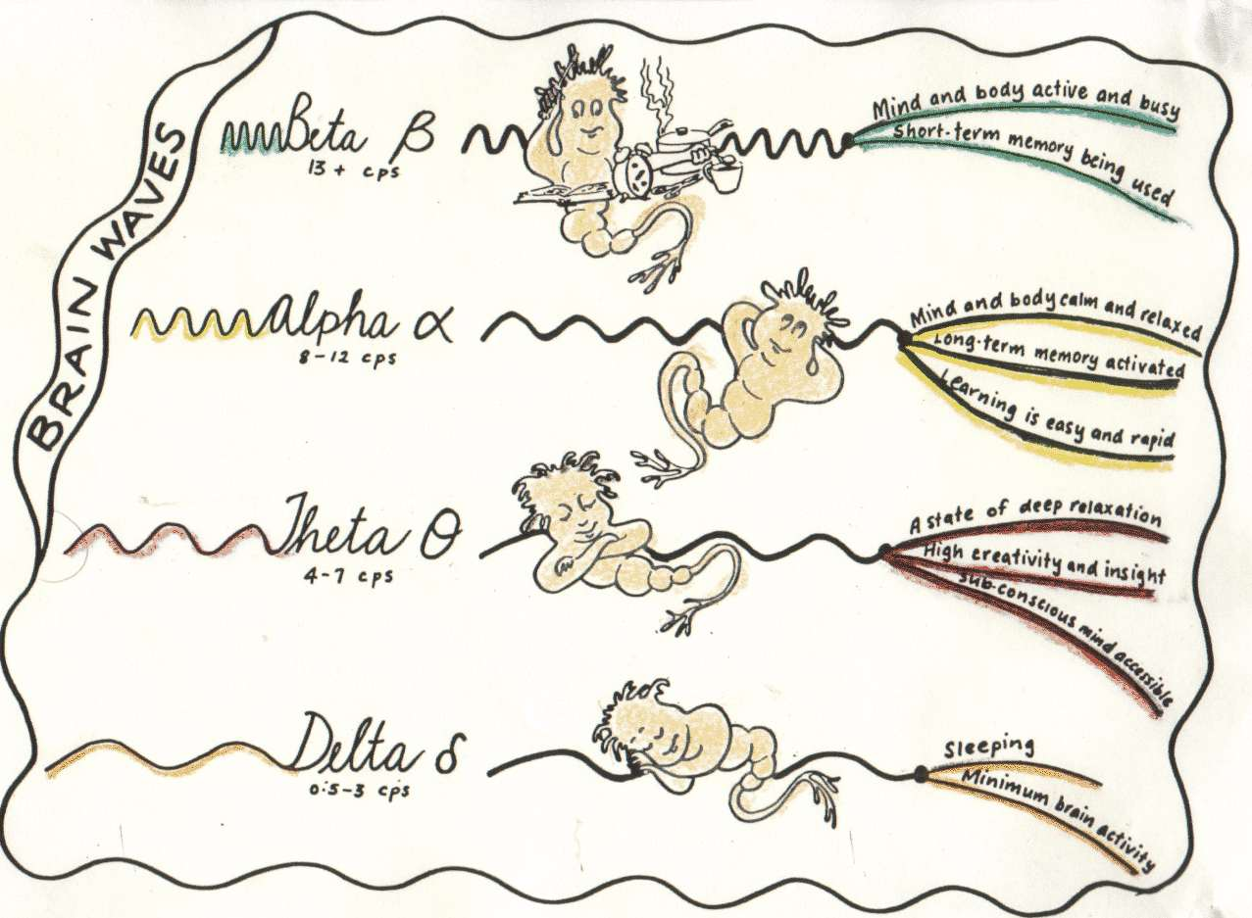
EEG Waveforms cont’d

Slide 16
EEG frequency Ranges
Delta: focal or diffuse
Theta: central or diffuse
Beta: frontal, central
Alpha: occipital (alpha rhythm different from alpha frequency)

Slide 17
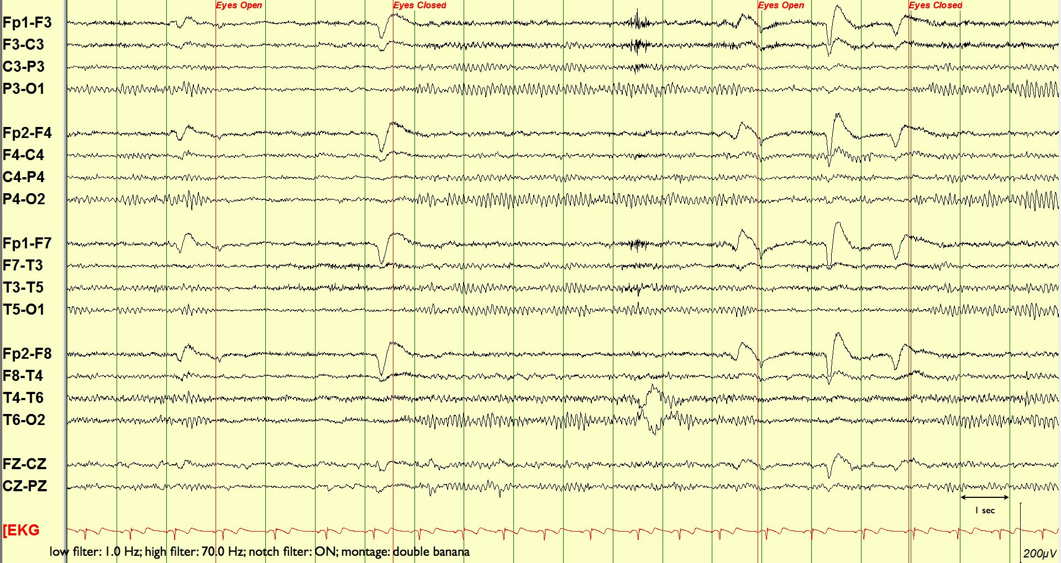
What is normal
Notes:
PDR: occiptial in awake person. Can become more anterior in drowsy patient. Sinusoidal, alpha frequency

Slide 18
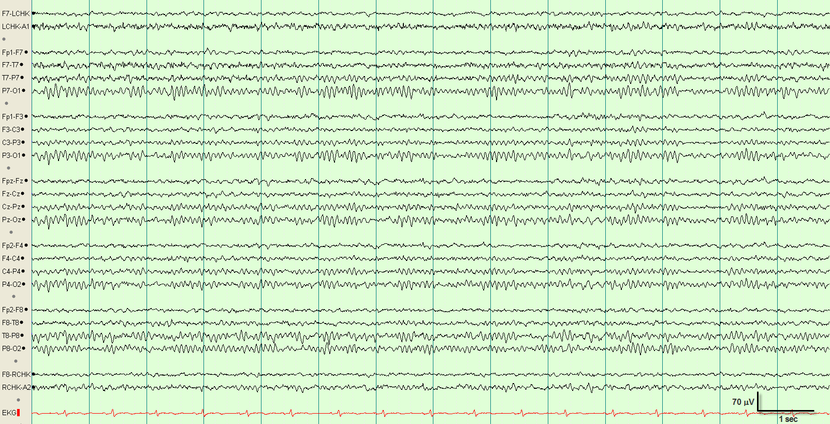
Normal EEG

Slide 19
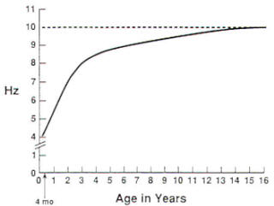
Normal Background Frequency changes with age

Slide 20
What are we looking for on the tracing?
Location
Symmetry
  Are waveforms the same on L & R (amplitude, frequency)
Synchrony
  Is there simultaneous occurrence of similar waveforms (epi on one side)
Reactivity
Morphology
  How would you describe the waveform
Rhythmicity
  Continuous repetition of waveforms that are similar

Slide 21
Abnormal EEG findings
Generalized or focal slowing
Lack of reactivity
Epileptiform discharges
Ictal patterns

Slide 22
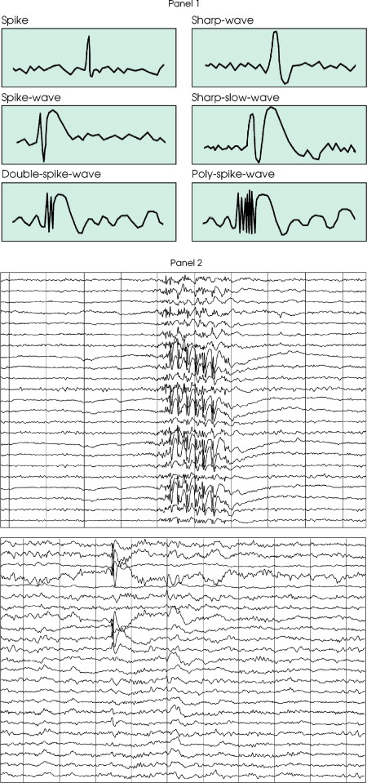
What are these sharp waves?
Notes:
Spike = 20-70ms
Sharp= 70-200ms

Slide 23
Pattern Recognition

Slide 24
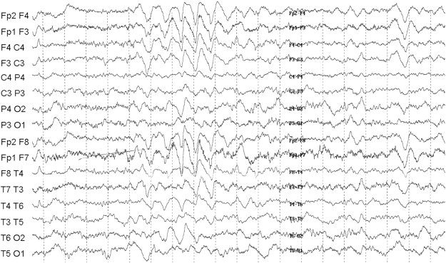
FIRDA

Slide 25
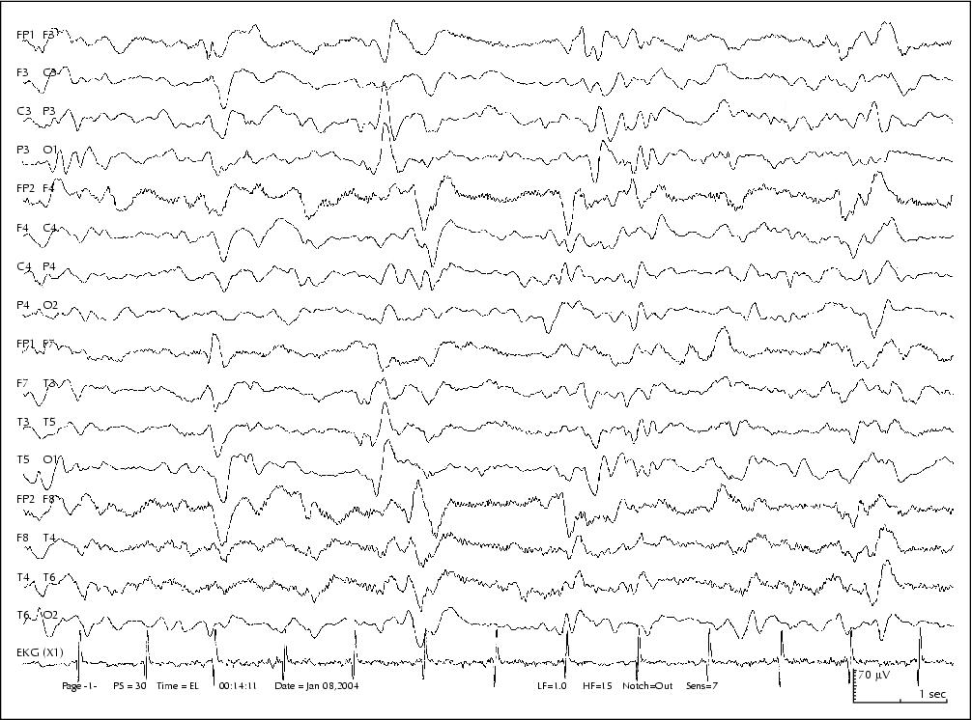
PLEDs

Slide 26
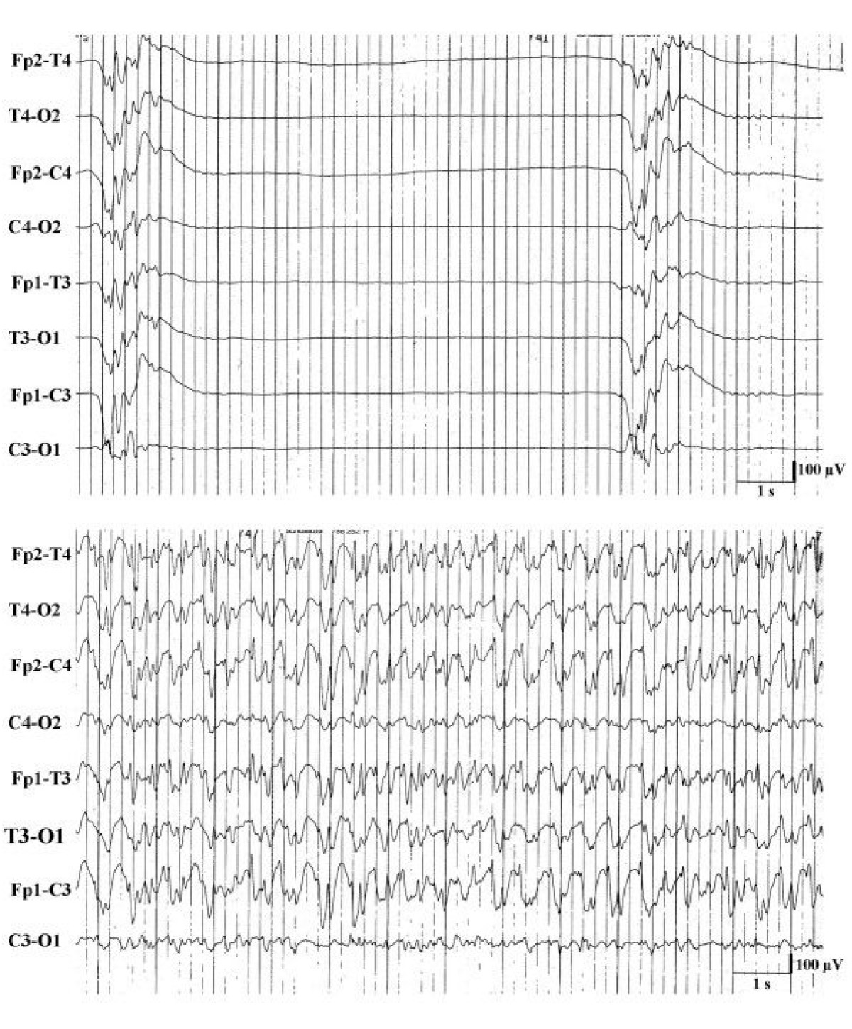
Burst Suppression

Slide 27
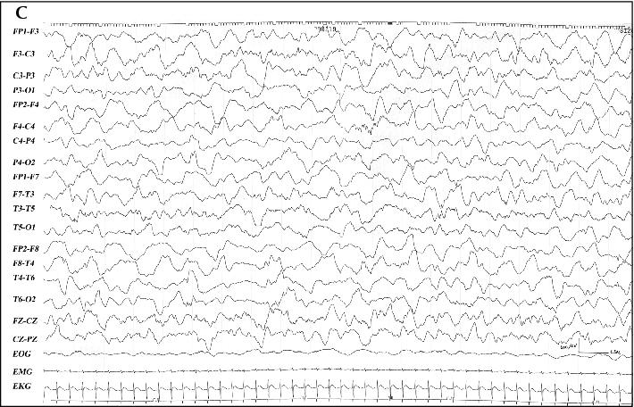
Diffuse Slowing

Slide 28
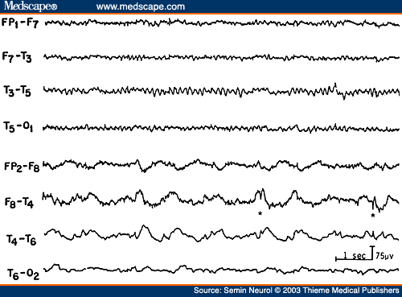
Focal Slowing

Slide 29
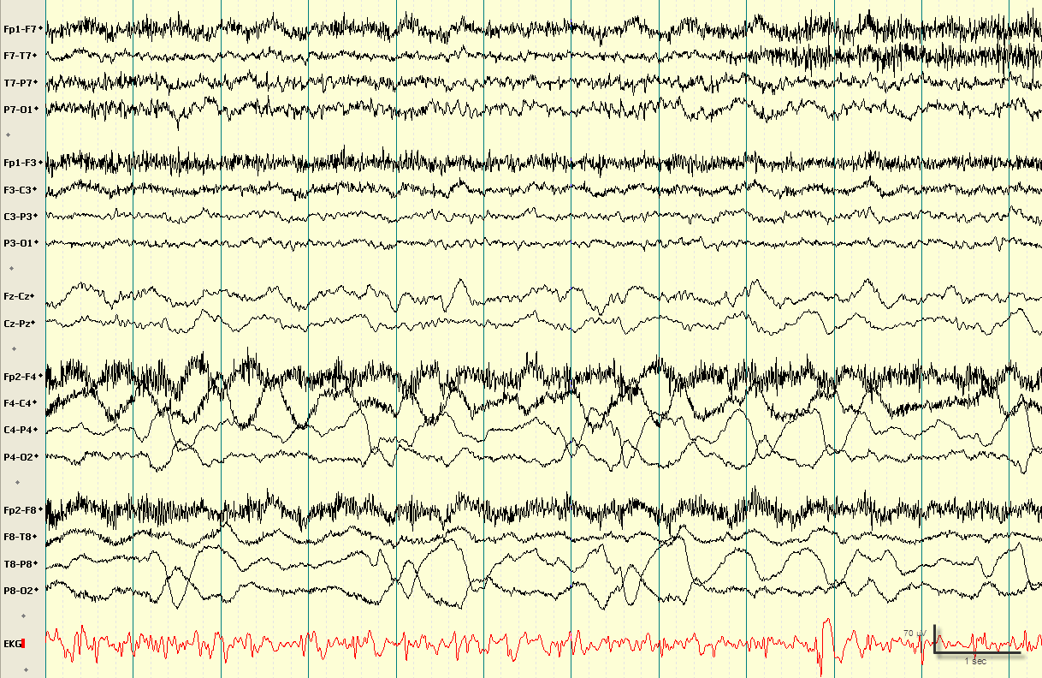
Breach Artifact

Slide 30
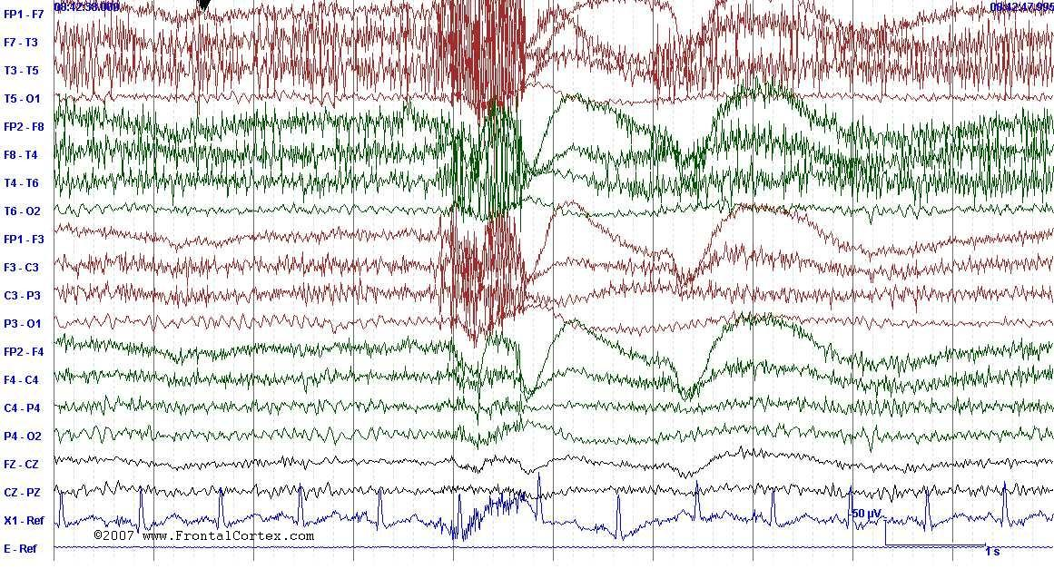
2 Types of Artifact

Slide 31
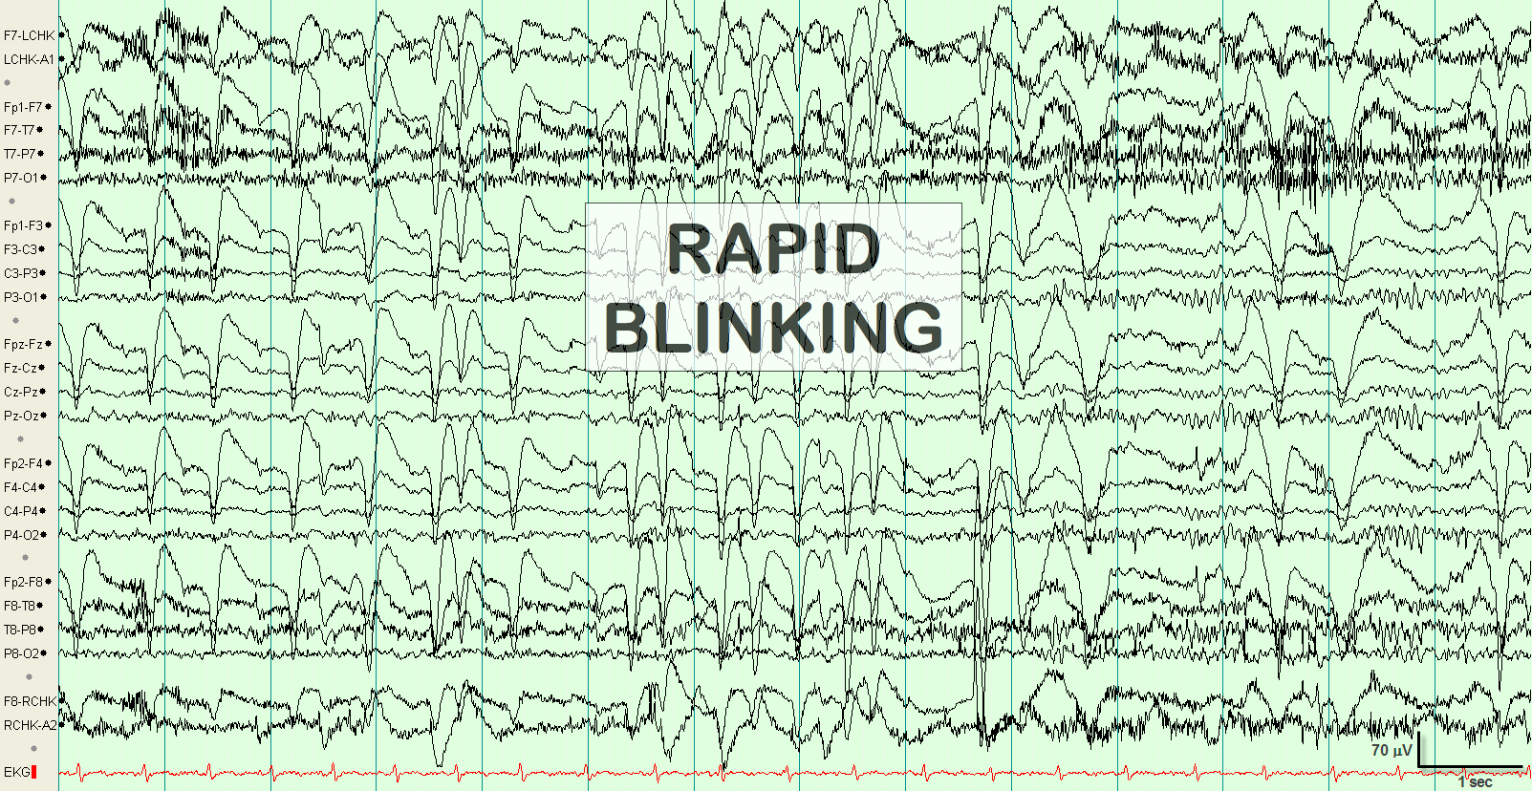
Looks like seizure…..
Notes:
Eye blinking – eye rolls up →creating a positive charge (negative deflection) in anterior frontal leads

Slide 32
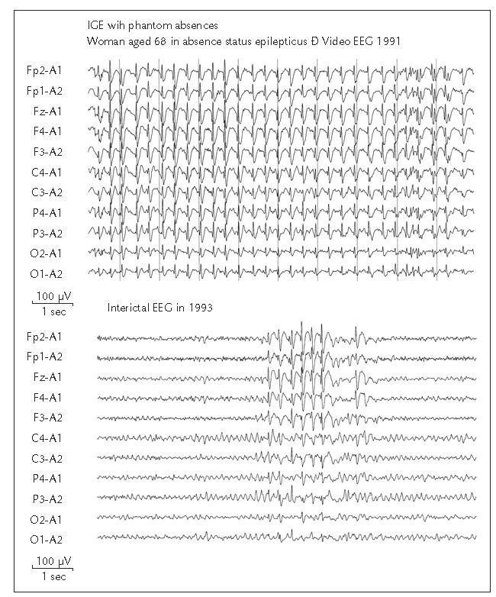
Status Epilepticus

Slide 33
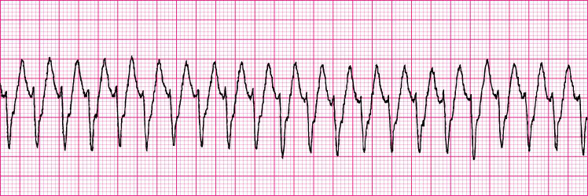
Pattern Recognition

