Slide 1
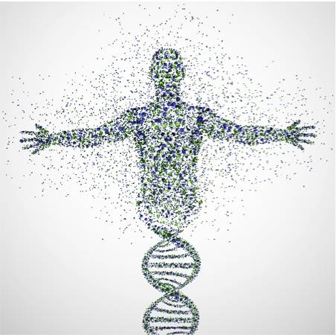
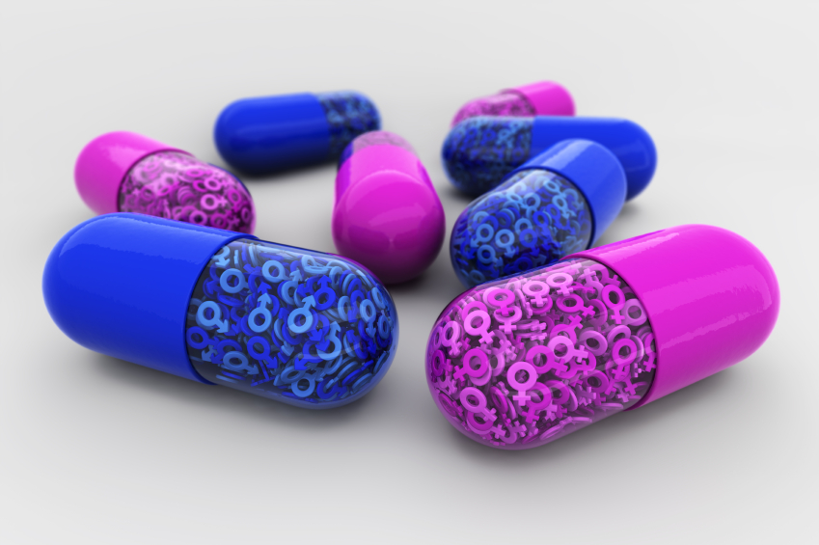
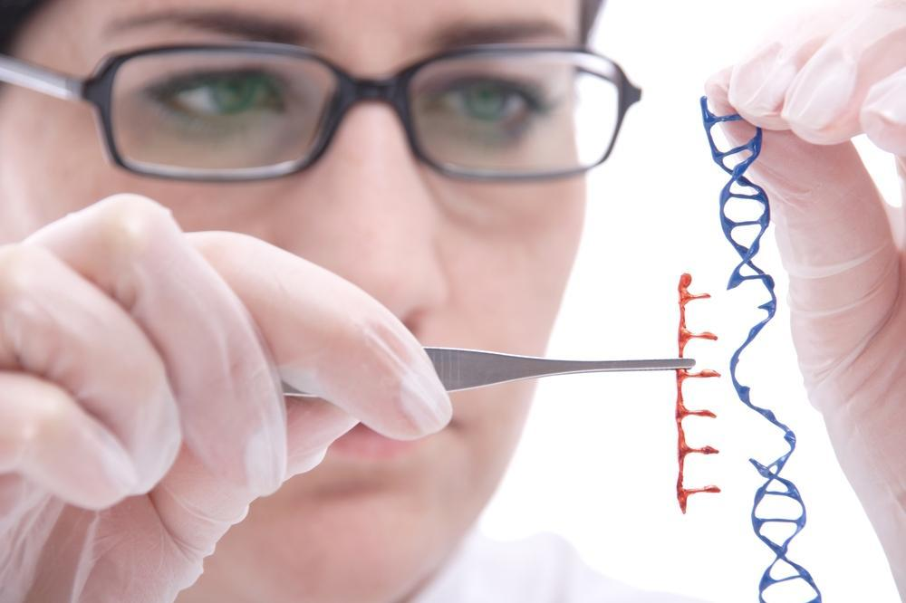
Chitosan: A versatile tool for drug and gene delivery
MSc. Antonio Di Martino, Ph.D.
Centre of Polymer Systems, University Institute Tomas Bata University in Zlin,
tr.T.Bati 5678,76001,Zlin,Czech Republic

Slide 2
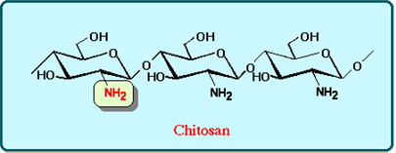
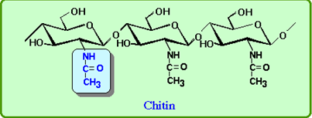
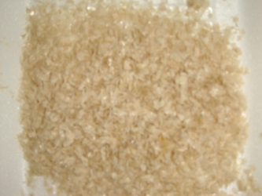
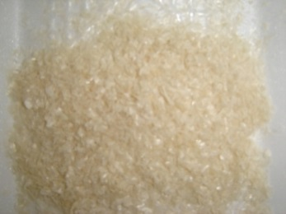
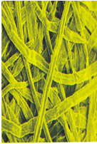
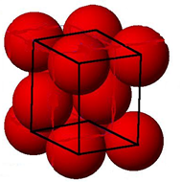
Chitin and Chitosan : Introduction
Deacetylation
Alkaline media
Temperature
Time
pH
Chitosan DD > 50%; DA <50%
2nd natural polymer for abundance
Exoskeleton of arthropods
Cell walls of fungi and yeast
INSOLUBLE
Chitosan is the only pseudonatural cationic polymer
Semicrystalline in solid state
Soluble in water at pH < 6
pKa ~ 6.5
Simple to process

Slide 3
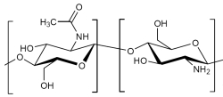
Chitosan : properties
Physiochemical
Cationic polyamine
High charge density at pH <6
Form gel with polyanions
Forms salts with organic and inorganic acid
Linear
Wide range of Mw
Chelate certain transition metals
Reactive amino/hydroxyl groups
Biological
Biocompatible
Biodegradable
Non toxic LD50> 16g/Kg
Haemostatic
Bacteriostatic
Fungistatic
Anticholestreremic
Spermicidal
Anticancerogenic (still not clear)

Slide 4
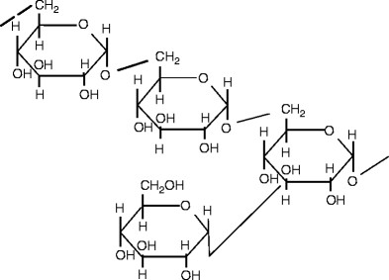
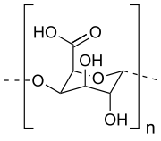
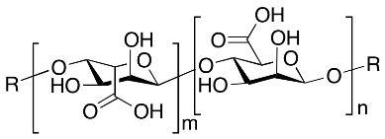
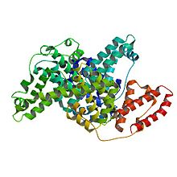
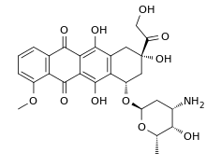
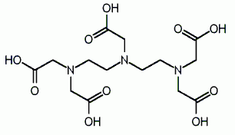
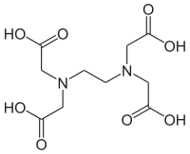
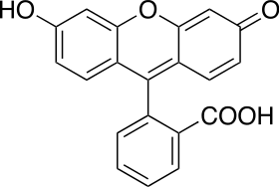
Chitosan derivatives
PDLLA
PLLA
Carboxy enriched
Branched
Reactive amino (C2) and hydroxyl groups in C3-C6
O-and N-Carboxymethlchitosans
Chitosan 6-O- and N-sulfate
Chitosan-grafted copolymers
Carbohydrate branched chitosans
Alkylated chitosans
Cyclodextrin-linked chitosans
Dextran
Pectic acid
Alginic acid
Folic acid
Doxorubicin
BSA
DTPA
EDTA
Fluorescein

Slide 5
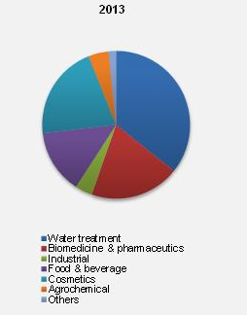
Chitosan: applications
Tissue Engineering
Biosensor
Wound dressing
Antibacterial
Drug and Gene delivery
Source: Nutraceuticals World,WebMD,EUCHIS,Market Research

Slide 6
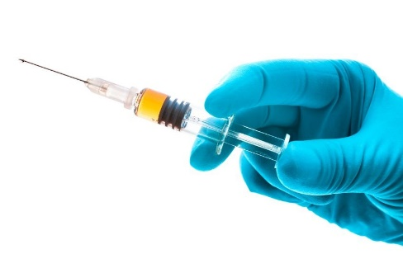
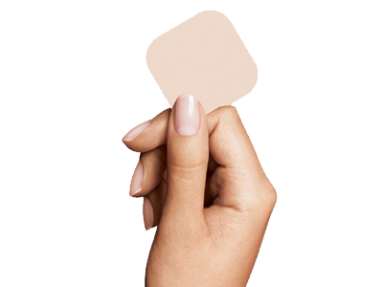
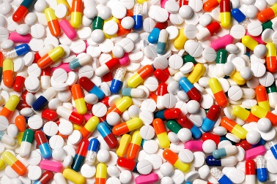
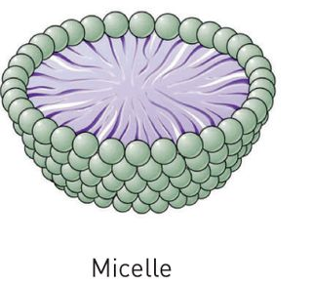
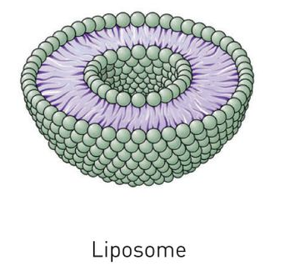
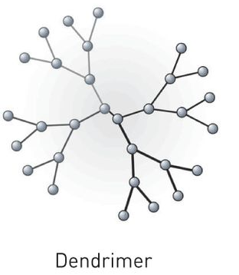
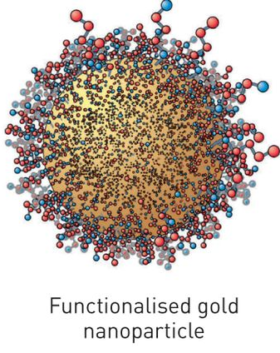
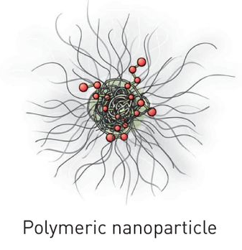
Chitosan: Drug delivery
Drug delivery refers to approaches, formulations, technologies, and systems for transporting a pharmaceutical active compound in the body to safely achieve its therapeutic effect
Oral
Injection based
Transdermal
Carrier-based
A drug carrier is any substrate used to improve
selectivity
effectiveness
safety
drug administration.

Slide 7
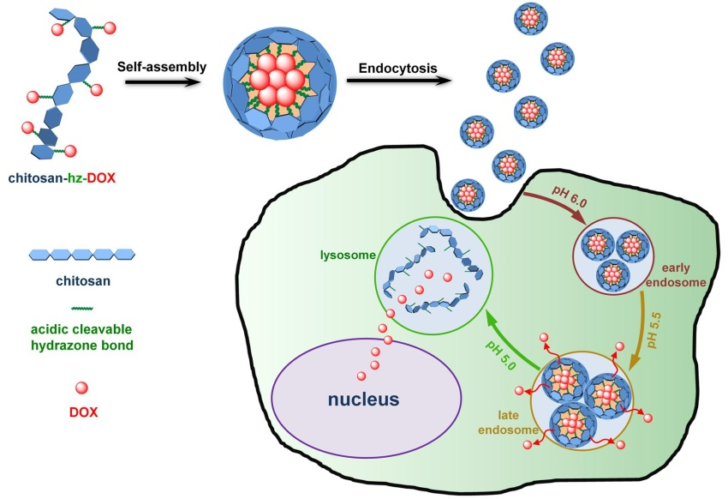
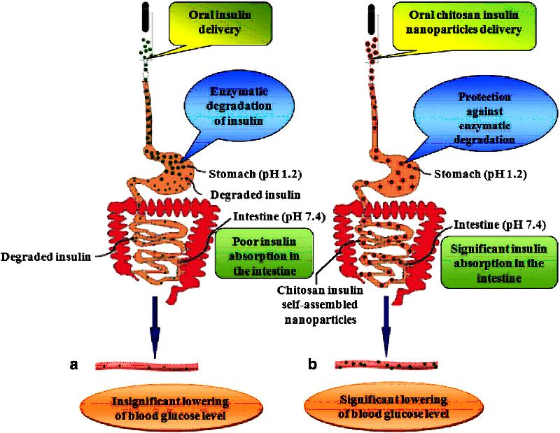
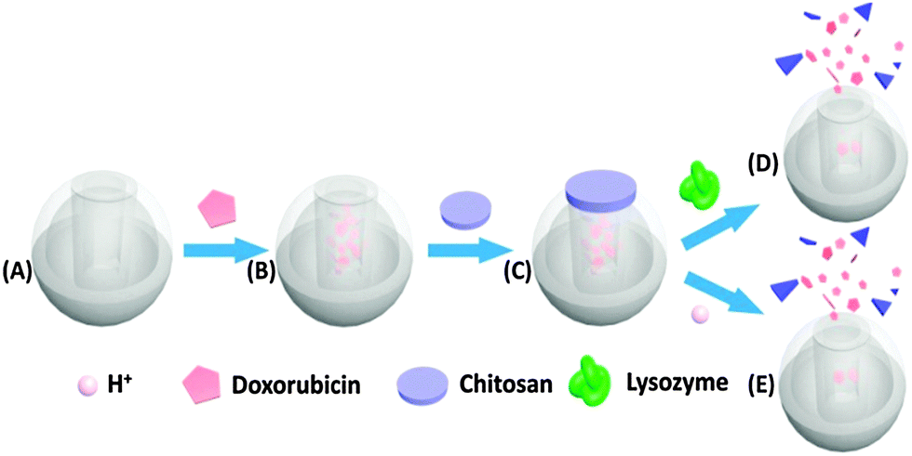
Chitosan: Drug delivery
Chitosan based pro-drug for intracellular delivery
Chitosan to protect environmental sensible molecules
Nanotechnology, 2015,25,25
Chitosan for stimuli responsive release
Nanotechnology and Nanomaterial ISBN 978-953-51-1628-8,
Chem. Commun., 2014,50, 13268-13271

Slide 8
Chitosan: Drug delivery
Type of system | Method of preparation | Active Pharmaceutical Ingredient (API)
Tablets | Matrix Coating | 5-ASA, Diclofenac Sodium, Theophylline, Mesalamine Glipizide, Propranolol HCl, Ibuprofen, Ketoprofen
Capsules | Capsule shell | Insulin, 5-ASA
Microspheres Microparticles | Emulsion cross-linking Coacervation/precipitation Spray-drying Ionic gelation Sieving method | Gentamicin Sulphate, Hemoglobin, Diclofenac Sodium, Clarithromicin, Propranolol-HCl,Cimetidine, Famotidine, Bovine serum albumin, Clozapine , NSAID, Indomethacin
Nanospheres Nanoparticles | Emulsion-droplet coalescence Coacervation/ precipitation Ionic gelation Reverse micellar method | Gadopentetic acid, Bovine serum albumin, Ascorbic acid, Cyclosporin, Doxorubicin, Temozolomide, 5-Fluorouracil, Bevacizumab, Insulin, Carmustine, NSAID, Ibuprofen, Naproxen
Beads | Coacervation/ precipitation | Bovine serum albumin, Insulin,
Films | Solution casting | Ofloxacin, Paclitaxel, Clarithromicin, Vancomicin
Gel | Cross-linking | 5-Fluorouracil, EGF, Paclitaxel, Aminolevulinic acid

Slide 9
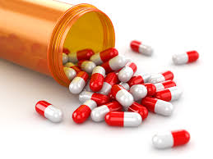
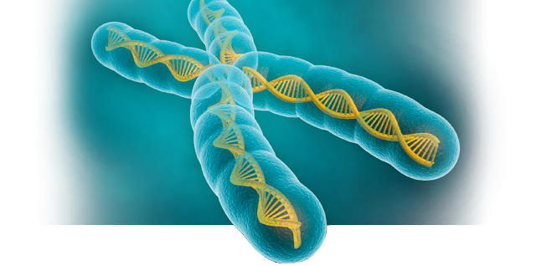
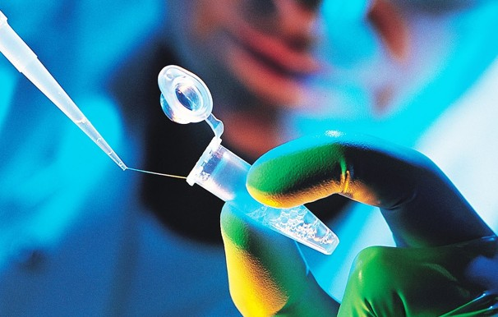
From Drug to Gene delivery…….

Slide 10
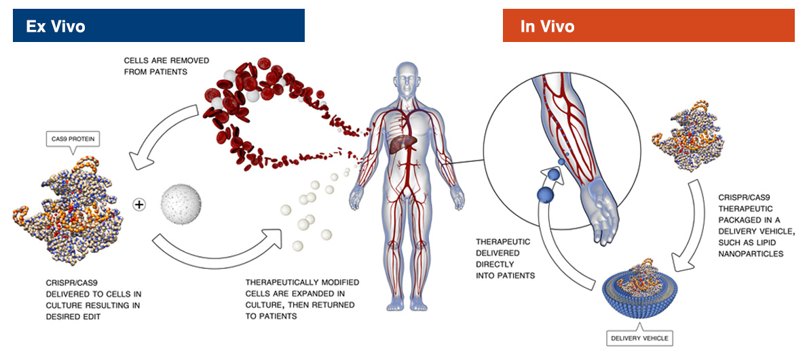
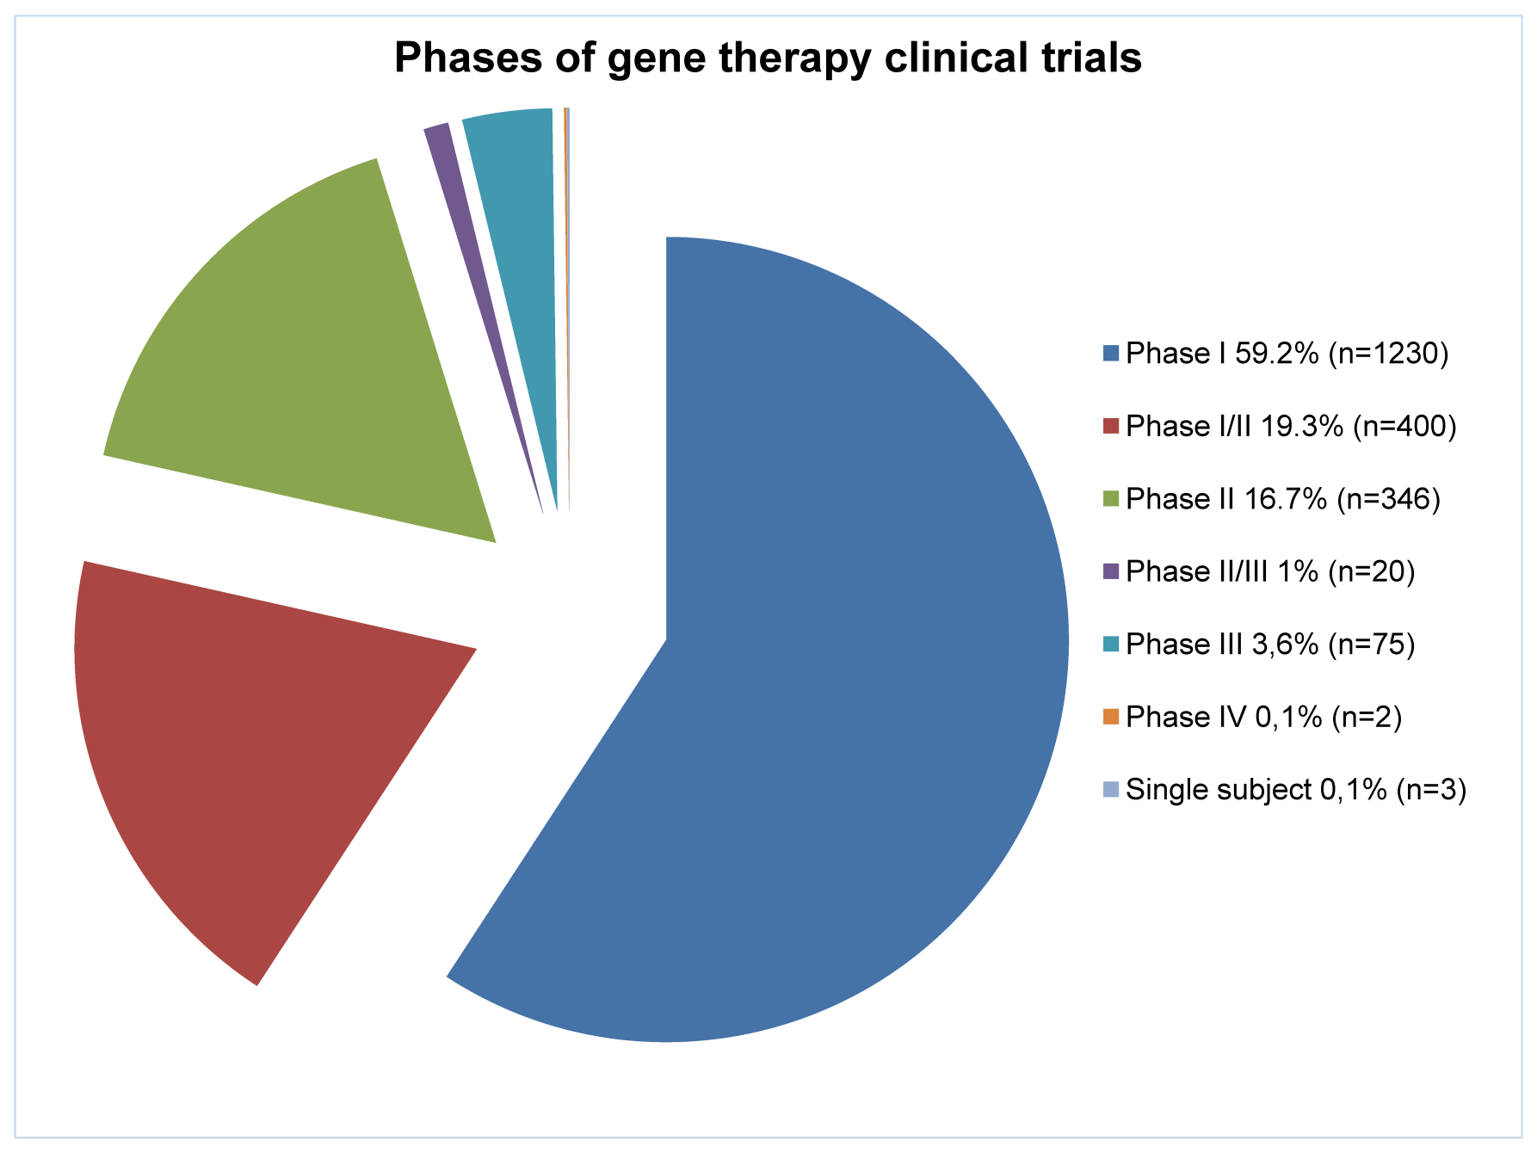
Gene Therapy…What is it?
Delivery of a transgene into a host genome
Different Approaches:
I) Germline Gene Therapy
II) Somatic Gene Therapy
Ex Vivo Delivery
In Situ Delivery
In Vivo Delivery
Single gene (X-recessive single gene disorders)
Polygenic disorders
Cancer
Neurodegenerative
Vascular
inflammatory
Cystic Fibrosis (CF)
Adenosine Deaminase (ADA)
Hemophilia
Duchenne Muscular Dystrophy (DMD)

Slide 11
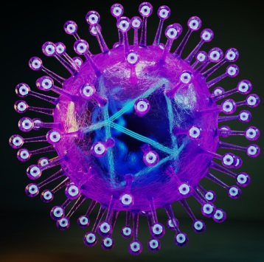
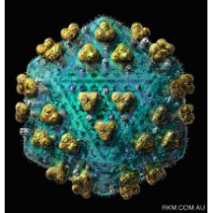
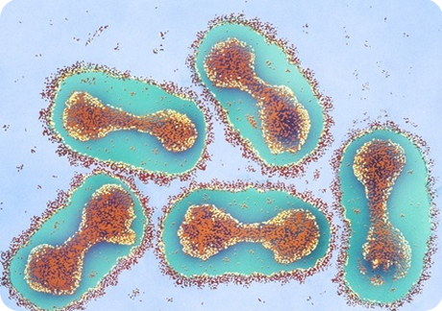
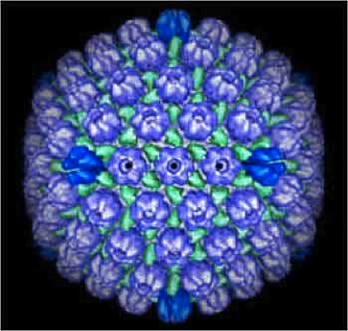
Gene Delivery: Vectors
v
v
Viral Vectors
Non-Viral Vectors
Physical methods
Naked DNA
Electroporation
Gene gun
Magnetofection
Cationic liposomes
Cationic polymers
HSV
Lentiviruses
PEI
High transfection
High stability
Toxic
Poxvirus
Epstein-Barr
CHITOSAN

Slide 12
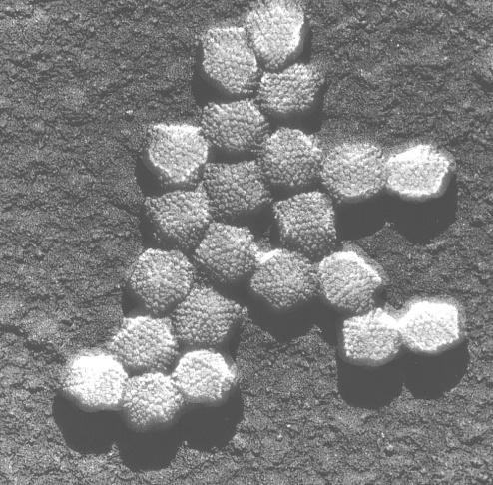
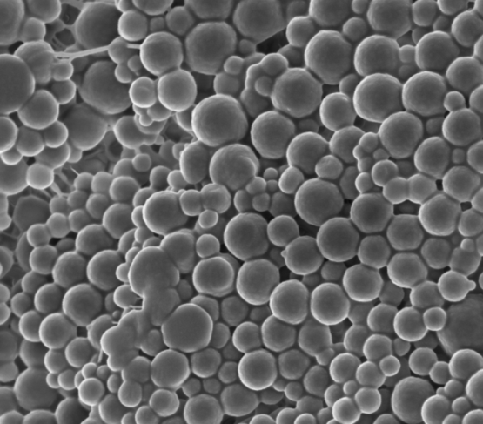
Virus VS Chitosan: Gene Therapy
Adenovirus
Chitosan nanospheres
http://www.virology.net/Big_Virology/BVDNAadeno.html
High efficient for in vivo transfection
Immunization
Restricted gene material
Possible toxicity
Immunogenicity
Inflammatory potential
Insertional mutagenesis
Need to be reassessed with regard to their safety
Low transfection efficiency in vivo
Ease of synthesis
Extensive modifications
Low immunogenicity
Biocompatible
Unrestricted gene materials
Stimuli responsive
Safe

Slide 13
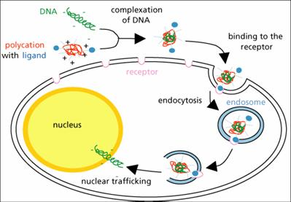
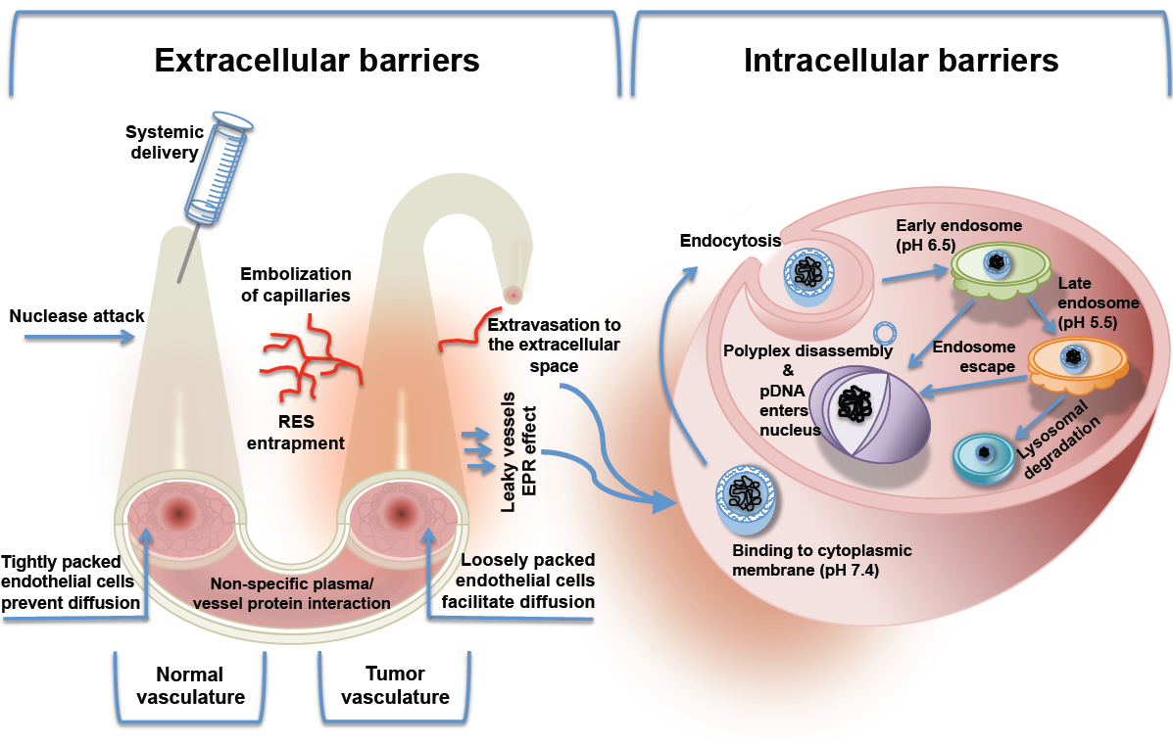
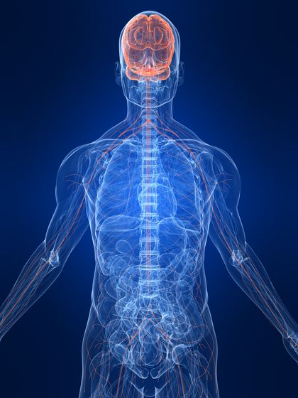
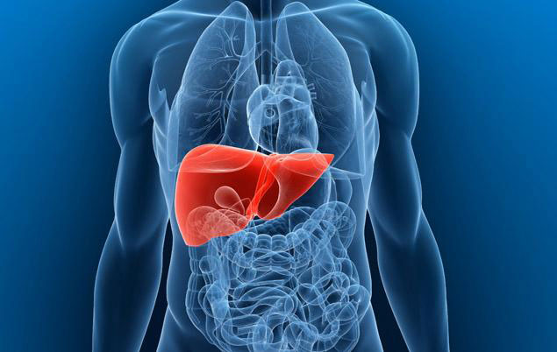
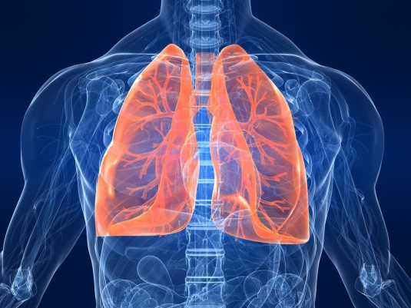
Chitosan: Gene Therapy
How to Overcome Bio-Barriers ?
Chitosan – DNA polyplexes
High Trasfection Efficiency in several cell lines…

Slide 14
Chitosan: Gene Therapy
Factors affecting the DNA delivery
Molecular weight
Chemical modification
Presence of ligand
Deacetylation degree
N/P ratio
Salt form
pDNA concentration
pH
Presence of additives
Preparation technique
Administration route
Chitosan derivatives
Hydrophilic modification
PEG-CS
PEI-CS TMC
PEG-g-TMC
Solubility
Stability
Trasfection Efficiency
Hydrophobic modification
L-Phenylalanine-CS
Stearic acid –CS
Urocanic acid-CS
Enhance endosomal rupture
Interaction with DNA
Muchoadesivity
Cellular uptake
Ligand modification
Folic Acid-CS
Transferrin-CS
Mannose-CS
Galactose-CS
Selectivity
Cellular uptake
Thermosensitive modification
TMC-N-isopropyl-acrylamide
Poly-acrylamide-vinyl laureate-CS

Slide 15
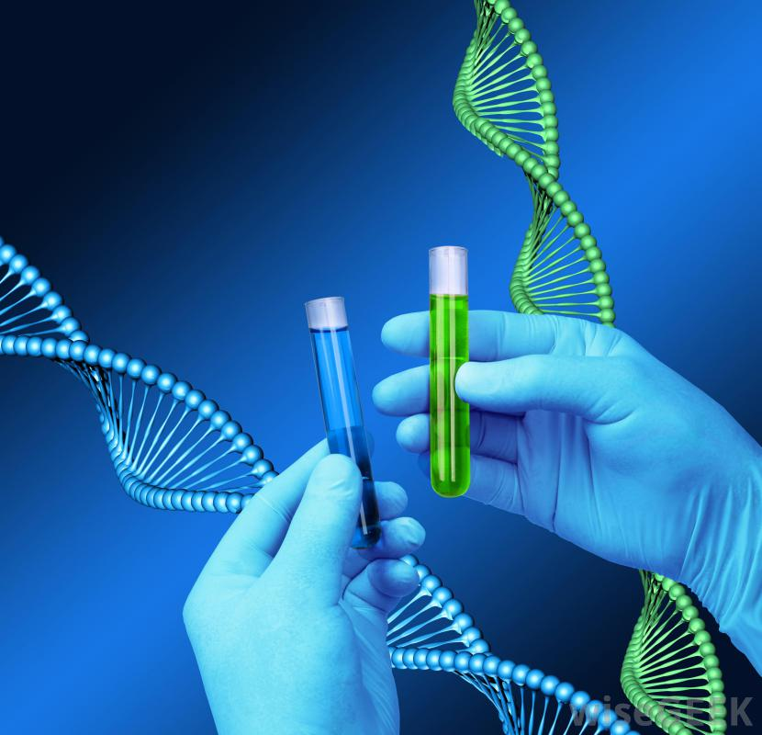
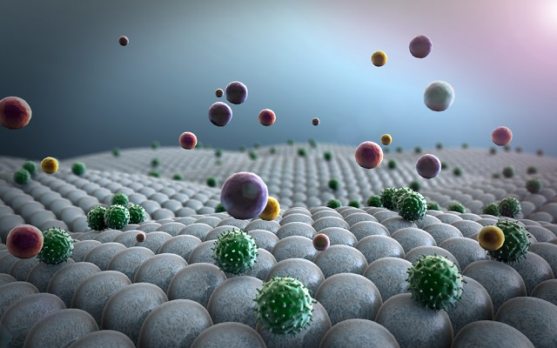
Conclusion
As evidenced by the last 10 years literature….
Chitosan represents a promising material for delivery of active pharmaceutical ingredients (API) and genes
Satisfying results have been obtained in vitro and in vivo
Still some drawbacks have to be solved

