Slide 1
Breast Cancer Screening:
Changing Philosophies in Educating Women and Teens
Courtney Benedict CNM MSN

Slide 2
Notes:
As I look around the room today - I see so many familiar faces… and am humbled and inspired by the experience, knowledge, and skills that you all bring with you to a conference like this. Reproductive health clinicians have to possess a lot of qualities… energy to get you through those busy days, strong foundation of clinical knowledge, skillful hands, and one thing we definitely need is a good memory. Not only are we expected to learn new guidelines constantly (think cervical cancer screening and follow up guidelines), but we are often able to commit these very complex concepts to memory. While we may be familiar with mastering all this new information thrown at us… we may struggle on how to translate and explain these highly technical concepts to our clients. And that is what I would like to explore with you today… in particular… how do we communicate breast cancer screening options to women??

Slide 3
Disclosures
Merck Nexplanon trainer

Slide 4
Session Objectives
Explain the rationale for initiation and frequency of clinical breast exams to clients
Compare screening mammogram recommendations from USPSTF and ACOG
Develop a script to discuss breast self awareness with clients
Detect health history components that place a client at increased risk for breast cancer

Slide 5
Notes:
There are layers of confusion surrounding who, when, and how often breast cancer screening should occur. The public is exposed daily to pink ribbons, the stories of survivors, and mostly the scary possibility of being diagnosed with breast cancer. We give confusing messages, then, when we advertise the scary reality of breast cancer, coupled with laxed screening recommendations for CBE and mammograms. This causes confusion and anxiety.
As clinicians, we become confused when the guiding professional organizations don’t agree on how women should be screened for breast cancer. How do we take this information back to clients and help them navigate their options and make meaningful decisions about their own breast cancer screening.

Slide 6
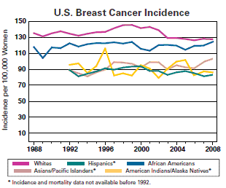
Notes:
Breast cancer incidence rates in the U.S. began decreasing in the year 2000, after increasing for the previous two decades. They dropped by 7% from 2002 to 2003 alone. One theory is that this decrease was partially due to the reduced use of hormone replacement therapy (HRT) by women after the results of a large study called the Women’s Health Initiative were published in 2002. These results suggested a connection between HRT and increased breast cancer risk

Slide 7
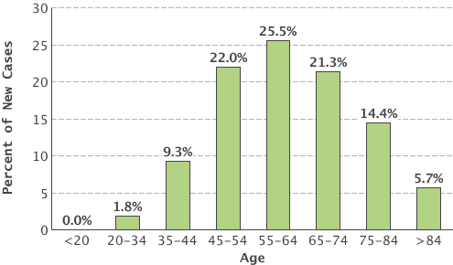
Percent of New Cases by Age Group: Breast Cancer
SEER 18 2007-2011, All Races, Females
Notes:
•About 1 in 8 U.S. women (just under 12%) will develop invasive breast cancer over the course of her lifetime
In 2013, an estimated 232,340 new cases of invasive breast cancer were expected to be diagnosed in women in the U.S., along with 64,640 new cases of non-invasive (in situ) breast cancer
About 2,240 new cases of invasive breast cancer were expected to be diagnosed in men in 2013. A man’s lifetime risk of breast cancer is about 1 in 1,000
Most commonly diagnosed cancer in women
•Second leading cause of cancer death in women
•Breast cancer dx increasing 0.3% per year (1990)
–USA 1 in 8 chance of invasive breast CA in lifetime
•Mortality decreasing 2.3% annually
–1999 age-adjusted mortality 27/100,000 population
–46% estimated due to screening
–Rest due to treatment such as chemotherapy and tamoxifen/femara
Breast cancer is most frequently diagnosed among women aged 55-64.
Median Age
At Diagnosis
61

Slide 8
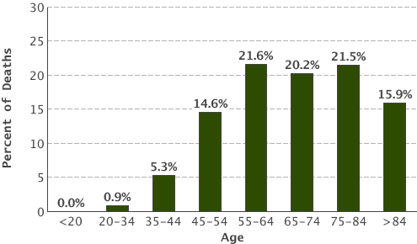
Percent of Deaths by Age Group: Breast Cancer
EER 18 2007-2011, All Races, Females
Notes:
About 39,620 women in the U.S. were expected to die in 2013 from breast cancer, though death rates have been decreasing since 1989 — with larger decreases in women under 50. These decreases are thought to be the result of treatment advances, earlier detection through screening, and increased awareness.

Slide 9
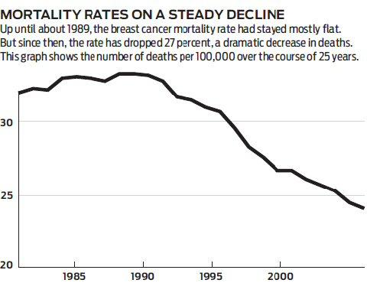
Notes:
The good news is that the number of women who die from breast cancer has steadily been declining. This is likely a result of early detection and improvement in treatment outcomes.

Slide 10
Notes:
So- we have clearly defined the good and bad news about the incidence of breast cancer in the US… why would there be controversy or disagreement about how best to screen for this cancer? Let’s take a quick look…
•Recommendations for prevention strive to maximize benefits and minimize harms.
•Competing factors: US population highly enthusiastic about frequent cancer screening; medico-legal environment rewards vigilance from clinicians
•Controversies common in determining: when to begin, when to end, screening frequency and use of newer screening technologies
•USPSTF: widely recognized as setting the standard for evidence-based recommendations related to prevention
•Devising recommendations for prevention can be complicated at all steps.
Determining the appropriate balance between benefits and harms is challenging
•What is the US Preventive Services Task Force?
•Congressionally mandated independent panel of non-Federal experts in prevention and evidence-based medicine
•16 primary care providers (e.g., internists, pediatricians, family physicians, gynecologists/obstetricians, nurses and health behavior specialists)
•
•What are US Preventive Services Task Force activities?
•recommendations published in the form of ”recommendation statements”; opportunity for public comment provided
•Affordable Care Act (July 2010) singles out positive recommendations by the USPSTF (those deemed an “A” or “B”) for coverage
•recommendations graded to convey two major elements: certainty and magnitude of net benefit of the service

Slide 11
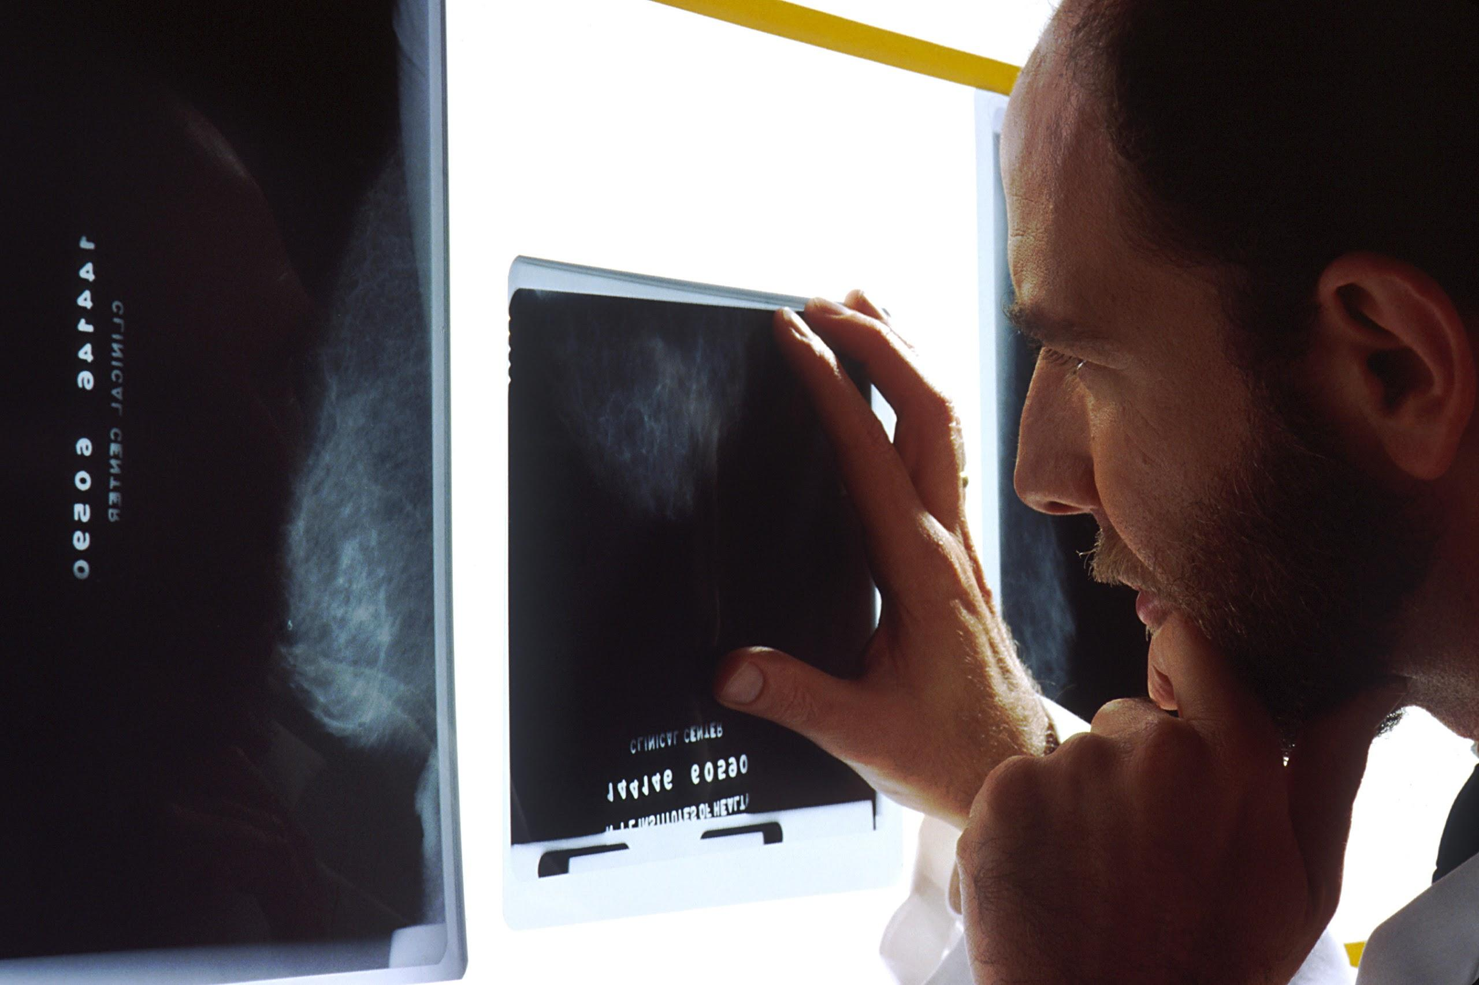
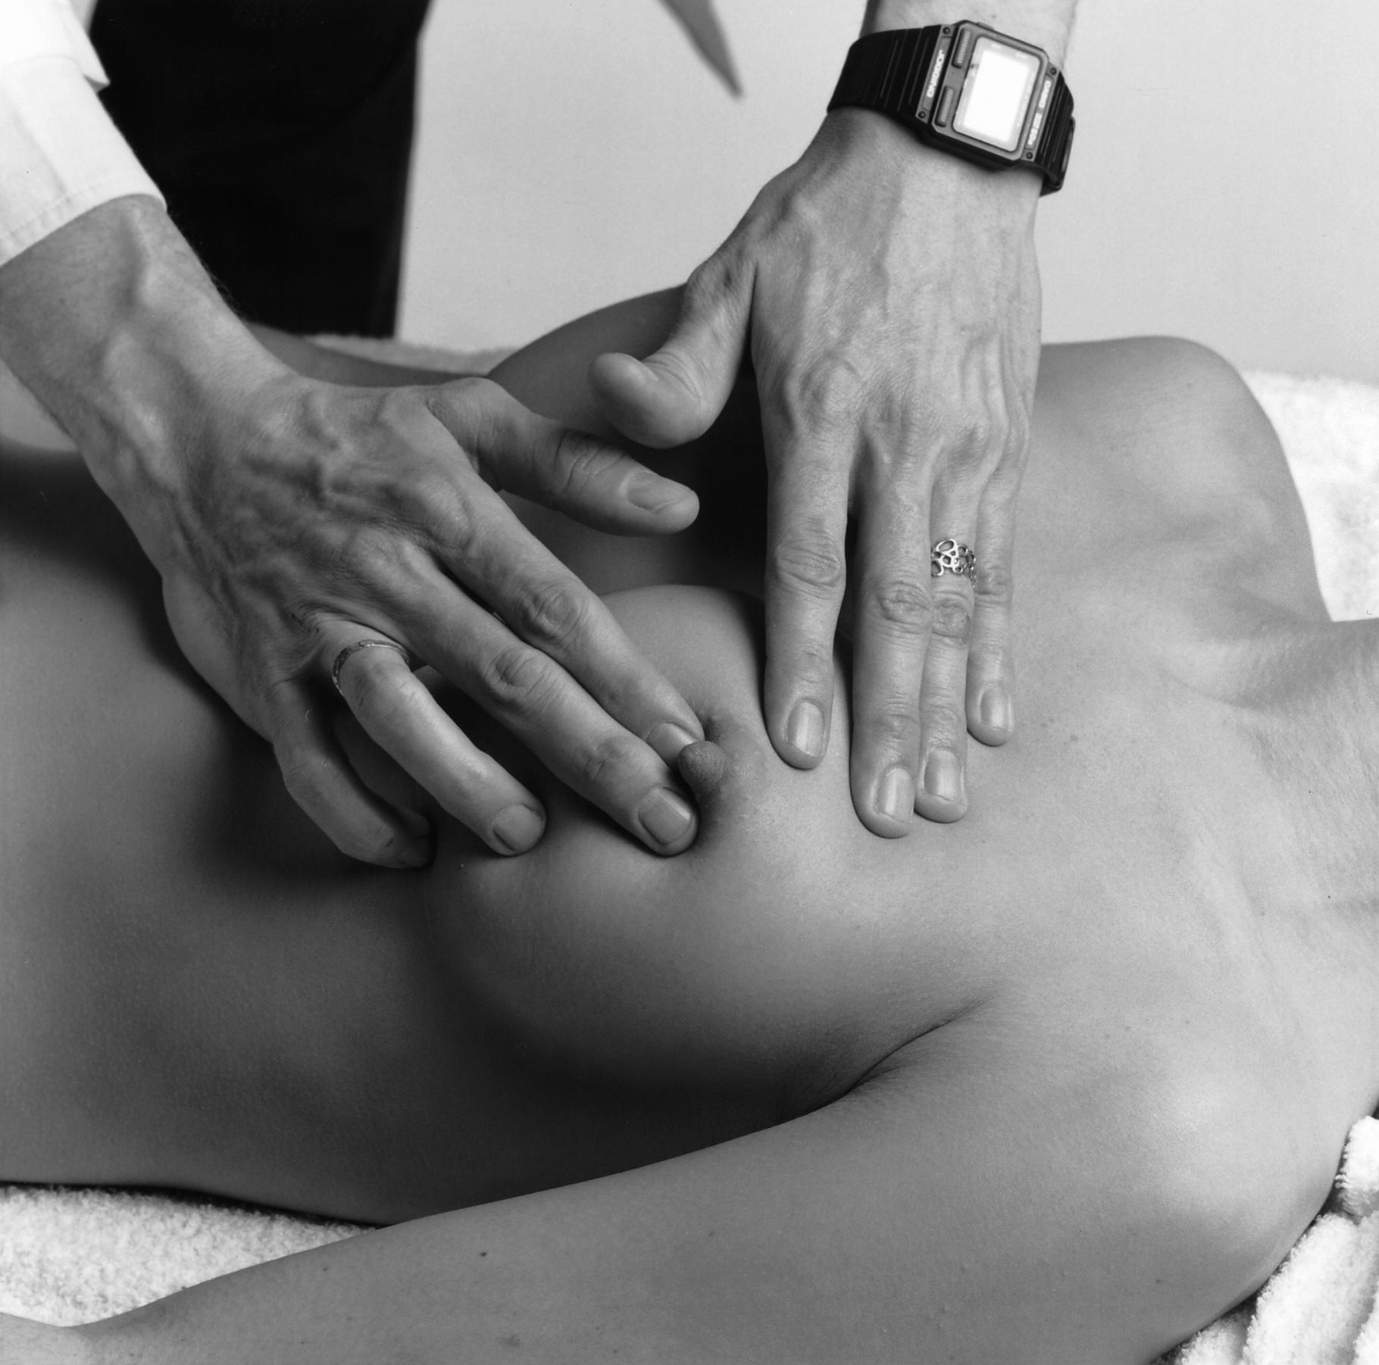
Notes:
Now - what specifically does breast cancer screening entail?
In the hunt for breast cancer… we look to these tools -
Clinical Breast Exam
Mammography
Risk Screening**
and Methods of Breast Self-Assessment
Let’s first look at the least controversial… Breast Cancer Risk Assessment

Slide 12
Breast Cancer Risk Factors
BRCA1 or BRCA2 gene mutation
Family history of breast cancer
Therapeutic radiation to the chest <30yo
Atypical ductal or lobular hyperplasia or lobular carcinoma in situ on previous biopsy
Notes:
Risk factors for breast cancer are powerful bits of knowledge that help you explain and the client decide about screening options. For instance, those who do not have risk factors and are at average risk may find it more acceptable to await initial mammography. Conversely, if someone is found to be at increased risk for breast cancer, you can guide her to the proper resources to aid her decision making about screening and in some risk categories there may be specific screening recommendations. Generally, those recommendations for increased risk clients should be made by a breast specialist and/or cancer genetic counselor. These four risk factors listed here carry the highest risk factors. The latter two questions could be incorporated into a health history… if she does have either of these two risk factors - she should be seen by a genetic counselor or breast specialist.The first two risks are a bit trickier and I will explain a simplified questionnaire you may choose to utilize to uncover more information about these two questions.

Slide 13
Breast Cancer Risk Factors
Late parity (>30yo) or nulliparity
Early menarche (<12) or late menopause (>55)
Combined hormonal replacement therapy > 10 yrs use
Postmenopausal obesity
Alcohol consumption ( 2 drinks per dy or more)
Smoking before first live birth
Sedentary lifestyle
White race
Notes:
These risk factors carry less risk but if a client has a combination of these risk factors - her risk could be even higher. Typically, these factors alone are not enough to warrant referral to a specialist or genetic counselor. The risk factors listed here typically are considered once one of the higher risk factors (from the previous slide) have been identified.

Slide 14
Simplified Risk Screening Questions
A. Have you had breast or ovarian cancer?
B. Has a blood relative had breast or ovarian cancer?
If answer to both questions are No, recommend average risk screening
If answer to Q.A is yes, ask f/u questions 2.A.
If answer to Q.B is yes, ask f/u questions 2.B.
Notes:
In addition to having some questions added to your health history questionnaire (history of therapeutic radiation to the chest and history of abnormal breast biopsy), these are two questions you could ask when initially seeing a client. Once documented, these questions don;t need to be repeated unless significant new relevant history occurs. Simply ask have you had breast or ovarian cancer, and has anyone in your family had breast or ovarian cancer? If the answer to both is no - she is considered average risk for breast cancer. If the answer to either is yes - then you should triage whether she needs to see a specialist or genetic counselor.

Slide 15
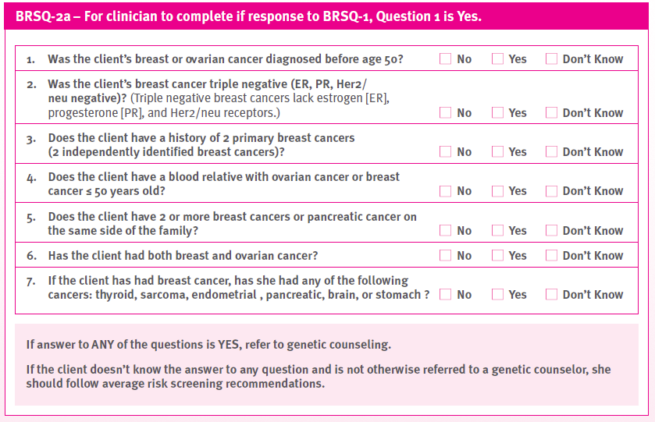
Notes:
If she herself has a history of breast or ovarian cancer, these are next set of questions that would help you determine if she should be seen by a specialist.

Slide 16
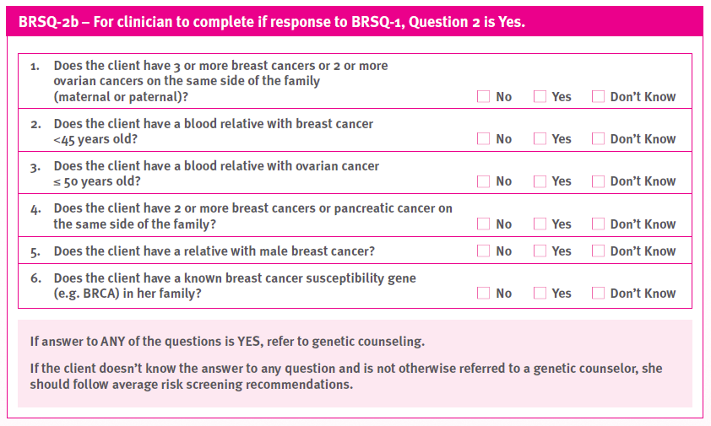
Notes:
If she answered yes to having a relative with breast or ovarian questions, you can ask her these questions to determine if she should be seen by a specialist. It will be with that specialist that she will discuss trhe best screening options for her.

Slide 17
CLINICAL BREAST EXAM
PROFESSIONAL ORGANIZATION | RECOMMENDATION
USPSTF | “I” - current evidence insufficient to assess benefits and harms
ACOG | Q1-3 yrs 20-39yo, then Q yr >40yo
ACS | Q 3yr 20-39yo
QFP | Lists all of the above

Slide 18
MAMMOGRAPHY
PROFESSIONAL ORGANIZATION | RECOMMENDATION
USPSTF | 50-74 biennial, <50 on individual basis taking patient context into account
ACOG | Offer annually 50-74 yo Offer annually 40-49
ACS | Annual 40 yo and continue as long as in good health
QFP | “Follow USPSTF”: 50-74yo biennial, <50 if other conditions support

Slide 19
BREAST SELF-EXAMINATION
PROFESSIONAL ORGANIZATION | RECOMMENDATION
USPSTF | “D” - recommends against teaching BSE
ACOG | BSA 20 yo and older
ACS | BSE optional starting in 20’s
QFP | “USPSTF recommends against teaching breast self-examination”

Slide 20
SUMMARY OF QFP SCREENING RECOMMENDATIONS
Clinical breast exams can be performed based on ACOG recommendation (q1-3 yrs 20-39yo, then annually >40yo)
Mammogram biennially 50-74yo,<50 if other conditions support doing so
Do not teach breast self-examination
Refer for genetic counseling if risk is increased

Slide 21
ASSESS RISK
DISCUSS OPTIONS
EDUCATE & VERIFY UNDERSTANDING
FORMULATE PLAN
Notes:
In the quest to educate women on their options for breast cancer screening… we need to use our eyes to assess risk, our mouth to discuss options, and hands to formulate a plan, and our brains to educate and verify understanding with our clients. You will assess risk by examining her health history and risk factors. You will discuss options and recommendations for screening based on her risk profile. You will also discuss the benefits and harms of each screening method in order to help her make a decision about screening. You will then together with the client formulate a plan for her screening initiation and intervals. You will then educate her on the screening methods she has chosen as well as on breast cancer risk reduction. A formal documentation of the plan you have collaborated on should be clearly marked in the medical record.

Slide 22
SHARED DECISION MAKING
Inform patient about issue needing decision
Invite patient participation in the process
Present benefits and harms
Help patients achieve decisions
Notes:
The process of shared decision making in the provider-patient relationship is recommended by the Affordable Care Act as well as ACS and USPSTF. The steps that should be included in SDM include: informing the patient about the need for a decision; inviting patient participation in the decision making process; presenting the benefits and harms, and then helping patients achieve decisions. Recent studies have shown that talks between providers and patients rarely address harms of testing and only about 1/3 of discussions meet criteria for SDM. Further, these studies show that discussions with women about testing are of lower quality than those with men and women’s preferences were considered less often than men’s. Some critics argue that mammography has been pushed on women without giving them an option to make an informed decision. Less than half of women undergoing mammography report being asked whether they wanted it.

Slide 23
CLIENT EDUCATION on CBE
AVERAGE RISK CLIENT
“We don’t have clear evidence that doing CBE actually helps to detect breast cancer. If you ever have any symptoms in your breasts that you are worried about.. I am happy to examine your breasts. I will examine your breast every 1-3 years if you would like. ”
Notes:
Let’s first look at clinical breast exam. So, how do we message this all to clients? We used to say, “I will examine your breasts every year.” We now can say I will examine your breast every 1-3 years if you would like. We don’t have clear evidence that doing CBE actually helps to detect breast cancer. If you ever have any symptoms in your breasts that you are worried about.. I am happy to examine your breasts.”

Slide 24
CLINICAL BREAST EXAM
BENEFITS
Potential to find a mass or other symptom that results in cancer detection
HARMS
False Positives (and subsequent additional imaging, biopsies, anxiety)
False Negatives (and failure to diagnosis cancer)
Notes:
You will then want to discuss the benefits and harms of CBE. There is no difference in mortality in women who had CBE performed than those who didn’t and just had mammography.

Slide 25
CLIENT EDUCATION on MAMMOGRAPHY
AVERAGE RISK CLIENT
You are at average risk for breast cancer
It is recommended that you have a mammogram every 2 yrs between 50-74yo
The decision to have a mammogram before 50 is yours
You should make this decision based on looking at the benefits and harms of mammograms
Notes:
We used to advise clients when they should start their mammograms and how often they should have them… now the decision making is shifting as a the provider discusses benefits, harms, and options and then allows the client to make the final decision on when and how often they will have mammograms. The conversation may sound something like, “According to your health history, you are at average risk for breast cancer. National guidelines recommend that when you are 50, you should have mammograms every two years. The decision to have a mammogram before 50 should be based on your feelings about the benefits and risks of having mammograms done. Although you chances of having breast cancer before 50 is low, having a mammogram might detect a rare cancer before 50. Results of mammograms are not perfect – sometimes they can miss cancer and sometimes they may find things within the breast that look like cancer, but end up not being cancer (this is called a false-positive). You may have to undergo further testing and biopsies only to find out that you do not have cancer. Although it is a low level, mammography exposes the breasts to radiation. If we are unlikely to find cancer in your breast because of your age and history… you could be exposing yourself unnecessarily to radiation.

Slide 26
MAMMOGRAPHY
BENEFITS
Potential detection of breast cancer
HARMS
Radiation Exposure
Pain
Anxiety, Distress
False Positives
Overdiagnosis
Notes:
You will then want to discuss the benefits and harms associated with mammography. The potential harms of mammography are important to discuss with clients. Even though mammography emits low energy radiation, if a woman receives multiple mammograms the cumulative dose of radiation could increase cancers especially in women who have BRCA gene mutation. Pain during the mammogram is something to mention although studies report overall tolerability of mammograms. Anxiety and distress relating to mammogram results is possible – especially if the woman is recalled for additional imaging and/or biopsies. False positive mammogram results subject women without cancer to additional imaging and biopsies uneccessarily. False positives are more likely in women 40-49 and if a woman begins mammograms at the age of 40 and has one yearly for ten years… she has a risk of false positives up to 55%. There is also the concept of overdiagnosis of breast cancers – this is especially difficult to explain to clients… but, essentially there are a significant amount of women who will be diagnosed with a breast cancer that was unlikely to have been clinically effected by the cancer in her lifetime.

Slide 27
CLIENT EDUCATION on BREAST SELF-EXAM
AVERAGE RISK CLIENT
Breast self-exam is not likely to find cancer
You do not need to check your breasts every month
Know what your normal anatomy feels like
See a clinician if you have any concerns
Notes:
We used to tell women that they should check their own breasts every month, after their period, and teach a methodical way to examining them. What we should now say is, “Research has found that examining your own breasts is not likely to find a cancer in your breast. In fact, you may feel normal structures in the breast thinking they are abnormal and end up having testing and biopsies unnecessarily. While it’s important to know what your normal anatomy feels like, you do not need to check your breasts every month. If you do ever find anything in your breast or are concerned about a symptom – don’t hesitate to come in and see me.”

Slide 28
BREAST SELF EXAMINATION
BENEFITS
Awareness of breast anatomy
Potential to find a mass or other symptom that results in cancer detection
HARMS
False Positives (and subsequent additional imaging, biopsies, anxiety)
False Negatives (and failure to diagnosis cancer)
Notes:
You will discuss the benefits and risks associated with performing breast self exam. There is no difference in mortality reduction in women who perform BSE than those who don’t

Slide 29
What Is Breast Self Awareness?
Women understanding the normal feel and texture of their breasts
No specific interval or technique
Goal is to be alert to changes
ACOG recommends educating on BSA for women 20 and older
Notes:
You may also want to mention the concept of breast self-awareness, as endorsed by the ACOG. The traditional breast self-exam (BSE) has shifted toward a newer concept called "breast self-awareness." BSE is performed in a systematic way on a regular basis, typically monthly. Breast self-awareness, on the other hand, is women understanding the normal appearance and feel of their breasts, but without a specific interval or systematic examination technique. The College endorses educating women ages 20 and older regarding breast self-awareness.
"The goal here is for women to be alert to any changes, no matter how small, in their breasts, and report them to their doctor," said Dr. Griffin. "Although we've moved away from routinely recommending BSEs, some women will want to continue doing them and that's OK."
According to The College, there is no consensus on the upper age limit for mammograms, although the benefits of screening declines with increasing age compared with the harms of overtreatment. Women ages 75 and older should discuss with their doctor whether to continue getting mammograms, said Dr. Griffin.

Slide 30
CLIENT EDUCATION on RISK REDUCTION
Limit alcohol consumption
Don’t smoke tobacco
Maintain ideal BMI
Exercise regularly
Limit dosing and total time on hormone therapy

Slide 31
Notes:
Hopefully this presentation alleviates confusion about breast cancer screening guidelines and will provide clarity for you on how to individualize breast cancer screening with your clients. Knowing her individual risk and understanding benefits and harms of each screening modality will hopefully provide clarity for clients about what screening is best for them. As for the professional organizations that create recommendations – we likely will not be able to force them to all get on the same page. The QFP is a trusted source for guideline clarity and will be updated as needed for any new evidence that becomes available.

