Slide 1
Osteoporosis
By Ali Naqvi, Jeff Hughes, and Shuktika Nandkekolyar

Slide 2
MKSAP
A 72-year-old man is evaluated for a two-week history of low back pain. The patient has a history of alcoholism but stopped drinking alcohol 10 years ago. He also has stage 3 chronic kidney disease and a 50-pack-year smoking history. Current medications are hydrochlorothiazide, ramipril, and a multivitamin.
On physical examination, vital signs are normal. Lumbar lordosis, decreased mobility and spasm of the paravertebral muscles, and tenderness to palpation at L4-L5 are noted. Neurologic screening examination findings are normal.
Laboratory studies show calcium 9.0 mg/dL (2.25 mmol/L), creatinine 2.1 mg/dL (185.6 µmol/L), phosphorus, 3.2 mg/dL (1.0 mmol/L), parathyroid hormone 50 pg/mL (50 ng/L), testosterone 400 ng/dL (13.9 nmol/L), 25-Hydroxy vitamin D 34 ng/mL (85 nmol/L), and estimated glomerular filtration rate 40 mL/min/1.73 m².
A radiograph of the lumbosacral spine shows a compression fracture of L4. A dual-energy x-ray absorptiometry scan shows a T-score of −3.0 in the lumbosacral spine and −3.2 in the left hip.

Slide 3
MKSAP
Q: Which of the following is the best treatment for this patient?
A. Alendronate
B. Calcitonin
C. Teriparatide
D. Testosterone

Slide 4
Overview
Characterized by low bone mass and deterioration of bone structure
Not a “natural part of aging”
Increased risk for women, post-menopausal, over age 65
All races, genders, and ages are susceptible
Preventable and treatable!

Slide 5
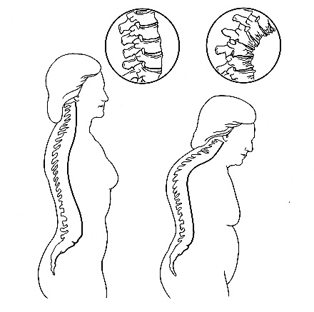
Osteoporosis
Normal
Spine
Osteoporotic
Spine
Source: National Osteoporosis Foundation, 2000

Slide 6

Risk Factors
Female gender/Caucasian race
Smoking history
Thin or small frame
Advanced Age
Family history- primary w/ fragility fracture
Post-menopausal
Ca/Vitamin D deficiency
Medications (esp. steroids)

Slide 7

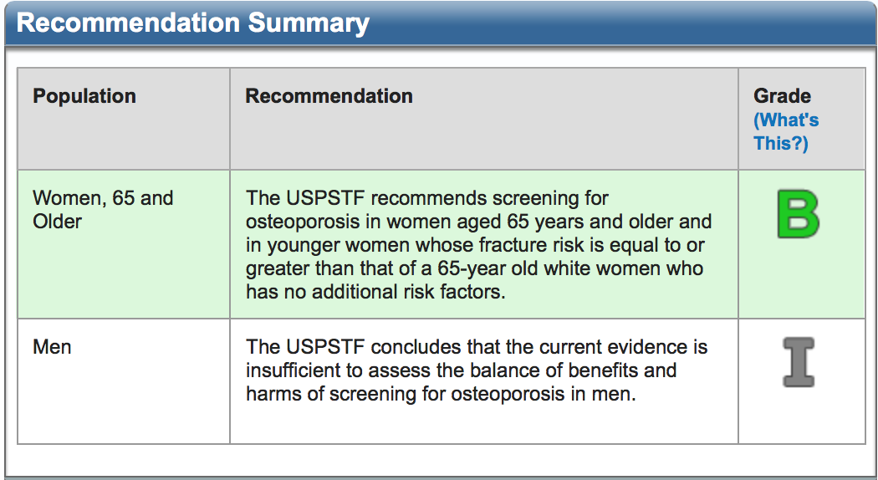
Screening

Slide 8
WHO Classification
T-Score | Z-Score (Age < 50) | Interpretation
> 1.0 | N/A | Normal
-1 to -2.5 | N/A | Osteopenia
< -2.5 | Z score < -2 | Osteoporosis
T score vs. Z score
T score- BMD compared with what it is normally expected in a young healthy adult of your sex
Z score- # of SDs above or below what is expected with age matched controls (used for younger patients)

Slide 9
National Osteoporosis Treatment Guidelines
Osteopenia:
  Check FRAX score, if 10-year hip fracture risk > 3% or 10 year major osteoporotic fracture risk > 20%-> begin bisphosphonate therapy
Osteoporosis:
  Begin therapy if T score < -2.5 at the femoral neck or lumbar spine if after appropriate evaluation is conducted to rule out secondary causes (ie. Hyperparathyroidism, hyperthyroidism, malabsorption, low Ca/Vit D)
Other:
  Evidence of hip or vertebral (clinical or morphometric) fracture
  Clinical judgment/Patient’s preference

Slide 10
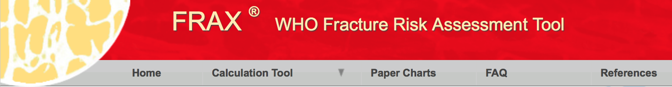
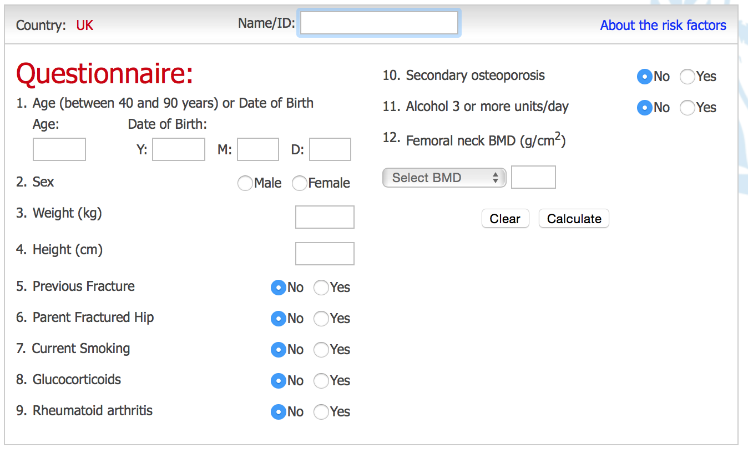

Slide 11
Pharmacotherapy
SERM (Selective Estrogen Receptor Modulators)- Raloxifene- increases BD by 2-3%, decreases incidence of fractures by 30%, and no increase in risk for breast or endometrial cancer. HOWEVER, increased risk for thrombo-embolic disease
Calcitonin- inhibit OC activity (can be given intra-nasally) for pain, rarely used
Bisphosphonates- mainstay of therapy, function to inhibit osteoclast activity
      Alendronate/Fosamax: 75mg weekly (can be dosed daily)
      Risendronate/Actonel: Similar in efficacy compared to Alendronate, can be used in men too, dosed weekly
      Ibandronate/Boniva- dosed monthly or given IV q3mos (150mg PO monthly vs. 3mg IV q3mos)
      Zolendronate/Reclast- only available in IV formulation given once a year, with excellent efficacy and improvement in BMD and reduction in fracture risk
Denosumab/Prolia- monoclonal antibody which targets activator of OC and decreases bone resorption and increases BMD (SE include rash, infections, hypocalcemia, HLD)
Teriparatide- promotes bone formation & resorption with net + effect. Available subq daily

Slide 12
Nutrition!!
FDA uses “Percent Daily Value” (% DV) to describe amount of calcium and Vitamin D needed by general U.S. population daily
Calcium- 100-120% of DV
= 1,000-1,200 mg of Ca
Vitamin D-
= 600IU-800IU daily

Slide 13
Calcium and Fractures
A recently published review calls into question the utility of correcting the “calcium deficiency” in osteoporosis
A pooling of 42 observational cohorts showed that increased dietary intake of Ca was not associated with a reduction in fracture risk
26 RCTs showed 11% fracture reduction with Ca supplementation, although these results were largely insignificant, with the largest and most unbiased studies showing no effect
Only one study involving frail, elderly women with low dietary Ca intake showed a significant reduction in fracture risk with Ca supplementation
Calcium supplementation to the currently recommended levels of 1000-1200 mg/day does not appear to have a significant impact on primary fracture prevention

Slide 14
MKSAP
A 72-year-old man is evaluated for a two-week history of low back pain. The patient has a history of alcoholism but stopped drinking alcohol 10 years ago. He also has stage 3 chronic kidney disease and a 50-pack-year smoking history. Current medications are hydrochlorothiazide, ramipril, and a multivitamin.
On physical examination, vital signs are normal. Lumbar lordosis, decreased mobility and spasm of the paravertebral muscles, and tenderness to palpation at L4-L5 are noted. Neurologic screening examination findings are normal.
Laboratory studies show calcium 9.0 mg/dL (2.25 mmol/L), creatinine 2.1 mg/dL (185.6 µmol/L), phosphorus, 3.2 mg/dL (1.0 mmol/L), parathyroid hormone 50 pg/mL (50 ng/L), testosterone 400 ng/dL (13.9 nmol/L), 25-Hydroxy vitamin D 34 ng/mL (85 nmol/L), and estimated glomerular filtration rate 40 mL/min/1.73 m².
A radiograph of the lumbosacral spine shows a compression fracture of L4. A dual-energy x-ray absorptiometry scan shows a T-score of −3.0 in the lumbosacral spine and −3.2 in the left hip.

Slide 15
MKSAP
Q: Which of the following is the best treatment for this patient?
A. Alendronate
B. Calcitonin
C. Teriparatide
D. Testosterone

Slide 16
Correct answer: A. Alendronate.
This patient with T-scores of −3.0 in the lumbosacral spine and −3.2 in the left hip has osteoporosis and should be treated with alendronate. Osteoporosis is a silent skeletal disorder characterized by compromised bone strength and an increased predisposition to fractures. The following risk factors are associated with osteoporosis in men:
Prolonged exposure to certain medications, such as corticosteroids, anticonvulsants, some cancer drugs, and aluminum-containing antacids
Chronic disease affecting the kidneys, lungs, stomach, and intestines
Hypogonadism
Smoking, excessive alcohol use, low calcium intake, and inadequate physical exercise
Older age (bone loss with increasing age)
Heredity and race (with white men seeming to be at greatest risk)
The diagnosis and treatment of any underlying medical condition affecting bone health are essential to preserve bone health. Medications that cause bone loss should be identified, evaluated, and stopped, if possible. Unhealthy habits, such as smoking, excessive alcohol intake, and inactivity, should be changed and vitamin D and calcium supplementation begun. A regular regimen of weight-bearing exercises in which bone and muscles work against gravity should be encouraged. Weight lifting or using resistance machines can also be recommended because they appear to help preserve bone density. The U.S. Food and Drug Administration (FDA) has approved three antiresorptive medications (the bisphosphonates alendronate, risedronate, and zoledronate) and the anabolic agent teriparatide as treatment of male osteoporosis. Bisphosphonates are not recommended for use in patients with an estimated glomerular filtration rate less than 30 mL/min/1.73 m².

Slide 17
Calcitonin is currently FDA-approved for the treatment of osteoporosis in women (but not men) who are at least 5 years postmenopausal. It has been shown in clinical trials to decrease bone loss and decrease risk of vertebral fractures; however, it has not been shown to reduce nonvertebral or hip fractures. Alendronate would be a more effective agent in this patient.
When osteoporosis is due to hypogonadism, testosterone replacement therapy should be considered unless there are contraindications. However, this patient's testosterone level is already normal.
Teriparatide is a recombinant human parathyroid hormone and a potent anabolic bone agent. Teriparatide is FDA-approved for treatment of postmenopausal osteoporosis in women at high risk of fracture and for treatment of hypogonadal or primary osteoporosis in men with high risk of fracture. Teriparatide is more expensive then bisphosphonates and requires subcutaneous injection. Treatment with teriparatide is limited to a maximum of 2 years (concerns related to risk of osteosarcoma) and is contraindicated in patients with a history of bone malignancy, Paget disease of bone, hypercalcemia, or history of skeletal irradiation. Given its cost, subcutaneous route of administration, long-term safety concerns, and the availability of other agents, teriparatide is generally not used as a first-line drug for treatment of osteoporosis.

Slide 18
References
Screening for osteoporosis: U.S. preventative services task force recommendation statement, Calonge et al, Ann Intern Med 2011 Mar 1; 154(5): 356-64
Clinical Risk Factors for Osteoporosis in Ireland and the UK: A comparison of FRAX and QFractureScores: Cummins et al, Calcified tissue international August 2011 Volume 89, Issue 2, pp 172-177
National Osteoporosis Foundation Clinician’s Guide to Prevention and Treatment of Osteoporosis, 2014
Bolland, M.; Leung W.; Tai, V.; Bastin, S.; Gamble, G.; Grey, A.; Reid, I. Calcium intake and risk of fracture: systematic review. BMJ 2015 Sept 29; 315: 1-13

Slide 19

Thank you!!

