Slide 1
Anemia in Pregnancy
O+G Update 2014
Hospital Sarikei

Slide 2
What is Anemia
Disorder by which the body is depleted of RBC to carry adequate oxygen to tissues
NICE Guidelines (for pregnant woman)
Hb level <10.5g/dl throughout pregnancy
Hb levels need to be checked at booking and again at 28 weeks

Slide 3
Metabolism of Iron
↑ erythropoietin production→ ↑erythropoiesis
In pregnancy, ↑ in plasma volume is > than red cell mass therefore HEMODILUTION
Demand for iron is ↑to meet the needs of the expanded red cell mass & requirements of developing fetus and placent
Fetus derives iron from maternal serum by active transport across placenta MAINLY @ last 4 weeks of pregnancy

Slide 4
ANEMIA
A BALANCE OF BOTH PRODUCTION AND LOSS!

Slide 5
Types of Anemia
Decreased Production | Increased Production
Iron Deficiency Anemia | Hemolytic Anemia (Thalassemia)
Folate Deficiency | Chronic blood loss
Vitamin B12 Deficiency
Bone marrow Failure
Chronic Illness (eg, malignancy)

Slide 6
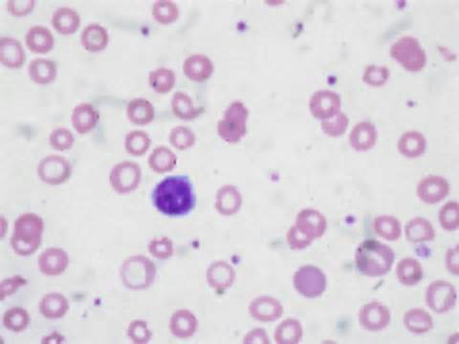
IRON DEFICIENCY ANEMIA
Commonest anemia in pregnancy
Physiological iron requirements are 3x higher in pregnancy, with increasing demand as pregnancy advances
Inadequate dietary supplement
Ineffective absorption
Increased iron loss

Slide 7
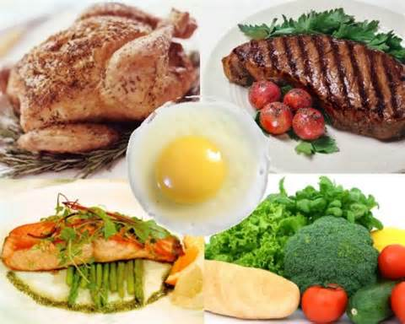
IRON RICH FOOD
Dark-green leafy vegetables
Iron-fortified cereals wholegrains eg brown rice
Beans, peas,soya bean
Nuts,peanut butter
Meat and fish
Oatmeals
Spinach
Apricots
Prunes
Raisins

Slide 8
IMPAIRED IRON ABSORPTION
Tea and coffee
Calcium, found in dairy products such as milk
Antacids (medication to help relieve indigestion)
Proton pump inhibitors (PPIs), which affect the production of acid in your stomach
Some wholegrain cereals contained phytic acid

Slide 9
Investigations
FBC FBC FBC!!!
Low Hb
Low MCH
Low MCV
Low serum ferritin
Low TIBC

Slide 10
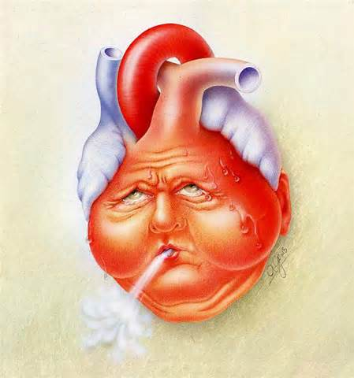
Complications IF Untreated
PPH → HYPOVOLEMIC SHOCK!
HEART FAILURE
FETAL IUGR
INCREASED RISK OF INFECTION
DELAY WOUND HEALING

Slide 11
Management
Total iron requirement 700-1400mg, 4mg/day
WHO recommends: 30-60mg/day ≈ 1tab Obimin/ 1tab Ferrous Fumerate (for women with normal iron stores)
Hb levels increase 0.3mg/week
At least 180mg/day of elemental iron required for therapeutic management
Hb levels need to be checked 2weeks after commencing treatment

Slide 12
Antenatal Managment
Routine screening of anaemia
If normal to be repeated during mid‐trimester (20--‐24/52) and around 36/52
Iron supplement is indicated if Hb < 11gm%
Elemental iron dose supplement

Slide 13
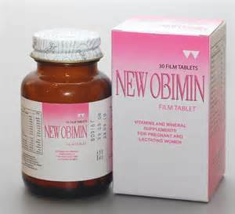

Slide 14
Routine Hematinics given:
T. Ferrous Fumarate 200mg od,
T. Folate 5mg od,
T. Vitamin C 1 tab od
T. Vitamin Bco 1 tab od
If in moderate/severe anemia, double hematinics

Slide 15
WHAT IF Hb DOESN’T INCREASE??
Other causes? → non compliance!
continued blood loss?
concomitant folate/B12 deficiency
thalassaemia

Slide 16
Thalassaemia
WHEN DO WE SCREEN?
In patients who have a significant family history of thalassemia
MCH is the most important screening parameter for thalassaemia. A low MCH (< 27) even with a normal haemoglobin levels is an indication to screen for thalasemia.
In thalassaemic patients, RBC s are normal or high.
Use the Mentzer index as a guide.
· MCV/RBC count < 13 favours thalassemia over iron deficiency.
· This test has a high sensitivity but low specificity.
· In iron deficiency, RBC count will be low along with the MCV.
· In thalassemia, RBC count is normal with a low MCV.

Slide 17
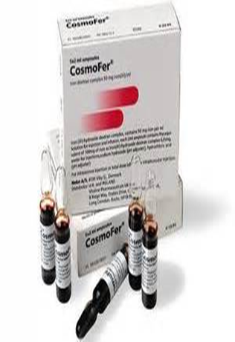
Parenteral Iron
Indicated in those who fail to respond to or are intolerant of oral iron (BCSH guidelines)
IM iron: test dose 50mg then 100mg daily or alternate days

Slide 18
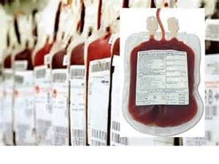
Blood Transfusion
Hb <7g/dL transfusion usually required
Severe anaemia with heart failure
Hb < 8 gm % at term or in early labour
Use packed cells!
Complications may
follow

Slide 19
INTRAPARTUM MANAGEMENT
GXM at least 2 units and transfusion require
High risk patient with Hb between 8-10g/dl require at least 2 pint of blood ( GXM) AND transfer to the hospital with specialist if possible
Patient with risk of PPH and anaemic is best delivered in the hospital with specialist

Slide 20
THANK YOU

