Slide 1
Escherichia.coli O157:H7
Food Poisoning caused by
E.coli O157:H7

Slide 2
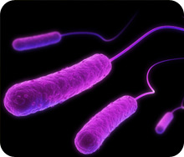
Introduction:
Escherichia coli (E. coli) are
bacteria that live naturally in
the intestines of cattle, poultry and other animals
However, certain types (or strains) of E.coli can cause food poisoning. One strain (E. coliO157:H7) can cause a severe case of food poisoning

Slide 3
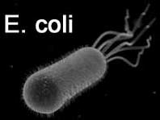
E.Coli O157:H7
enterohemorrhagic strain of
the bacterium Escherichia coli
Gram negative, rod shaped bacterium
The "O" in the name refers
to the cell wall (somatic) antigen
number, whereas the "H" refers
to the flagella antigen

Slide 4
Escherichia coli O157:H7 is an emerging cause of food borne illness
An estimated 10,000 to 20,000 cases of infection occur in the United States each year.
Infection may lead to hemorrhagic diarrhea (bloody diarrhea) and to kidney failure
Transmission is via the fecal-oral route, and most illness has been through undercooked, contaminated ground beef or ground pork being eaten

Slide 5
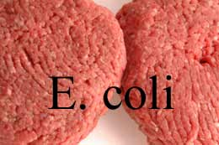
Bacteria may get into your food in different ways:
Meat or poultry may come into
contact with normal bacteria from
the intestines of an animal while it
is being processed
Water used during growing or shipping may contain animal or human waste
Food may be handled in an unsafe way during transport or storage
Unsafe food handling or preparation in grocery stores, restaurants, or homes

Slide 6
Food poisoning can occur after eating or drinking:
Any food prepared by someone who did not wash their hands well
Any food prepared using unclean cooking utensils, cutting boards, or other tools
Dairy products or food containing mayonnaise (such as coleslaw or potato salad) which have been out of the refrigerator too long

Slide 7
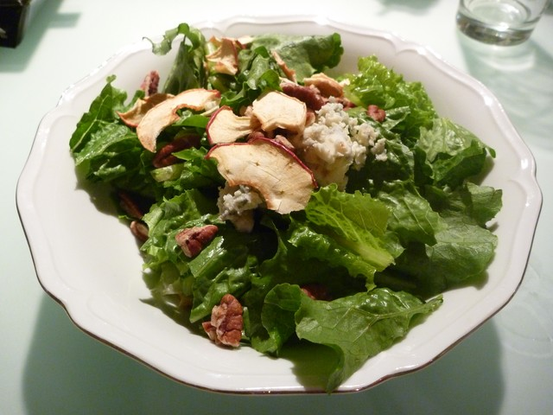
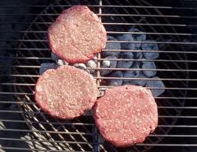
Frozen or refrigerated foods that are not stored at the proper temperature or are not properly reheated
Fish or oysters
Raw fruits or vegetables that
have not been washed well
Raw vegetable or fruit juices
and dairy products
Undercooked meats or eggs
Water from a well or stream,
or city or town water that has not been treated

Slide 8
Although not common, E. coli can be spread from one person to another. This may happen when someone does not wash his or her hands after a bowel movement and then touches other objects or someone else's hands.

Slide 9
Research Article 1: An Outbreak of Diarrhea and Hemolytic Uremic Syndrome From Escherichia coli O157:H7 in Fresh-Pressed Apple Cider
ABSTRACT
Objective. —Esherichia coli O157:H7 causes hemorrhagic colitis and the hemolytic uremic syndrome. In the fall of 1991, an outbreak of E coli O157:H7 infections in southeastern Massachusetts provided an opportunity to identify transmission by a seemingly unlikely vehicle.
Design. —Case-control study to determine the vehicle of infection. New England cider producers were surveyed to assess production practices and determined the survival time of E coli O157:H7 organisms in apple cider.

Slide 10
Results. —Illness was significantly associated with drinking one brand of apple cider. Thirteen (72%) of 18 patients but only 16 (33%) of 49 controls reported drinking apple cider in the week before illness began (odds ratio [OR], 8.3; 95% confidence interval [CI], 1.8 to 39.7). Among those who drank cider, 12 (92%) of 13 patients compared with two (13%) of 16 controls drank cider from cider mill A (lower 95% CI, 2.9; P<.01). This mill pressed cider in a manner similar to that used by other small cider producers: apples were not washed, cider was not pasteurized, and no preservatives were added. In the laboratory, E coli O1 57:H7 organisms survived for 20 days in unpreserved refrigerated apple cider. Addition of sodium benzoate 0.1% reduced survival to less than 7 days.

Slide 11
Conclusions. —Fresh-pressed, unpreserved apple cider can transmit E coli O157:H7 organisms, which cause severe infections. Risk of transmission can be reduced by washing and brushing apples before pressing, and preserving cider with sodium benzoate. Consumers can reduce their risk by only drinking cider made from apples that have been washed and brushed.

Slide 12
Research Article 2: A Waterborne Outbreak in Missouri of Escherichia coli O157:H7 Associated with Bloody Diarrhea and Death
Objective: To describe and determine the source of a large outbreak of Escherichia coli O157:H7 (ECO157) infections in Missouri.
Design: A case-control study and a household survey.
Setting: A small city in a rural Missouri township that had an unchlorinated water supply.

Slide 13
Patients: Case patients were residents of or visitors to Burdine Township with bloody diarrhea or diarrhea and abdominal cramps occurring between 15 December 1989 and 20 January 1990.
Measurements: Escherichia coli O157 H7 was isolated from 21 stool specimens. All isolates were resistant to sulfisoxazole, tetracycline, and streptomycin; produced Shiga-like toxins I and II; and had one 60-megadalton plasmid.

Slide 14
Results: Among the 243 case patients, 86 had bloody stools, 32 were hospitalized, 4 died, and 2 had the hemolytic uremic syndrome. In the case-control study, no food was associated with illness, but ill persons had drunk more municipal water than had controls (P = 0.04). The survey showed that, during the peak of the outbreak, bloody diarrhea was 18.2 times more likely to occur in persons living inside the city and using municipal water than in persons living outside the city and using private well water (P = 0.001). Shortly before the peak of the outbreak, 45 water meters were replaced, and two water mains ruptured. The number of new cases declined rapidly after residents were ordered to boil water and after chlorination of the water supply.

Slide 15
Conclusions: This was the largest outbreak of ECO157H7 infections, the first due to a multiply resistant organism, and the first shown to be transmitted by water. System-wide chlorination as well as hyperchlorination during repairs might have prevented this outbreak. Both bloody and nonbloody diarrhea may be common manifestations of this infection, which is probably underdiagnosed because of the failure of routine stool cultures to identify the organism. Cities with deteriorating water systems using untreated water risk widespread illness from contaminated drinking water.
Presented by:
Rohama Ejaz
(MSMIB02123012)

Slide 16
Referencec : www.slideshare.com

