Slide 1
Vaccines: A Molecular View
Shuchismita Dutta, Ph.D.
Assistant Research Professor,
Chemistry and Chemical Biology
Science Education Development Lead, RCSB PDB
Rutgers University
Lisa Denzin, Ph.D.
Associate Professor
Dept. of Pediatrics,
RWJ Med. School
The Child Health Institute of NJ Rutgers University

Slide 2
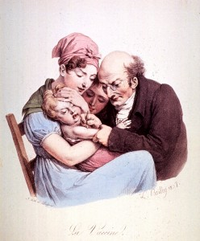
Learning Objectives
About Vaccines
How do Vaccines Work?
Types of Vaccines
Herd Immunity
The Annual Flu Vaccine
About Influenza Virus
Influenza Types
Influenza Antigens
Types of Influenza Virus
What is in the Flu vaccine?
Summary
http://www.smithsonianmag.com/science-nature/vaccine-week-a-brief-history-and-how-vaccines-work-18814542/?no-ist

Slide 3
About Vaccine
What is it?
Preparations of pathogen or parts of them
Induces immune system to respond to it (as if it is the real pathogen) and generate memory T- and B-cells
What does it do?
Prepares the immune system to recognize and destroy a pathogen when exposed to it.
Why is it important?
Vaccines protect individuals (and communities) from a large number of infectious pathogens by enabling them to rapidly mount a protective immune response upon encounter.
Notes:
Ensure that students have a clear understanding of what vaccines are, how they work and why they are important. Explain this in the context of innate and adaptive immune system discussions that students should have been introduced to (prior to going over this content).

Slide 4
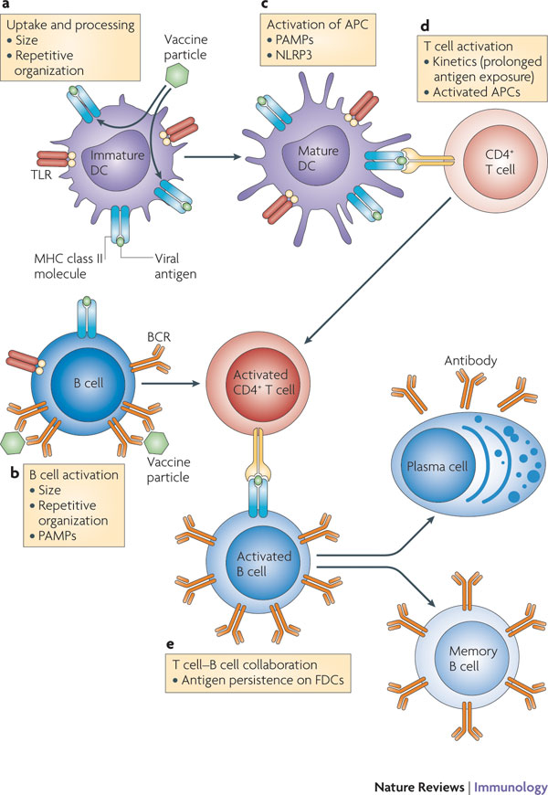
How do Vaccines Work?
Vaccines are taken up by macrophages (MΦ)/dendritic cells which activate the adaptive immune response
T-cells are activated
B-cells are activated
Antibodies are produced
Memory T- and B-cells are formed
Host is now prepared to mount immune response and protect the individual upon exposure to pathogen
http://www.nature.com/nri/journal/v10/n11/images/nri2868-f1.jpg
Notes:
Point out to students how the vaccine acts as a pretend infection. The vaccine material usually does not have the potential to cause the disease so it prepares the individual’s immune system to respond to the real infection (if exposed).

Slide 5
Types of Vaccines
Vaccine Type | What is it? | Challenges | Examples
Live Attenuated | Weakened version of living microbe that can’t cause disease | Mutation; Storage | Measles, mumps, rubella, polio (Sabin vaccine), yellow fever
Inactivated or “killed” | Microbes killed with chemicals, heat or radiation | Weaker immune response; Need boosters | Cholera, flu, hepatitis A, Japanese encephalitis, plague, polio (Salk vaccine), rabies
Subunit | Include antigens (or epitopes) that best stimulate immune system | Identifying specific antigen takes time | Hepatitis B, pertussis, pneumonia caused by S. Pneumoniae
Toxoid | Formalin inactivated toxins used as vaccine | Used when main cause of illness is a bacterial toxin | Diphtheria, Tetanus
Conjugate | Specialized subunit vaccine where antigens are linked to polysaccharides | Most effective for immature immune system of infants | H. Influenzae type b, pneumonia caused by S. Pneumoniae
DNA | DNA of important Antigens introduced to cell | Experimental | influenza and herpes as well as HIV
Recombinant vector | attenuated virus or bacterium (vector) used to introduce microbial DNA to cells | Experimental | HIV, rabies, and measles
http://www.niaid.nih.gov/topics/vaccines/documents/undvacc.pdf
http://www.vaccines.gov/more_info/types/
Notes:
Various types of vaccines along with some examples of which diseases use that specific type of vaccine material. The teacher may discuss this in the context of recommended common childhood immunizations.

Slide 6
Herd Immunity
What is it?
Immunized majority allows few unimmunized in community (due to immature/compromised immune systems) to be protected from disease
Protection requirements
Required percentage of immunized individuals → depends on R₀ (how many people 1 sick individual can infect in an unimmunized population)
Higher percentages of immunized individuals could stop the infection completely
http://cid.oxfordjournals.org/content/52/7/911/F1.expansion.html
Notes:
It is important that students recognize that vaccines not only protect them but also all other individuals in the community around them. If there was no immunization different pathogens can make different numbers of people around a sick individual to be infected. That number is called R0 or R naught.

Slide 7
The Annual inFLUenza Vaccine
About Influenza
HA and NA
What is in the Flu Vaccine?
Notes:
This takes the case of a common immunization and explains why flu shots need to be taken every year

Slide 8
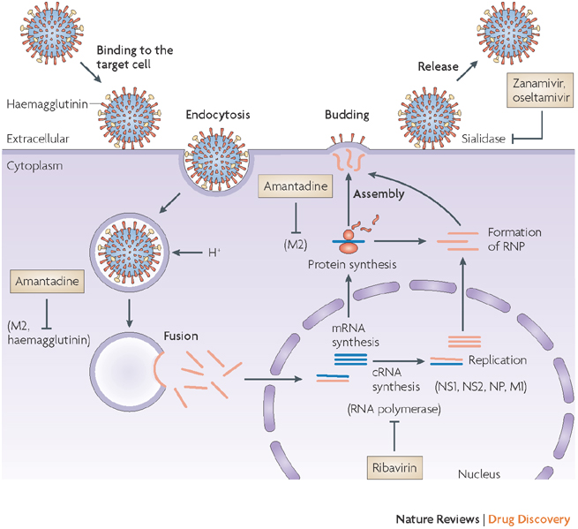
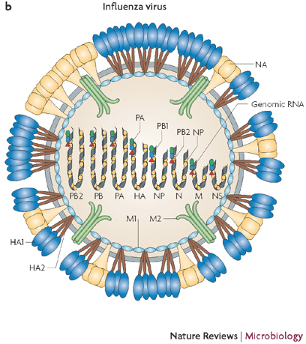
About Influenza Virus
Life cycle of influenza virus and targets for therapeutic intervention
Schematic diagram of influenza A virus
Nature Reviews Microbiology 6, 143-155 (February 2008)
Nature Reviews Drug Discovery 6, 967-974 (December 2007)
Notes:
The main antigens in Influenza are Hemagglutinin and Neuraminidase.
Hemagglutinin (HA) is a viral surface glycoprotein that recognizes and binds to sialic acid (a special type of sugar) on the surface of target cells, such as the upper respiratory tract cells.
Neuraminidase (NA) is also a surface glycoprotein, an enzyme, that removes terminal sialic acid residues from proteins in order to allow newly produced viral particles to be released from a cell.
Variations in these proteins (HA and NA) generates different subtypes of the virus, some that only infect humans and some that infect other hosts (e.g. pigs, chicken etc.).
Different antibodies are needed to recognize and neutralize these different subtypes.

Slide 9
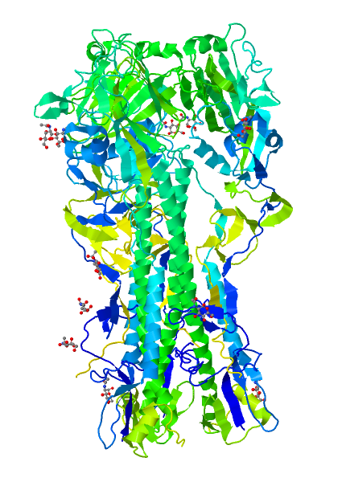
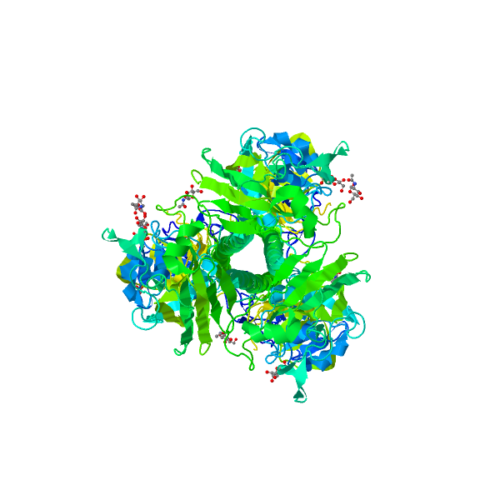
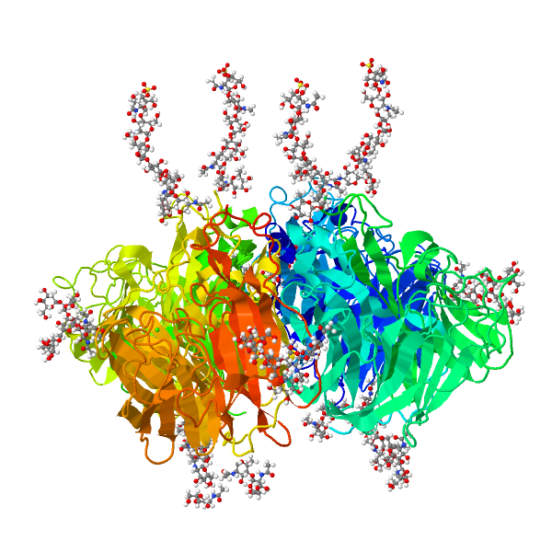
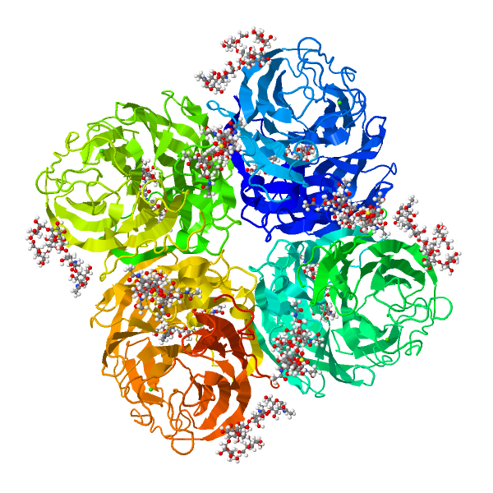
The Main Influenza Antigens
Hemagglutinin (HA)
Neuraminidase (NA)
Proteins on surface of Influenza virus
Binds to host cell surface receptors
Enzyme - clips off polysaccharide chains from host cell surface
Facilitates new viral particle release
PDB entry 1ruz (Gamblin et al., 2004)
PDB entry 1nn2 (Vargheese and Coleman., 1991)
Notes:
HA – hemagglutinin antigen is a trimeric glycoprotein
NA- Neuraminidase antigen is a tetrameric enzyme molecule
Note the various glycosylations shown in the structures (as ball and stick representations (beyond the ribbons, that represent the protein chains)

Slide 10
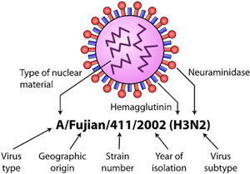
Types of Influenza Virus
Types A and B (related to seasonal epidemics); Type C (mild symptoms)
Influenza A – subtypes (H#N#)
Based on viral surface proteins
hemagglutinin (H) Types H1-H18
neuraminidase (N) Type N1-N11
Different strains seen
Influenza B – no types
Lineages
Yamagata
Victoria
Different strains may be seen
CDC follows internationally accepted naming convention for influenza viruses
Type/Geog. Origin/strain #/Year isolated (H#N#)
e.g. A/Perth/16/2009 (H3N2) for a virus from human origin
http://www.cdc.gov/flu/about/viruses/types.htm
Notes:
While students may not want to memorize the various types of Influenza virus – it is important to note that variations may arise at different levels and that these are tracked in developing suitable vaccinations for seasonal flu.

Slide 11
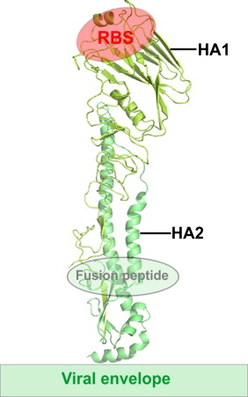
Why Do the HA Numbers Matter?
RBS
RBS
H6, PDB entry 4wst
H10, PDB entry 4wsx
H5 structure showing RBS – Receptor Binding site and Fusion peptide
Yang et al., 2015, Journal of Virology
Velkov et al., 2013, Molecular Immunology
Notes:
The green structure is that of H5, the blue is H6 and red is H10.
The overall architecture of these proteins are similar – they are initially made of a single polypeptide chain that is cleaved into two (HA1 and HA2) but covalently linked to each other via S-S bonds.
The receptor binding site (RBS) is located on HA1 (see marked above as HAS), the Fusion peptide in located in HA2.
There are many small differences that affect the binding of these proteins to their receptors - note the minor variations in the structures of these proteins (marked with arrows) in the H6 and H10 structure. Many of these differences prevent neutralizing Antibodies from binding to these antigens, while the virus can bind to host cells and infect them.

Slide 12
What is in the Flu Vaccine?
Nasal Spray Flu Vaccine
Intradermal Flu Shot
Live Attenuated Vaccine
Usually protects against 2 influenza A and 2 influenza B viruses
Inactivated virus Vaccine
Traditional flu shots are “trivalent” – i.e. protects against 2 influenza A and 1 influenza B virus
Also available Quadrivalent flu vaccine – protects against 2 influenza A and 2 influenza B virus
Also available as shots:
A high-dose trivalent shot,
A trivalent shot containing virus grown in cell culture
A recombinant trivalent shot that is egg-free.
Other vaccines in development
http://www.cdc.gov/flu/protect/keyfacts.htm
Notes:
Summary of currently available versions of the flu shot and what each of these preparations contain.

Slide 13
Summary
Vaccines prepare individuals to mount a protective immune response against the real pathogen(s)
Various types of vaccines are available – in all cases the pathogens or parts of them are modified so that they do not cause infection but do generate an immune response
Herd Immunity provides protection to individuals who have immature or weak immune systems, and cannot be vaccinated
Due to the variations in the influenza antigens, the flu vaccine needs to be taken annually to prevent serious infection

