Slide 1
Dermatitis Herpetiformis
SH Madani MD,AP,CP 23.Feb.2016

Slide 2
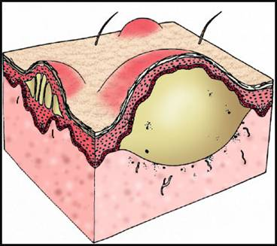
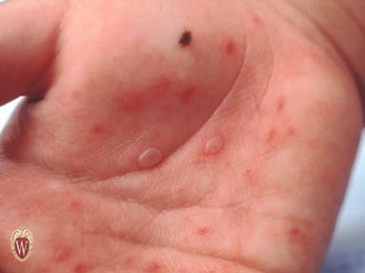
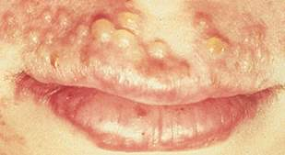
Dermatologic Vocabulary
Vesicle – a fluid-filled raised area <10mm in diameter
fluid

Slide 3
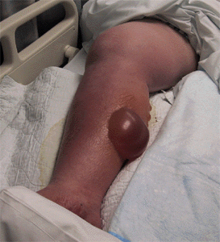
BULLA (a.k.a., BLISTER)
A fluid-filled blister >1.0 cm in diameter caused by the
presence of serum, or occasionally by an injected substance.

Slide 4
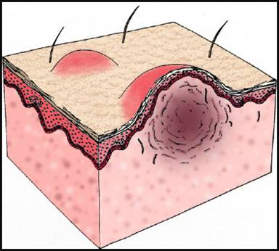
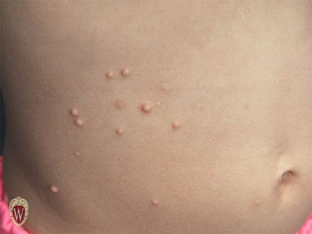
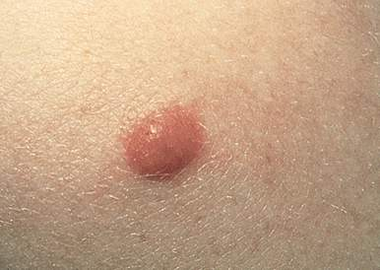
Dermatologic Vocabulary
Papule – an elevated solid lesion <10mm in diameter

Slide 5
DH or Duhring-Brocq dis.
1.Autoimmune dis. 2.widespread,intensely pruritic,papulovesic. 3.All ages(esp. 2nd or 3rd decade). 4.M/F:2/1 5.N.EUROPE,LESS IN USA 6.Familial form(10.5% of cases) :AD 7.symmetric,grouped on post.scalp,shoulders, back,buttock,extensor aspect of limbs. 8.Oral lesion is rare

Slide 6
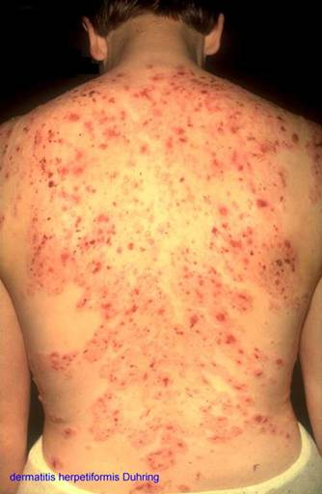
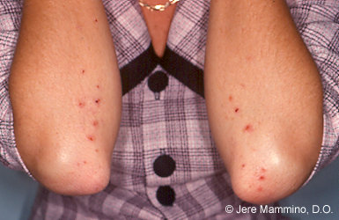
DERMATITIS HERPETIFORMIS

Slide 7
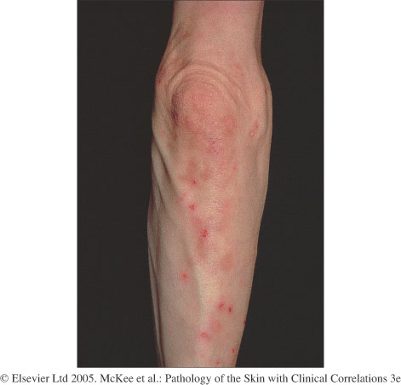
Intensely pruritic rash of elbows, knees, back

Slide 8
9.Dapsone response:Therapeutic, diagnostic 10.usually lifelong 11.65-75% ;histologic evidence of celiac dis. (only 20% clinical malabsorbtion) 12.increased risk of lymphoma 13.HLA-B8,HLA-DR3,HLA-DQ2 14.Hallmark:papillary microabsc.(early lesion) or away from blister(later lesion). Then multilocular subepidermal blister

Slide 9
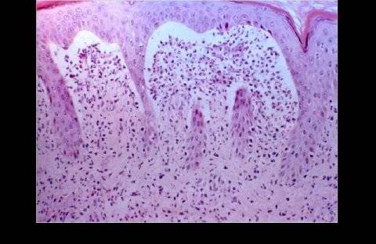
DERMATITIS HERPETIFORMIS - histology
Accumulation of PMNs at the tips of the dermal papillae
Subepidermal blister

Slide 10
 | PEMPHIGUS | PEMPHIGOID | DH
age | mid - older | elderly | 30-40
antibody | IgG | IgG | IgA
location | Suprabasilar | Subepidermal | subepidermal
inflammation | mixed | eosinophils | neutrophils
Site of dysfunction | Desmosomes | Basement membrane and hemidesmosomes | Anchoring fibrils
Antibody against: | Desmoglein | Bullous pemphigoid antigen | reticulin
Immuno | “fish net” | Linear basement membrane | Dermal tip

Slide 11
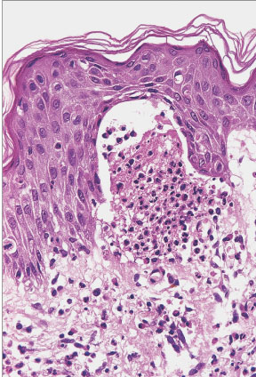
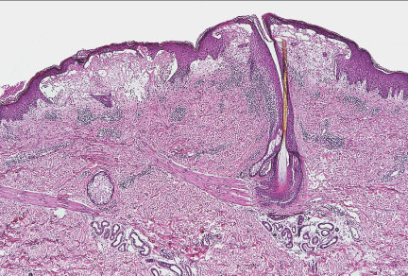
Early
Late

Slide 12
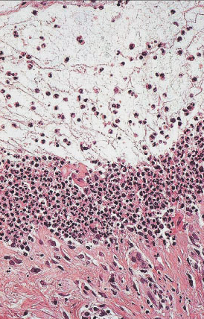
Floor of blister

Slide 13
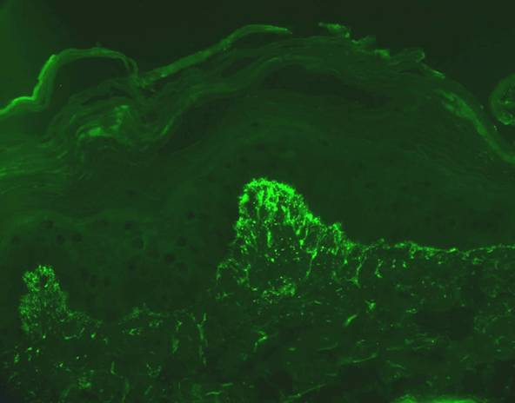
DERMATITIS HERPETIFORMIS – direct immunofluorescence
Granular deposits of IgA at the tips of the dermal papillae

Slide 14
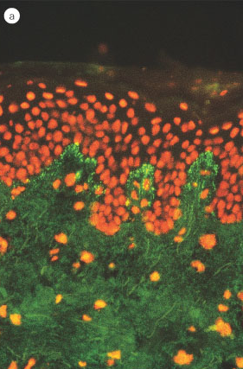
DIF granular IgA in dermal papillae

Slide 15
Dermatitis herpetiformis
clinically Grover’s, atopic dermatitis, scabies & Pityriasis lichenoides are always part of differential.
Commonly due to intense pruritus of DH, a bx will come in as r/o scabies or atopic dermatitis
Biopsy may often show only erosions or scale crusts

Slide 16
Clinician should biopsy nonexcoriated, non-vesicular erythematous plaque or papule for best diagnosis
d/dx of neutrophils in papillary dermis includes Bullous eruption of LE, mucous membrane pemphigoid, flea bites, leukocytoclastic vasculitis, linear IgA dermatosis.
Notes:
DIF DH- granular IGA; Linear IgA dermatosis-linear IgA, lack of gluten sensitive enteropathy, Bullous pemphigoid-linear IgG

