Slide 1



Lactobacillus Species: Strengthen Intestinal Barrier Function and Tight Junction Integrity
Brian P Blackwood MD, Carrie Y Yuan BS, Joseph Nicolas,
Douglas R Wood BS, Catherine J Hunter MD

Slide 2
Disclosures
I have nothing to disclose for this presentation

Slide 3
Necrotizing Enterocolitis (NEC)
NEC is the most common gastrointestinal emergency in the newborn, representing 1-5% of NICU admissions
Average Mortality 15-30%
Associated with long-term morbidities: short gut syndrome, neurodevelopmental syndromes, growth delay
The etiology unknown and treatment remains supportive

Slide 4
Prophylactic Probiotics and NEC
Prophylactic probiotics have been shown to decrease the incidence of NEC
AlFaleh, K. and J. Anabrees, Probiotics for prevention of necrotizing enterocolitis in preterm infants. Cochrane Database Syst Rev
  Reviewed 24 randomized control trials
  Found that enteral supplementation with Lactobacillus sp. alone or in combination with Bifidobacterium sp. significantly decreased the incidence of NEC
However, the mechanism behind this effect is unknown

Slide 5
Hypothesis:
Lactobacillus species (rhamnosus (LR) and plantarum (LP)), would strengthen intestinal barrier function and tight junction (TJ) integrity in an experimental model of NEC

Slide 6
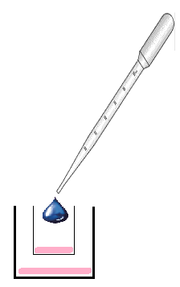
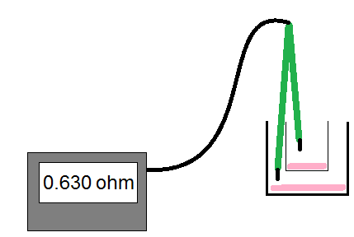
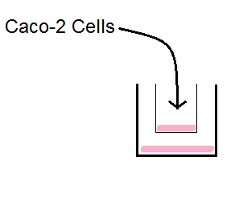
Methods: in vitro, Caco-2 cells
- 2 Hr Pretreated with Probiotic
(LR or LP)
- Or no pretreatment
- Measured Trans-epithelial Electroninc Resistance (TER) at the 1hr and 2 hr timepoint

Slide 7
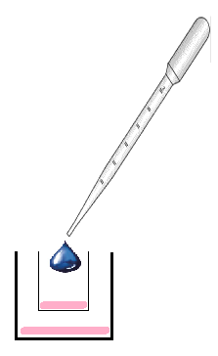
Methods: in vitro, Caco-2 cells
- EGTA Calcium Switch or LPS treatment to disrupt the TJ
- Measured TER at the 3hr and 5 hr timepoint

Slide 8
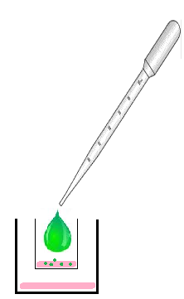
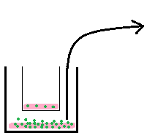
Methods: in vitro, Caco-2 cells
- After the timecourse 3 kDA Fitc Dextran was added to the apical layer
- After 2 hrs the basal layer’s Fitc Dextran Conc was measured to assess permeability
Immunofluorescence

Slide 9
Caco-2 TER Experiment Results

Slide 10
Caco-2 Fitc Experiment Results

Slide 11
Results: Caco-2 in vitro model,
ZO-1 staining

Slide 12
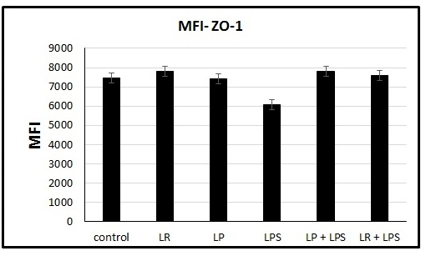
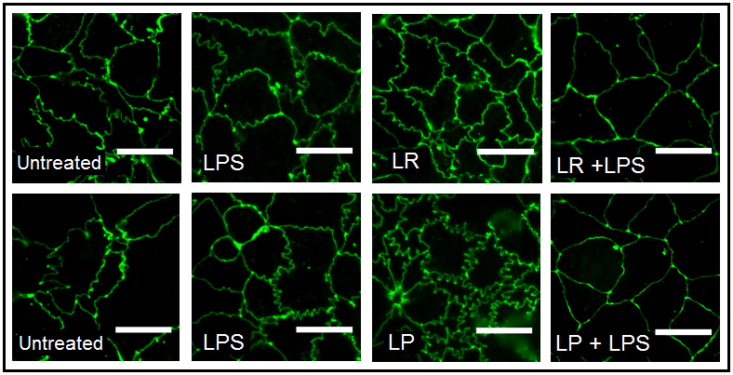
Results: Caco-2 in vitro model,
ZO-1 staining
*

Slide 13
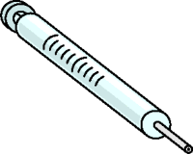
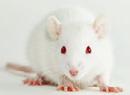
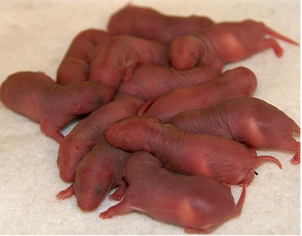




Methods: in vivo, Rat Pup Model
On day of life 4, the pups were gavage fed Fitc Dextran 2 hrs before intestinal segments were collected and injury scores were calculated
Modified from Barlow et al 1977

Slide 14
Results: Rat pup in vivo model
Survival by Groups
Clean: 93%
LR Probiotic: 74%
CS Bacteria: 75%
Probiotic + CS: 90%

Slide 15
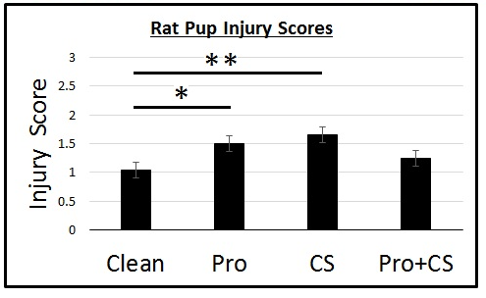
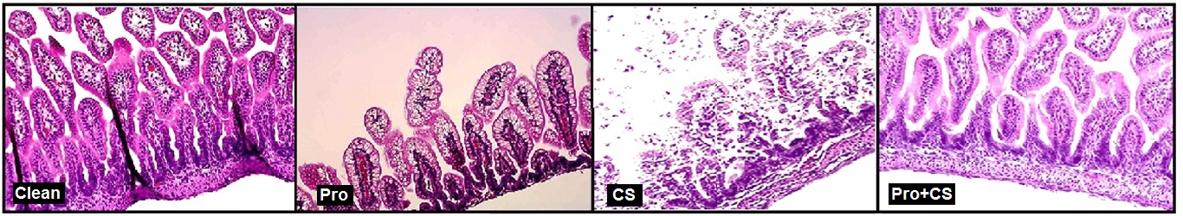
Results: Rat pup in vivo model

Slide 16
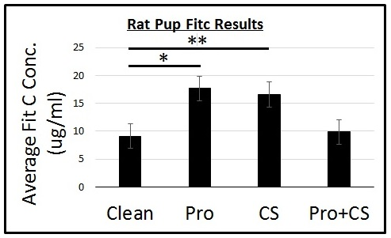
Results: Rat pup in vivo model

Slide 17
Conclusions
In vitro NEC model: Lactobacillus species strengthen intestinal barrier function and tight junction integrity
In vivo NEC model: Lactobacillus species protected against intestinal epithelial cell damage in the presence of CS bacteria

Slide 18
Future Direction
Fractionation techniques in conjuncture with western blot analysis to evaluate probiotic effects on the expression and localization of the TJ proteins
Analysis of rat pup stool using culture and 16s RNA analysis to obtain a better understanding of the effects of microbial biodiversity on the efficacy of the probiotics

Slide 19
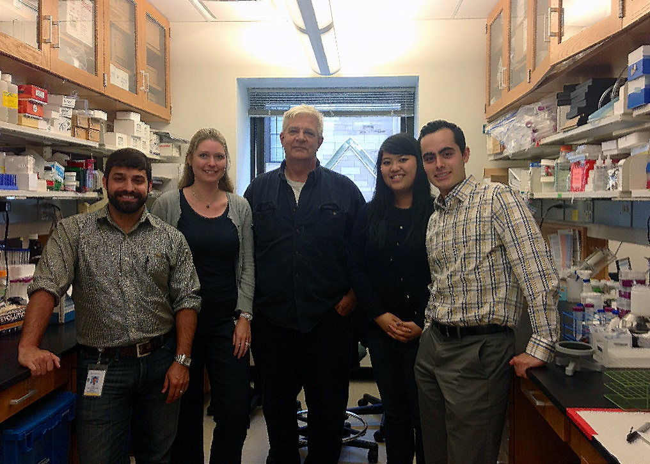




Acknowledgements
Lab Team
Catherine Hunter, MD
Doug Wood, BS
Carrie Yuan, BS
Joseph Nichols
Justyna Grothaus, MD
Grant Support
AGA
Children’s Research Foundation

