Slide 1
GelrinC: Hydrogels for Cartilage Repair
Catie Pittman and Donnie Sproal

Slide 2
The Knee
Articular Cartilage
Low friction
High wear resistance
Poor regeneration
Protects bones
Notes:
Bone protection by preventing rubbing
Articular Cartilage in the knee is hyaline cartiage- comes from greek word meaning glass and allows for the bones to slide past each other- its is 2-4 mm in depth, low coefficient of friction (1/15th of ice)
The low coefficient of friction is due to the fact that it is avascular- does not have a blood supply- so it can not regenerate once it is damaged

Slide 3
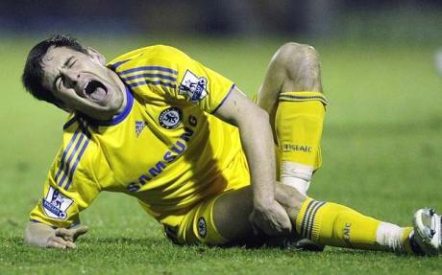
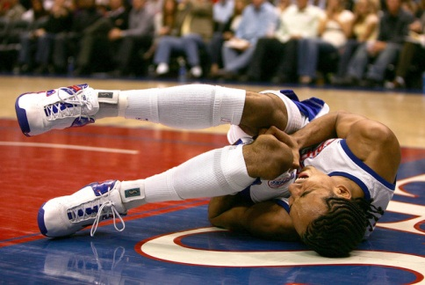
Injury
Traumatic
Post traumatic
DJD
Osteochondritis dissecans
Notes:
Traumatic- sudden direct blow to the cartilage (traumatic) e.g. a high-energy injury such as a bad fall on directly onto your knee or during sporting activities.
Post traumatic- slow degradation following a nee injury because of improper care. If you have had a previous injury to your ligaments and/or menisci then you are at greater risk of articular cartilage damage due to the altered mechanics of the joint even if the original injury has been successfully repaired eg anterior cruciate ligament reconstruction.
DJD- Degenerative Joint Disease- wear and tear over time especially when there is malalignment or instability in the joint and/or if you are overweight.
Osteochondritis dissecans- condition that is thought to occur due to poor blood supply to the underlying bone resulting in a piece of cartilage and subchondral bone separating from the articular surface.

Slide 4
Diagnosis
Articular Cartilage Damage
Wide range of symptoms
Difficult to diagnose
Anthroscopy typically used
Notes:
When and where are you getting your pain, what makes your pain worse and what eases it, is the problem getting better or worse – this type of information is useful guidance. There are a variety of symptoms that you may experience but they vary considerably between individuals and can often mimic other common knee injuries.
Could have a range of swelling from none to severe

Slide 5
Anthroscopy
Notes:
Anthroscopy is a procedure used to diagnose problems with the knee because the insdie of your joint and surrounding soft tissue can be viewed. A sample for biopsy can be taken during this procedure too. The anthroscope has a light and a camera attached to it. It is less costly, less painful, and has a shorter recovery time than open surgery. It also does not require an overnight stay like open surgery. It is used when physical exams and other diagnostic tests (x-rays, MRIs) are inconclusive. It can be done under local or general anaesthesia.

Slide 6
Damage Levels
1)
2)
3)
4)
Notes:
1- softening and blistering
2-partial thickness (less than 50%) defect or minor tears in the surface of the cartilage
3-deeper defect (more than 50%)
4-full thickness cartilage loss with exposure of the subchondral bone
The deeper the damage, the more likely that bones on the nerve are exposed and there will be pain. Often times, people with grades 1 and 2 damage don’t even know the damage is there, but if left untreated, the damage will intensify.

Slide 7
Fibrocartilage
Natural healing
Stiffer
Not ideal
Notes:
If damage goes all the way down to the bone, the subchondral bone can start a healing process in the defect. This results in the formation of scar tissue made up of a type of cartilage called fibrocartilage.
This is more dense than the hyaline cartilage and thus alters the structure of the knee joint. This was one of the causes of repetitive injuries. It is also worse at handling the demands of everyday activity and thus is more likely to breakdown.
The new scarred fibrocartilage is not an ideal replacement for the smooth, glassy articular cartilage that would normally facilitate knee movement.

Slide 8
Repair Options
Anthroscopy
Marrow Stimulation
Osteochondral Autografts and Allografts
Notes:
The Anthroscopy can be exploratory to diagnose problems, or it could be used to remove unstable or degenerative flaps. This is a short term option only and is not considered a repair option, but rather a treatment option. Usually this is only used for patients with minimal damage (stage 1 or 2).
Marrow Stim- Two steps: Remove damaged cartilage to expose the bone and then penetrate the subchondral bone to expose blood vessels and form blood clot within the defect.
Older Stim used drilling into the bone, but the heat can cause cell death (necrosis)
Twenty years or so ago the newer technique of microfracture was introduced where, instead of motorised, heat producing tools, a fine bone pick (awl) is used to punch into the subchondral bone at 2-3-mm intervals to a depth of 2-4mm. Microfracture is usually used for younger patients with smaller defects because it can be done arthroscopically. This technique causes the creation of fibrocartilage. It has a higher success rate with injuries due to trauma; however, as the fibrocartilage wears away (1-2 years), the damage worsens.
Auto/Allografts- Cores of cartilage are taken from other healthy parts of the knee, either yours or someone else’s, and inserted into matching holes drilled into the defect. Can be completed arthroscopically if possible, but generally requires a larger incision. The cores are hyaline cartilage, but the spaces fill with fibrocartilage. For autographs, this can create donor site morbidity- or problems due to the damage created at the donor site.
Allographs are hard to come by and run the risk of not fitting properly into the incision and thus create unstable patches of fibrocartilage which ultimately causes more damage.

Slide 9
Hydrogels
Johns Hopkins Studies: Combining a binding agent with the hydrogel
Notes:
Hydrogels can be combined with microfracture to release stem cells from the bone in order to provide regeneration, but to then ensure that the new cartilage formed has the properties of hyaline cartilage and not fibrocartilage.
Johns Hopkins studies released in January of this year showed the success of the hydrogel use. 15 patients were treated with hydrogel additive and 3 with only microfracture. 6 months after the repair, the hydrogel patients had new caritlage filling 86% of the defect, whereas the microfracture only patients only had 64% filled. This hydrogel had to be combined with a binding agent to stick to the bone

Slide 10
GelrinC
Fills to shape of knee
Acellular
UV Light
http://www.youtube.com/watch?v=NcNLlfhFk0Q
Notes:
GelrinC is the first synthetic implant to be CE-approved March 2013 (Conformite Europeene, meet health, safety and environmental standards of EU)
Takes the Johns Hopkins idea, but includes binding agent and light thickening gel to create a scaffold for new cell growth
The matrix of synthetic polyethylene glycol diacrylate and denatured fibrinogen creates an environment conducive to cartilage tissue regeneration. After GelrinC is implanted, it starts to bio-degrade as it is replaced with new hyaline-like cartilage.
The clinical trial treated 23 patients with 100% success rate where every patient regained full knee usage and was pain free.
It is low cost because it is off the shelf and can be applied with one process, so it is a viable option that all surgeons can offer. It is not available in the US currently, but a clinical trial is being conducted in Europe.

Slide 11
Sources
http://www.cartilagehealth.com/acr.html
http://arthritis.webmd.com/arthroscopy-surgical-procedure
http://www.hopkinsmedicine.org/news/media/releases/tissue_engineers_report_knee_cartilage_repair_success_with_new_biomaterial
http://www.medlatest.com/2013/03/19/ce-mark-gelrinc-hydrogel-cartilage-implant/
http://www.medlatest.com/2013/01/14/hydrogel-cartilage-repair-work-researchers-say-yes/

