Slide 1

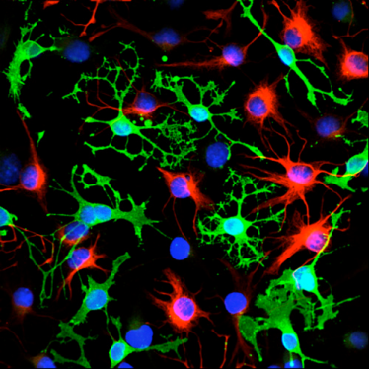
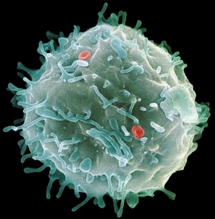
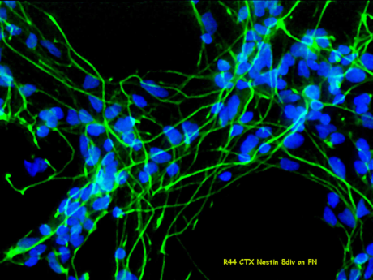
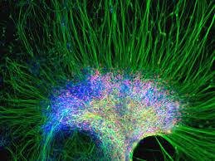
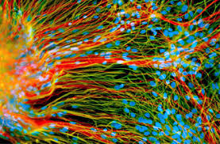
STEM CELLS and Ethics
Sam Roberts
PhD student

Slide 2
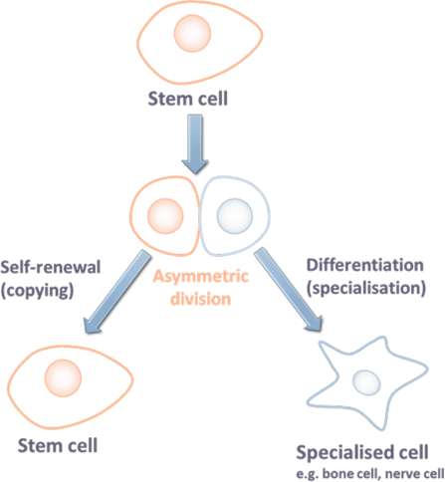
What is a STEM CELL?

Slide 3
Induced pluripotent stem (IPS) cells
Embryonic stem cells
Adult stem cells
Inner cell mass of the blastocyst of a donated IVF embryo
Tissues throughout the body e.g. bone marrow
Specialised cells genetically reprogrammed
Source:
Status:
Pluripotent
Multipotent
Pluripotent
Role in the body:
Inner cell mass cells becomes the developing embryo
Tissue specific stem cells are essential for repair
Clinical trials:
Limited patient trials
Ongoing patient clinical trials
In vitro/ in vivo trials only
Safety/ ethical concerns:
Highly controversial and some concerns over tumour formation
Gene transfer of oncogenes increased risk of tumour formation
Autologous stem cell transfer relatively safe

Slide 4
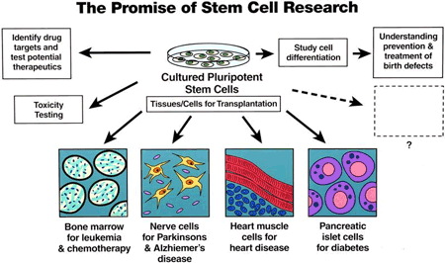

Slide 5
STEM CELLS the debate
Embryonic stem cells
When does life begin? Conception? Birth? 14 days after conception? What is your opinion on this question?
Is it right to destroy an embryo to try and cure diseases, or should the embryo have the right to life?
Are the laws in place enough to regulate the use of Embryonic stem cells?
Are there any alternatives?

Slide 6
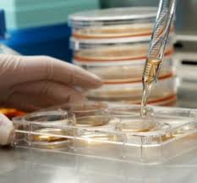


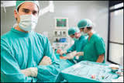
STEM CELL Tourism
Were Joe and Susan McCarthy wrong to risk their daughters health on unproven therapies or right to try and find a cure abroad?
Should individuals have the right to choose to travel abroad for treatment if they want?
What happens if a treatment goes wrong? Should the NHS be liable to pick up the bill for follow-up treatments?

Slide 7
STEM CELL Tourism
Why do stem cell therapies need to undergo clinical trials?
Is Dr Fieldsend wrong to set up his clinical aboard to avoid UK regulations?
Different countries around the world have different rules on the use of stem cells. What impact does this have on stem cell tourism? How could this problem be tackled?
Clinical trials cost millions of pounds. Where will this money come from to fund these trials?
Clinical trials take years, meaning millions of people will suffer and die before treatments are licenced. If there is a chance that the treatments offered abroad work, is it not better to allow them to go ahead to see? This could potential cure people?
Why are video testimonials on websites not considered valid scientific evidence? How do scientists prove treatments work?
How will these treatments be funded in the future? Should the NHS be made to pay for treatments or should they just be available to people who can afford to pay for them?

Slide 8




STEM CELLs and the Media
In January 2012, scientists published results of a clinical trial using embryonic stem cells to treat macular degeneration, a cause of blindness. The findings were published in a paper in the Lancet entitled
‘Embryonic stem cell trials for macular degeneration: a preliminary report’
The media reported the story, with headlines including
‘Human stem cell therapy works in blind patients in first trial’
‘A glimpse of hope as blind are given stem cell jab to give back sight’
‘West Yorkshire man takes part in stem cell eye trial’

Slide 9

STEM CELLs and the Media
In September 2012 UK scientists published a paper detailing their findings using embryonic stem cells to restore hearing in gerbils. The paper was entitled
‘Restoration of auditory evoked responses by human ES-cell-derived otic progenitors’
and the authors suggested that ‘These results should stimulate further research into the development of a cell-based therapy for deafness’
Following a press release by their university, the story was reported by the media, with a range of different headlines.
‘Cure for deafness a reality as scientists make animals hear again... and promise first human patients will be treated in a 'few years'
‘Deaf gerbils 'hear again' after stem cell cure’ and stated that ‘treating humans is still a distant prospect’

Slide 10




STEM CELLs and the Media
How can scientists avoid “miracle cure” statements in the media?
Should it be the responsibility of the scientists or the media to get it right?
How much should the public be told about research into treatment for diseases? At what stage should the public be informed?

Slide 11
Resources
www.re-gen-x.com
- Videos
Teachers pack
Links to other resources
www.stembook.org/
www.eurostemcell.org/factsheet/embryonic-stem-cell-research-ethical-dilemma
www.futuremedicine.com/doi/pdfplus/10.2217/rme.12.38
stemcells.nih.gov/info/Pages/cellmovie.aspx
www.newscientist.com/topic/stem-cells
www.eurostemcell.org/

