Slide 1
Fatty Liver and Liver Cancer
In the Hispanic Community

Slide 2
Howard P. Monsour, Jr., M.D.
Associate Professor of Clinical Medicine
Weill Cornell Medicine
Chief, Hepatology
Houston Methodist Hospital

Slide 3
Everything is Big In Texas
Texas has one of the largest populations of BMI > 30 in the US
Texas is in the Top 4 of HCV population in the US
Texas has the 2nd largest Asian population in the US
Texas has the 2nd largest Mexican American populations in the US
Texas ranks 1st or 2nd in the size of inmate population in the US
Notes:
3

Slide 4
HOUSTON TEXAS

Slide 5
HOUSTON TEXAS

Slide 6
HOUSTON TEXAS

Slide 8
TEXAS: PRIMARY LANGUAGES SPOKEN IN THE HOME
65.8% (14,740,304): ENGLISH
29.21% (6,543,702): Spanish
0.75% (168,886): Vietnamese / Chinese
0.56% (122,921): other

Slide 9
TEXAS:
Between 2000 and 2040 (assuming that the net migration rate will equal half that of 1990-2000):
Hispanic public school enrollment
Increase by 213%
non-Hispanic white enrollment will decrease by 15%

Slide 10
TEXAS:
2010: 45% of Texas residents had Hispanic ancestry
recent immigrants from Mexico, Central America, and South America, as well as Tejanos
2007: the first time since the early nineteenth century
Hispanics accounted for more than half of all births (50.2%)
while non-Hispanic whites accounted for just 34%.

Slide 11
Chronic Liver Disease in the Hispanic Population of the US
Hispanic population: 15% of the US population - 30% by 2050
Mexican American’s: 65%
Central and South Americans: 17.4%
Puerto Rican: 8.6%
Cuban: 4%
Less than one third living in the United States are immigrants
“the Hispanic paradox” socioeconomic status equal to African-American but life expectancy 3 years greater than non-Hispanic white people

Slide 12
Chronic Liver Disease in the Hispanic Population of the US
6 th most common cause of death Hispanic population
(Not included in the 10 most frequent cause of mortality and non-Hispanic whites and African-American populations)
Mortality from chronic liver disease: 50% higher than non-Hispanic whites
13.7 per 100,000
Non-Hispanic whites: 9.2 per 100,000
African-Americans: 7.5 per 100,000
In the last decade deaths from chronic liver disease disease declined in all populations except the Hispanic populations

Slide 13

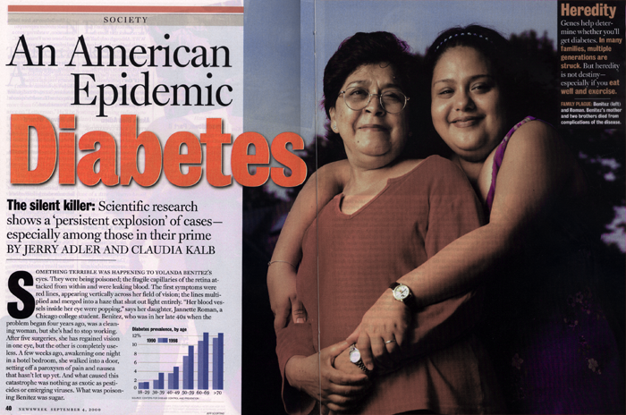
FATTY LIVER Chronic Disease Epidemic

Slide 14


Age-adjusted Percentage of U.S. Adults Who Were Obese or Who Had Diagnosed Diabetes
Obesity (BMI ≥30 kg/m²)
1994
2000
2008
No Data <14.0% 14.0-17.9% 18.0-21.9% 22.0-25.9% >26.0%
Diabetes
1994
2000
2008
No Data <4.5% 4.5-5.9% 6.0-7.4% 7.5-8.9% >9.0%
CDC’s Division of Diabetes Translation. National Diabetes Surveillance System available at http://www.cdc.gov/diabetes/statistics

Slide 16
Non-Alcoholic Fatty Liver Disease (NAFDL)
The most common cause of liver disease in the USA (prevalence: 20-30%)
3-5% of NAFLD pts. have Non-Alcoholic Steatohepatitis (NASH)
The most common cause of elevated ALT in DM
Hepatology 2004,

Slide 17
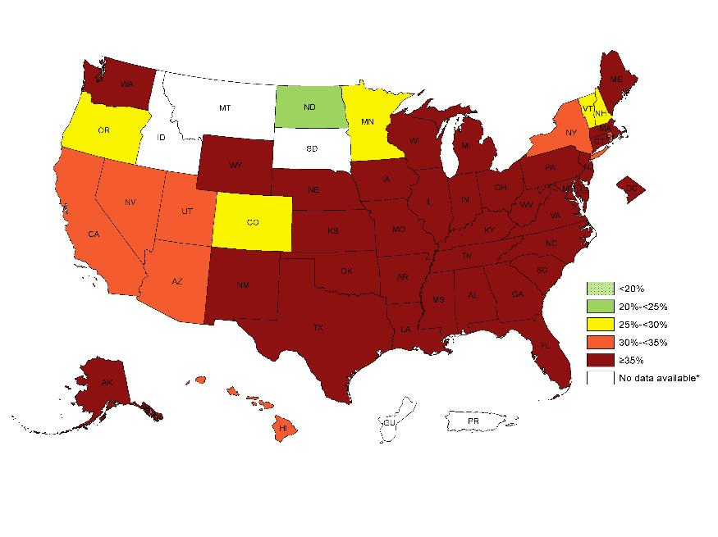
Prevalence of Self-Reported Obesity Among Non-Hispanic Black Adults, by State and Territory, BRFSS, 2013-2015

Slide 18
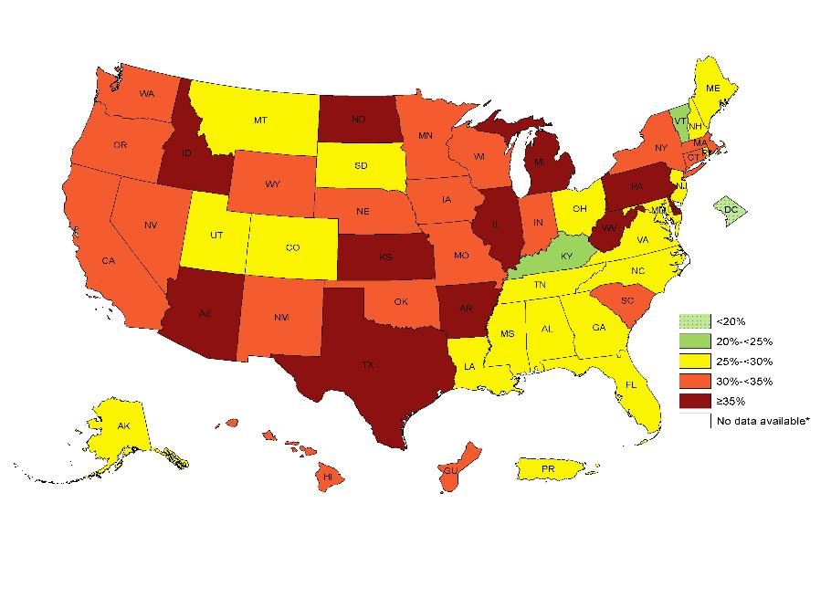
Prevalence of Self-Reported Obesity Among Hispanic Adults, by State and Territory, BRFSS, 2013-2015

Slide 19
After 15 yrs. Living in the US Immigrant obesity incidence is equal to the native US population

Slide 20

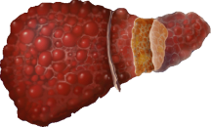
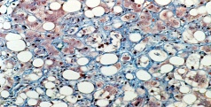
NASH is the Subtype of NAFLD the Primarily Progresses
NAFL
Stable
Liver Failure
24% of the US Population
NAFLD
(58% HISPANICS)
?
NASH
10-15%
Cirrhosis
Death
25 million
20-30%
40-60%
65-75%
HCC
(Annual incidence 2%)
Stable
Ludwig 1980 , Diehl 1988, Lee 1989, Powell 1990, Bacon 1994, Matteoni 1999, Angulo 1999, Caldwell 1999, Ponawala 2000, Contos 2001, Ong 2001,, Bugianesi 2002, Ratziu 2002, Harrisson 2003, Marchesini 2003, Younossi 2004, Fassio 2004, Sanyal 2004, Ong 2005, Adams 2005, Ong 2006, Rafiq 2008, Stepanova 2010, Younossi 2012
Notes:
20

Slide 21
NAFLD
The most common cause of elevated liver enzymes in the U.S.
NAFLD is more common in U.S. Hispanics than NHW or African Americans
MRI Triglyceride content: 45% of Hispanic population
(1.4 X more frequent in Hispanics than NHW and 1.9 X than AA)

Slide 22
NAFLD
Biopsy proven NAFLD:
Hispanic: 58.3%
Caucasian: 44.4%
African Americans: 35.1%
Gastro 2011

Slide 23
WHY is NAFLD so Common?
Metabolic Syndrome:
Hispanics: 31.9%
NHW: 23.8%
AA: 21.6%
Hispanics have higher insulin resistance and obesity
Hispanics increased risk of diabetes
JAMA 2002, Hepatology 2009

Slide 24
WORSE Than THAT!
Hispanics have higher elevations in aminotransferases
(liver tests)

Slide 25
PNPLA3
(Patatin-like phospholipase domain containing 3,adiponutrin)

Slide 26
PNPLA3
(Patatin-like phospholipase domain containing 3,adiponutrin)
Highly expressed in liver and adipocytes
J. Bol. Chem., 2001; J. Lipid Res 2006
SNP rs738409(I148M): strongly associated hepatic fat content independent of BMI, diabetes, and ETOH
Nat. Genet. 2008
SNP rs738409 (I148M): associated with 50% increase risk of NASH and significant Fibrosis
Hepatology, 2010

Slide 27
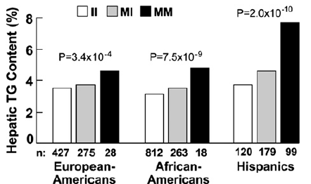
PNPLA3 (Patatin-like phospholipase domain containing 3,adiponutrin)
I148M:
Hispanics 49%
African Americans 17%
Nat. Genet. 2008
Higher ALT and AST activity
J. Lipid Res., 2009
Increased hepatic steatosis, portal and lobular inflammation, and higher fibrosis scores
Hepatology, 2010

Slide 28
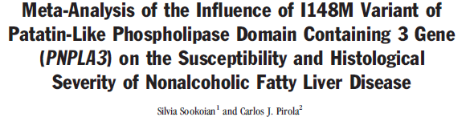
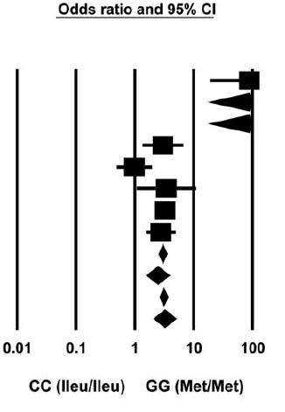
rs738409(I148M): NASH - 3.488 X

Slide 29
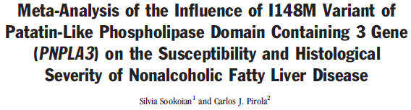
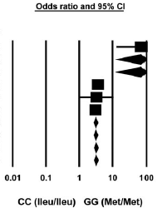
rs738409(I148M): 3.2 X greater risk of developing fibrosis

Slide 30
PNPLA3:
Homozygotes: 2X Liver Fat Content
Hispanics: 49%
NHW: 23%
AA: 17%
Biopsy Proven NAFLD: PNPLA3 present
Hispanics: 91%
NHW: 70%
NAT GENET 200H
Hepatology 2010

Slide 31
TREATMENT
Weight Loss and Exercise
Eating Habits?
Cultural, Social, Emotional and Linguistic issues!
Medications

Slide 32
PRIMARY LIVER CANCER

Slide 33
Hepatocellular carcinoma
HCC:
5th most common cancer and the 3rd most common reason for cancer-related mortality worldwide

Slide 34
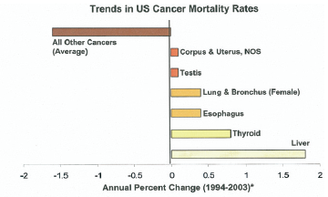
Liver Cancer: The Fastest Growing Death Rate in the US

Slide 35
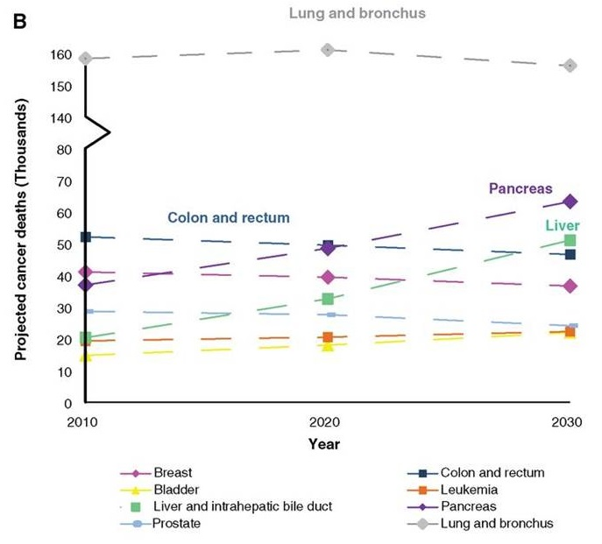
HCC is projected to be top cancer killer by 2030
Rahib L et al. Cancer Res 2014;74:2913-2921

Slide 36
HCC incidence & mortality rates* among individuals aged 50-64 in the US (2006-2010)
Incidence
Mortality
*Age-adjusted rates per 100,000 persons
Altekruse SF et al., Am J of Gastroenterol 2014
Notes:
The biggest increase in rate was experienced by people age 50-64. Among these individuals, the highest incidence and mortality rates were observed among blacks, followed by hispanics, asians, and lowest in whites. This is the first time, Hispanics have higher rates than Asians.

Slide 37
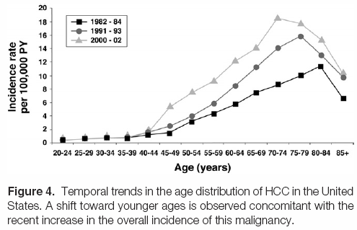
HCC: Incidence is Increasing at a Younger Age

Slide 38
Risk Factors Identified for HCC
Male
AGE
Race
HBV
HCV
Alcohol
Toxic Exposures (Aflatoxin)
NAFDL
Obesity
Diabetes Mellitus
Oral Contraceptives
Hemochromatosis
Diet
Coffee Drinking

Slide 39
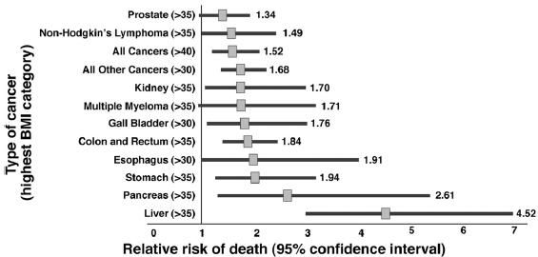
Nonalcoholic Fatty Liver Disease

Slide 40
Epidemiology of HCC in Texas
Arch. Int. Med. 2007
Between 1992-1995 and 2000-2002 the incidence of HCC increased by 31% in men and 63% in women
HCC rates were 65% higher in Native Hispanic men than Immigrant Hispanic men

Slide 41
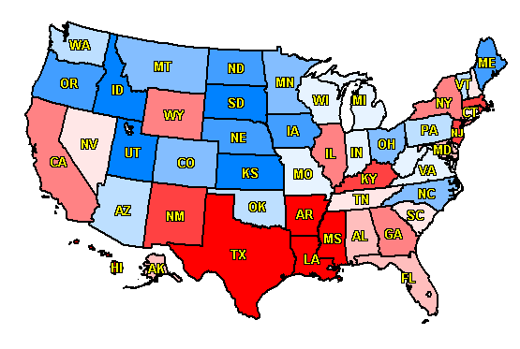
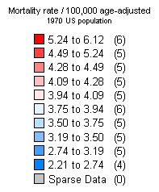
Regional Variations in HCC-related Mortality
Mortality Rate / 100,000 Age-Adjusted
5.24 to 6.12 (6)
4.49 to 5.24 (5)
4.28 to 4.49 (5)
4.09 to 4.28 (5)
3.94 to 4.09 (5)
3.75 to 3.94 (6)
3.50 to 3.75 (5)
3.19 to 3.50 (5)
2.74 to 3.19 (5)
2.21 to 2.74 (4)
Sparse Data (0)
Notes:
Slide 18
Regional Variations in HCC-related Mortality
Color coded age-adjusted mortality rates (adjusted to 1970 US Population) that show a South to North gradient in HCC incidence in the United States (Source: CDC Vital Statistics). These differences are only partly explained by underlying rates of smoking, alcohol use, obesity, and diabetes.
El-Serag HB. Hepatocellular carcinoma: recent trends in the United States.Gastroenterology. 2004 Nov;127(5 Suppl 1):S27-34.
Davila JA, Petersena NJ, Nelson HA, El-Serag HB. Geographic variation within the United States in the incidence of hepatocellular carcinoma. J Clin Epidemiol. 2003 May;56(5):487-93.

Slide 42
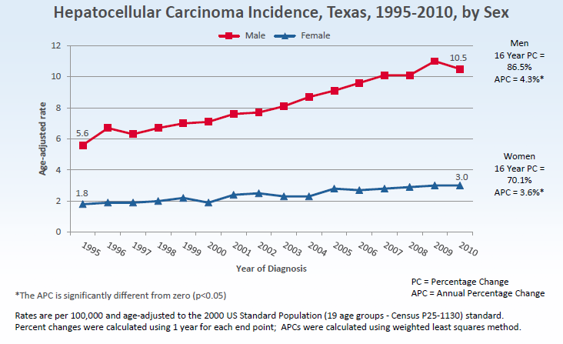

Slide 43
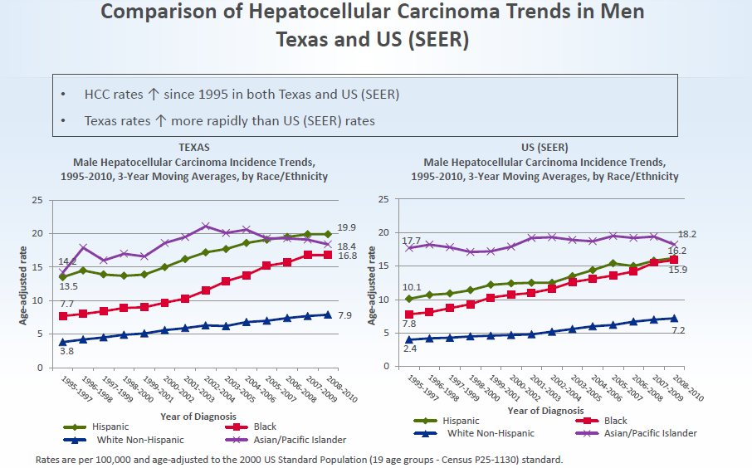

Slide 44
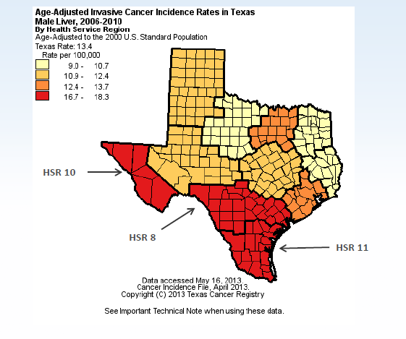

Slide 45
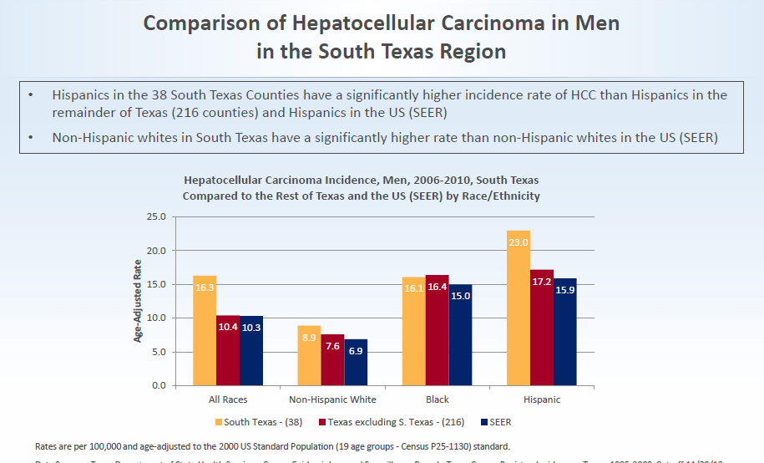

Slide 46
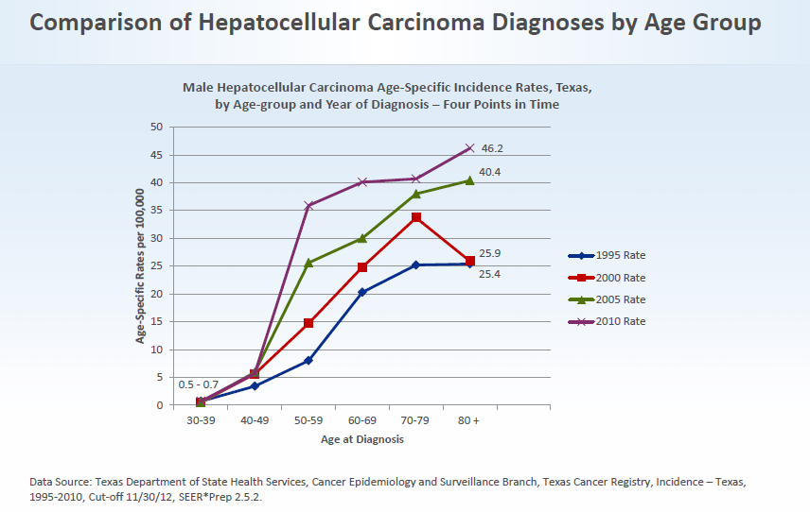

Slide 47
HCC Incidence Rates in the MEC
(470 incident HCC cases, 16 years of follow up)
California
AAIR
per 100,000
Age-adjusted incidence rates per 100,000 (standardized to US 2000 population)
Setiawan et al., JNCI 2014
Notes:
Through dec 31, 2010

Slide 48
PRIMARY LIVER CANCER: TEXAS
Hepatocellular Carcinoma
Etiology: CIRRHOSIS
BIG 3:
Hepatitis C
Fatty Liver Disease
Alcohol

Slide 49
Alcohol:
24% of Chronic Liver Disease in the US is caused by Alcohol
Hispanics consume less than NHW
Mexican Americans and Puerto Ricans consume the most in the Hispanic populations

Slide 50
ALCOHOL
Important Risk Factor:
Acculturation into the American Society: drink more
Hispanics born
US vs. Foreign
(ETOH abuse and dependence)
16% vs. 9.1%
14.5% vs. 6.2%
Alcohol Clin Exp Res 2007Drug
Alcohol Dep 2009

Slide 51
ALCOHOL
Hispanics have an increased susceptibility to
LIVER INJURY !!!!
Pts. With Alcoholic Hepatitis:
CIRRHOSIS MORE FREQUENT IN HISPANICS
Hispanics: 73%
NHW: 52%
AA: 44%
Alcohol Alcohol 1989

Slide 52
Alcohol:
Treatment:
Hispanics are significantly less likely to receive care in professional settings specializing in substance abuse than NHW and AA.
5.7% vs.9.6% vs. 9.0%
No difference in attendance to Alcoholics Anonymous meetings

Slide 53
Private Health Care Organizations, United States, 2006-2008
HCV Infection by Race
HCV infection defined as either positive anti-HCV or HCV RNA
Clin Infect Dis. 2012

Slide 54
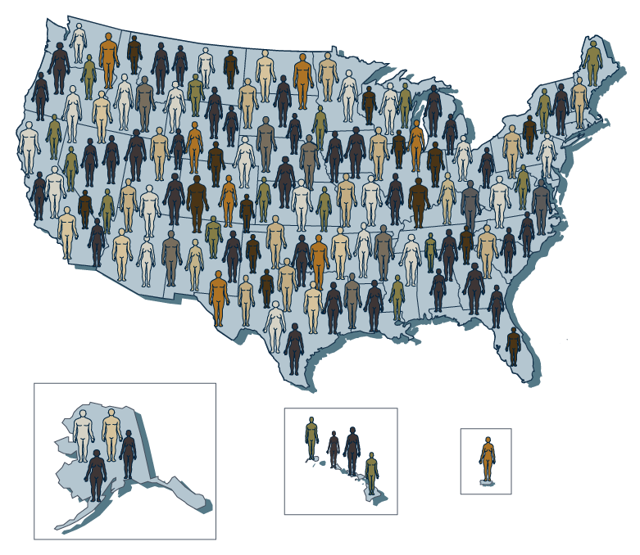
Private Health Care Organizations, United States, 2006-2008
Awareness of HCV Infection Status
Knowledge of HCV Infection
Clin Infect Dis. 2012

Slide 55
NHANES Survey, United States, 2001-2008
Lack of Knowledge of HCV Infection Status, by Race
Hepatology. 2012

Slide 56
Hepatitis C
Age adjusted Mortality rates from cirrhosis due to HCV 2 X higher in Hispanics compared to NHW
3.3 / 100,000 vs. 1.46 / 100,000
Hispanics are less likely than NHW to be tested for HCV
Evolution of HCV is more rapid in Hispanics than NHW and AA
Am J Public Health 2001, World J Gastroenterol 2007, Am J Gastroenterol 2006

Slide 57
Hepatitis C
Hispanic patients with Hepatitis C are more likely than other ethnic groups to meet established criteria for antiviral therapy
More likely to have chronic hepatitis with significant fibrosis
More likely to have compensated liver disease
BUT Hispanics are less likely to be referred for treatment than NHW
40% vs. 71%
Am J Gastroenterol 2005

Slide 58
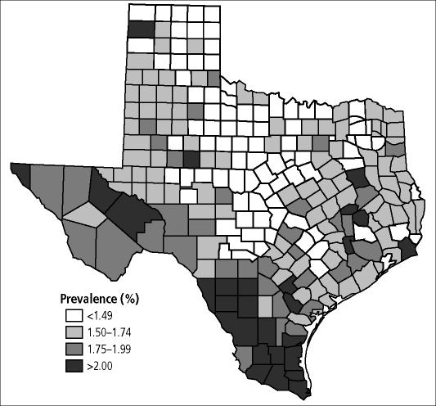
HCV Prevalence by County in Texas

Slide 60
HCC Complicating HCV in Texas
Davis G. : Baylor Medical Center Proceedings
Cirrhosis as a proportion of HCV- infected patients will increase to 40.6% in 2025 and remain over 40% thereafter
Pts with decompensated will liver disease will peaked in 2012 to 12,495 cases

Slide 61
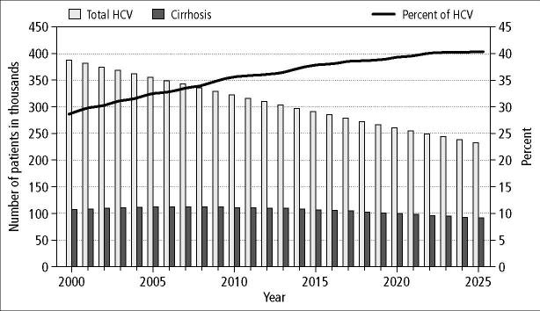
Rise in Cirrhosis Prevalence in Texas
38%

Slide 62
What to do about the HCC in Texas
1st: Treat HCV
Identify and educate
Screen for Alcohol abuse
Screen for HCC in Cirrhotic Patients
Ethnic Matching of Patients and Providers

