Slide 1
HIV/AIDS

Slide 2
What is HIV?
HIV stands for
HUMAN IMMUNO-DEFICIENCY VIRUS
It is the virus that primarily infects cells of the immune system and that causes the disease known as AIDS.
(HIV attacks and destroys the disease-fighting cells of the immune system, leaving the body with a weakened defense against infections and cancer)

Slide 3
Where did HIV come from?
It was first discovered in the US in the early 1980’s (emerging in the late 1970’s)
Scientists believe it came from central Africa
(Theory: Researchers believe that HIV was introduced into the human population when hunters became exposed to infected blood.)

Slide 4
What is AIDS?
AIDS is the most serious stage of HIV infection.
AIDS is the disease CAUSED by HIV. HIV is the VIRUS that leads to AIDS.
AIDS stands for ACQUIRED IMMUNE DEFICIENCY SYNDROME
HIV weakens the person's immune system. (change on your notes)

Slide 5
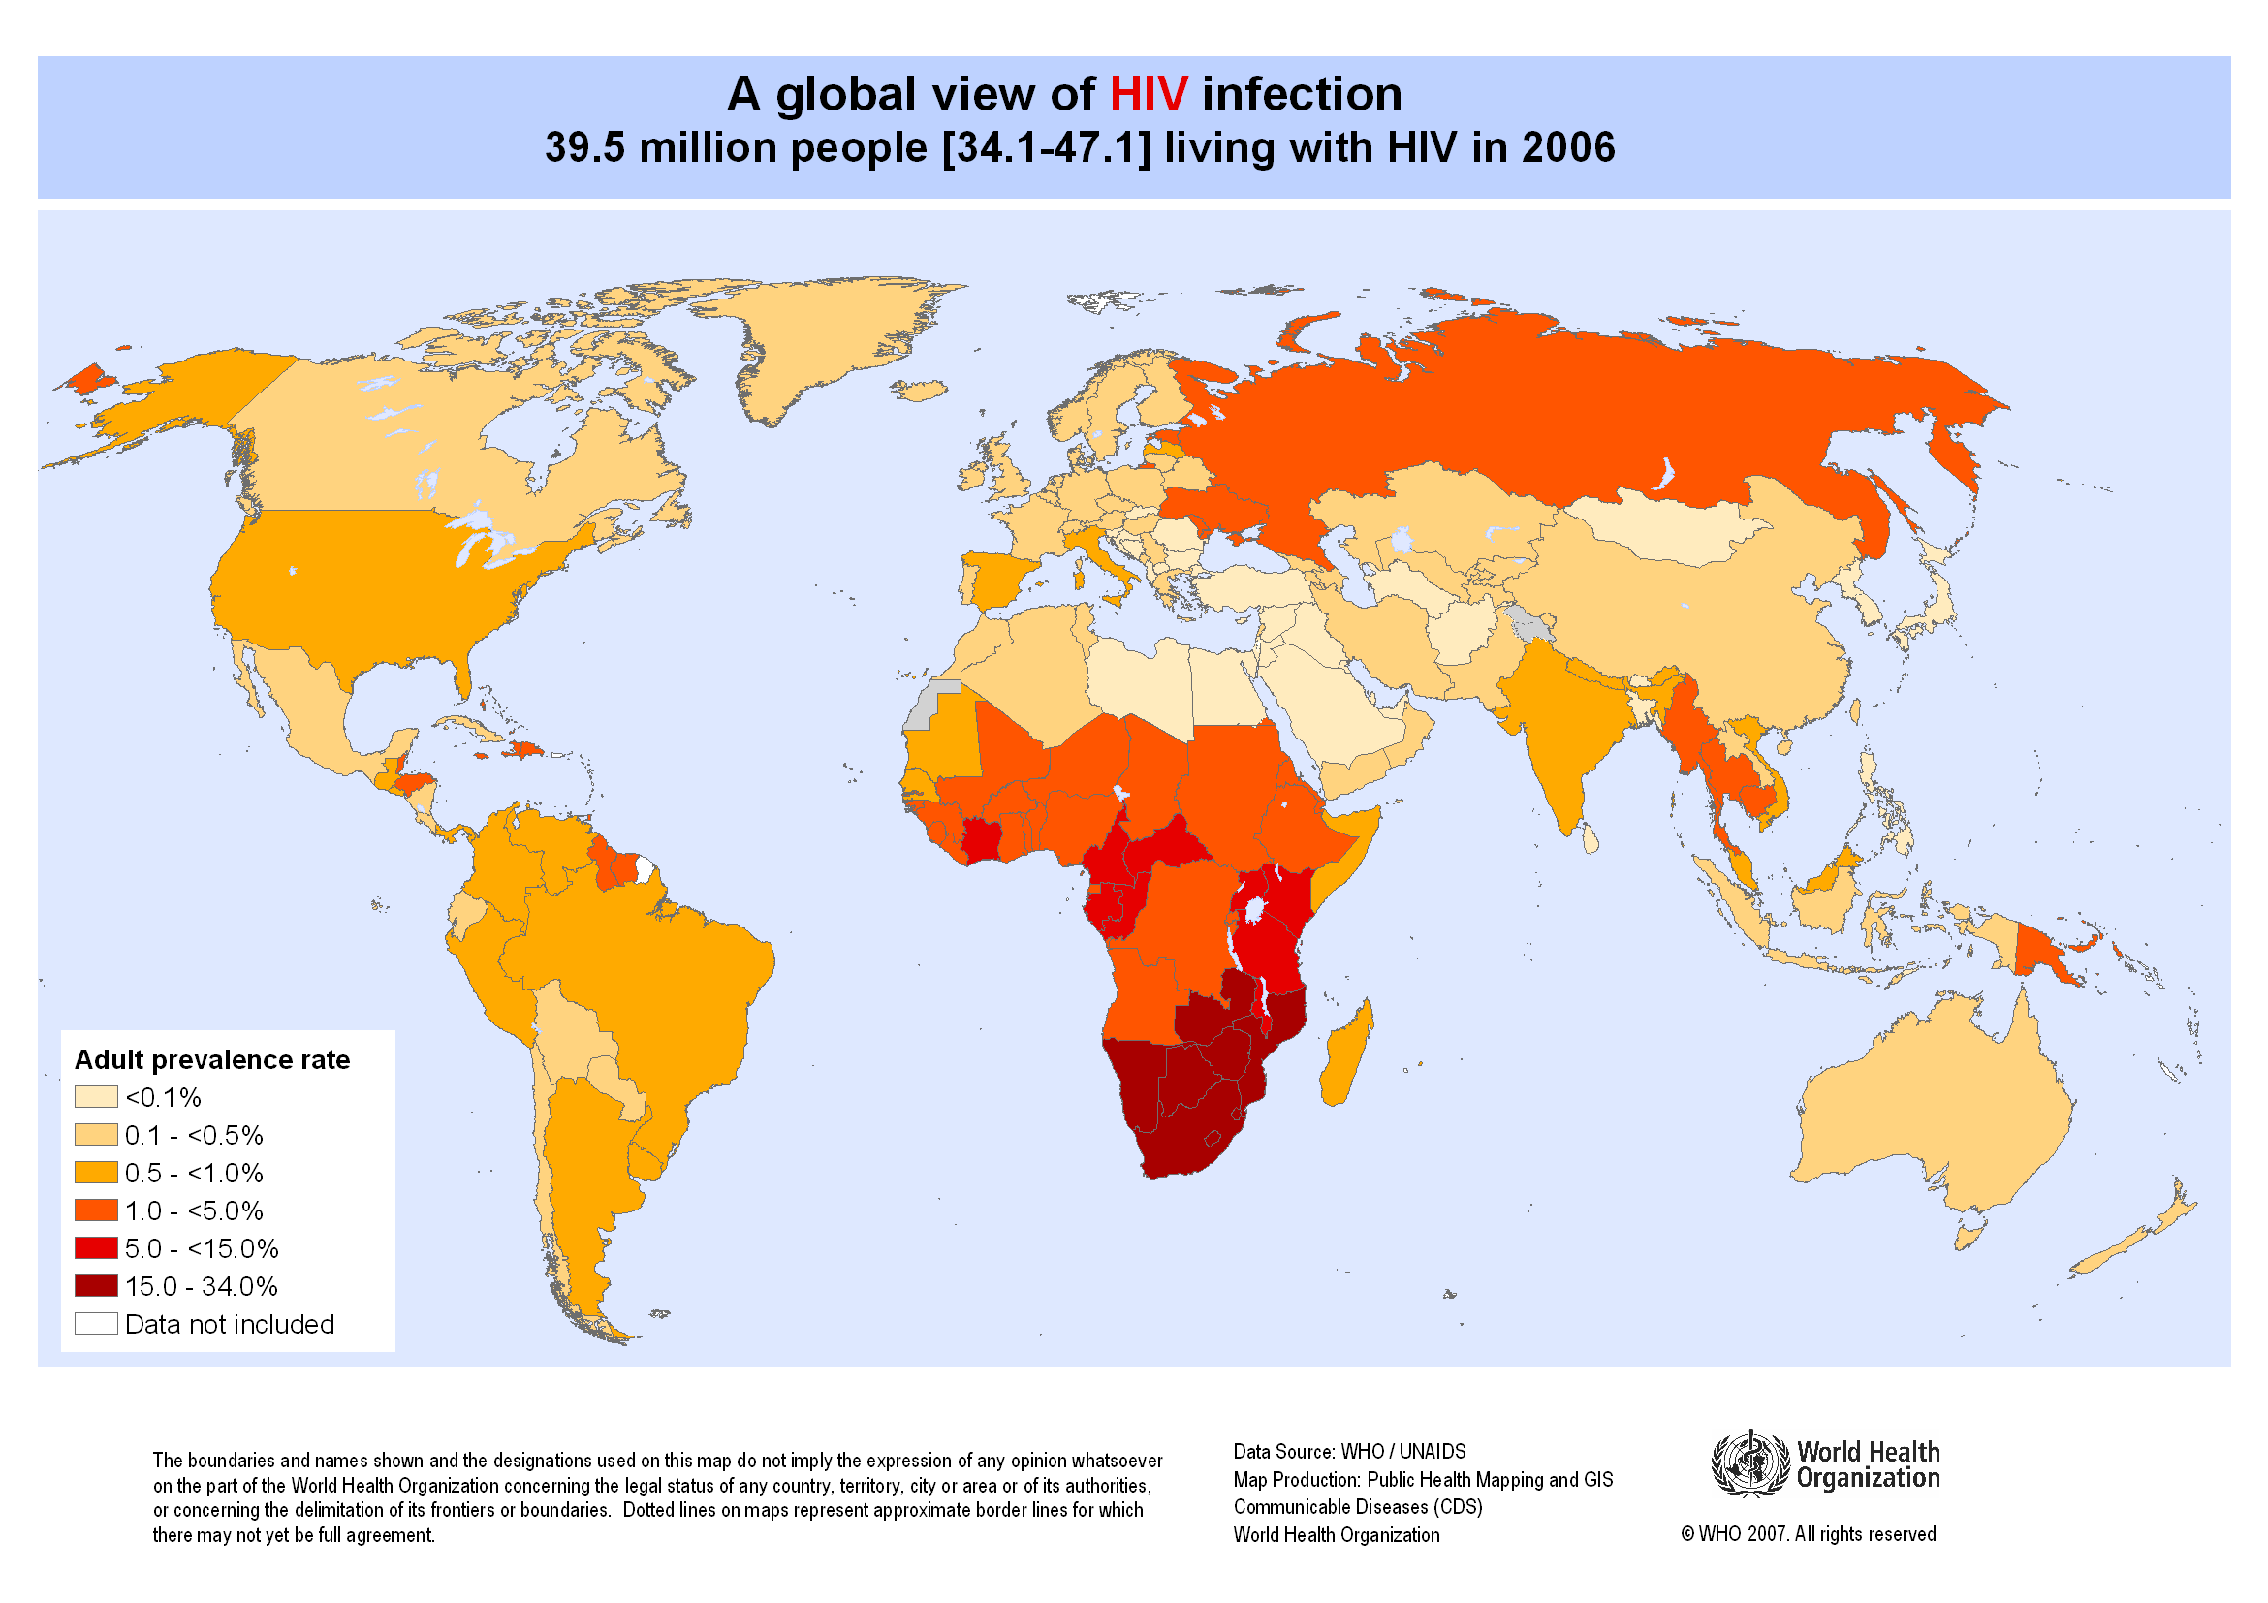

Slide 6
How is HIV spread?
Sexual activity: oral, anal, or vaginal sex
Sharing needles or other injection equipment
Mother-to-baby: during childbirth or breastfeeding
Blood Transfusions (rare)

Slide 7
What is an HIV antibody test?
A test to determine whether a person has been infected
The test checks a person’s BLOOD for antibodies to HIV
Antibodies are substances (proteins) produced in the blood to fight diseased organisms.
When antibodies to HIV are present in a person's bloodstream, it means that he or she is infected with the virus.

Slide 8
What does HIV do to the body?
HIV destroys important key parts of the immune system
Remember, the immune system is what keeps you healthy and fights infection
Because the immune system is being destroyed, the body isn’t able to fight infections like it normally would. The immune system can’t do it’s job, infections win!

Slide 9
What are the signs/symptoms?
PHASE ONE:
Asymptomatic stage:
The LARGEST numbers of people with HIV are in phase one
People are HIV-positive; however, show few signs or symptoms
Symptoms may not appear for up to TEN years! If so, you may not realize you have it and might be passing it on to others!

Slide 10
Three Stages of the HIV infection
Asymptomatic Stage (Stage 1)
Stage 2: Symptoms Appear
AIDS Stage
(Stage 3)

Slide 11
PHASE TWO
People begin to show signs/symptoms:
Swollen lymph glands
Fatigue
Weight loss
White spots or unusual blemishes on the tongue, in the mouth, or in the throat
Fever
Diarrhea
Cough
Trouble remembering things/memory problems

Slide 12
PHASE THREE
A person is considered to be in the last phase, the AIDS phase, when a persons T4 cell count is fewer than 200 cells per micro liter.
(Less than 14% of the white blood cells in the blood)
This means that they are at extreme risk because their body cannot fight infection
The person develops an “opportunistic infection”- and usually dies of that infection (example: Kaposi’s Sarcoma- a type of cancer, pneumonia, etc)

Slide 13
Three Stages of the HIV infection
Asymptomatic Stage (Stage 1)
Stage 2: Symptoms Appear
AIDS Stage
(Stage 3)

Slide 14
If I have HIV, then I have AIDS?
Being infected with HIV does not mean that a person has AIDS automatically, it means they have the VIRUS that can LEAD to the condition known as AIDS.
However, if left untreated, HIV infection damages a person's immune system and can progress to AIDS.
While HIV cannot be cured, medications can help a person to live with HIV and keep it from progressing further though the virus can STILL BE TRANSMITTED TO OTHERS!

Slide 15
Important to note:
Finding a small amount of HIV in a body fluid does not necessarily mean that HIV can be transmitted by that body fluid.
Contact with saliva, tears, or sweat has never been shown to result in transmission of HIV.

