Slide 1
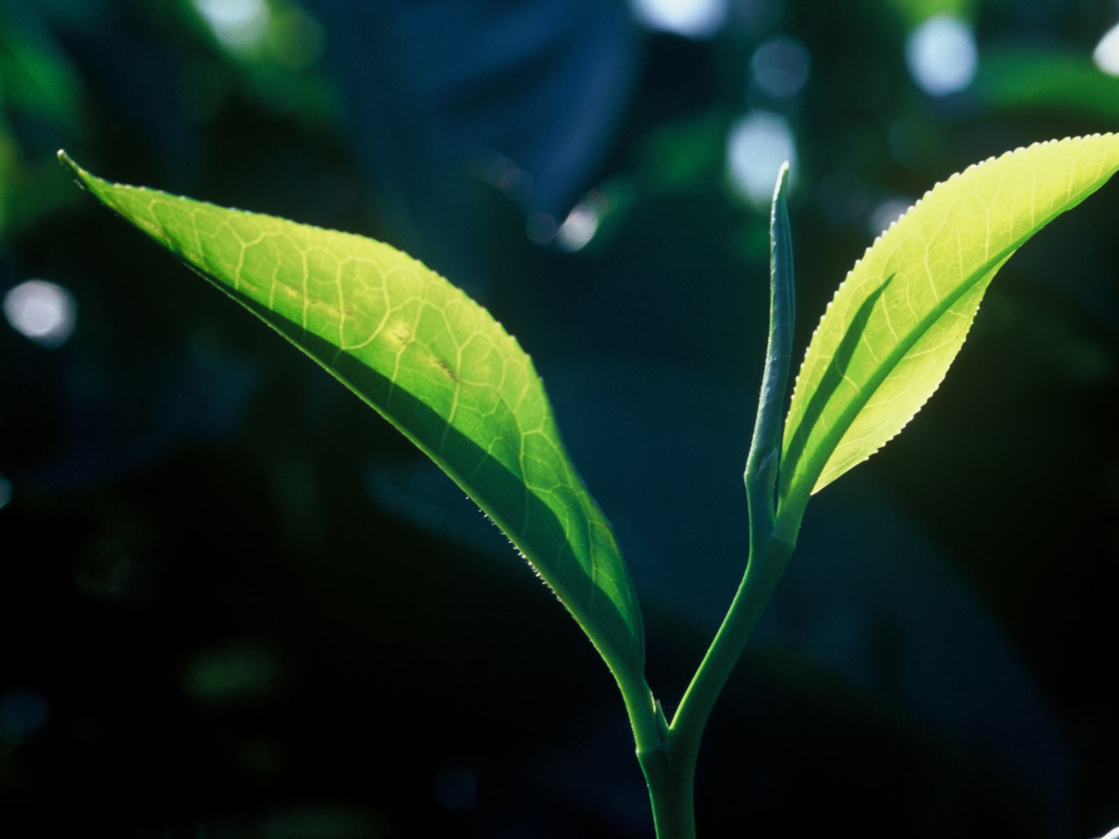
Wet-Cupping and Anemia
3rd International Conference and Exhibition on
Traditional & Alternative Medicine
August 03-05, 2015 Birmingham, UK
In Association with
Presented By
Name: Nouran Aleyeidi, SB-CM (EPI)
Country: Saudi Arabia

Slide 2
Contents
Introduction
Literature Review
Methods
Results
Conclusions
Recommendations

Slide 3
Introduction

Slide 4
Dry-Cupping VS Wet-Cupping
Introduction
Dry Cupping: Is the process of using a vacuum on different areas of the body in order to gather the blood in that area without incisions. ⁽¹⁾
Wet Cupping: Uses negative pressure suctioning and skin pricking , or incision, to open the skin barrier and excrete a bloody mixture of fluids with soluble wastes and causative pathological substances. ⁽²⁾
_______________________________________
Mahdavi MR, Ghazanfari T, Aghajani M, Danyali F, Naseri M. Evaluation of Effect of Traditional Cupping on the Biochemical, Hematological, and Immunological Factors of Human Venous Blood. A Compendium of Essays on Alternative Therapy. 2011;(1):67–88.
Mahmoud HS ESS. Methods of Wet Cupping Therapy (Al-Hijamah): In Light of Modern Medicine and Prophetic Medicine. Alternative & Integrative Medicine [Internet]. 2013 [cited 2014 Feb 16];02(03). Available from: http://www.esciencecentral.org/journals/methods-of-wet-cupping-therapy-al-hijamah-in-light-of-modern-medicine-and-prophetic-medicine-2327-5162.1000111.php?aid=12803

Slide 5
Dry-Cupping
Introduction
Picture Source: ashyum.com

Slide 6
Wet-Cupping (Hijama)
Introduction
Picture Source: goahealth.blogspot.com

Slide 7
Important Questions
Introduction
Since wet-cupping contains some blood loss,
Can anemia be a side effect of wet-cupping?
Is it safe to do wet-cupping to an anemic patient?

Slide 8
Literature Review

Slide 9
Evaluation of the Effects of Traditional Cupping on the Biochemical, Hematological and Immunological Factors of Human Venous Blood
Literature Review
Done in Iran, published in 2011 by M. Mahdavi et al.
They performed wet-cupping on 56 healthy males aged between 20 and 40, on one point between the two scapulas in the back, opposite to T2-T5 vertebrates.
They did many blood tests before the procedure and 2 weeks after it. Complete blood count (CBC) was one of those blood tests.
1. Mahdavi MR, Ghazanfari T, Aghajani M, Danyali F, Naseri M. Evaluation of the Effects of Traditional Cupping on the Biochemical, Hematological and Immunological Factors of Human Venous Blood. A Compendium of Essays on Alternative Therapy. 2011;67–88.

Slide 10
Evaluation of the Effects of Traditional Cupping on the Biochemical, Hematological and Immunological Factors of Human Venous Blood
Literature Review
The mean hemoglobin level before wet- cupping was 15.67 ±1.2 , and after cupping was 15.12 ±1.25. The p value was 0.045, which was a statistically significant difference, but apparently, a clinically non-significant difference.
We cannot generalize those results because it was a small sample size, they included only healthy male younger adults and there was no control group(1)
1. Mahdavi MR, Ghazanfari T, Aghajani M, Danyali F, Naseri M. Evaluation of the Effects of Traditional Cupping on the Biochemical, Hematological and Immunological Factors of Human Venous Blood. A Compendium of Essays on Alternative Therapy. 2011;67–88.

Slide 11
Case Reports and Case Series
Literature Review
There are a number of case reports of patients who performed excessive wet-cupping for a long period and then developed anemia.
I have found 5 papers in literature with the same story of a patient who had developed anemia after an excessive course of wet-cupping, and in one of them dry-cupping.

Slide 12
Cupping Therapy-induced Iron Deficiency Anemia in a Healthy Man Hyo Jin Lee Nam Hwan Park Hwan Jung Yun Samyong Kim Deog Yeon Jo, MD
Literature Review
Case Reports and Case Series #1
January of 2007, in Korea
A case report of a 39-year-old man
Underwent bloodletting cupping therapy for approximately 6 months
The blood tests showed iron deficiency anemia (Hb 7.9 g/dL ) which was claimed to be due to the cupping therapy, but there was no baseline investigations done before the cupping therapy.

Slide 13
Bloodletting-induced cardiomyopathy: reversible cardiac hypertrophy in severe chronic anaemia from long-term bloodletting with cupping Il-Suk Sohn1*, Eun-Sun Jin1, Jin-Man Cho1, Chong-Jin Kim1, Jong-Hoa Bae1, Ju-Young Moon2, Sang-Ho Lee2, and Myung-Jae Kim2
Literature Review
Case Reports and Case Series #2
June 2008,in South Korea
A case report of a 66-year-old woman
She had done wet-cupping at home for more than 10 years
She had severe iron deficiency anemia, which was again claimed to be due to the cupping therapy, but there was no baseline investigations done before the cupping therapy.

Slide 14
􏰁􏰂􏰃􏰄􏰅􏰆􏰇􏰈􏰉􏰊􏰉􏰇􏰄􏰊􏰋􏰅􏰌􏰄􏰇􏰍􏰉􏰎􏰅􏰏􏰐􏰇􏰅􏰑􏰃􏰅􏰒􏰃􏰄􏰓􏰔􏰑􏰉􏰍􏰇􏰅 􏰕􏰖􏰃􏰃􏰏􏰖􏰇􏰑􏰑􏰉􏰄􏰓􏰅􏰗􏰘􏰉􏰄􏰓􏰅􏰙􏰐􏰚􏰚􏰉􏰄􏰓 Iron Deficiency Anemia Due to Long-time Bloodletting Using Cupping Seung-Jun Lee, Young-Sung Suh*, Yeon-Ju Lee, Dong-Gil Cho, Min-Ji Lee, Dae-Hyun Kim
Literature Review
Case Reports and Case Series #3
January 2011,in Korea
A case series of three cases of iron deficiency anemia due to long term wet-cupping (a minimum of 5 months)
None of them had their HB measured before wet-cupping
Their HB levels were 7.9, 6.4 and 10.9 g/dl.
They all improved after iron replacement therapy

Slide 15
􏰁􏰂􏰃􏰄􏰅􏰆􏰇􏰈􏰉􏰊􏰉􏰇􏰄􏰊􏰋􏰅􏰌􏰄􏰇􏰍􏰉􏰎􏰅􏰏􏰐􏰇􏰅􏰑􏰃􏰅􏰒􏰃􏰄􏰓􏰔􏰑􏰉􏰍􏰇􏰅 􏰕􏰖􏰃􏰃􏰏􏰖􏰇􏰑􏰑􏰉􏰄􏰓􏰅􏰗􏰘􏰉􏰄􏰓􏰅􏰙􏰐􏰚􏰚􏰉􏰄􏰓 Anaemia and skin pigmentation after excessive cupping therapy by an unqualified therapist in Korea: a case report Kun Hyung Kim,1 Tae-Hun Kim,2 Min Hwangbo,3 Gi Young Yang4
Case Reports and Case Series #4
September 2012, in Korea
A case report of a 77-year-old woman who did repeated dry-cupping (almost 30 sessions in 2 months duration) by an unqualified person.
She didn’t have her HB measured before the treatment, but 3 months after dry-cupping, it was 6.2 g/dl .
She improved after iron replacement therapy

Slide 16
An Unusual Case of Iron Deficiency Anemia in a Healthy Man: Hijamah􏰁􏰂􏰃􏰄􏰅􏰆􏰇􏰈􏰉􏰊􏰉􏰇􏰄􏰊􏰋􏰅􏰌􏰄􏰇􏰍􏰉􏰎􏰅􏰏􏰐􏰇􏰅􏰑􏰃􏰅􏰒􏰃􏰄􏰓􏰔􏰑􏰉􏰍􏰇􏰌􏰄􏰅􏰐􏰄􏰐􏰘􏰐􏰎􏰖􏰅􏰊􏰎􏰐􏰘􏰇􏰅􏰃􏰈􏰅􏰉􏰂􏰃􏰄􏰅􏰏􏰇􏰈􏰉􏰊􏰉􏰇􏰄􏰊􏰋􏰅􏰎􏰄􏰇􏰍􏰉􏰎􏰅􏰉􏰄􏰅􏰎􏰅 􏰮􏰇􏰍􏰯􏰉􏰅􏰌􏰏􏰄􏰎􏰄􏰅􏰌􏰪􏰏􏰃􏰨􏰎􏰄􏰰􏰜􏰅􏰱􏰖􏰉􏰈􏰅􏰌􏰪􏰏􏰃􏰨􏰎􏰄􏰠 Remzi Adnan Akdogan, Elif Akdogan
Literature Review
Case Reports and Case Series #4
2011, in Turkey
A case report of a 55-year-old man who had been doing wet-cupping for 4 years with self made incisions.
He presented with 􏰤􏰇􏰍􏰃􏰓􏰖􏰃􏰫􏰉􏰄􏰅􏰖􏰇􏰶􏰇􏰖􏰥􏰅􏰷􏰵􏰼􏰅􏰓􏰛􏰏􏰒HB level of 3.6 g/dl.
Again, no HB measurements before the wet-cupping.

Slide 17
Common Points Between Those Reports
Literature Review
The sessions were performed very frequently, for example 2 to 3 times per week as described in one study.
The duration of treatment was long in all of those studies ranging from 2 months to more than 10 years.
Although they were only case reports, but they have things in common which raises the hypothesis that very frequent cupping for a long duration might cause severe anemia.

Slide 18
Difference between wet-cupping methods in the middle east and in the far east
Wet cupping maybe further divided into two types:
Puncturing and Cupping (PC): Used in Chinese Medicine and some German studies. It has five steps: demarcation, sterilization, puncturing, cupping and sterilization.
Cupping, Puncturing and Cupping (CPC): well known in Arab region and Islamic literature, and it has six steps: demarcation, sterilization, dry cupping of the desired site, puncturing, cupping and sterilization. This is called “hijama” in Arabic.
______________________________
Mahmoud HS ESS. Methods of Wet Cupping Therapy (Al-Hijamah): In Light of Modern Medicine and Prophetic Medicine. Alternative & Integrative Medicine [Internet]. 2013 [cited 2014 Feb 16];02(03). Available from: http://www.esciencecentral.org/journals/methods-of-wet-cupping-therapy-al-hijamah-in-light-of-modern-medicine-and-prophetic-medicine-2327-5162.1000111.php?aid=12803

Slide 19
Methods

Slide 20
Methods
Study design:
A randomized controlled trial pilot study.
Sample size:
17 participants divided into 9 participants in the intervention group and 8 participants in the control group

Slide 21
Methods
This pilot study was based on the data of a previous RCT that we did in Saudi Arabia 2013/2014 under the title “The efficacy of wet-cupping on blood pressure in hypertensive patients: a randomized controlled trial”.
This study is not published yet, but it is under publishing process

Slide 22
Methods
That previous RCT study had a sample size of 80 participants, 17 of them had CBC done few days before wet-cupping and less than 6 months after that, for different reasons.
Those 17 who did CBC were the ones included in this pilot study.

Slide 23
The Intervention
Methods
The intervention under study was the performance of wet cupping or hijama.
we have done three hijama sessions every other day, on the 17th, 19th and 21st days of the Arabic calendar month, (lunar month).

Slide 24
The Intervention
Methods

Slide 25
Methods
None of the participants were on iron replacement therapy
By chance all of those 17 participants were females, except one participant
Their ages are ranging from 34 to 65 years old (mean age 53.8)
They are all hypertensive participants

Slide 26
Outcomes
Methods
The main outcome in this study is the Hb level in blood.

Slide 27
Results

Slide 28
Baseline Characteristics
Results
The intervention and control groups were well matched in regards to baseline characteristics of them.

Slide 29
Baseline CBC
Results
Table 1: Comparison of baseline blood work between the intervention and control groups
Measurement | Intervention Group | Control Group | P value (t test)
Mean Hb at Baseline (±SD) | 12.2 (±1.9) | 12.7 (±1.4) | 0.548
Mean RBC at Baseline (±SD) | 4.5 (±0.5) | 4.7 (±0.5) | 0.416
Mean MCV at Baseline (±SD) | 82.0 (±7.5) | 74.2 (±15.7) | 0.196
Mean MCH at Baseline (±SD) | 27.1 (±3.3) | 34.0 (±5.5) | 0.223

Slide 30
CBC Comparison
Results
Table 2: Comparison of blood work after wet-cupping between the intervention and control groups
Measurement | Intervention Group | Control Group | P value (t test)
Mean Hb after follow up (±SD) | 12.1 (±1.5) | 12.6 (±1.4) | 0.600
Mean RBC after follow up (±SD) | 4.5 (±0.5) | 4.7 (±0.6) | 0.515
Mean MCV after follow up (±SD) | 81.5 (±7.0) | 80.8 (±5.5) | 0.819
Mean MCH after follow up (±SD) | 26.8 (±3.1) | 27.0 (±2.1) | 0.881

Slide 31
CBC Comparison
Results
Table 3: Comparison of blood work before and after wet-cupping within the intervention group
Measurement | Intervention Group before wet-cupping | Intervention Group after wet-cupping | P value (paired t test)
Mean Hb (±SD) | 12.2 (±1.9) | 12.1 (±1.5) | 0.561
Mean RBC (±SD) | 4.5 (±0.5) | 4.5 (±0.5) | 0.730
Mean MCV (±SD) | 82.0 (±7.5) | 81.5 (±7.0) | 0.358
Mean MCH (±SD) | 27.1 (±3.3) | 26.8 (±3.1) | 0.258

Slide 32
Conclusion

Slide 33
Conclusion
There was no significant difference in Hb, RBC, MCV or MCH between the intervention and control groups before wet-cupping and few months after wet-cupping (less than 6 months later).
Within the intervention group, there was no significant difference in Hb, RBC, MCV or MCH before and after the wet-cupping procedure (pre-post comparison).

Slide 34
Conclusion
These results are similar to those found in Iran Study, although it has a smaller sample size, but it is still important because it has a control group for comparison and it was done on participants with different characteristics (older female adults with hypertension).

Slide 35
Conclusion
Most of the case reports and case series that were done before and showing anemia after wet-cupping, apparently had those results because of the unusual excessive wet-cupping for long periods. This method is never usually done or recommended by wet-cupping experts.

Slide 36
Recommendations

Slide 37
Recommendations
Further studies are needed on larger sample size.
I suggest that this outcome of Hb level before and after wet cupping should be done in any future study of wet cupping as a secondary outcome.

Slide 38
Thank You

